Slide 1
Geology 5660/6660
Applied Geophysics
23 Mar 2026
Last Time: Gravity Measurements
• Measurements may be surface-based (i.e., taken with
instruments placed on the ground surface) or
space-based; absolute or relative
• Surface measurements are accurate to ~3-6 μGals (for absolute
gravimeters or relative measurements by Lacoste-Romberg):
i.e., nearly one part in 10⁹ of the total acceleration!
• Satellite measurements (especially GRACE, GOCE) can be
extremely accurate (<0.1 μGal!), but only as an average
over very large spatial scales (> 500 km)
• Time-variable gravity can be useful for understanding
dynamical processes (fluid envelopes & solid Earth)
• Surface-based time-variable g also used for environmental/
hydrologic applications
Read for Wed 25 Mar: Burger 349-378 (§6.1-6.4)
© A.R. Lowry 2008-2026

Slide 2
Gravity Reduction:
Corrections include:
• Tidal attractions from nearby
celestial bodies (dominated by
distance & direction to Moon, Sun, Jupiter)
• Associated solid Earth tidal deformation
• Mass of atmosphere above (approximately
given by atmospheric pressure)
For these corrections, record time/location of
measurement and the atmospheric pressure.

Slide 3
Corrections include:
• Earth’s ellipticity and spin
Distance r from Earth’s
center of mass is a function
of latitude, so we subtract
gravity at a specified
ellipsoidal surface from
the total gravity.
Earth’s rotation induces
an outward (centrifugal)
acceleration as a function of
radial distance from axis of
rotation (i.e., latitude), so we
correct for this also.
6356 km
φ
6378 km
Latitude correction:
(1 μGal accuracy ⇒
1.25 m latitude accuracy!)
(See text eqn 6.12 for g₀, A & B)

Slide 4
Corrections include:
• Altitude (“free air correction” )
Following topography also results in differences in radial
distance to the center of mass. Correction for that change
in distance due to topography is called “free air”:
More accurately, including the ellipsoid:
(latter terms are small ⇒ ~ –0.3086 mGal/m)
(1 μGal accuracy ⇒ 3 mm height accuracy!)

Slide 5
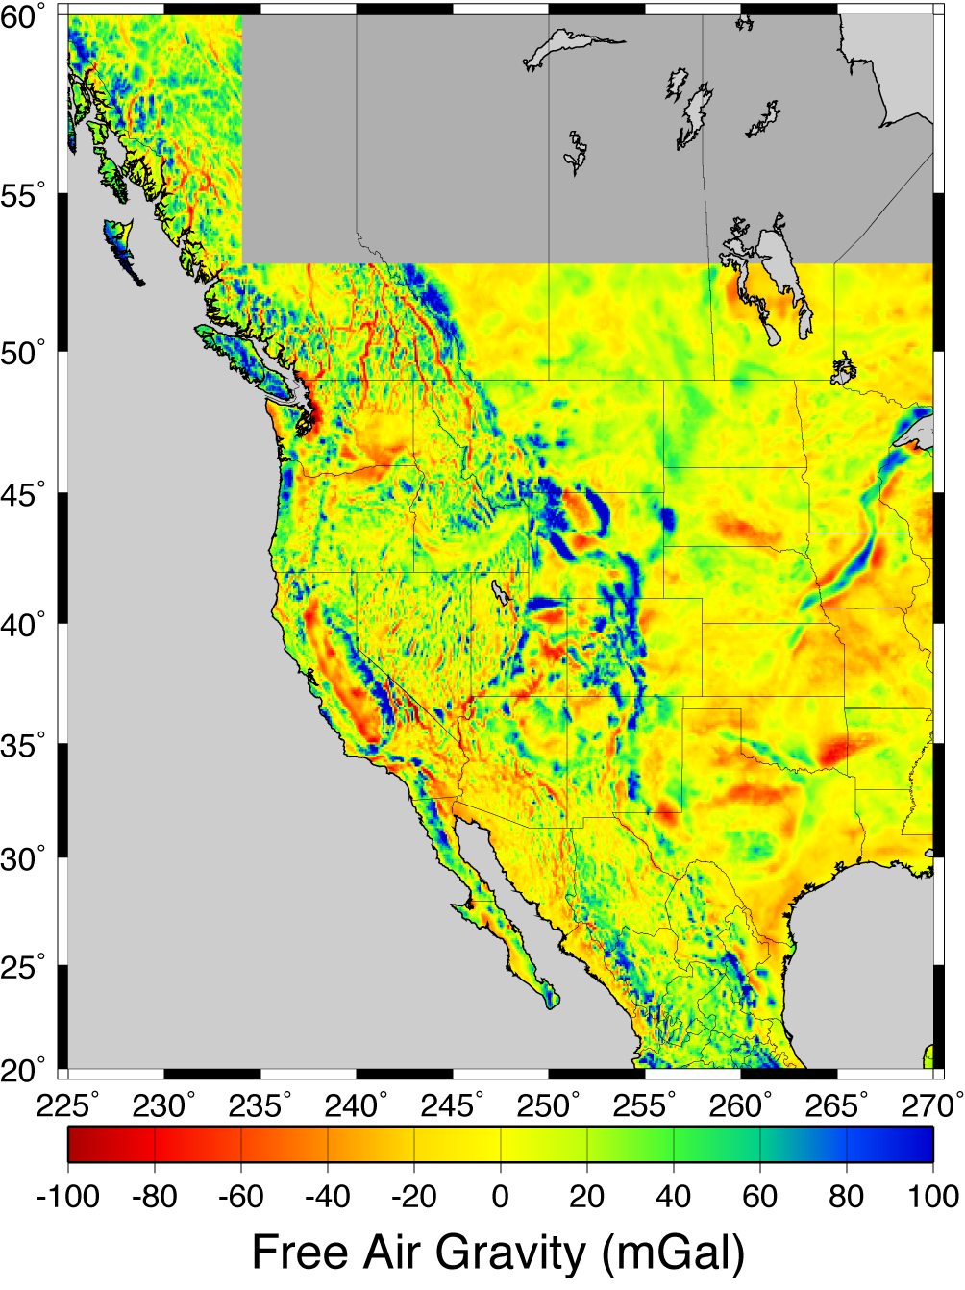
After observed gravity
measurement is corrected
for free air and other
effects talked about so far,
we call it the
free air anomaly
At right, millions of
terrestrial free air relative
measurements have been
referenced to a small
network of absolute
gravity stations and
adjusted to a common
reference gravity ellipsoid.

Slide 6
Corrections include:
• Topographic mass (“Bouguer correction” )
z
Simple Bouguer : Approximate topography as a slab with
thickness h:
For standard ρ = 2670 kg/m³, simple Bouguer correction is
0.11195 mGal/m.
Complete Bouguer : Further correct for upward attraction
of mass above; “negative attraction” of missing mass
below…

Slide 7
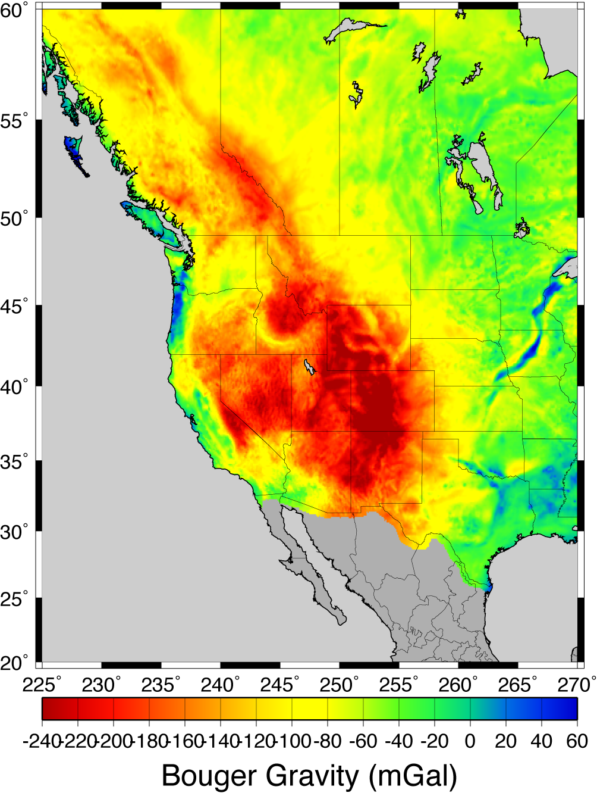
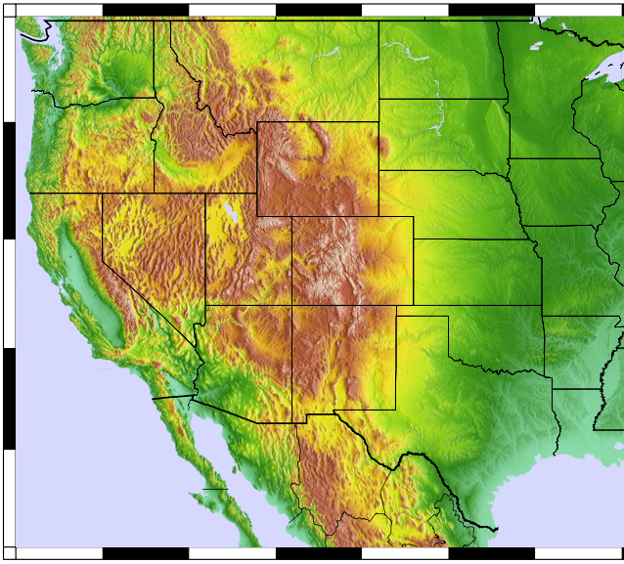

Slide 8
Some applications take a
further step and calculate
a correction for mass that
isostatically compensates
topography…
Implicitly assumes that all
loading is topographic mass
“piled on” at the surface,
and also assumes a
lithospheric plate strength
(usually local isostasy ⇒
no strength)
Explicitly wrong!!!– better to
model the true strength
and loading…

Slide 9
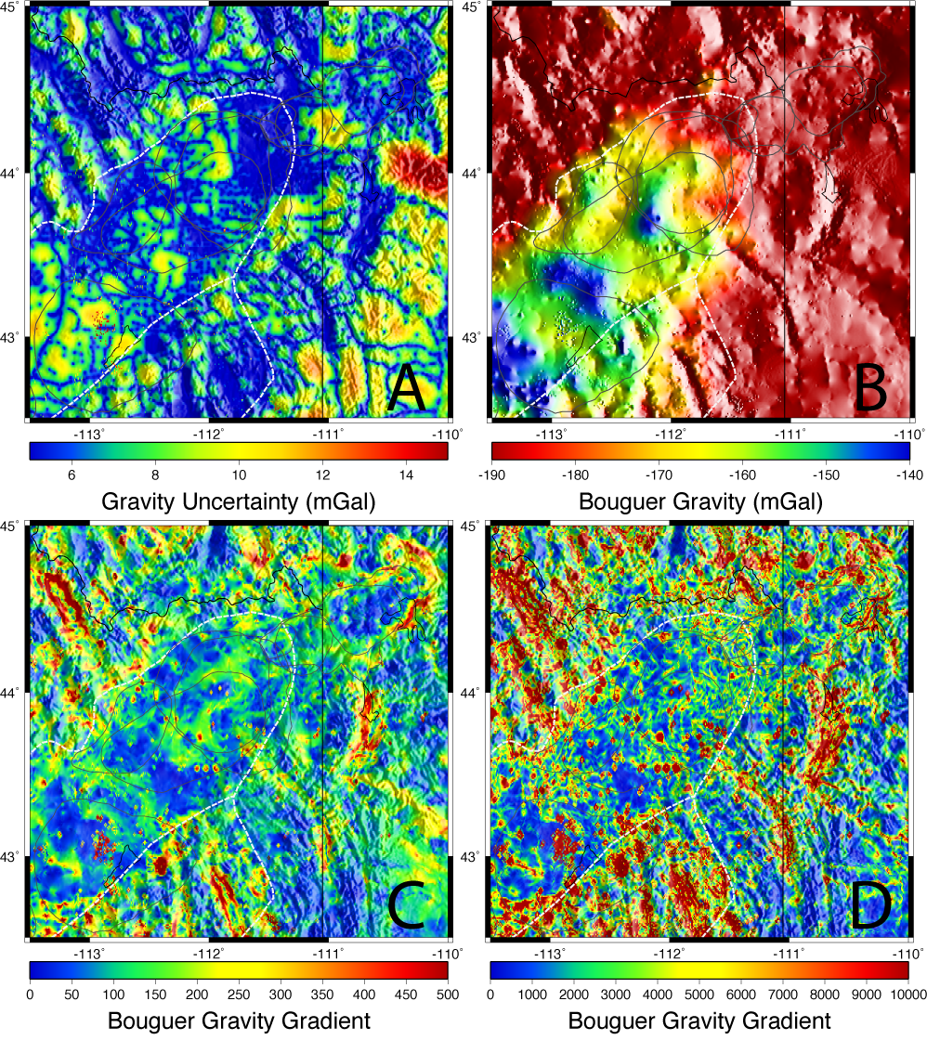

Bouguer gravity
from PACES data
set for the region
around Yellowstone
& Snake River
Plain (shaded
relief is gravity in
B; terrain for all
of the others).
Note “outlier”
measurements
(=> position error,
poor reduction,
or incorrect network
reference value);
high uncertainty
away from meas.
This is why careful gravity reduction and network adjustment is important!
Curvature

