Slide 1
Geology 5660/6660
Applied Geophysics
25 Feb 2026
Last Time: Reflection Seismic Interpretation
• 3D gives higher resolution, better positioning (because it
enables migration of “out-of-plane” seismic reflection energy)
• Vertical resolution : Whether or not a layer is “visible”
to seismic reflection depends in part on properties of the layer
(including both thickness and impedance contrast)
• Lateral resolution : Faults are not directly imaged but
inferred from both layer offsets and “blurring” caused by
near-fault scattering of seismic energy
Read for Fri 27 Feb: Burger 524-539 (§8.4)
© A.R. Lowry 2008-2026

Slide 2
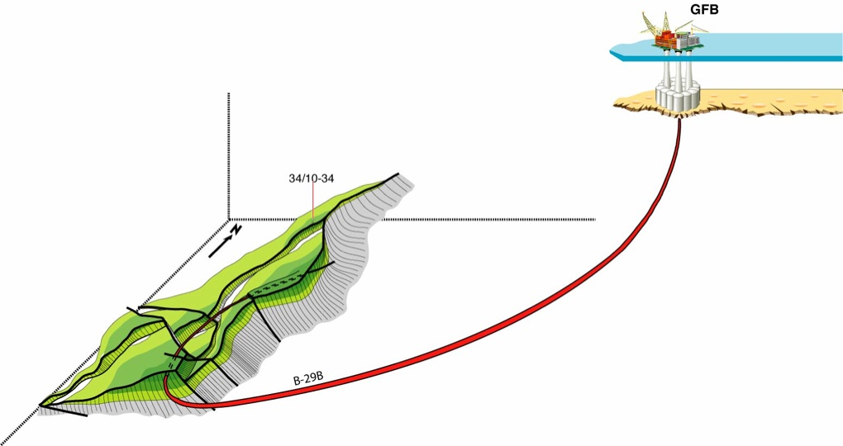
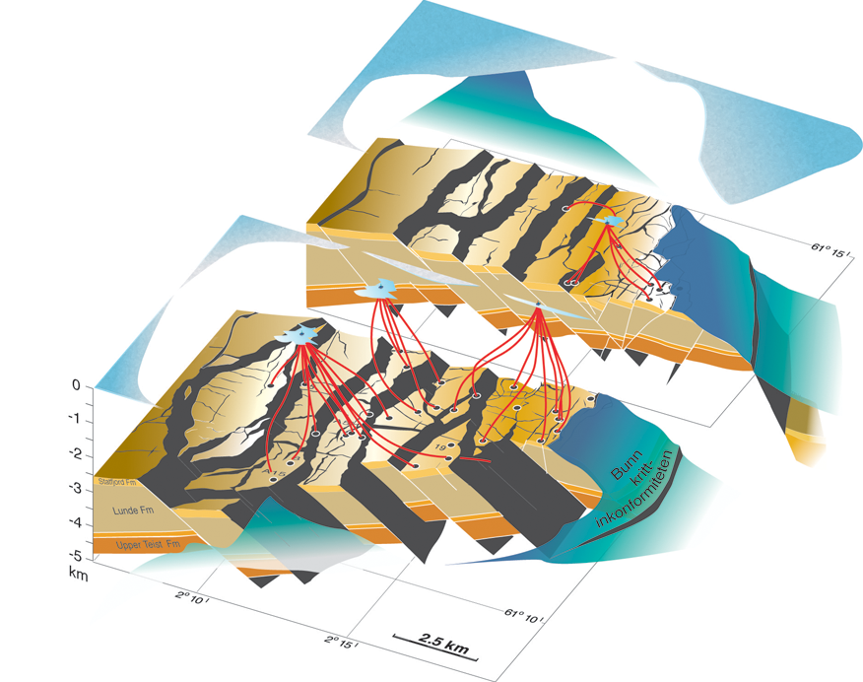

Haakon Fossen 2010
Directional drilling/steering technology is another reason for
accurate depth migration!

Slide 3
Haakon Fossen 2010
Seismic quality
Depends on:
• Acoustic impedance contrast
• Depth (⇒ frequency)
• Layer thickness (⇒ interference)
• Properties of overlying layers
• Source energy
• Processing parameters
• Acquisition direction
• Instrumentation

Slide 4
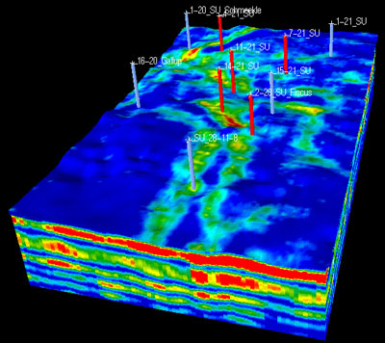
Haakon Fossen 2010
Seismic inversion
In industry parlance, the process of determining
physical properties of rocks and pore
fluid that could have produced a given
seismic image/
data set

Slide 5
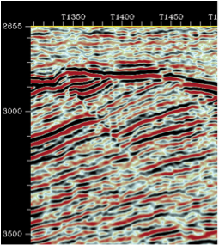
Haakon Fossen 2010
Correlation
One approach to imaging
structure is to focus on
one particular impedance
horizon (often representing
a particular formation of
interest) and mapping the
depth or two-way travel time
of that horizon as a surface
using cross-correlation
techniques

Slide 6
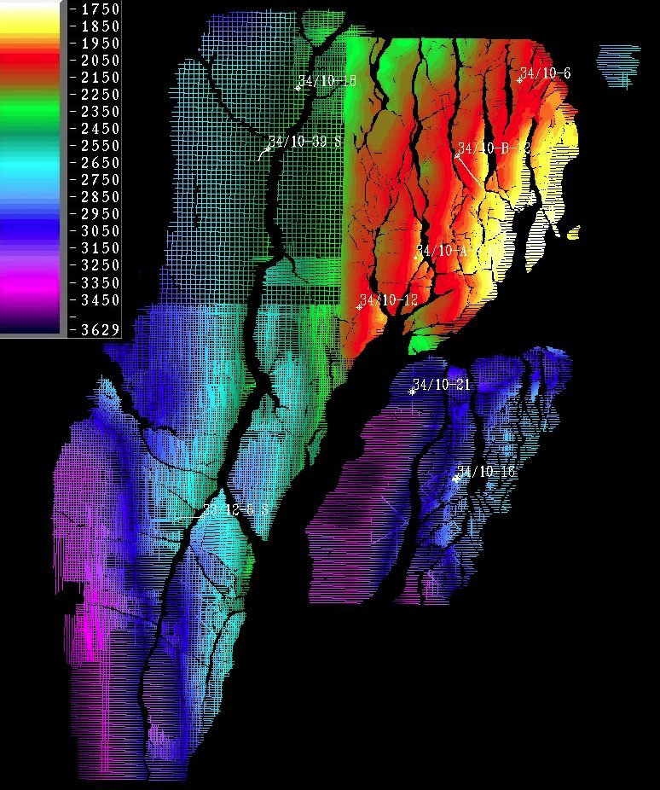
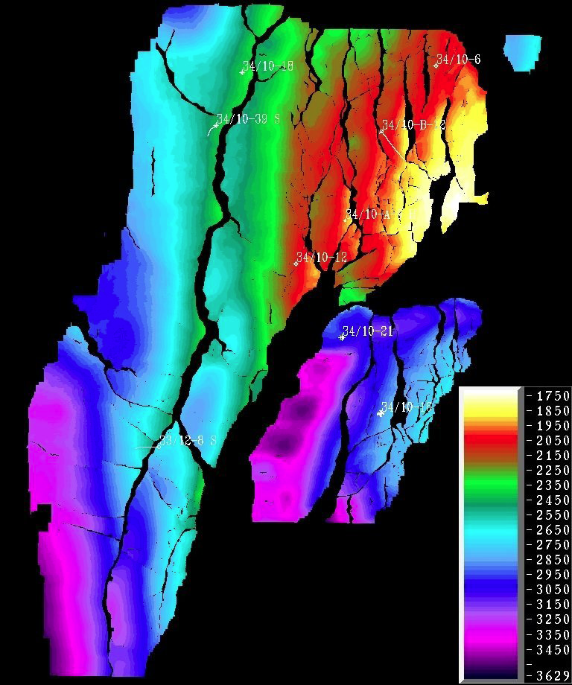
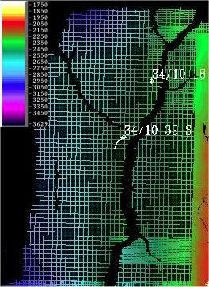
Haakon Fossen 2010

Slide 7
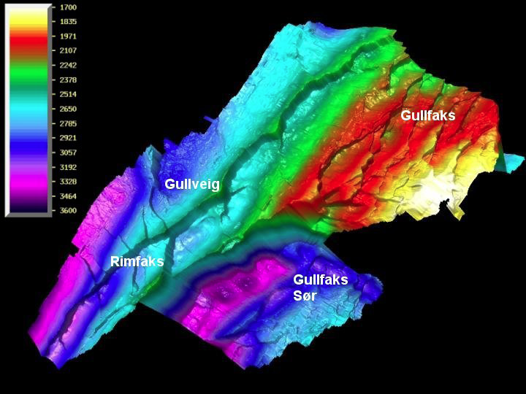
Haakon Fossen 2010
Note this is mapped in
two-way travel-time (ms)!

Slide 8
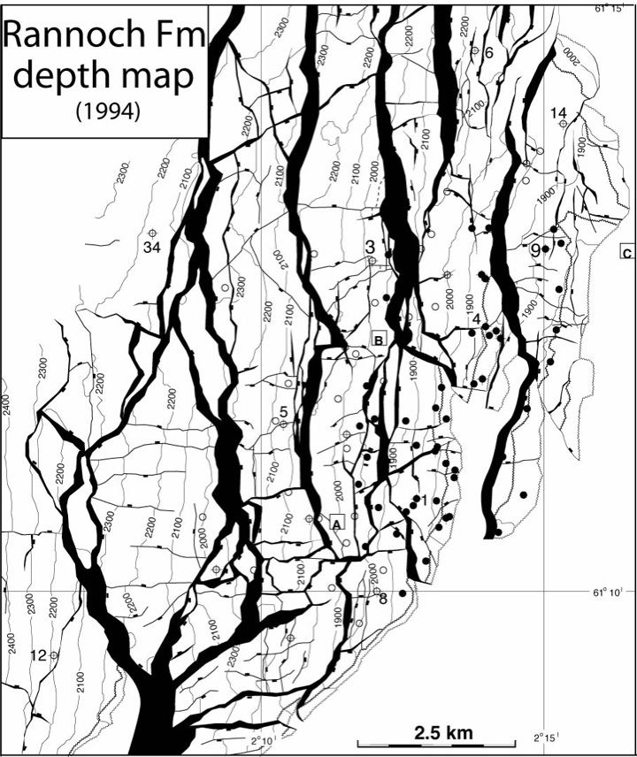
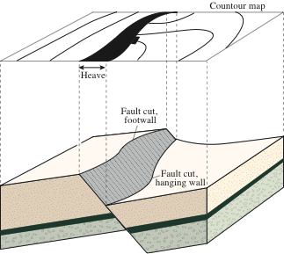
Haakon Fossen 2010

Slide 9
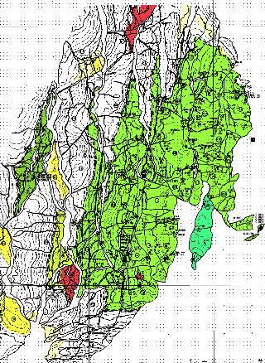
Haakon Fossen 2010
Depth conversion
Requires a velocity model, based on well
information and/or stacking velocities
(from processing of the seismic data)
Time
Depth

Slide 10
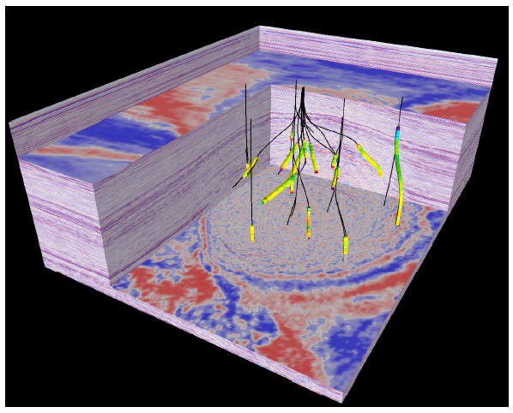
Haakon Fossen 2010
Depth migration
• Some 3D seismic is depth migrated, which
gives a more realistic image (geometrically)
• May not be easy to manage in a field with new
wells being drilled

Slide 11
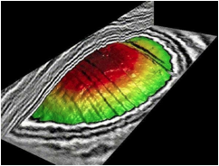
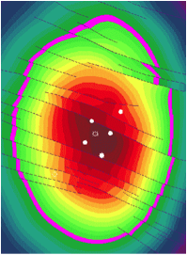
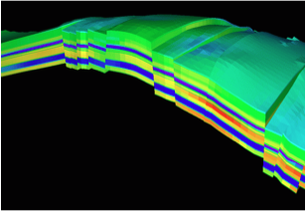

Slide 12
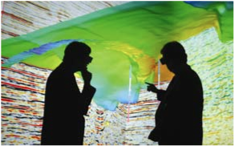
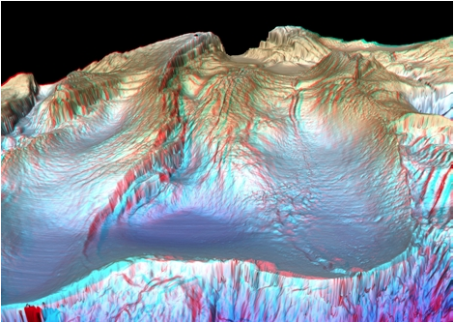
Haakon Fossen 2010
3-D visualization

Slide 13
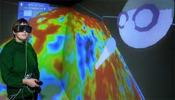
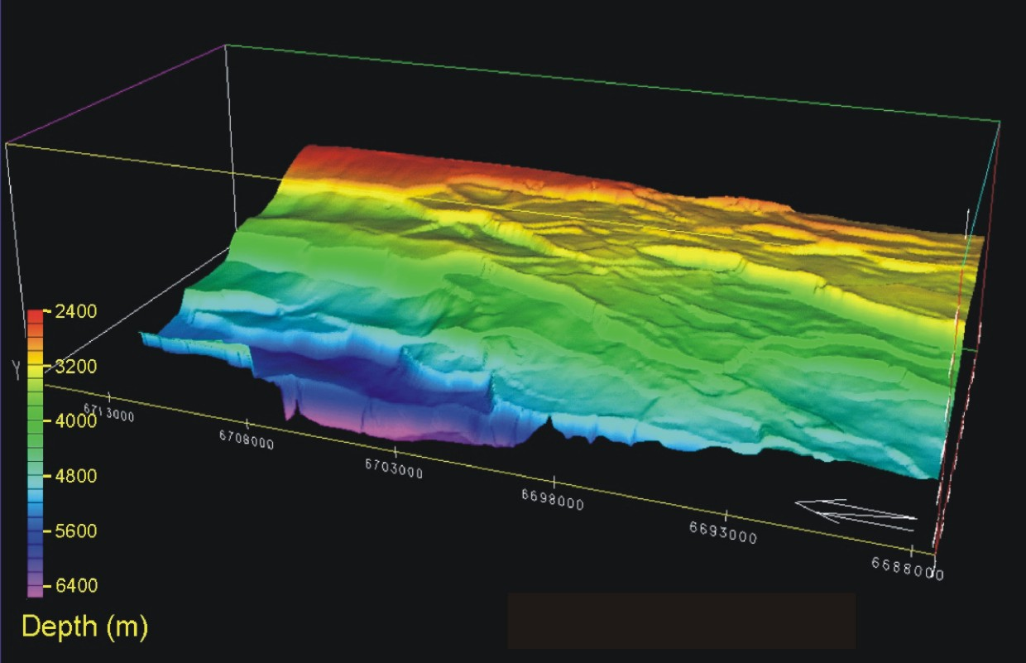
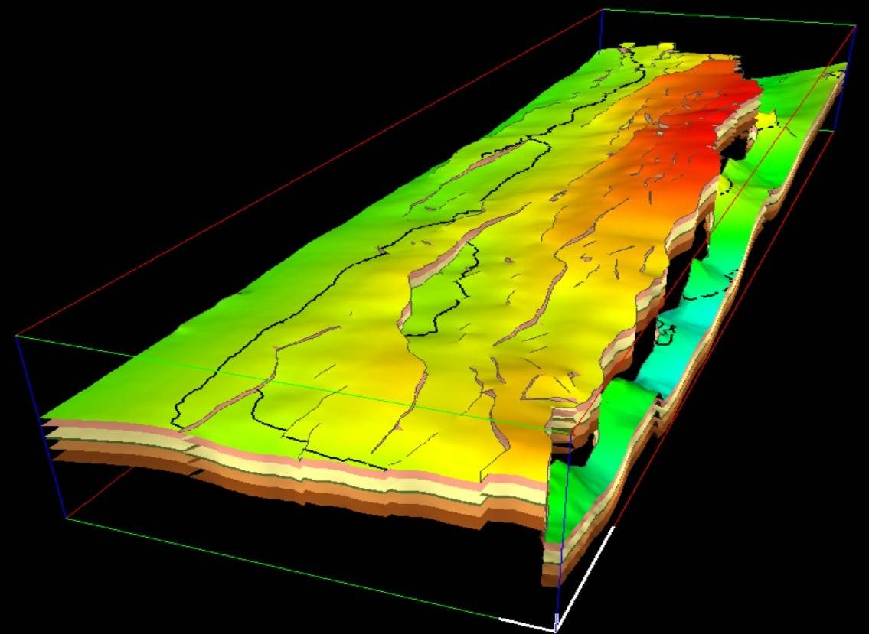
Haakon Fossen 2010

Slide 14
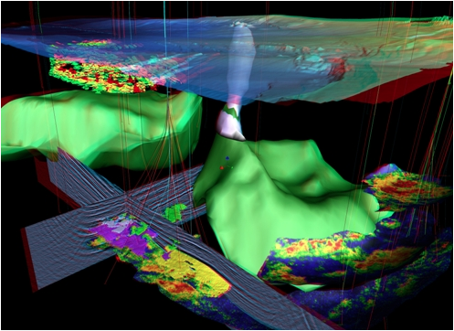
Haakon Fossen 2010
3-D visualization
A complete 3D picture of the subsurface near two producing oil fields in the Gulf of Mexico shows the seabed at some 1,000 m water depth, and features such as salt structures in green and a salt diapir that penetrates the seabed (white). Thin lines show the paths of wells drilled to over 2000m below the seabed to develop the fields, fanning out to penetrate various reservoirs. Shallow bodies in front of the well paths on the left-hand side may provide hazards to drilling. Oil field reservoirs can be seen in colour (yellows and reds) at deeper levels. Most features are extracted from the actual data, though parts of two seismic profiles are shown in black and white near the base of the display.

Slide 15
Haakon Fossen 2010
4-D seismic
• 4D seismic data is the combination of several 3D datasets collected at different times and collected/processed in the same way
• The difference tells us where and how changes have occurred in the reservoir during production in the time interval.
• This information is used for optimal positioning of new wells

Slide 16
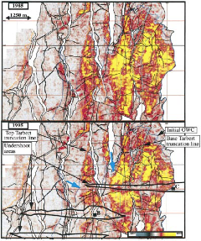
Haakon Fossen 2010
1988
1995

