Slide 1
Geology 5660/6660
Applied Geophysics
25 Mar 2024
Last Time: Density; Gravity Anomalies & Modeling
• Model structures as having anomalous mass density Δρ
⇒ lithology, porosity, temperature (lowest for soils/seds,
higher for lithified sed rocks, highest for crystalline rocks)
• Gravity anomaly due to a sphere:
(represents only the “vertical” component
of the total vector anomaly!)
where: R is radius of the sphere; d is
depth of the sphere’s center; Δρ is the difference in density
from surrounding; and x is horizontal distance from the
center of the sphere.
For Wed 27 Mar: Burger 429-446 (§7.1-7.2)
© A.R. Lowry 2008-2024

Slide 2
Note: Given only the gravity anomaly, the source of gravity is
non-unique!
Could increase the
density contrast,
decrease the radius
to get an identical
anomaly
(2) Could also decrease
the depth & spread
the density anomaly
over a broader area
to get identical anom
Saltus & Blakely, GSA Today 2011
However, gravity unfairly gets a bad rap: ALL geophysical
(& ALL geological) models are non-unique. Gravity narrows
the solution space (or range of possible solutions).

Slide 3
In principle, we can calculate a gravity anomaly for a density anomaly
with any arbitrary body shape using:
Δρ = 400
R = 200
Recall for a sphere:
d = 500
d = 1000
E.g., ∞ horizontal cylinder:
d = 500
d = 1000

Slide 4
Vertical cylinder (top at h₁, bottom at h₂):
where R is cylinder radius; measurement is
centered above the cylinder… More generally,
135°
90°
Radius:
1 m
Depth to top:
10 m
Rod length:
100 m
Δ-Density:
400 kg m⁻³

Slide 5
Gravity on a Dipping Fault
Recall:
Sediments:
ρ = 2200 kg/m³
Basement:
ρ = 2700 kg/m³
Basement:
ρ = 2700 kg/m³

Slide 6
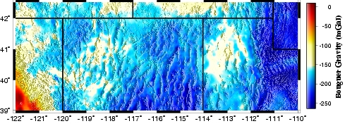
x = 0
x
α
θ₂
β
r₂
t = 3 km
Δρ = 0
Δρ = 500
Δρ = 0

Slide 7
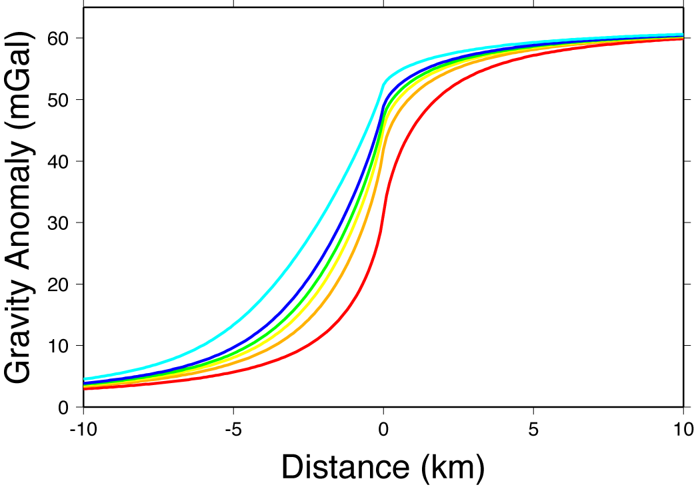
α = 30°
α = 90°
40
60

Slide 8
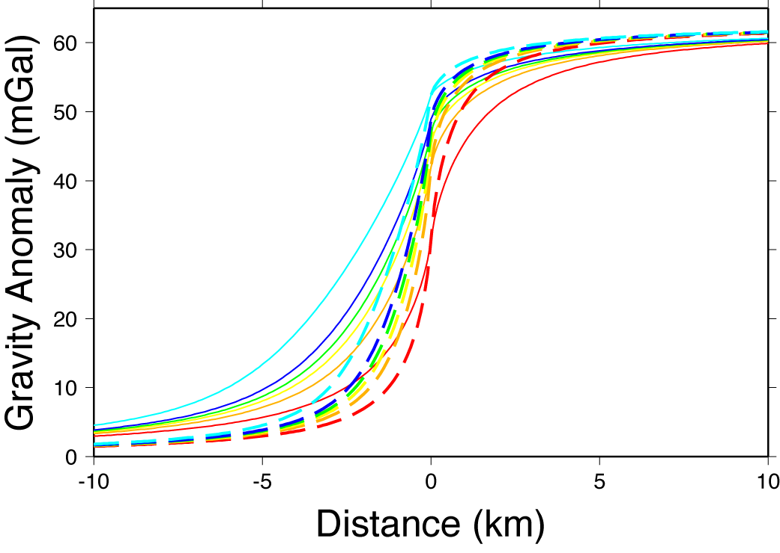
Note asymptotes
depend on tΔρ!
t = 3 km;
Δρ = 500 kg/m³
t = 1.5 km;
Δρ = 1000 kg/m³

