Slide 1
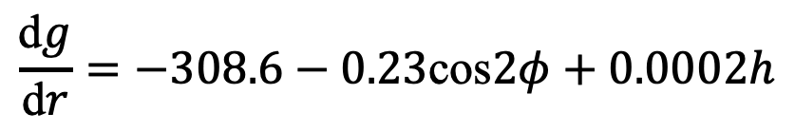
Geology 5660/6660
Applied Geophysics
25 Mar 2026
Last Time: Gravity Reduction
• For terrestrial measurements, we record measurement time
and atmospheric pressure; correct for lunar, solar,
planetary & solid Earth tides + atmospheric mass
• Measurement latitude ⇒ correction for ellipsoidal height and
centrifugal force of Earth’s rotation (see text eqn 6.12)
• Free air correction is ~ –308.6 μGal/m:
• Free air anomaly :
• Bouguer slab correction :
• Complete Bouguer anomaly :
(D_{corr} is instrumental drift; ρ = 2670; T_{corr} is terrain correction)
$$\frac{\text{d}g}{\text{d}r}=−308.6−0.23\text{cos}2φ+0.0002h$$
Δg_{B} = Δg_{fa} – 111.95h – T_{corr}
(μGal)
Read for Fri 27 Mar: Burger 349-378 (§6.5-6.8)
© A.R. Lowry 2008-2026

Slide 2
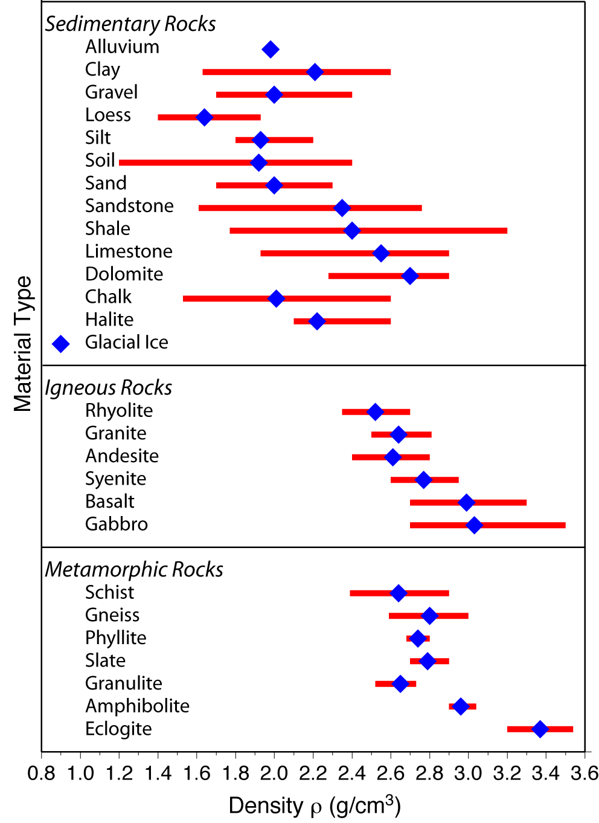
Gravity Modeling
seeks to characterize
subsurface structures
via geometry of
variations in mass
density ρ…
ρ depends on rock
type, porosity and
pore fluids,
temperature
Generally ρ lowest for
soils/seds, higher for
lithified sed rx, highest
for crystalline rx,
increases with depth

Slide 3
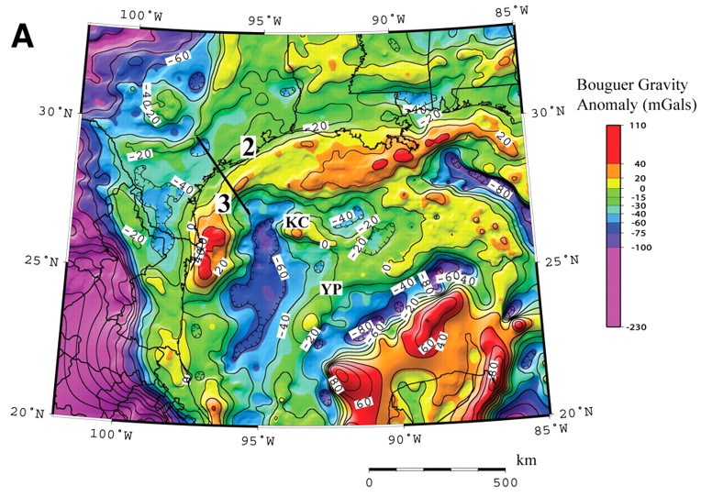

Mafic complexes
from past
continental
rifting?
Mickus et al., Geology 37 (2009)

Slide 4
Gravity Anomaly Due to a Spherical Source:
Recall gravitational acceleration from a spherical source
is given by
We measure Δg along a ~flat
(ground) surface (i.e., x varies but
d is fixed) so
This is small relative to total
(< 10⁻⁴!!) and the gravimeter
measures only the component of
the anomaly in the ~ direction:
Δg
x = 0
Δg_{z}
d
θ
r
R
Δρ

Slide 5
Note: Given only the gravity anomaly, the source of gravity is
non-unique!
Could increase the
density contrast,
decrease the radius
to get an identical
mass anomaly Δm
(2) Could also decrease
the depth & spread
the density anomaly
over a broader area to
get the same anomaly
Saltus & Blakely, GSA Today 2011
However, gravity unfairly gets a bad rap: ALL geophysical
(& ALL geological) models are non-unique. Gravity narrows
the solution space (or range of possible solutions).

Slide 6
In principle, we can calculate a gravity anomaly for a density anomaly
with any arbitrary body shape using:
→
Δρ = 400
R = 200
Recall for a sphere:
d = 500
d = 1000
E.g., ∞ horizontal cylinder
oriented orthogonal to the profile:
d = 500
d = 1000

Slide 7
Vertical cylinder (top at h₁, bottom at h₂):
where R is cylinder radius; measurement is
centered above the cylinder… More generally,
135°
90°
Radius:
1 m
Depth to top:
10 m
Rod length:
100 m
Δ-Density:
400 kg m⁻³

Slide 8
Gravity on a Dipping Fault
Recall:
→
Sediments:
ρ = 2200 kg/m³
Basement:
ρ = 2700 kg/m³
Basement:
ρ = 2700 kg/m³

Slide 9
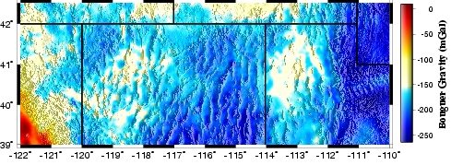
x = 0
x
α
θ₂
β
r₂
t = 3 km
Δρ = 0
Δρ = 500
Δρ = 0

Slide 10
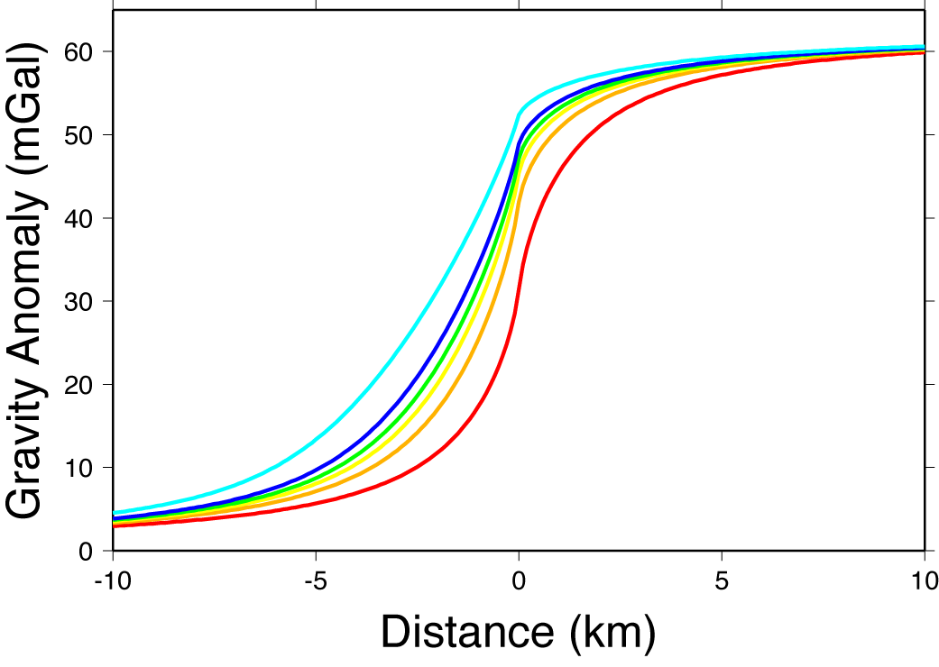
α = 30°
α = 90°
40
60

Slide 11
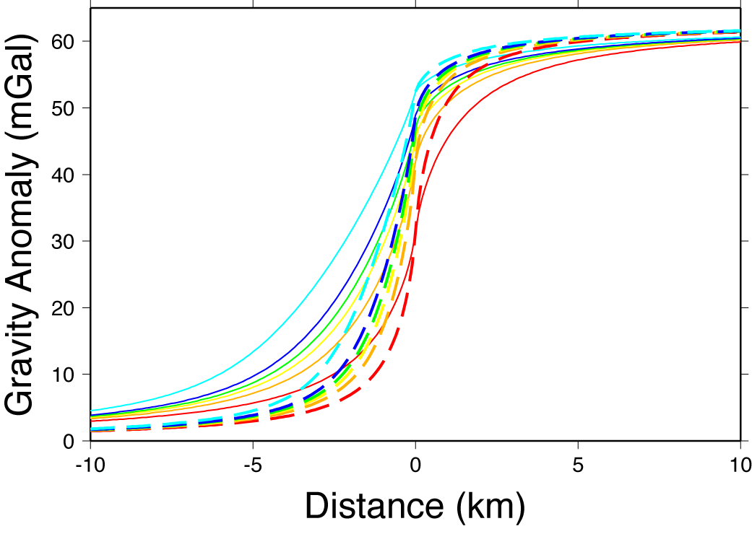
Note asymptotes
depend on tΔρ!
t = 3 km;
Δρ = 500 kg/m³
t = 1.5 km;
Δρ = 1000 kg/m³

