Slide 1
Geology 5660/6660
Applied Geophysics
25 Mar 2026
(Lab)
Lab 6: Gravity reduction and modeling!
Due Fri April 10 at 2:30 pm
© A.R. Lowry 2008–2026

Slide 2
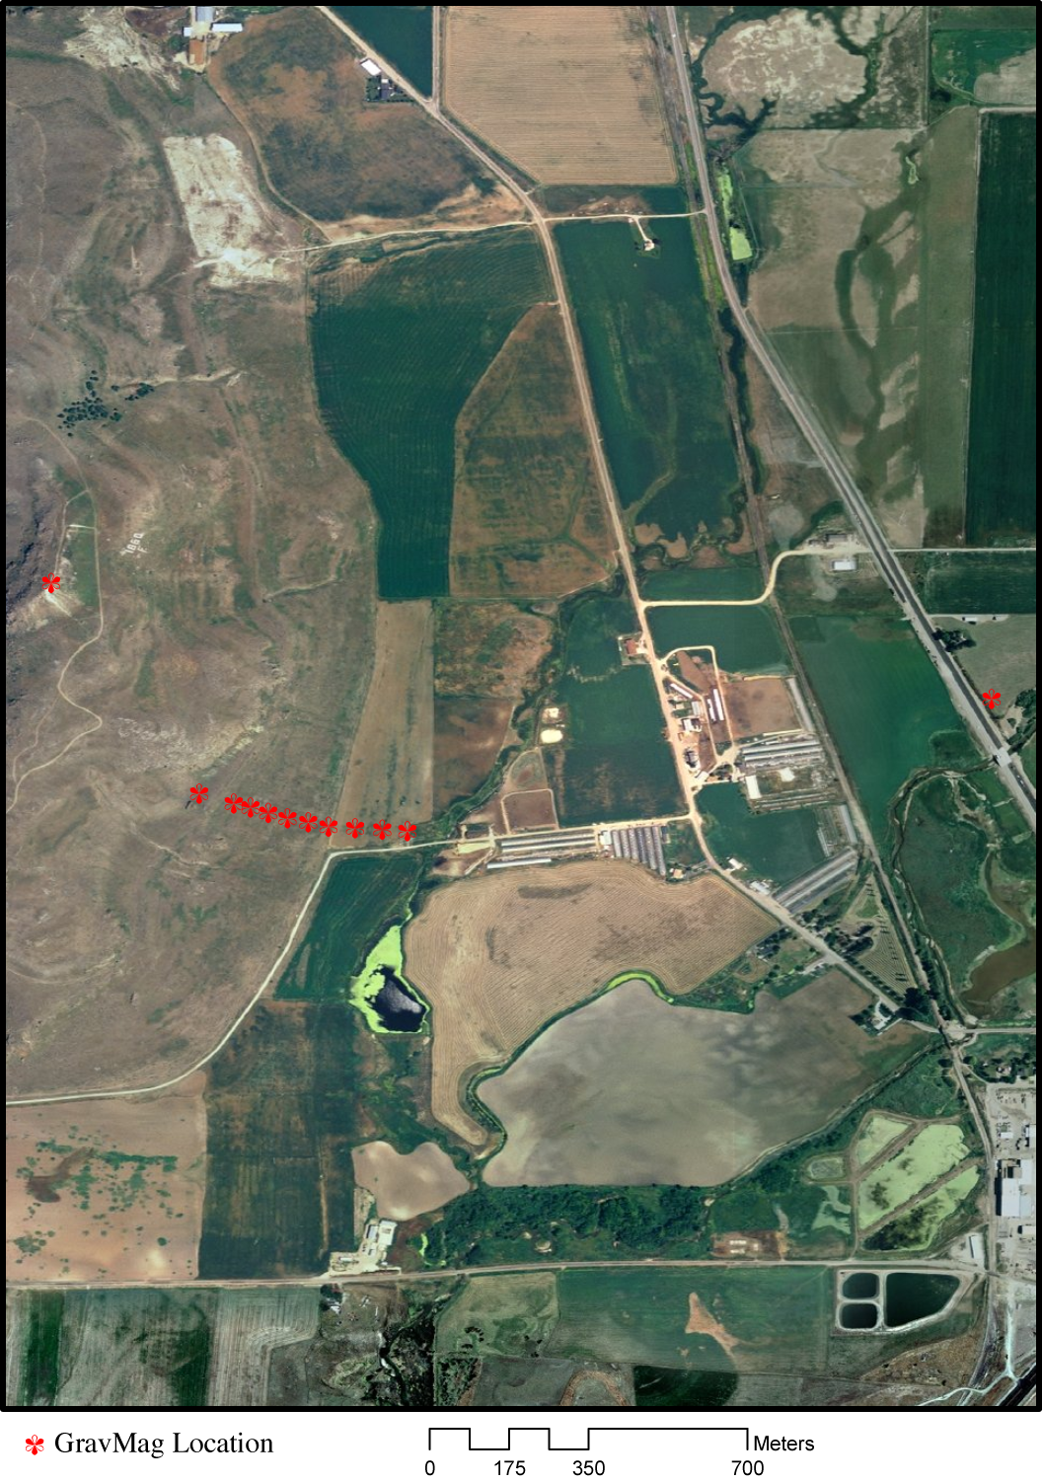
Lab 5: Gravity Data Modeling
Introducing the field locale:
East slope of Little Mountain,
West of Franklin, ID
Two reversed seismic lines
One DC resistivity profile
Twelve relative gravity
measurements
Collocated magnetic field
measurements (vertical
component)
Grav collected on east slope…
• Note missing GPS
location at one
grav/mag site!!!
With thanks to Dan Munger for arc-image!
(GPS/RTK Base Site)
(Estimated Location)
(Far-Field Site)

Slide 3
The Raw Gravity Observations…
Note: Estimated position at this site!
GPS Base
11
1
12

Slide 4
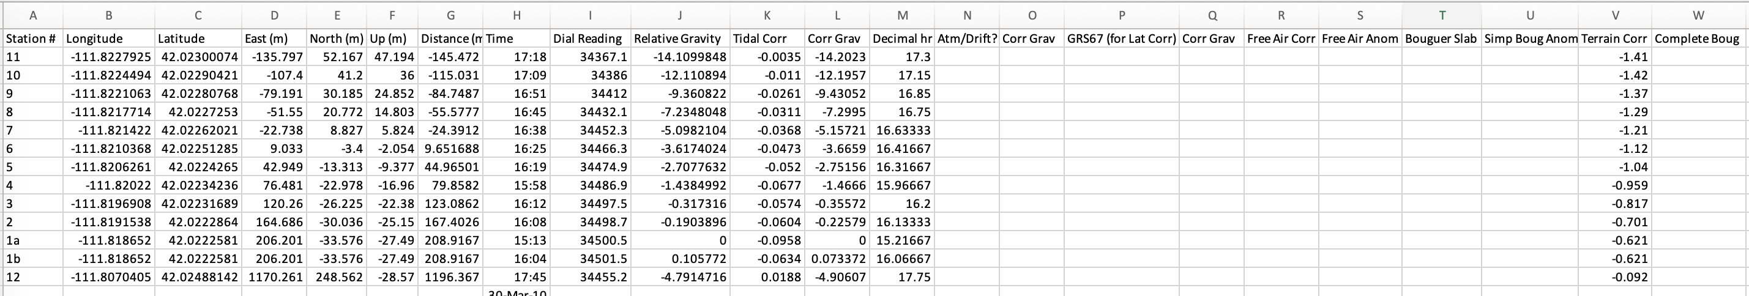
An Xcel spreadsheet is included on the website with raw measurements of
position and gravity, and some of the corrections that require specialized
software to calculate (tidal correction, terrain correction…)
You should download the spreadsheet, reduce the gravity with other
corrections using Xcel formulas, and include plots of the results in your
writeup. Note that the base station 1a has reference value of zero in each
of columns J and L; subsequent columns labeled “Corr Grav” should be
calculated so that 1a also has a value of zero. (You should turn in the
spreadsheet along with your writeup so we can check for errors.)

Slide 5
Strong Hint: There is a function in Excel
Called RADIANS(•). You will need to use it!

Slide 6
(2) Evaluate possible errors.
• There was some uncertainty regarding whether
the dial readings from site 1 were correct! This calls into
question both the measurements at site 1 and the
estimate of drift correction. Plot your data at the following
steps with and without the drift correction:
Free air anomaly, simple Bouguer anomaly, complete
Bouguer anomaly. Are the values at site 1 consistent
with the other measurements? Does the profile of data
seem cleaner with or without the drift correction? Does
this help us determine whether our dial reading edits
were reasonable?
• Note also that the position at site 10 was not measured
but approximated (by interpolating between adjacent
sites). Do you see any evidence this estimate of position
might be off? If so, by about how much?

Slide 7
(3) Model the Complete Bouguer Gravity Anomaly
Using GravMag
• We considered three possible end-member
models to explain why Little Mountain is there:
a. A horst associated with active normal faulting
b. An allochthonous remnant from Laramide thrusting
c. Paleotopographic surface that was not buried by
Cache valley normal faulting & sedimentation
• Create a GravMag prismatic model for each end
member, and vary the density contrasts/prism
endpoints as needed to optimize fit for that model type
• Remember that the RMS residual is key to
evaluating the validity of your model!
• Discuss your results. Can any of the end member
models be ruled out based solely on the gravity data?
Why, or why not?

