Slide 1
Geology 5660/6660
Applied Geophysics
26 Jan 2026
Last time: Fundamentals of Seismic Amplitudes
• The Impedance of a medium is Z = ρV. Reflected and
refracted amplitudes depend on the impedance contrast
via reflection & refraction coefficients (for normal-incidence):
• Source amplitude determines the total energy in an
(idealized) elastic wave
• Geometrical Spreading distributes energy over increasing
surface area of the wavefront. Uniform half-space
spherical spreading decreases amplitude as 1/r:
Read for Wed 28 Jan: Burger 65-81 (Ch 3-3.2)
© A.R. Lowry 2008-2026

Slide 2
Last time continued: Amplitude
• For a refracted head wave, geometrical spreading is
cylindrical spreading :

Slide 3
Anelastic Attenuation or Absorption:
Geometrical spreading assumes a perfectly elastic medium
in which there is no conversion of strain energy to other
forms. However, observation ⇒ most Earth media are
dissipative (energy is lost to work— anelastic strain—
and ends up converted to heat).
For a plane wave, the Amplitude A decreases as
where a is the absorption coefficient, a = πf/QV = ω/2QV
Q is generally called Quality factor… High Q implies
low attenuation.

Slide 4
So amplitude gets smaller with greater distance traveled x and
higher frequency f ; remains larger when intrinsic quality
factor Q and velocity V are higher.
Q differs for P-waves (Q_{p}) and S-waves (Q_{s}).
For sediments,
5 < Q_{p} < 300 (lower if porosity is high)
5 < Q_{s} < 100
For crystalline rocks,
100 < Q_{p} < 800
Example: Pierre shale Q_{p} = 20, V_{p} = 2100 m/s
How far until a 30 Hz plane wave is 10% of original amplitude?
ln(0.1) = –π (30 Hz) / 20 (2100 m/s) ⇒ ~ 1000 m

Slide 5
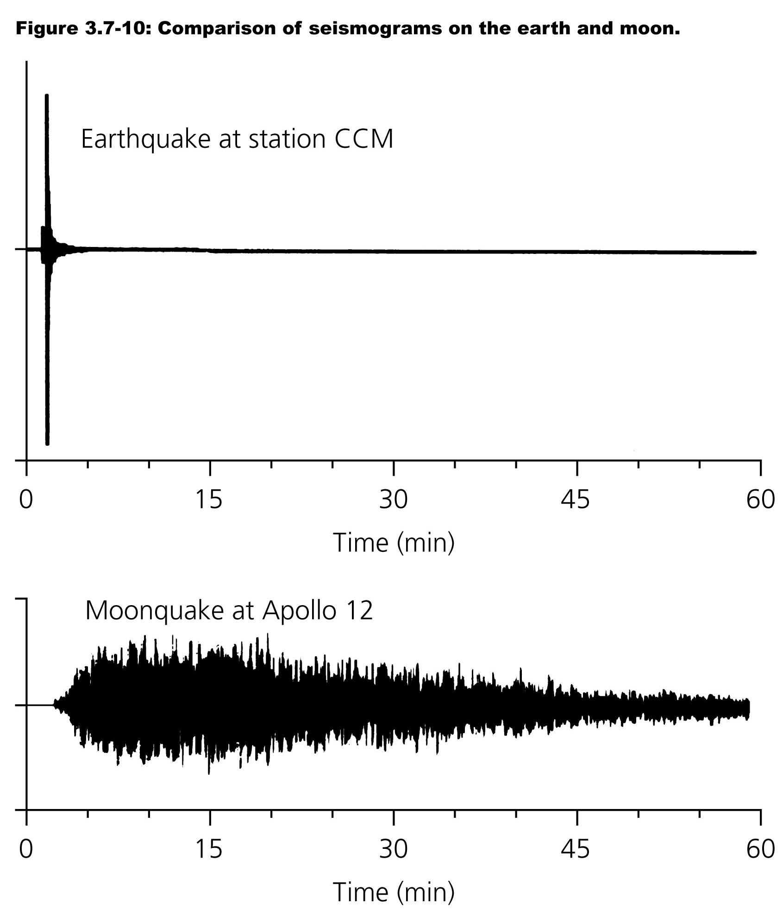
Interesting aside:
Coda (scattered)
energy in the Earth
tends to attenuate
much more rapidly
than on the Moon!
This is mostly
because lunar
regolith contains
no fluids (and has
consequently much
less intrinsic
attenuation!)
Stein & Wysession, “An Introduction to Seismology, Earthquakes and Earth Structure”

Slide 6
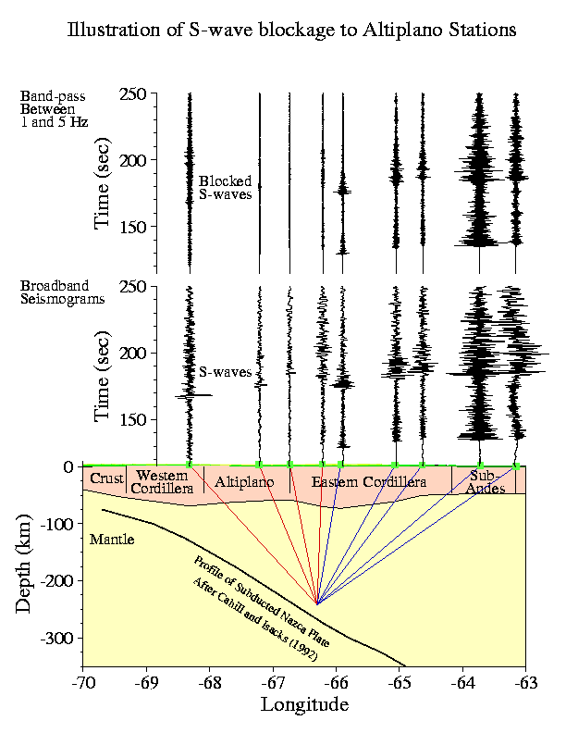
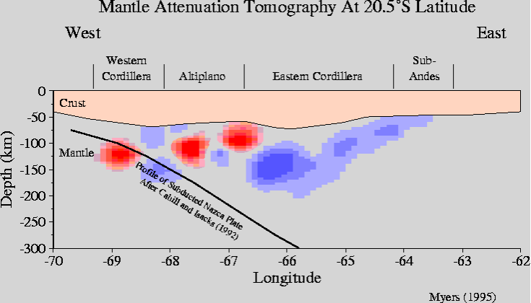
Note seismic attenuation gives different information than
velocity and can be helpful for interpreting subsurface
properties (but it is challenging to image!)

Slide 7
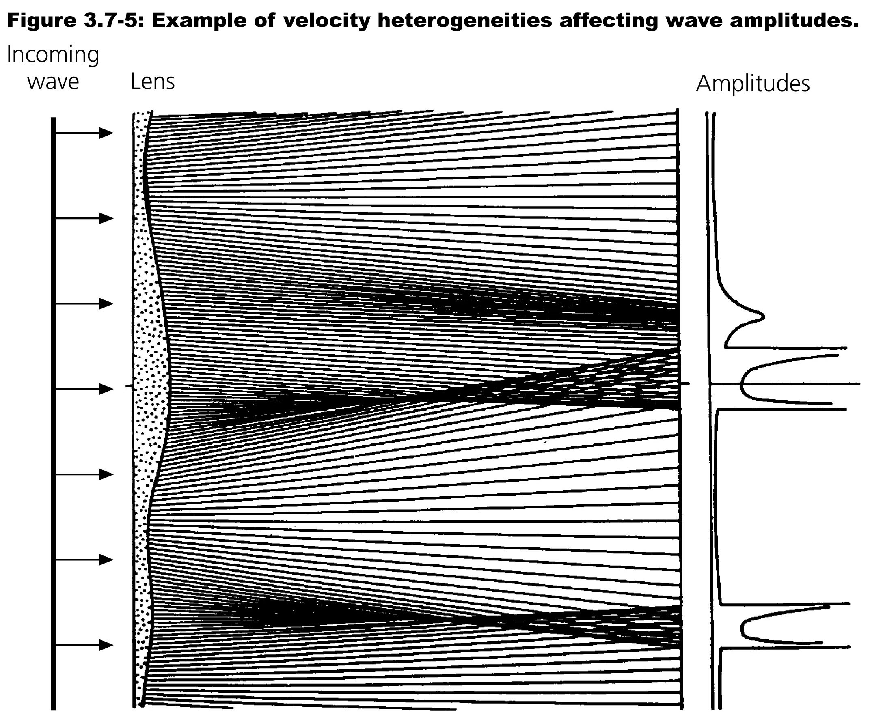
Imaging seismic attenuation is challenging because
amplitude is also affected by multipathing, energy
partitioning, and scattering:
Stein & Wysession, Blackwell 2003
Multipathing:
Seismic waves
can be focused
and defocused
by velocity
variations
in the medium.

Slide 8
Seismic velocity depends on a lot of fields, but not all
are independent:
Velocity
Temperature
Composition
Partial Melt
Pressure
Porosity/Fluid
Density
And some fields can be determined to within
small uncertainty (e.g. pressure at given depth)

Slide 9
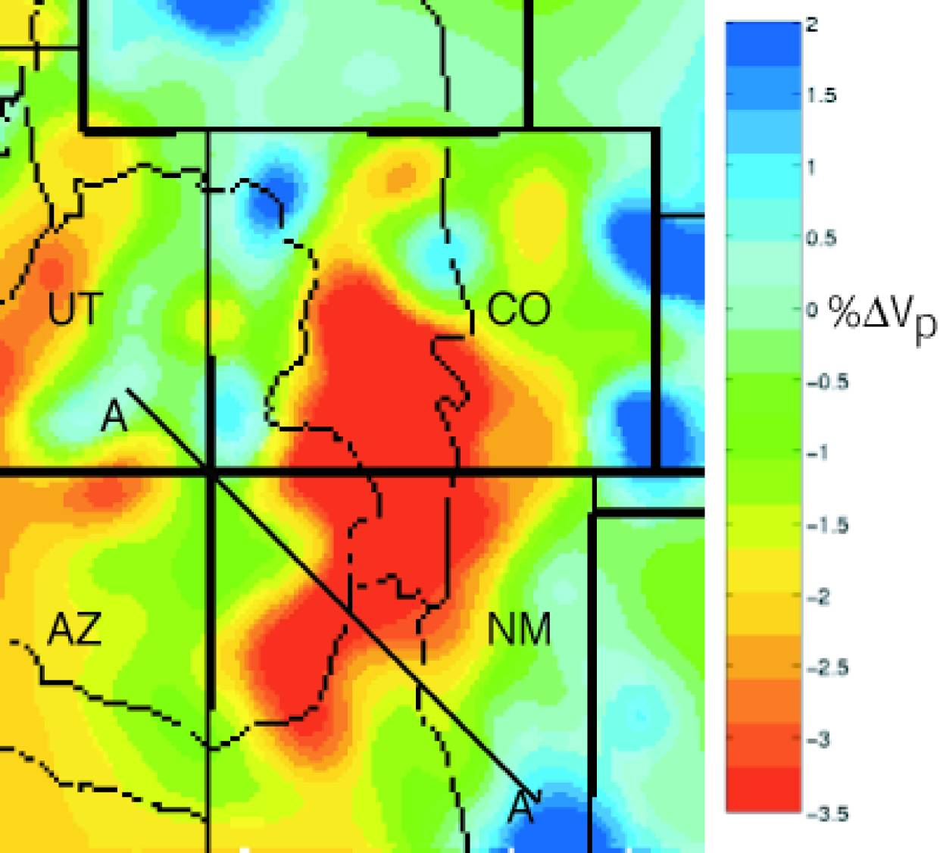
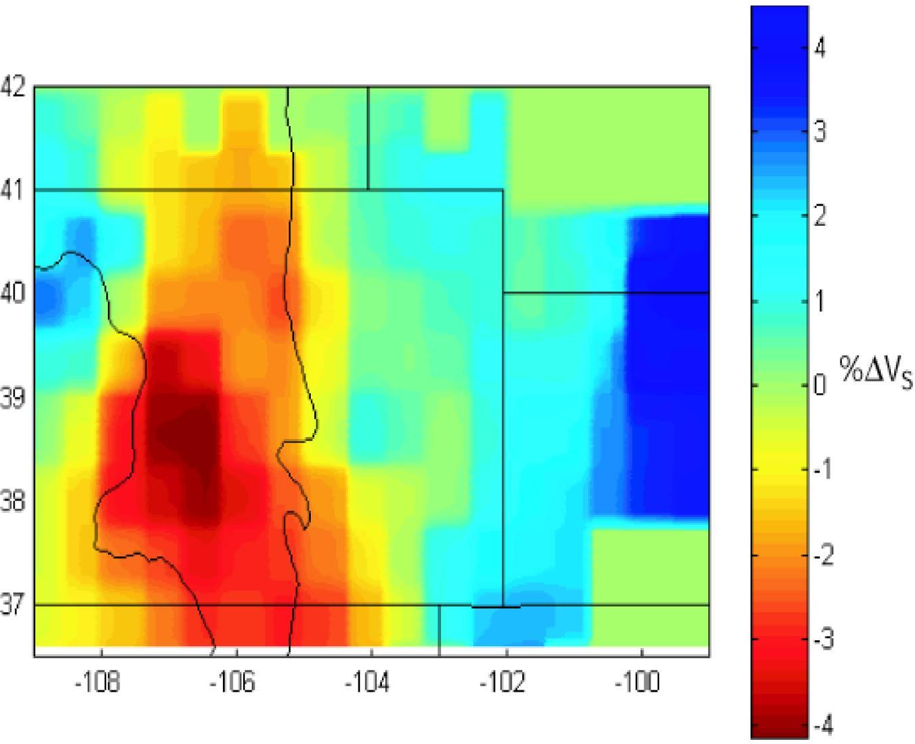
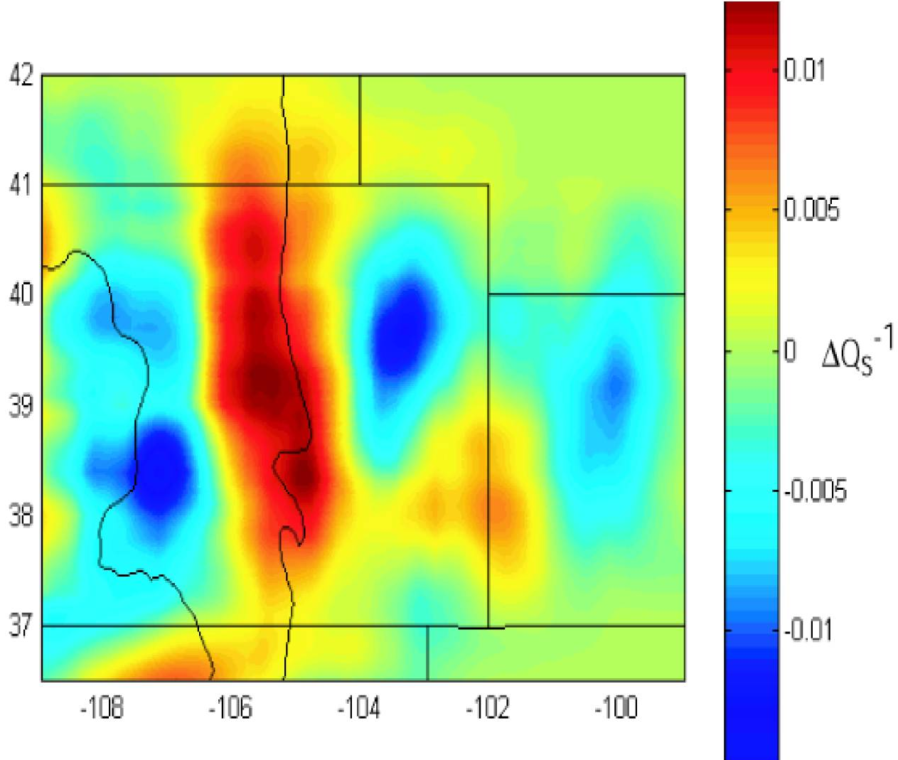
Example: Seismic properties
from the Rio Grande Rift region
of CO & NM (all at 100 km depth)
Here, “Δ” denotes a % or
fractional difference from a
simple 1D model!

Slide 10
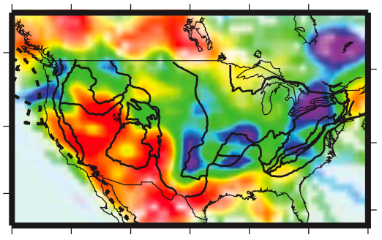
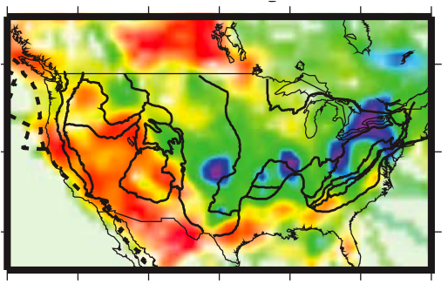

Measured
“Pn” is a refracted
wave from the top
of the mantle (&
the earliest arrival
from earthquakes
at ~100 to ~1200
km distance)
What patterns
do you see?
Why might this
matter?
Pn-Q_{P}
Pasyanos, BSSA, 2013
Sn-Q_{S}

Slide 11
In this course, I cannot emphasize enough
that using more than one type of
measurement, and more than one
geophysical property, will provide far more
insight into the subsurface than using a
single imaging tool.

Slide 12
V_{P}, V_{S}, Q_{P}, Q_{S}, Z seismic properties are five
independent pieces of information that can
be used to separate effects of lithology,
porosity, fluids, cementation and
temperature… Much of the emphasis
in industry seismic is on imaging “geometry”
(structure) of impedance contrasts, but
characterizing the physical properties is
becoming increasingly important!

