Slide 1
Geology 5660/6660
Applied Geophysics
27 Feb 2026
Last Time: Seismic Reflection Interpretation
• Seismic quality depends on:
→ Acoustic impedance contrast
→ Depth (⇒ frequency)
→ Layer thickness (⇒ interference)
→ Properties of overlying layers
→ Source energy
→ Processing parameters
→ Acquisition direction
→ Instrumentation
• Seismic inversion = using velocity information for physical
properties, true depth, better resolution via depth migration
• Trace cross-correlation is used to map fault offsets
Read for Mon 2 Mar: Burger 524-539 (§8.4)
© A.R. Lowry 2008-2026

Slide 2
Last Time continued: Industry Seismic Interpretation
• Depth migration required for accurate depths and
geometries of structures
• 3D visualization (“data caves”) an important part of interpretation
• 4D seismic: Multiple 3D reflection images over time aid in
optimization of reservoir models and production

Slide 3
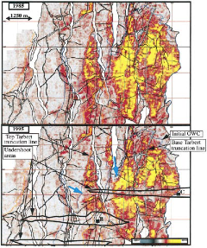

Haakon Fossen 2010
1988
1995

Slide 4

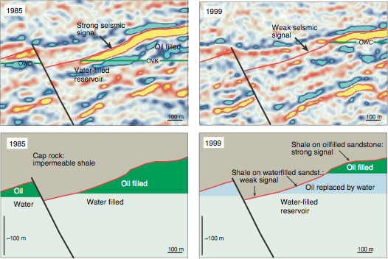
Haakon Fossen 2010

Slide 5
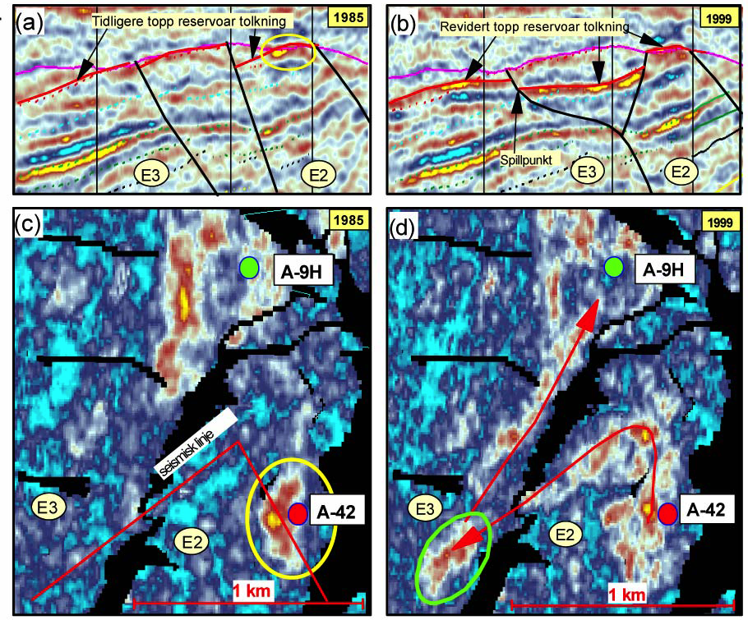
Haakon Fossen 2010
Production
Injection

Slide 6
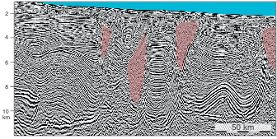
Haakon Fossen 2010
Salt structures

Slide 7
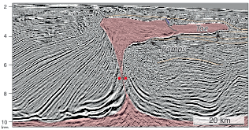
Haakon Fossen 2010
Salt structures

Slide 8
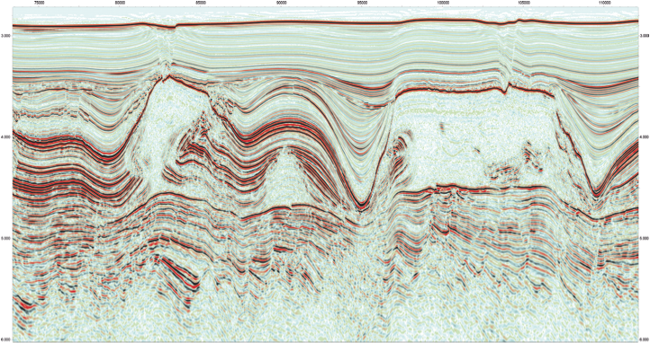
Haakon Fossen 2010

Slide 9
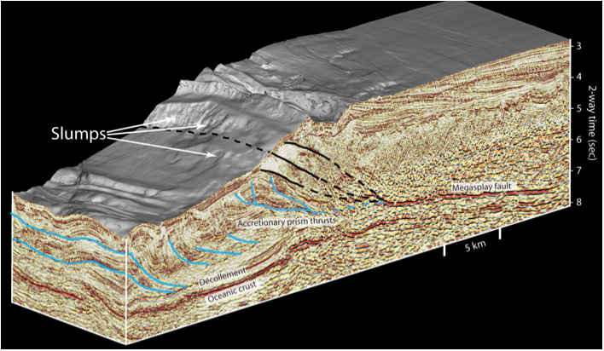
Haakon Fossen 2010

Slide 10
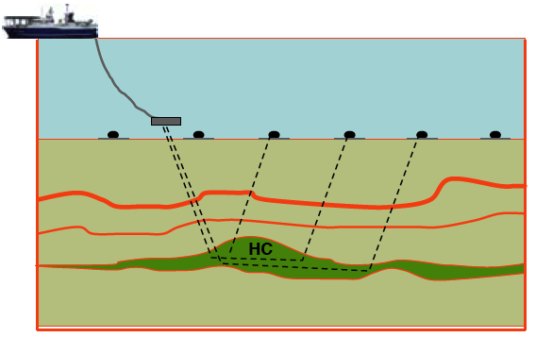
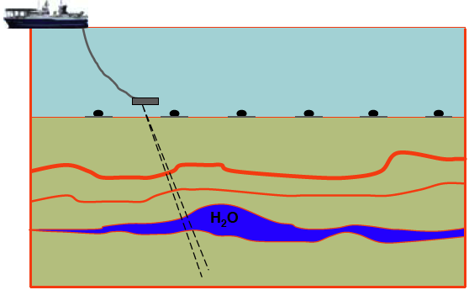
Haakon Fossen 2010
Electromagnetic imaging also growing in use…
Hydrocarbon-filled reservoir is high resistivity
(charge flows preferentially in surrounding rock)
Water-filled reservoir is low resistivity
(charge flows preferentially in brines).

Slide 11
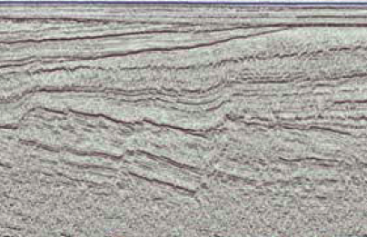
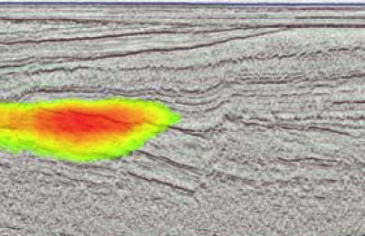
Haakon Fossen 2010
… Here combined with seismic data

