Slide 1
Geology 5660/6660
Applied Geophysics
27 Mar 2024
Last Time: Gravity Anomalies & Modeling
• Discussed nonuniqueness:
→ Different density (but same mass, same center of mass)
can yield an identical gravity anomaly!
→ Different shape at a shallower depth can yield the exact
same gravity anomaly!
(But all geophysical/geological models are nonunique…
Gravity provides info others can’t!)
• Anomalies for:
horizontal cylinder:
vertical cylinder:
fault-bounded block:
For Fri 29 Mar: Burger 429-446 (§7.1-7.2)
© A.R. Lowry 2008-2024

Slide 2
Magnetics:
Like gravity, a potential field method governed by
Poisson’s equation: ∇ ²u = f (sources)
Unlike gravity, source term is a vector rather than a scalar
Gravity :
Monopole source ⇒ field is always
directed radially toward a “sink” location
Magnetics:
S
Dipole source ⇒ field direction & strength
depend on one “source”, one “sink”
N

Slide 3
Coulomb’s Law describes the force of attraction
exerted between two magnetic poles:
p₂
r₂
“unit
monopole”
p₁
r₁
where is the distance & direction between two poles
p₁ & p₂ are pole strengths
μ is magnetic permeability, a property
of the medium (usually ~1)
Magnetic Field Strength is, e.g., the force that would
be exerted by each pole on a hypothetical “unit monopole”:
(MKS units of Teslas;
magnetic anomalies
usually given in nT or γ s)

Slide 4
Definitions:
Magnetic Dipole Moment : Two poles +p and –p
separated by a distance l have moment
Intensity of Magnetization:
(where V is volume) is a material property of the
magnetic source.
*** If a material that can produce a magnetic field (μ > 1)
is situated within an external magnetic field , then
intensity of the induced magnetization is
where k = μ – 1 is
magnetic
susceptibility
of the material.
(e.g., magnetite-rich body)

Slide 5
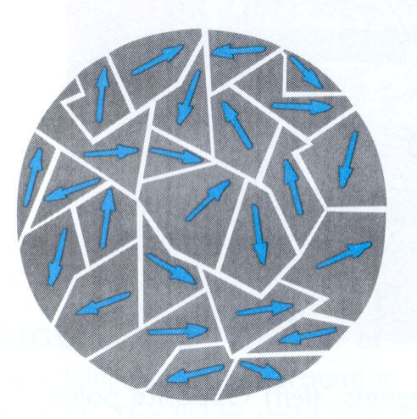
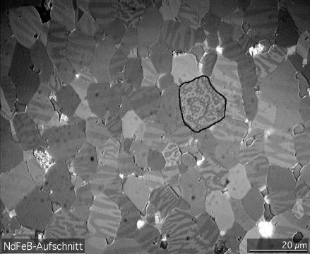
Most Earth materials are diamagnetic:
→ very small negative k ~ –10⁻⁵ (e.g., quartz)
Fe-Mg silicates (pyroxene, amphibole, olivine)
are paramagnetic (moments can align within
small magnetic domains) → k ~ 0.02 to 0.2
Magnetic domains are subcrystalline regions of magnetic alignment of electron orbits– Here illuminated as light and dark shading, using a Kerr microscope
Credit: Wikipedia user “Gorchy”

Slide 6
Most Earth materials are diamagnetic:
→ very small negative k ~ –10⁻⁵ (e.g., quartz)
Fe-Mg silicates (pyroxene, amphibole, olivine)
are paramagnetic (moments can align within
small magnetic domains) → k ~ 0.02 to 0.2
Hematite (“rust” in aeolian soils) is antiferromagnetic:
domains align, ~equal amounts parallel & antiparallel
→ k ~ 0.05 positive and non-negligible, but still small
Magnetite is ferrimagnetic: domains align parallel &
antiparallel but one dominates: k ~ 0.5 to 10! (Also
titanomagnetite, ilmenite, pyrrhotite)
Crystalline iron, nickel, cobalt are ferromagnetic:
domains align parallel (not common in crust, but
common in the core!)

