Slide 1
Geology 5660/6660
Applied Geophysics
28 Feb 2024
Last Time: Seismic Reflection Interpretation
• Seismic quality depends on:
→ Acoustic impedance contrast
→ Depth (⇒ frequency)
→ Layer thickness (⇒ interference)
→ Properties of overlying layers
→ Source energy
→ Processing parameters
→ Acquisition direction
→ Instrumentation
• Seismic inversion seeks Physical Properties
• Trace cross-correlation is used to map fault offsets
• Depth migration required for accurate depths and
geometries of structures
Read for Fri 1 Mar: Burger 524-539 (§8.4)
© A.R. Lowry 2008-2024

Slide 2
Last Time: Industry Seismic Interpretation
• Seismic inversion = using velocity information for physical
properties, true depth, better resolution via depth migration
• 3D visualization (“data caves”) an important part of interpretation
• 4D seismic: Multiple 3D reflection images over time aid in
optimization of reservoir models and production
• Salt structures are especially challenging but have been a
focus of innovation
• EM imaging is a tool of growing importance; electrical
resistivity is sensitive to fluids and clay content
• Knowledge of geological processes is key to
interpretation!!!! BUT, it’s critically important to
also understand attributes/artefacts/limitations
of the seismic reflection data.

Slide 3
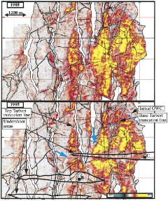
Haakon Fossen 2010
1988
1995

Slide 4
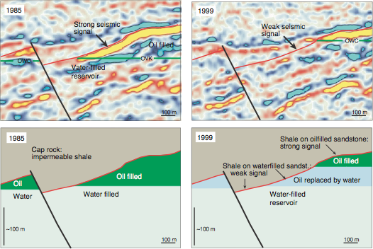
Haakon Fossen 2010

Slide 5
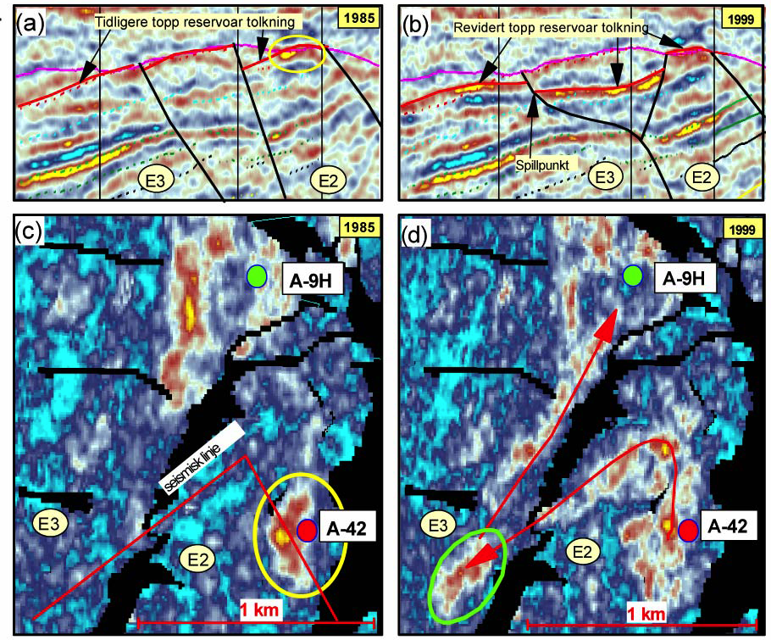
Haakon Fossen 2010
Production
Injection

Slide 6
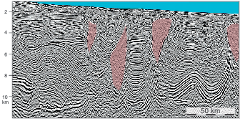
Haakon Fossen 2010
Salt structures

Slide 7
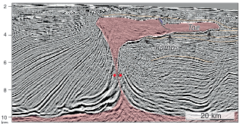
Haakon Fossen 2010
Salt structures

Slide 8
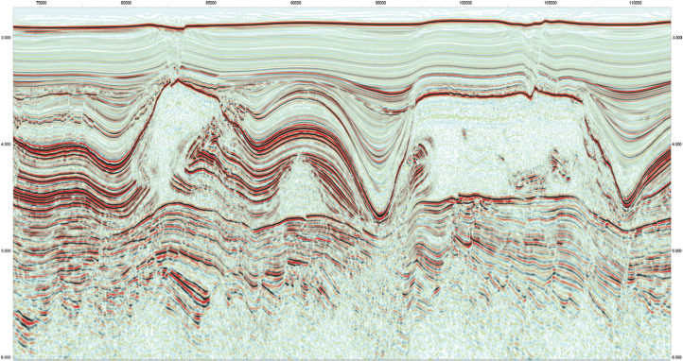
Haakon Fossen 2010

Slide 9
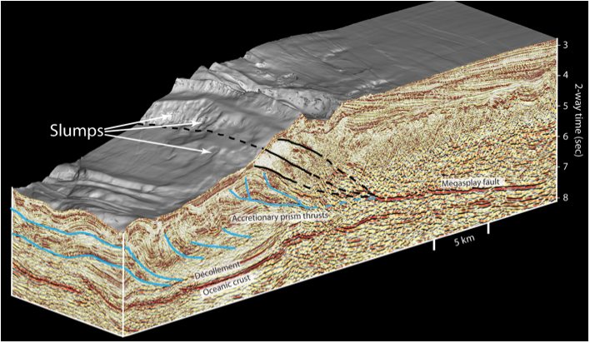
Haakon Fossen 2010

Slide 10
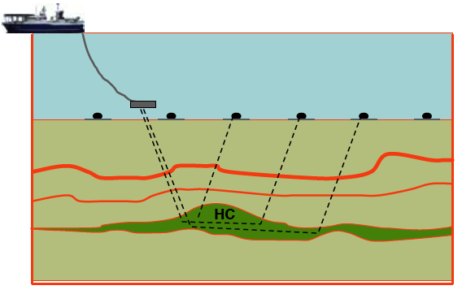
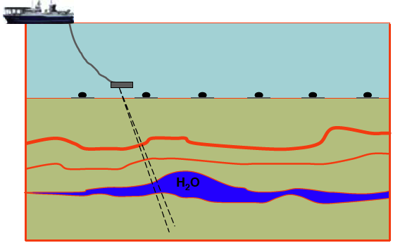
Haakon Fossen 2010
Electromagnetic imaging also growing in use…
Water-filled reservoir is low resistivity
(charge flows preferentially in reservoir).
Hydrocarbon-filled reservoir is high resistivity
(charge flows preferentially in surrounding rock)

Slide 11
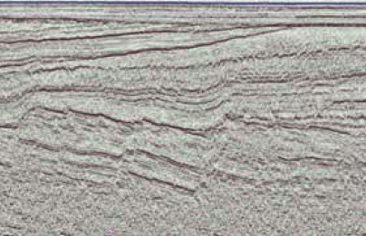
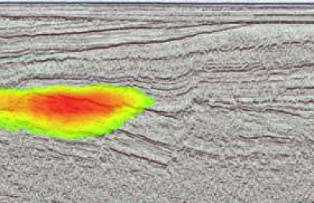
Haakon Fossen 2010
… Here combined with seismic data

