Slide 1
Geology 5660/6660
Applied Geophysics
28 Feb 2024
This Week’s Lab:
• Review Lab 3
© A.R. Lowry 2008-2024

Slide 2
Lab 3: Modeling Refraction Data

Slide 3
Your lab assignment (due at 2:30pm on 21 Feb):
0. Install the Burger et al software on a pc/laptop you use.
1. Using Refract, model the travel-times for the picks given on
slide 3 of this powerpoint. Be sure to test a range of different
parameters for the velocity of the two layers and thickness of
the upper layer, and your lab write-up should discuss your
results for the best possible model (i.e., the model
parameters that give a minimum RMS misfit between the
model prediction and the measured travel-times!) Your lab
report should include screenshots of all four of the Refract
windows (Model, Data, Plot, and Cross-section windows)
for completeness. The RMS misfit is shown in the Data
window!

Slide 4
A note on using Refract (& any other code or
method):
The goal of any modeling exercise is to match the model
predictions to the data as closely as possible. This
means you should check (repeatedly!!!) whether another
model with slightly different parameters gives a better
fit to the data, before accepting a model as “correct”!
The RMS misfit of your model will be the final arbiter
of whether or not your model is a likely representation of
the subsurface structure.
Always include the RMS misfit of the model
to the data in any write-ups of labs for this
class in which you model real data!!!

Slide 5
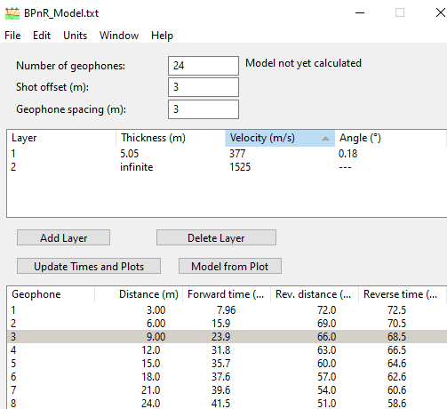
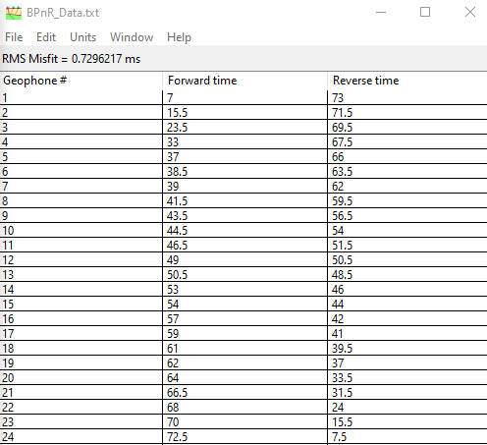
The best possible model has upper layer thickness/velocity of about 5.05 m &
377 m/s, lower layer velocity of 1525 m/s, and layer dip of 0.18°. (Some of you
did slightly better than this using more significant digits in the parameters!)

Slide 6
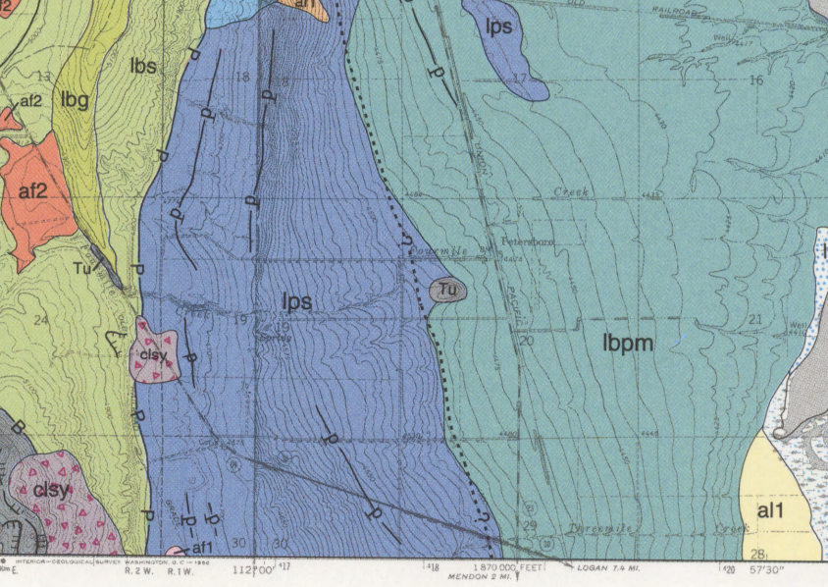
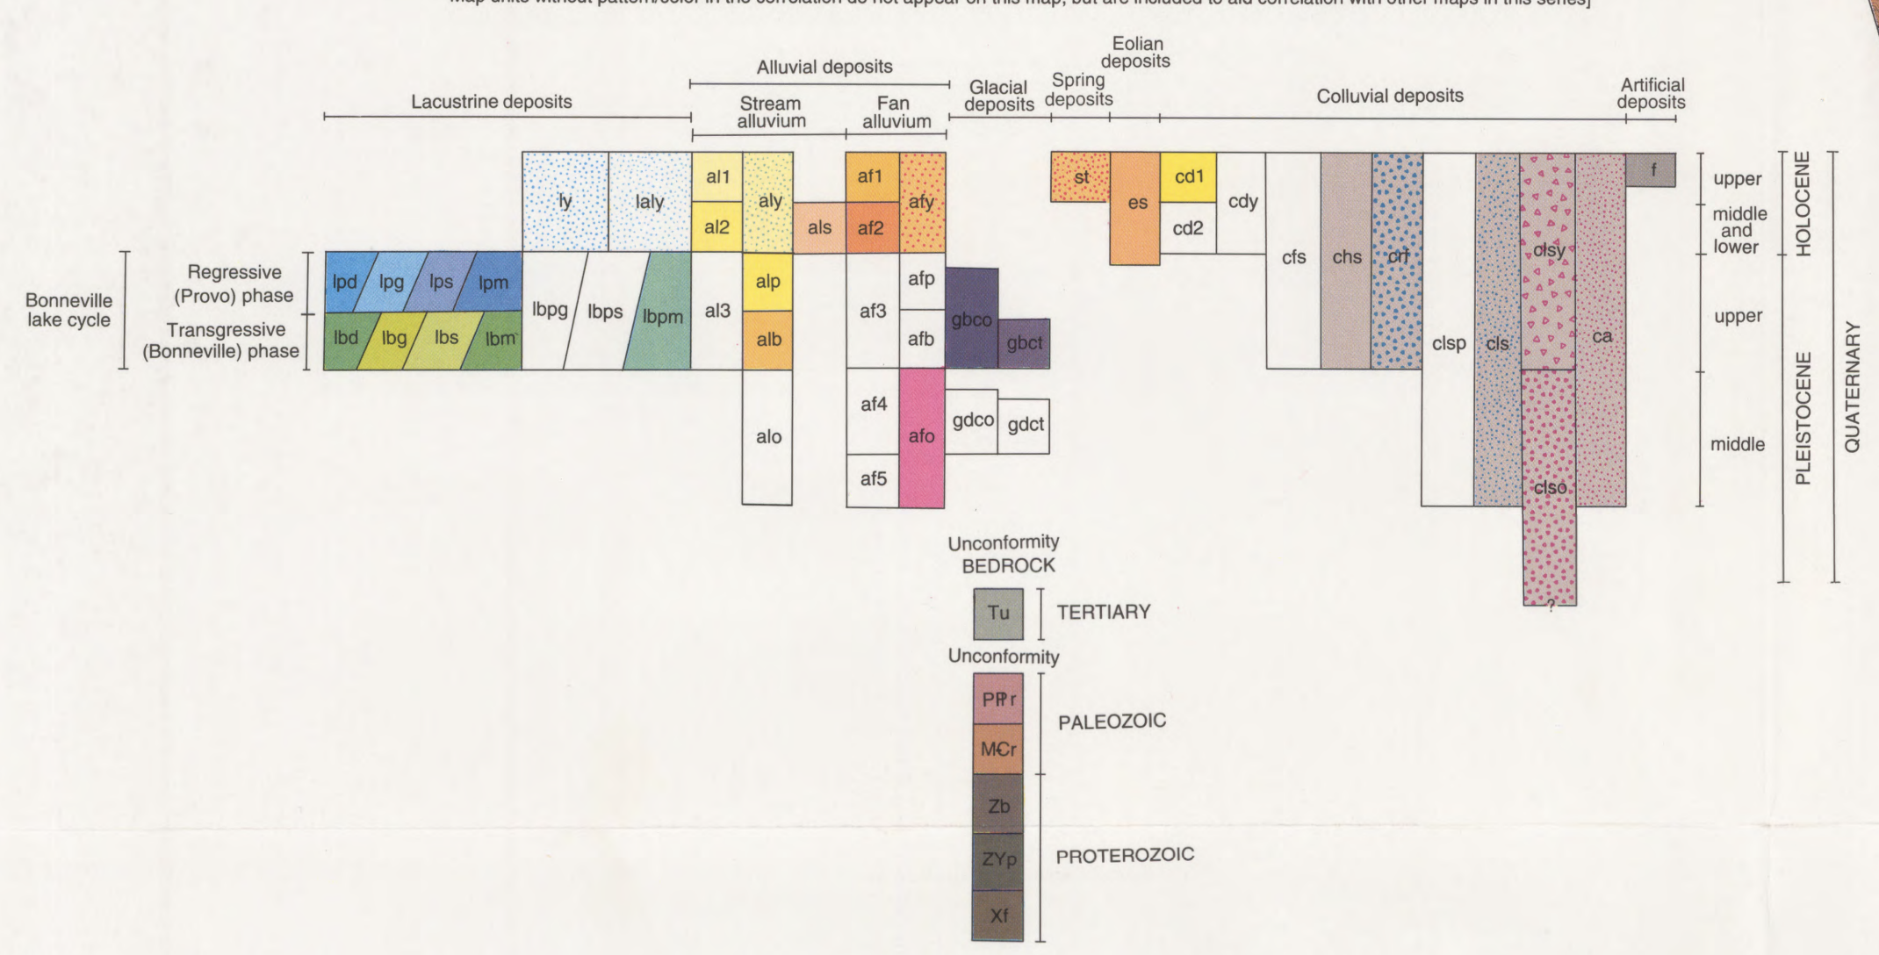
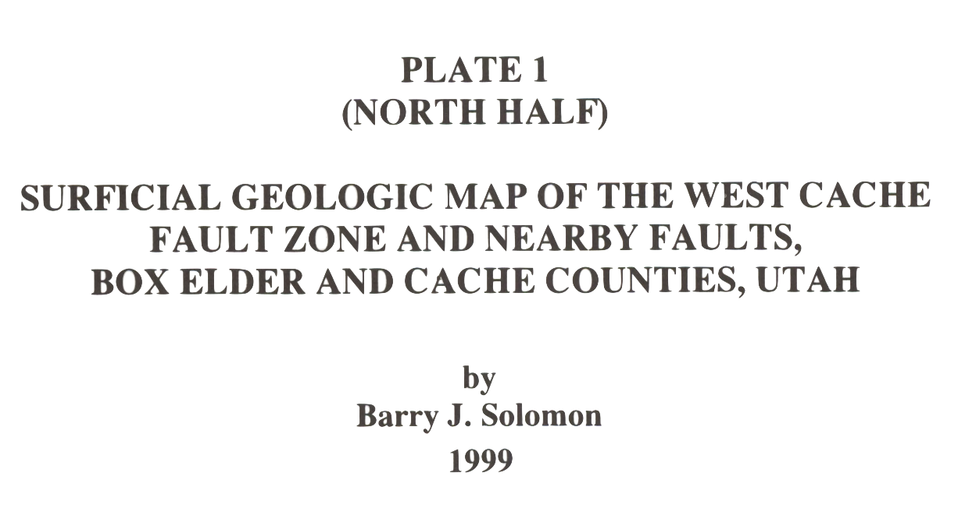
Background for the Benson Park-n-Ride site: Our motivation was to assess whether
we could find evidence for an inferred location of the West Cache Fault. Inspection at
the site showed the surface layer is a soil with fairly high clay content. Geologic
mapping near the location (circled above, from Solomon [1999]) suggests the surface
deposits are Provo lacustrine sand and silts (lps), and interprets the West Cache fault
(dashed w/ question marks, indicating the fault is not mapped based on observational
evidence there) as approximately following the contact with Provo/Bonneville lacustrine
silts and clays (lbpm). It is worth noting that only one recent offset of the WCF has been
dated after Lake Bonneville dropped to the Provo level. We placed our seismic
profile about 100 m west of the mapped fault “guess” (because further east was muddy
and still snow-covered!)

Slide 7
Lab 3 Continued
Your write-up should address the following:
(1.a) Is there unequivocal evidence for dip on the layer interface(s)
generating your arrivals?
(1.b) If the model has a “dipping” layer, is the dip consistent with
the thickness change you’d expect at this location if it were offset
by the WCF?
(1.c) Is there misfit in your best-fitting model of the picks that
can’t be reduced by changing the model parameters?
(1.d) If so, how might you interpret that misfit?

Slide 8
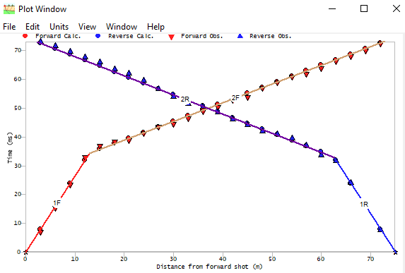
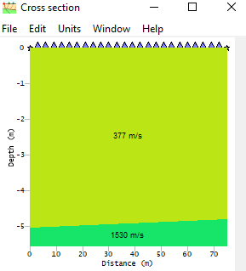
E
W
E
W
(1.a) Is there unequivocal
evidence for dip on the layer
interface(s) generating your
arrivals?
(1.a) The data are very well-fit (RMS 0.7296 ms) by a two-layer model with a very
slight dip (0.18°). The best model with similar parameter significant digits and no dip
gives an RMS misfit of 0.7582 ms. I suggested in class that a difference of 0.01 ms is
significant… But using statistical tests, this difference is significant at only about 22%
confidence. So while the dip improves the fit, it is not “required” at high confidence.

Slide 9
Aside: For those who may want to test statistical confidence in model
parameters for themselves, you can use the Likelihood Ratio Method for this.
We expect:
in which E is the RMS misfit for a set of parameters m; E_{min} is the smallest
possible misfit; M is the number of model parameters; N is the number of
measurements, (1 – α) is the confidence expressed as a fraction of 1; and F ^{–1} is
the inverse of the F-cumulative statistical distribution. The finv function can be
found in Matlab, Excel, and other software!
For my calculations, E = 0.7582, E_{min} = 0.7296, M = 4, N = 48, and I varied
(1 – α) to match the ratio of E/E_{min} in order to find the confidence.

Slide 10
(1.b) If the model
has a “dipping” layer,
is the dip consistent
with the thickness
change you’d expect
at this location if it
were offset by the
WCF?
E
W
E
W
(1.b) I left out an important piece of information: The forward source was on the East
side of the profile! So the sign of the thickness change is correct (i.e., Provo near-shore
sediments are thicker on the eastern, hanging-wall side of any hypothetical fault). But
the very slight dip (0.18°) translates to only 23 cm of thickness change of the upper
layer across the profile. So, if we crossed the West Cache normal fault (or a splay of
the fault), it apparently didn’t offset this (fairly deep!) layer boundary by much! If the
velocity change represents a change from shallow- to deep-water Bonneville sediments,
23 cm is much less than one might anticipate for a ~12 ka layer boundary!

Slide 11
(1.c) Is there misfit in your best-fitting model
of the picks that can’t be reduced by
changing the model parameters?
(1.d) If so, how might you interpret that
misfit?
All late!
All early!
(1.c) There is, but in these data it is very small! The largest are ~2 ms, with many of
the distal measurements exceeding 1 ms.
(1.d) Some of the differences appear systematic (e.g., consistently late arrivals in the
last eight geophones on the reverse shot), but the misfit can’t be reduced much with a
planar layer-over-halfspace model so we can’t attribute this to parameter error. One
possible explanation is picking error (because the onset of displacement is hard to see
in the presence of noise), but it could also result from a non-planar thickness variation
or nonuniform velocity of the upper layer.

Slide 12
Lab 3 Continued
(2) If we crossed the West Cache fault trace, our target would
have travel-times somewhere on a spectrum between a layer
over a vertical contact and an offset layer boundary:
There are no Xcel spreadsheet models of these among the Burger
codes, but I’ve created one (on the website; E-W_Seismic.xlsx).
m = 1/V₂
m = 1/V₂
m = 1/V₃
m = 1/V₂
m = 1/V₃
m = 1/V₂
m = 1/V₂
m = 1/V₂
m = 1/V₁
m = 1/V₁
m = 1/V₁
m = 1/V₁
V₁ = 500 m/s
B
V₁ = 500 m/s
A
z
V₂ = 2000 m/s
V₃ = 1000 m/s
V₂ = 2000 m/s

Slide 13
Lab 3 Continued
Use the spreadsheet to model both “fault-like” cases. Start out
using the parameters for V₁, thickness & V₂ from your Refract
model; then vary all five parameters as needed to improve the fit.
(2.a) Which of the three models is most successful (i.e., which has
the smallest RMS misfit)?
Be sure to include screenshots of your spreadsheet models (params,
data, RMS misfits, and plots!
m = 1/V₂
m = 1/V₂
m = 1/V₃
m = 1/V₂
m = 1/V₃
m = 1/V₂
m = 1/V₂
m = 1/V₂
m = 1/V₁
m = 1/V₁
m = 1/V₁
m = 1/V₁
V₁ = 500 m/s
B
V₁ = 500 m/s
A
z
V₂ = 2000 m/s
V₃ = 1000 m/s
V₂ = 2000 m/s

Slide 14
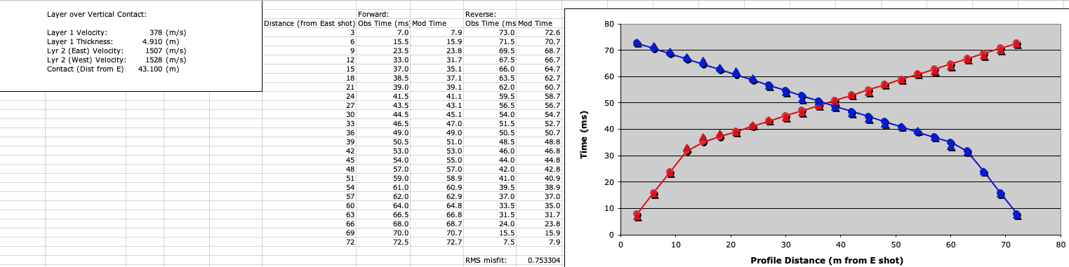
(2.a) The faulted model invoking a lateral velocity change in the second layer does not
improve significantly on the best-fitting model of a single horizontal layer boundary
and constant velocity within layers. The best-fitting Refract model with zero dip and
a misfit of 0.75817 ms (compared to 0.753304 ms above) had similar parameters
except for a constant 1514 m/s velocity in layer 2. The tiny improvement in misfit and
small difference (21 m/s) in layer 2 velocities suggests that we are fitting noise, and
does not justify adding two extra parameters to the model. (In fact, with a 0.72962 ms
RMS misfit, the dipping layer model does better than the fault model with changing
second-layer velocity while using one less parameter.)

Slide 15
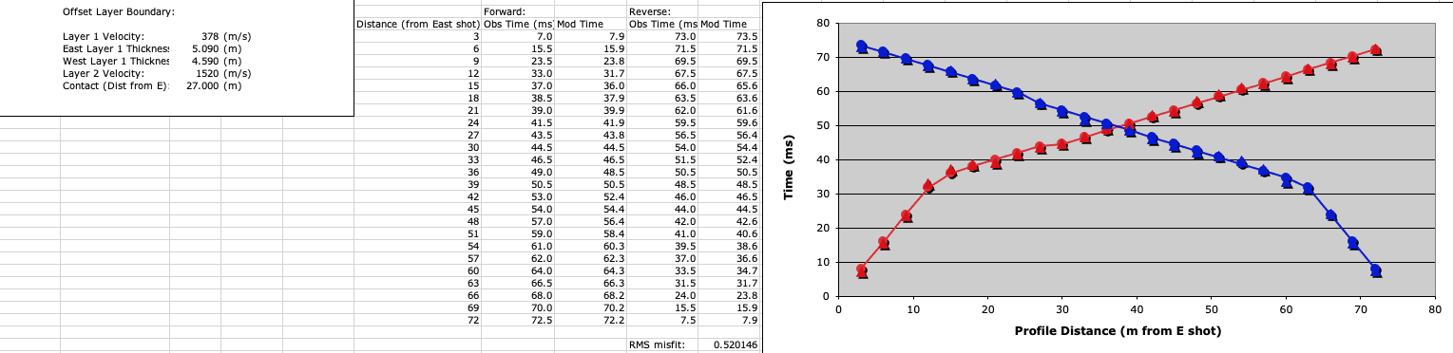
(2.a) The model with an offset layer boundary, on the other hand, does improve
very significantly over Refract ’s best-fitting model of a single horizontal layer
boundary and constant velocity within layers. The RMS misfit of 0.52015 ms is an
improvement over the dipping layer model (0.72962 ms) at 99% confidence (or 3σ),
which is equivalent to saying that such an improvement could happen by chance only
1 out of 100 times. The 0.5 meter offset indicated by the model is small for a surface-
breaking earthquake so could just be a near-surface splay, but given a lack of
geomorphic expression nearby it may be the main scarp of the Wellsville fault branch
of the West Cache fault zone! Trenching of the WCFZ further south suggests one to
three events since Bonneville highstand with the most recent occurring 3-5 ka.

