Slide 1
Geology 5660/6660
Applied Geophysics
28 Jan 2026
Last time: Seismic Amplitude
• Anelastic Attenuation converts part of the
elastic wave energy to work and depends on
Quality Factor Q:
• Multipathing changes amplitude by (Snell’s Law) bending or
“lensing” at nonplanar boundaries that can focus or defocus
seismic wave energy
• Q is hard to measure because amplitudes depend on multipathing
and other amplitude effects (e.g., energy partitioning, scattering)
BUT it is another physical rock property giving different information
than velocity (more sensitive to shallow porosity & fluids, deep
temperature, melt & volatiles)
• So, Q can help to interpret seismic images (if you can measure it)!
Read for Fri 30 Jan: Burger 81-105 (Ch 3.3-3.6)
© A.R. Lowry 2008-2026

Slide 2
Amplitudes from mode partitioning:
Recall that reflected & refracted amplitudes depend on
Impedance Contrast:
A function of energy
partitioning at the boundary.
The normally-incident (θ = 0)
P-wave with amplitude A_{i}
produces a reflected P with
amplitude:
and a refracted P:
θ
A
(reflection
coefficient)
incoming P
(refraction
coefficient)
where Z_{i} = ρ_{i}V_{i} is the impedance in layer i

Slide 3
Mode Conversions:
A₁
reflected P
A₂
Here, algebra
would get
messy using
previous
variable
names...
So, let’s let:
V_{P} = α
V_{S} = β
θ_{P} = i
θ_{S} = j
A_{P} = A
A_{S} = B
i₁
reflected S
B₁
refracted P
i₂
j₁
B₂
refracted S
j₂
i₀
incoming P
A₀
α₁, β₁, ρ₁
α₂, β₂, ρ₂
Snell’s Law predicts ray angles: For i₀ ≤ i_{c},
(For i₀ > i_{c}, rules change a bit.)
However Snell’s law gives no information about amplitudes!

Slide 4




Mode Conversions:
A₁
reflected P
A₂
i₁
reflected S
B₁
refracted P
i₂
j₁
B₂
refracted S
j₂
i₀
z
incoming P
A₀
x
α₁, β₁, ρ₁
α₂, β₂, ρ₂
Consider particle displacements & stress at the interface:
u_{x}, u_{z} are nonzero (u_{y} = 0) and must be continuous
across the boundary:
Also stress must be continuous:
$u_{x}^{+}=$ $u_{x}^{–}$
$u_{z}^{+}=$ $u_{z}^{–}$
$σ_{xz}^{+}=$ $σ_{xz}^{–}$
$σ_{xx}^{+}=$ $σ_{xx}^{–}$

Slide 5
We also require that energy is conserved: Sum of energy
in wave amplitudes leaving the boundary must equal the
energy in the incident wave. After lots of algebra & trig:
x
x
z
z
xz
xz
xx
xx

Slide 6
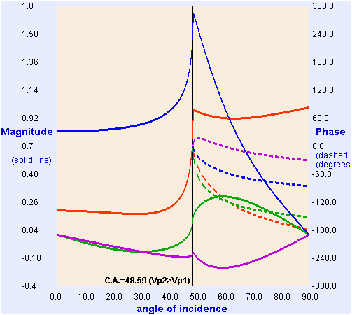
These four equations in four unknown amplitudes leaving a velocity
boundary are called Zoeppritz’ Equations.
If we choose an amplitude for the incident wave (e.g., A₀ = 1),
we can solve for the other four algebraically.
Model from:
https://crewes.org/
ResearchLinks/
ExplorerPrograms/ZE/
ρ₁ = 2000, ρ₂ = 2200
kg/m³
α₁ = 3000, α₂ = 4000
m/s
β₁ = 1500, β₂ = 2000
m/s
(T = “Transmitted”;
R = “Reflected”)
T_{p}
R_{p}
R_{s}
T_{s}
Crewes Zoeppritz Explorer

Slide 7
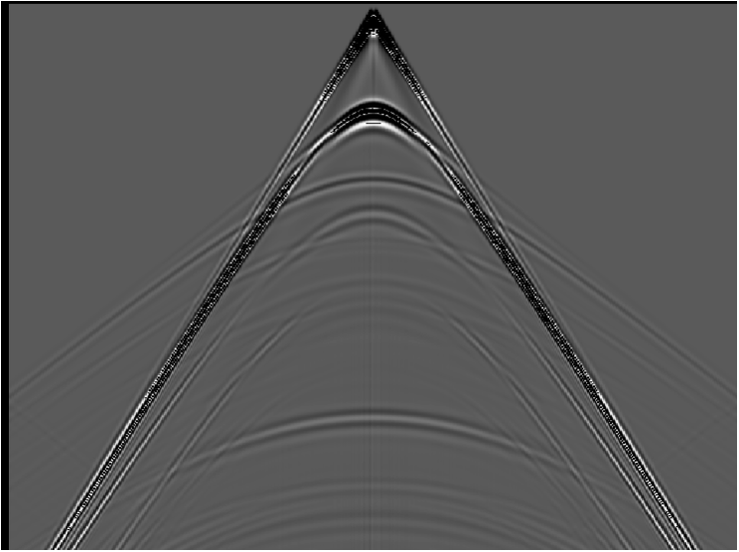
water
Example for
a synthetic
seismogram
shale
gas sand
shale

Slide 8
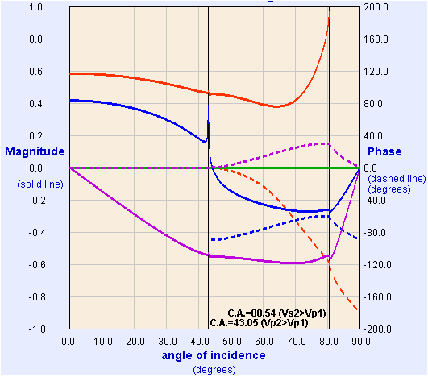
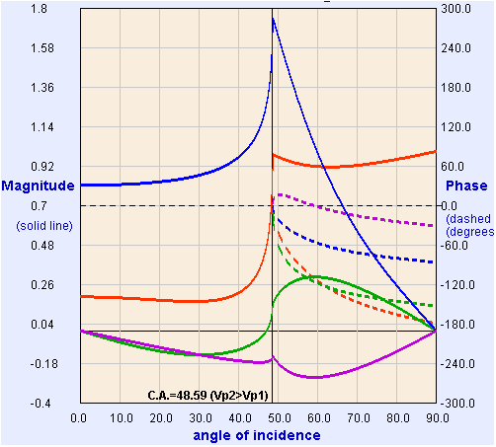
water
shale
gas sand
shale
Water/Shale
Shale/Gas Sand
R_{p}
T_{p}
R_{s}
T_{s}

Slide 9
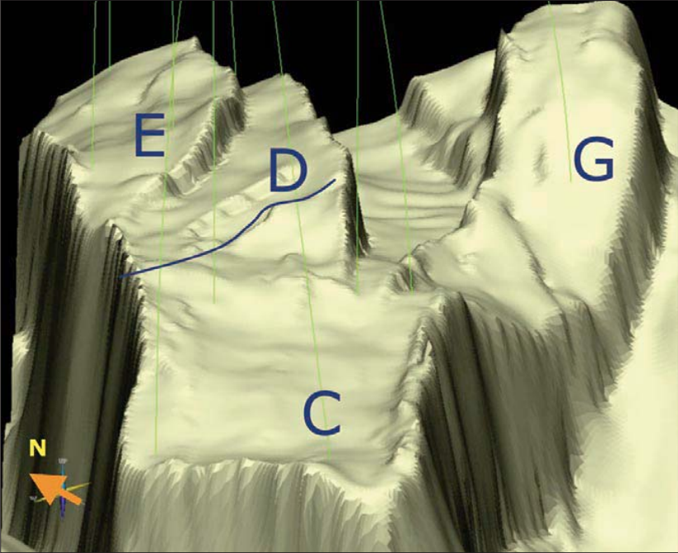
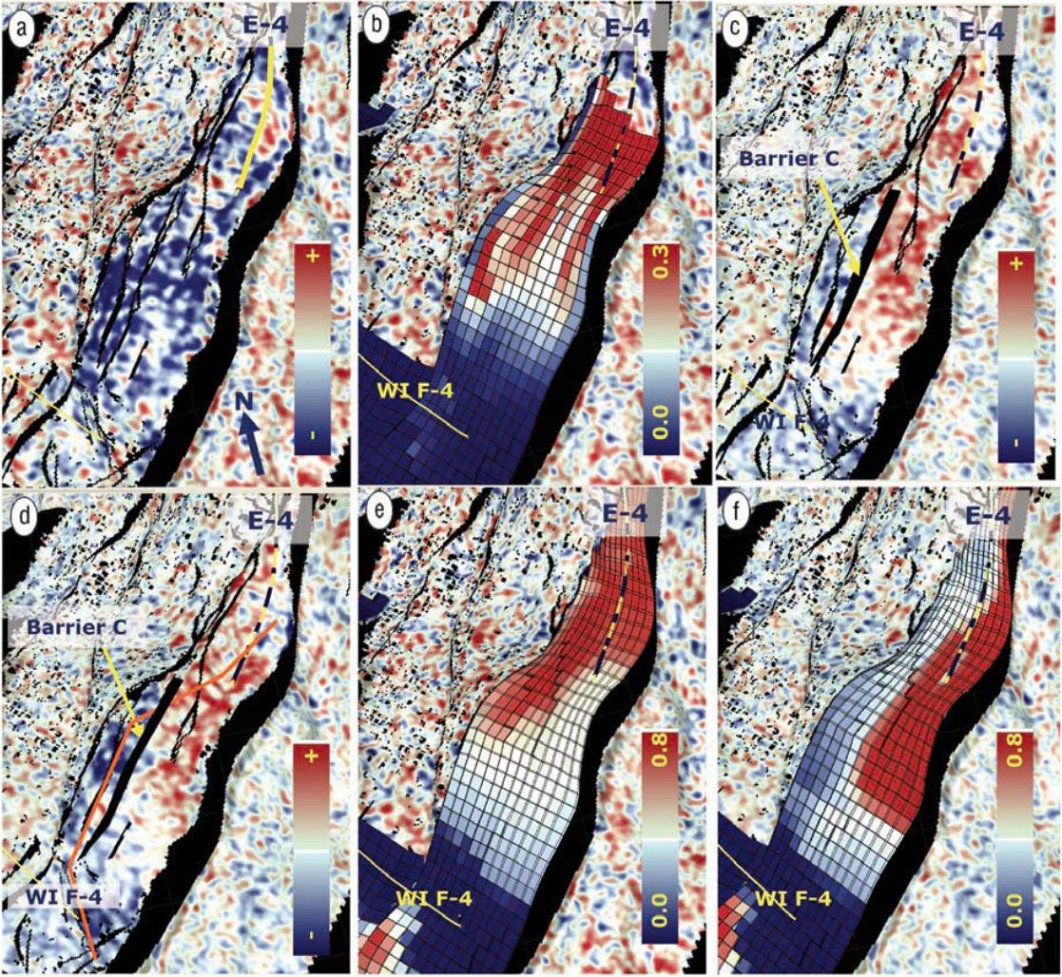
2001-2003
2001-2004
Model
w/out
seismic
Model
with
seismic
4D: imaging
changes in
impedance:
From Osdal
et al., The
Leading
Edge, 2006
Red = gas cap over oil (neutral colors); blue = ⬇ Z from injected water

