Slide 1
Geology 5660/6660
Applied Geophysics
29 Jan 2024
Last time: Fundamentals of Seismic Amplitudes
• The Impedance of a medium is Z = ρV. Reflected and
refracted amplitudes depend on the impedance contrast
via reflection & refraction coefficients (for normal-incidence):
• Source amplitude determines the total energy in an
(idealized) elastic wave
• Geometrical Spreading distributes energy over
increasing surface area of the wavefront.
Uniform half-space spherical spreading:
Read for Wed 31 Jan: Burger 65-81 (Ch 3-3.2)
© A.R. Lowry 2008-2024

Slide 2
Last time continued: Amplitude
• For a refracted head wave, geometrical spreading is
cylindrical spreading :
• Anelastic Attenuation converts part of the elastic
wave energy to work and depends on Quality Factor Q:

Slide 3
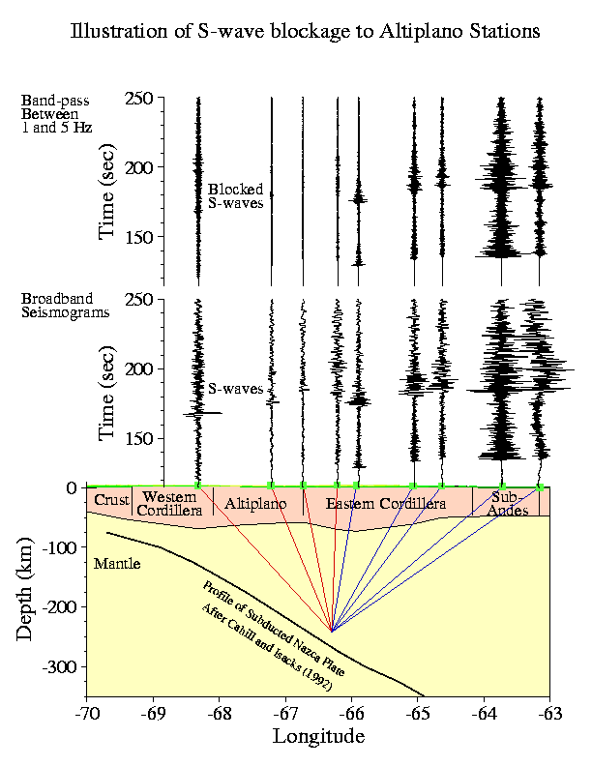
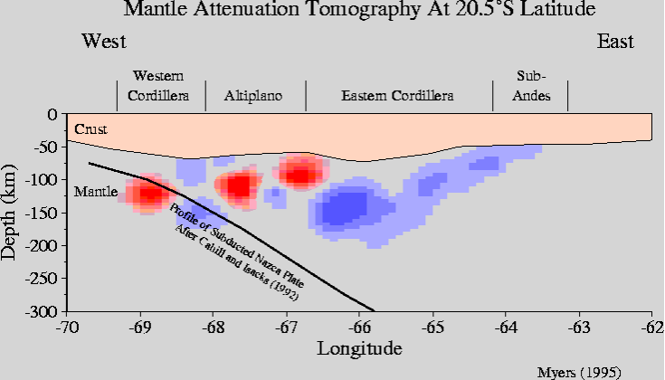
Note seismic attenuation gives different information than
velocity and can be helpful for interpreting subsurface
properties (but it is challenging to image!)

Slide 4
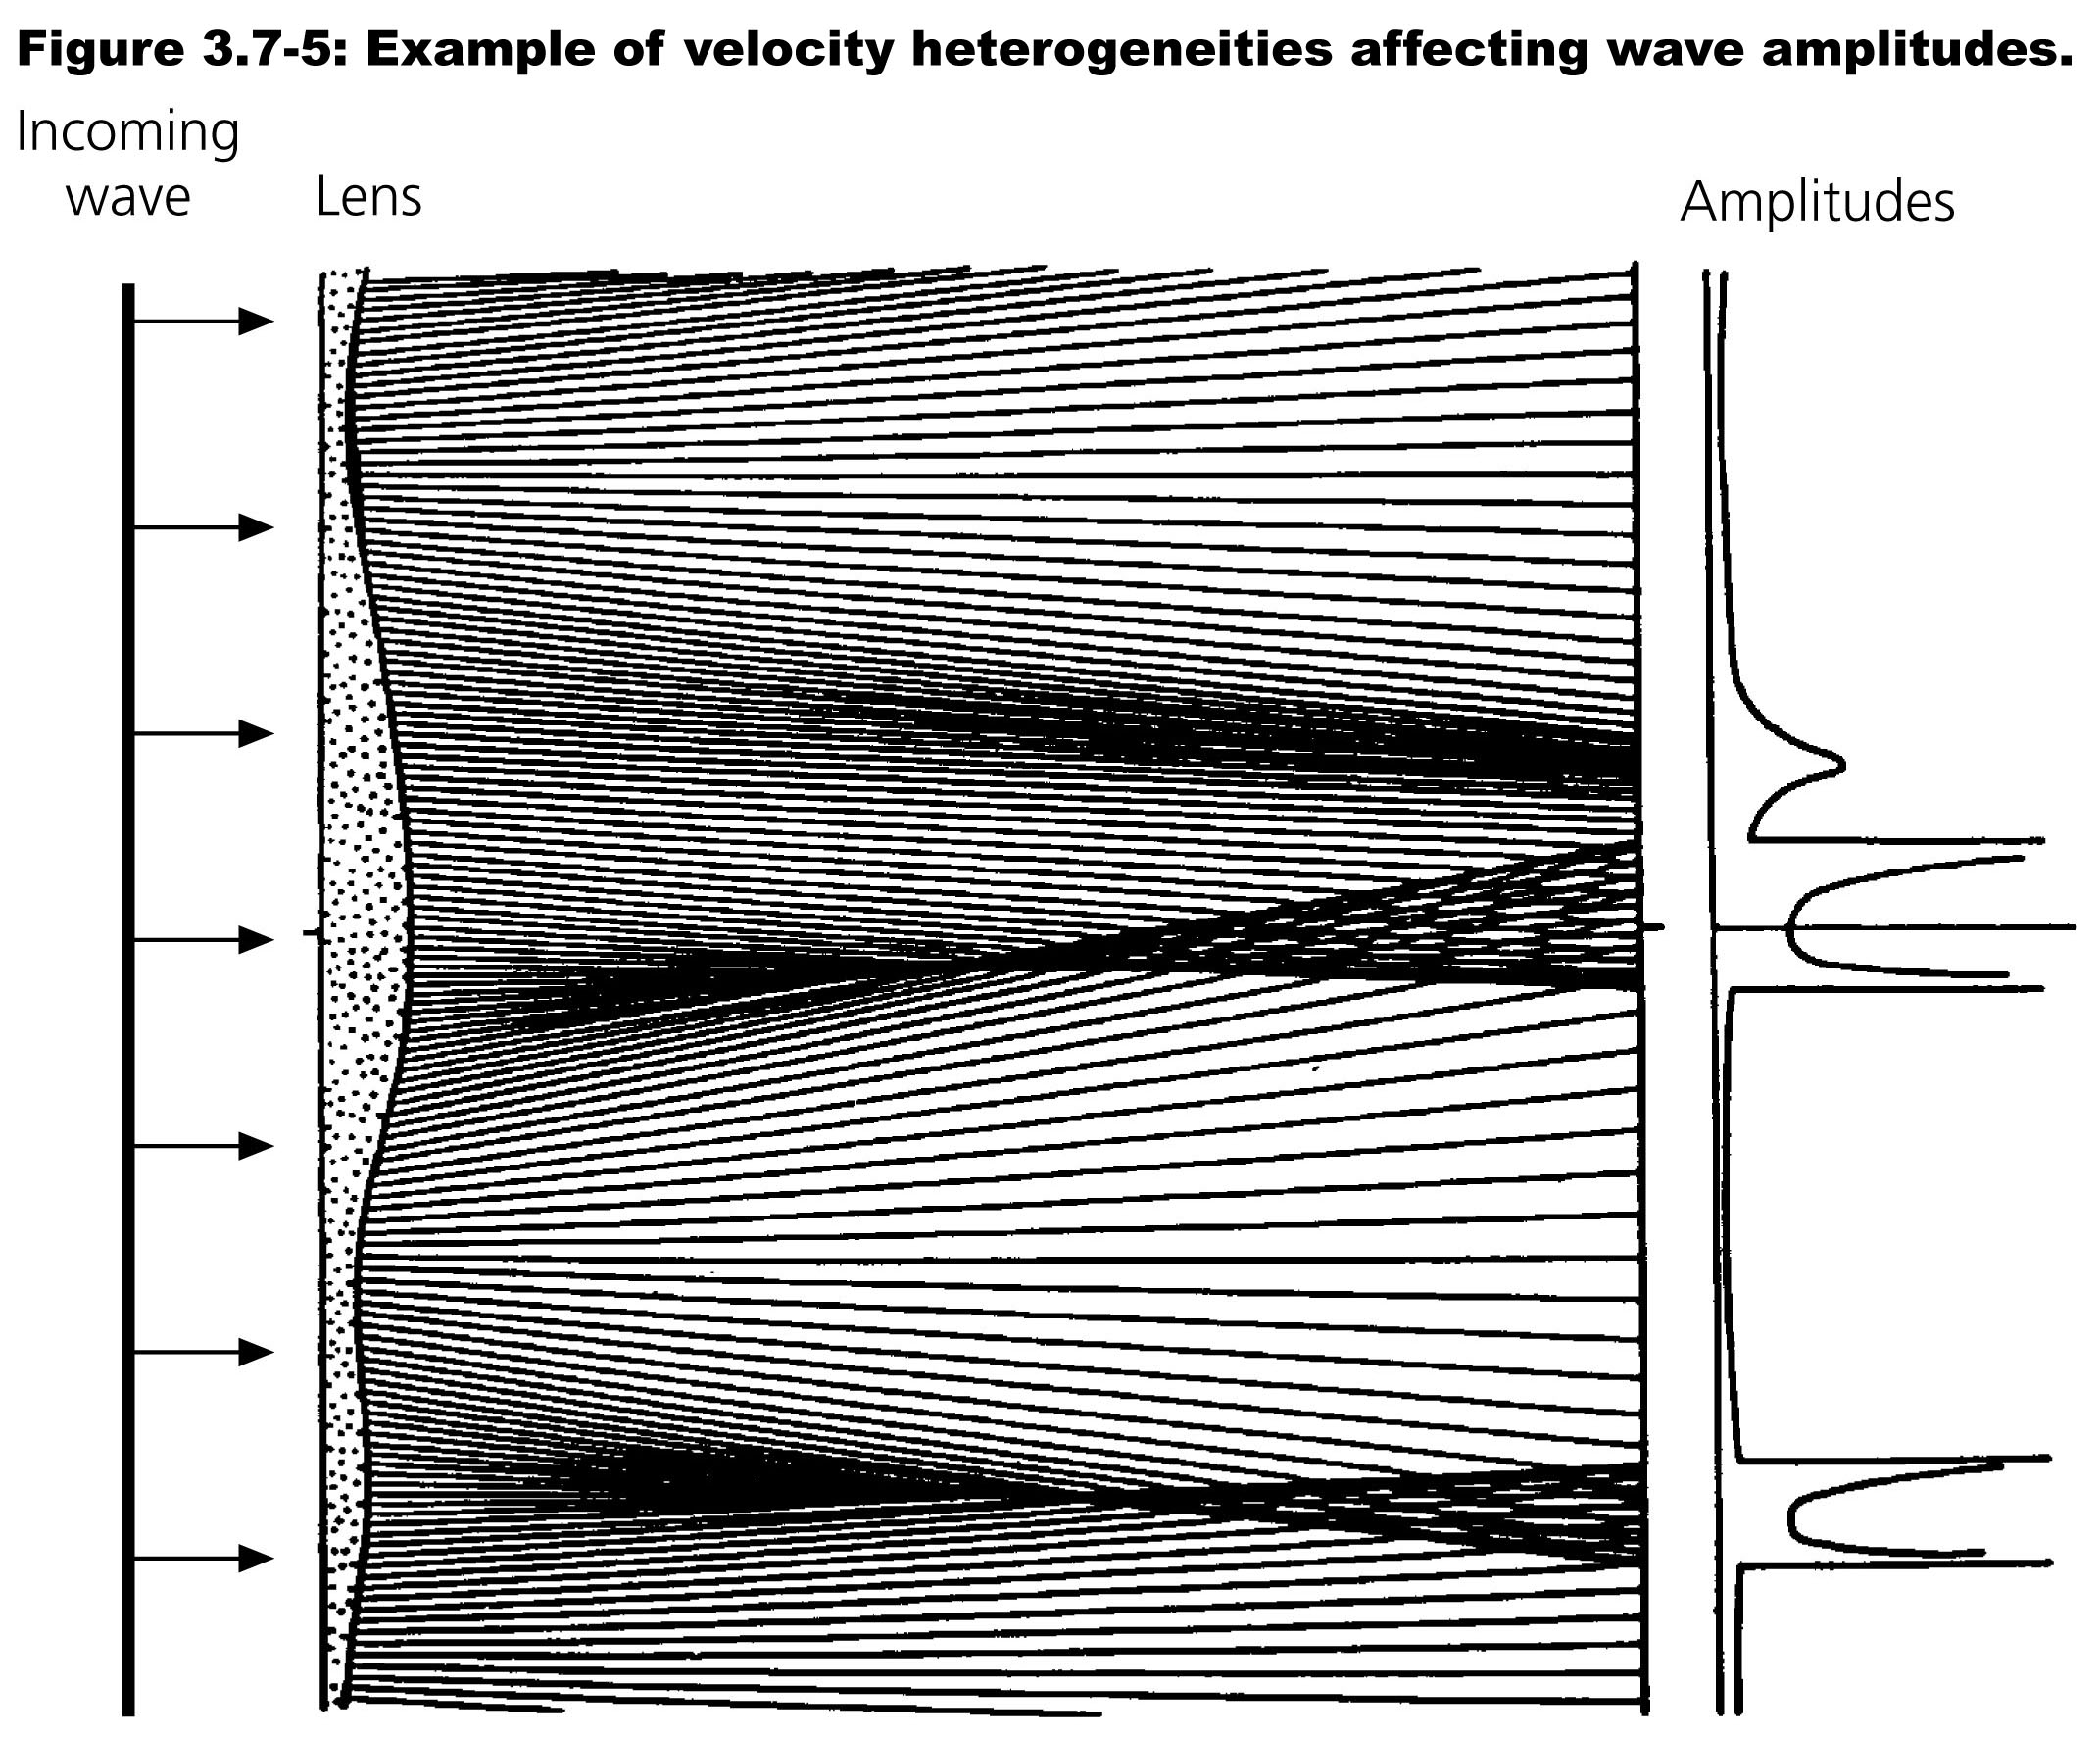
Imaging seismic attenuation is challenging because
amplitude is also affected by multipathing, energy
partitioning, and scattering:
Stein & Wysession, Blackwell 2003
Multipathing:
Seismic waves
can be focused
and defocused
by velocity
variations
in the medium.

Slide 5
Seismic velocity depends on a lot of fields, but not all
are independent:
Velocity
Temperature
Composition
Partial Melt
Pressure
Porosity/Fluid
Density
And some fields can be determined to within
small uncertainty (e.g. pressure at given depth)

Slide 6
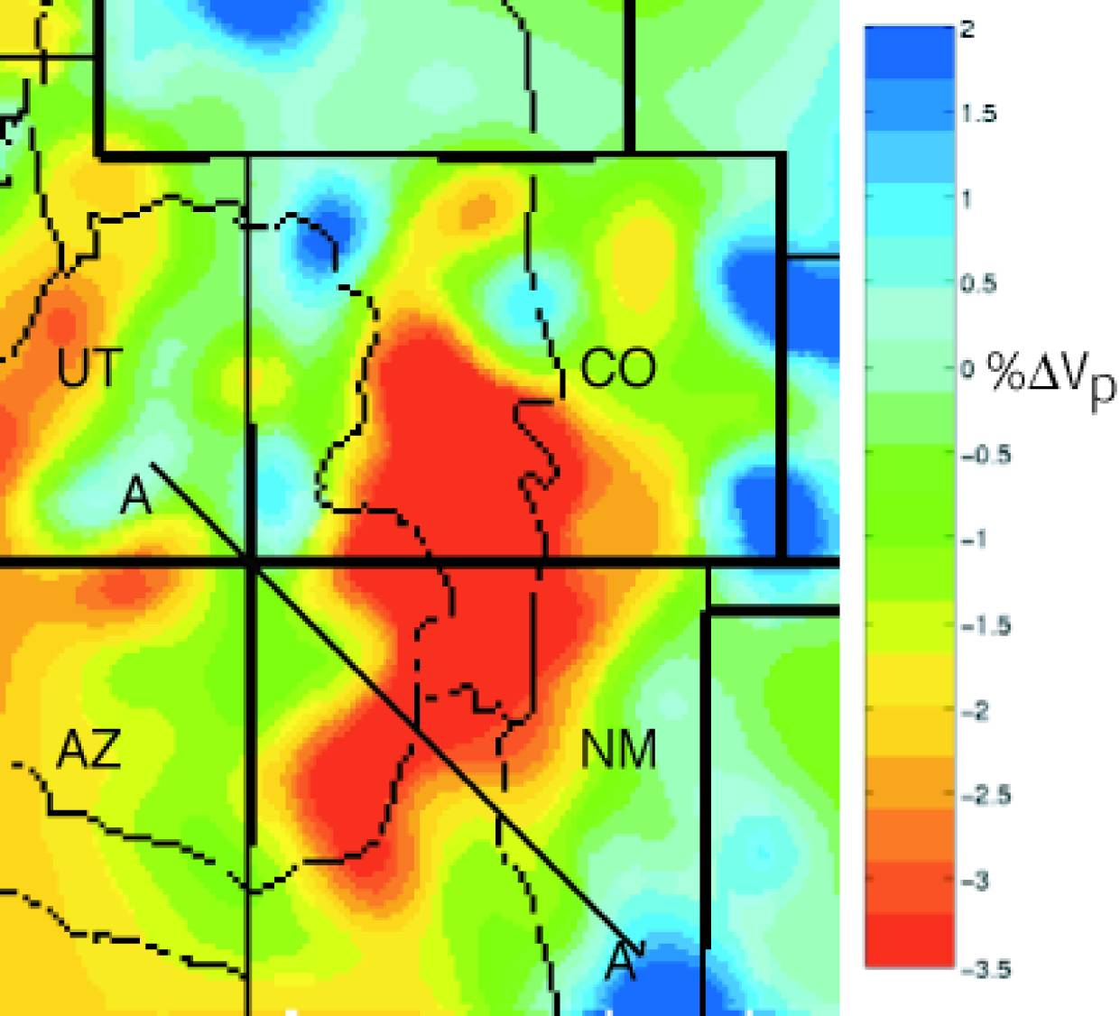
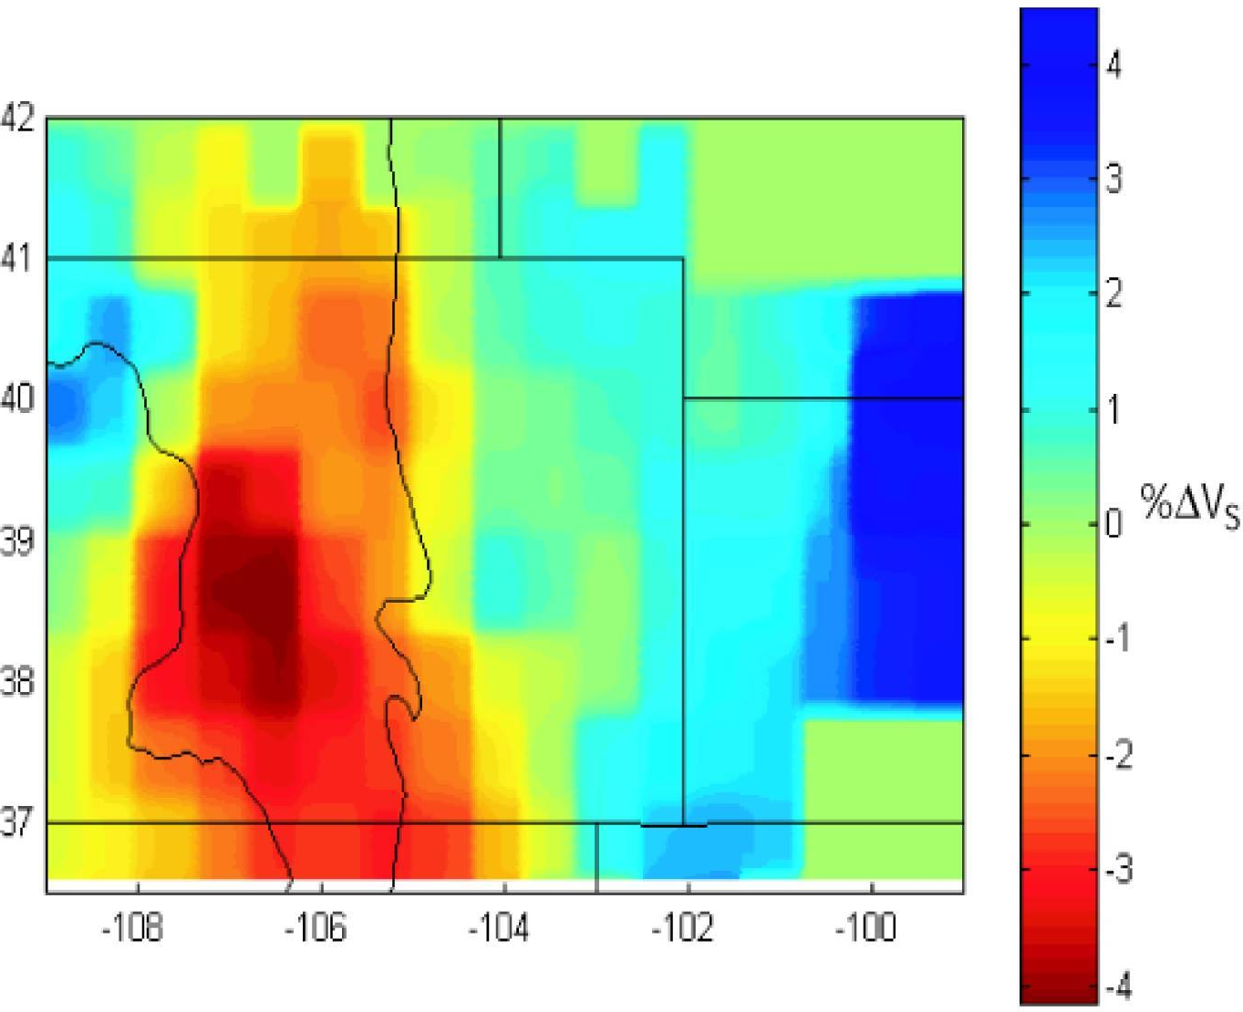
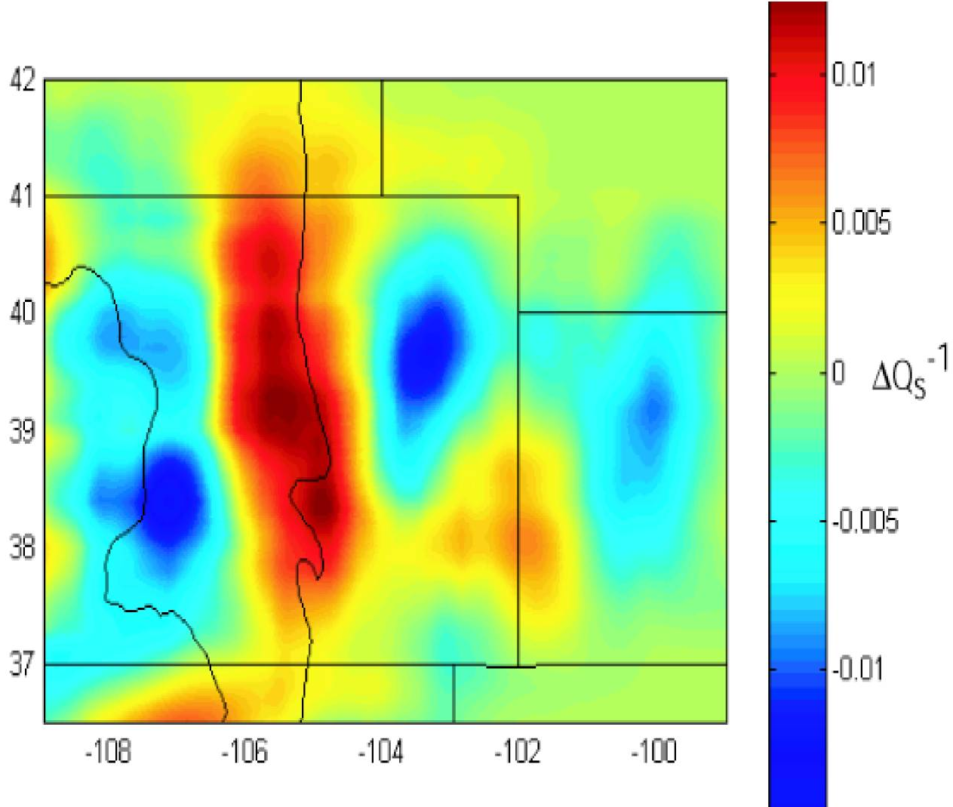
Example: Seismic properties
from the Rio Grande Rift region
of CO & NM (all at 100 km depth)
Here, “Δ” denotes a % or
fractional difference from a
simple 1D model!

Slide 7
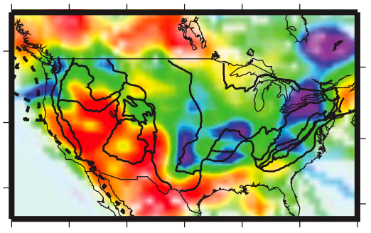
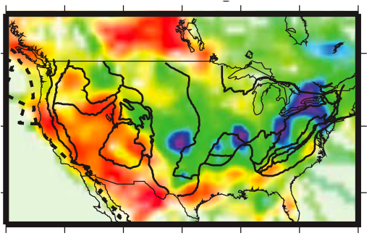

Measured
“Pn” is a refracted
wave from the top
of the mantle (&
the earliest arrival
from earthquakes
at ~100 to ~1200
km distance)
What patterns
do you see?
Why might this
matter?
Pn-Q_{P}
Pasyanos, BSSA, 2013
Sn-Q_{S}

Slide 8
In this course, I cannot emphasize enough
that using more than one type of
measurement, and more than one
geophysical property, will provide far more
insight into the subsurface than using a
single imaging tool.

Slide 9
Important: V_{P}, V_{S}, Q_{P}, Q_{S}, Z seismic properties
are five independent pieces of information
that can be used to separate effects of
lithology, porosity, fluids, cementation
and temperature… Much of the emphasis
in industry seismic is on imaging “geometry”
(structure) of velocity contrasts, but
characterizing the physical properties is
becoming increasingly important!

Slide 10
Amplitudes from mode partitioning:
Recall that reflected & refracted amplitudes depend on
Impedance Contrast:
A function of energy
partitioning at the boundary.
The normally-incident (θ = 0)
P-wave with amplitude A_{i}
produces a reflected P with
amplitude:
and a refracted P:
θ
A
(reflection
coefficient)
incoming P
(refraction
coefficient)
where Z_{i} = ρ_{i}V_{i} is the impedance in layer i

Slide 11
Mode Conversions:
A₁
reflected P
A₂
Here, algebra
would get
messy using
previous
variable
names...
So, let:
V_{P} = α
V_{S} = β
θ_{P} = i
θ_{S} = j
A_{P} = A
A_{S} = B
i₁
reflected S
B₁
refracted P
i₂
j₁
B₂
refracted S
j₂
i₀
incoming P
A₀
α₁, β₁, ρ₁
α₂, β₂, ρ₂
Snell’s Law predicts ray angles: For i₀ ≤ i_{c},
(For i₀ > i_{c}, rules change a bit.)
However Snell’s law gives no information about amplitudes!

Slide 12




Mode Conversions:
A₁
reflected P
A₂
i₁
reflected S
B₁
refracted P
i₂
j₁
B₂
refracted S
j₂
i₀
z
incoming P
A₀
x
α₁, β₁, ρ₁
α₂, β₂, ρ₂
Consider particle displacements & stress at the interface:
u_{x}, u_{z} are nonzero (u_{y} = 0) and must be continuous
across the boundary:
Also stress must be continuous:
$u_{x}^{+}=$ $u_{x}^{–}$
$u_{z}^{+}=$ $u_{z}^{–}$
$σ_{xz}^{+}=$ $σ_{xz}^{–}$
$σ_{xx}^{+}=$ $σ_{xx}^{–}$

Slide 13
We also require that energy is conserved: Sum of energy
in wave amplitudes leaving the boundary must equal the
energy in the incident wave. After lots of algebra & trig:
x
x
z
z
xz
xz
xx
xx

Slide 14
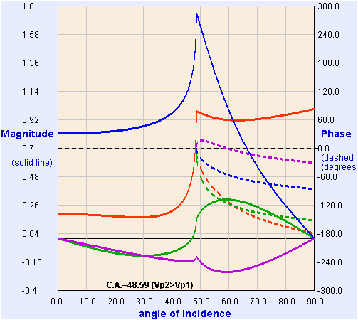
These four equations in five unknowns are called
Zoeppritz’ Equations.
If we fix the amplitude for the incident wave (e.g., A₀ = 1),
we can solve for the other four algebraically.
Model from:
https://crewes.org/
ResearchLinks/
ExplorerPrograms/ZE/
ρ₁ = 2000, ρ₂ = 2200
kg/m³
α₁ = 3000, α₂ = 4000
m/s
β₁ = 1500, β₂ = 2000
m/s
(T = “Transmitted”;
R = “Reflected”)
T_{p}
R_{p}
R_{s}
T_{s}
Crewes Zoeppritz Explorer

