Slide 1
Geology 5660/6660
Applied Geophysics
29 Mar 2024
Last Time: Introduction to Magnetic Methods
• Governed by Poisson’s eqn: ∇ ²u = f (sources)
• Source is a dipole rather than monopole
• Magnetic field strength relates to force exerted by
the dipole on a
hypothetical unit monopole:
• Intensity of induced magnetization by an external field is
(where k = μ – 1 is magnetic susceptibility)
• Crustal minerals can be diamagnetic (k ~ –10^{–5});
paramagnetic (k ~ 0.02–0.2); antiferromagnetic
(k ~ 0.05); or ferrimagnetic (k ~ 0.5–10)
• Core minerals (native metals) are ferromagnetic…
For Mon 1 Apr: Burger 446-493 (§7.3-7.7)
© A.R. Lowry 2008-2024

Slide 2
Gravity Anomaly
Magnetic Anomaly
Magnetic Prospecting : Measure e.g. magnitude H of the
total field, subtract out magnitude H_{E} of the Earth’s (core
dynamo-derived) main field to get a magnetic anomaly

Slide 3
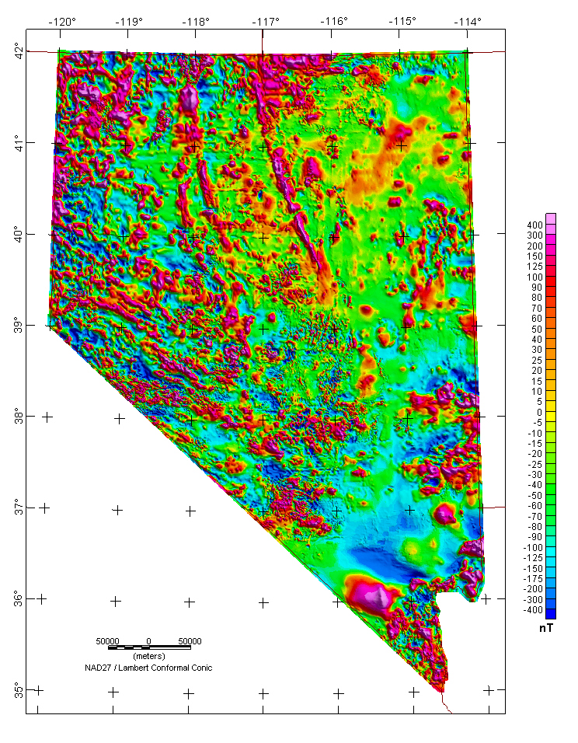

Despite the
complexities of modeling,
magnetic anomalies are
heavily used (particularly
by the mining industry
and for investigations of
tectonic basement structure)

Slide 4
• Induced magnetization is always in the direction
of the ambient field
→ Must know strength & direction of the Earth’s
ambient field to determine location and
magnetic susceptibility k of a source body!
Magnetic field strength falls off proportional to 1/r³
• Total intensity of magnetization
where remanent magnetization I_{R}
is in the direction of H_{E} at the time of magnetization…

Slide 5
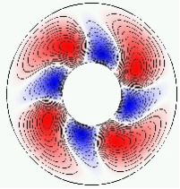
The Earth’s Main Field (Core Field) :
Earth’s main field is generated by convection of Earth’s
fluid Ni-Fe outer core. As the solid inner
core cools & grows, released heat drives
thermo-chemical convection. Movement of
charge within the electrically-conductive
molten iron produces electric currents
which in turn generate a magnetic field.
Rotation of the Earth → Coriolis forces which cause a
Magnetohydrodynamic Dynamo Effect, in which
magnetic fields organize in a way that amplifies the current
flow. Positive feedbacks are self-stabilizing & produce a very
large, predominantly dipolar magnetic field (with smaller
higher-order terms).

