Slide 1




Geology 5660/6660
Applied Geophysics
30 Jan 2026
Last time: Zoeppritz Equations
• Mode Conversion (P to S or S to P) occurs when θ ≠ 0
• Introduced the ray parameter (based on Snell’s Law):
→ Predicts propagation paths if α, β structure is known!
• Continuous displacements ( , ) and stresses
( , ) provide four equations in five unknown
amplitudes of incoming and outgoing waves… Normalize
by amplitude of incoming wave gives Zoeppritz’ equations
• Graphical user interface models of Zoeppritz’ equations are at
http://www.crewes.org/ResearchLinks/ExplorerPrograms/ZE/
$u_{x}^{+}=$ $u_{x}^{–}$
$u_{z}^{+}=$ $u_{z}^{–}$
$σ_{xz}^{+}=$ $σ_{xz}^{–}$
$σ_{xx}^{+}=$ $σ_{xx}^{–}$
Read for Mon 2 Feb: Burger 106-141 (§3.7-3.11)
© A.R. Lowry 2008-2026

Slide 2
Amplitude versus offset (AVO) methods
give information about deep layers that you can’t get
from travel-times or reflection migration alone, and
are especially useful for evaluating fluid types &
pressures from reflection seismic data…

Slide 3
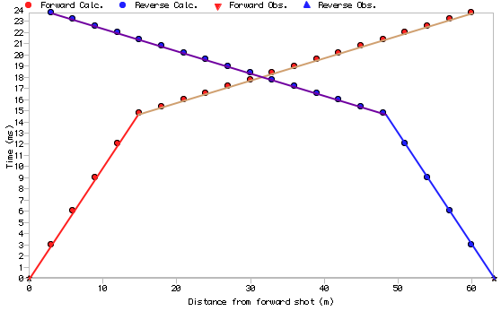
The Refraction Method:
Recall first arriving seismic wave is the direct wave near
the source, and refracted (head) waves further out:
Problem:
We start knowing little
or nothing about the
subsurface, and our
objective is to use the
observations to
learn what’s under our
feet.

Slide 4
Direct arrival
h
a
V₁
i_{c}
Refracted arrival
b
V₂
Consider the simple case of one horizontal layer over a
half-space with higher velocity:
Direct wave travels horizontally at velocity V₁. On a plot of
time vs distance, arrivals are a straight line with
slope Δt/Δx = 1/V₁ and intercept t = 0, i.e., t = x/V₁.
Refracted wave travels horizontally at velocity V₂ at the
top of layer 2, so a line with slope 1/V₂. The intercept
now adds the time traveled in the first layer (& subtracts the
time not traveled in the second layer), i.e., t₀ = 2a/V₁–2b/V₂.
This wave has incident angle i_{c} = sin⁻¹(V₁/V₂), so
(Exercise)

Slide 5

The mathematical
simplicity of finding
structure from slope &
intercept of a line made
refraction the tool of
choice in early imaging
studies (i.e., pre-computer)!
So, we can fit lines t = m_{i} x + b_{i} to the first arrival travel-times…
Then V₁ = 1/m₁ , V₂ = 1/m₂ , and
In the plot above, m₁ = 0.001 s/m, m₂ = 0.0002 s/m,
b₂ = 0.0118 s. What are the velocities & depth?
(Exercise)

Slide 6
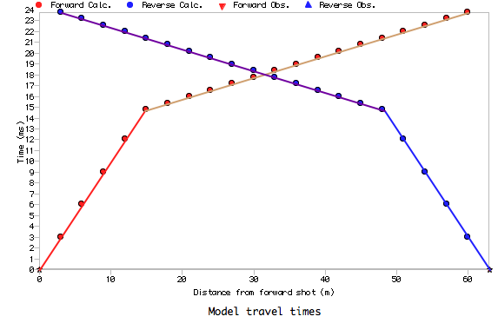
x_{co}
Direct arrival
h
a
V₁
i_{c}
Refracted arrival
b
V₂
Practical note: This works for a horizontal interface, and then
only if there are enough geophones before & after the
crossover distance x_{co} (where arrival times for the direct
& refracted arrival are the
same) to solve for
equations of the two
lines:
or
x_{co}

Slide 7
Spatial sampling is key to getting accurate estimates
of thickness: Must have multiple geophones that sample
each layer. Since we don’t know the structure when
designing the experiment, this means lots of closely-
spaced geophones… Where “close” is determined by
minimum expected thickness and maximum expected
velocity difference!

Slide 8
Direct arrival
h
a
V₁
i_{c}
Refracted arrival
b = x_{c}/2
V₂
Another term that crops up in refraction studies is the
critical distance = the horizontal distance traveled in
layer 1 by the ray having critical angle i_{c} (i.e., x_{c} = 2b).
In situations where we have some approximate idea of the
range of thicknesses & velocities we might expect to find,
calculating the crossover and critical distances inform
experiment design (i.e., how many geophones to use,
offset & spacing).

Slide 9
Direct arrival
h₁
V₁
i₁
h₂
V₂
Refracted arrival
V₃
For multiple layers we take advantage of Snell’s Law:
Via similar algebra & geometry to the one-layer case,
or, generalizing to n-layers:

Slide 10
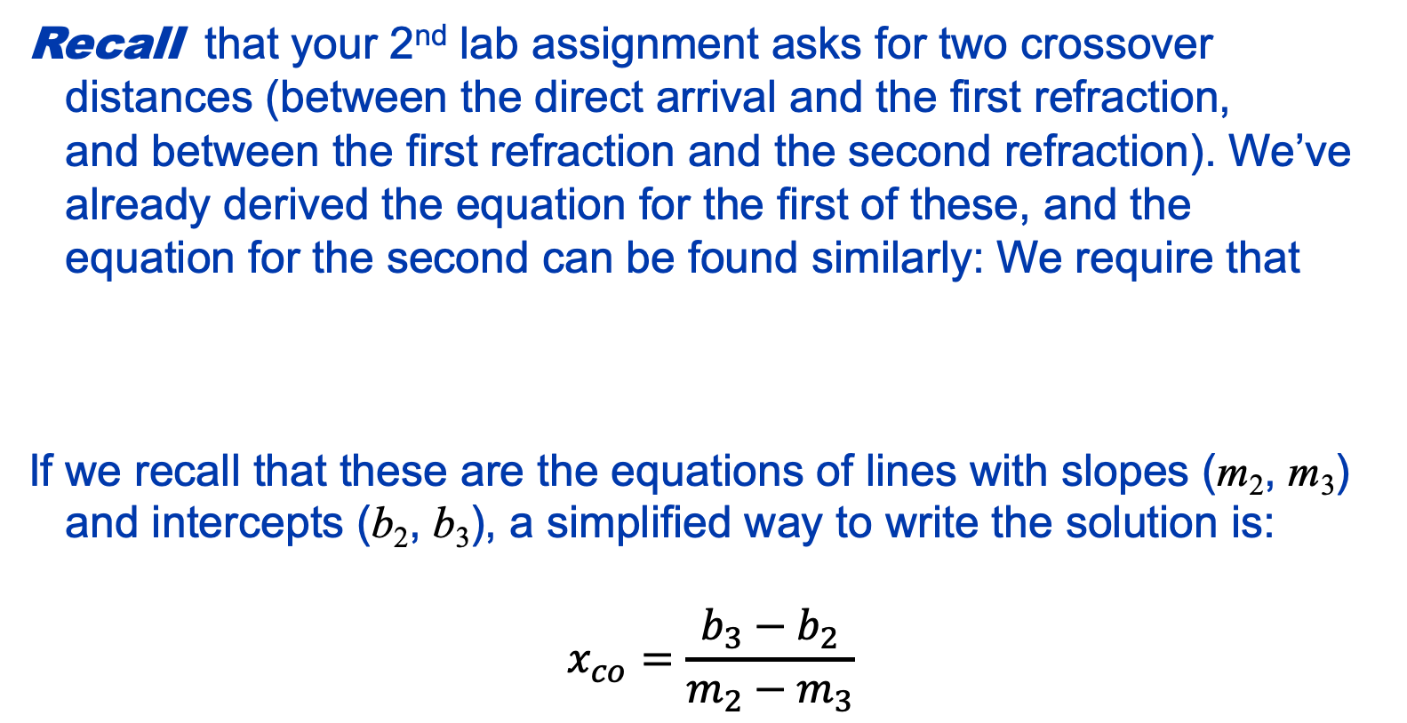
Recall that your 2nd lab assignment asks for two crossover
distances (between the direct arrival and the first refraction,
and between the first refraction and the second refraction). We’ve
already derived the equation for the first of these, and the
equation for the second can be found similarly: We require that
If we recall that these are the equations of lines with slopes (m₂, m₃)
and intercepts (b₂, b₃), a simplified way to write the solution is:
$$x_{co}=\frac{b_{3}−b_{2}}{m_{2}−m_{3}}$$
1

