Slide 1
Geology 5660/6660
Applied Geophysics
31 Jan 2024
Last time: Seismic Amplitudes
• Attenuation quality factor Q is another physical rock property
that gives different information than velocity (more sensitive
to shallow porosity & fluids, deep temperature, melt & volatiles)
• Q is hard to measure though because amplitudes also depend
on energy partitioning (i.e., mode conversions),
multipathing, and scattering
• Still, Q can help to interpret seismic images (if you can measure
it)!
Read for Fri 2 Feb: Burger 81-105 (Ch 3.3-3.6)
© A.R. Lowry 2008-2024

Slide 2




Last time continued: Zoeppritz Equations
• Mode Conversion (P to S or S to P) occurs when θ ≠ 0
• Introduced the ray parameter (based on Snell’s Law):
→ Predicts propagation paths if α, β structure is known!
• Continuous displacements ( , ) and stresses
( , ) provide four equations in five unknown
amplitudes of incoming and outgoing waves… Normalize
by amplitude of incoming wave gives Zoeppritz’ equations
• Graphical user interface models of Zoeppritz’ equations are at
http://www.crewes.org/ResearchLinks/ExplorerPrograms/ZE/
$u_{x}^{+}=$ $u_{x}^{–}$
$u_{z}^{+}=$ $u_{z}^{–}$
$σ_{xz}^{+}=$ $σ_{xz}^{–}$
$σ_{xx}^{+}=$ $σ_{xx}^{–}$

Slide 3
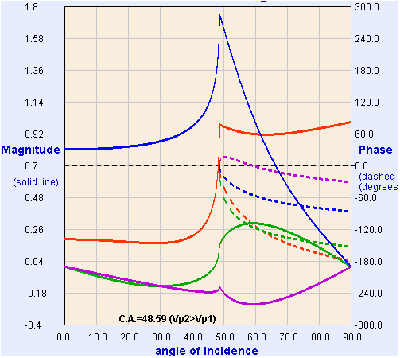
Four equations in five unknown amplitudes leaving a velocity
boundary are called Zoeppritz’ Equations.
If we fix the amplitude for the incident wave (e.g., A₀ = 1),
we can solve for the other four algebraically.
Model from:
https://crewes.org/
ResearchLinks/
ExplorerPrograms/ZE/
ρ₁ = 2000, ρ₂ = 2200
kg/m³
α₁ = 3000, α₂ = 4000
m/s
β₁ = 1500, β₂ = 2000
m/s
(T = “Transmitted”;
R = “Reflected”)
T_{p}
R_{p}
R_{s}
T_{s}
Crewes Zoeppritz Explorer

Slide 4
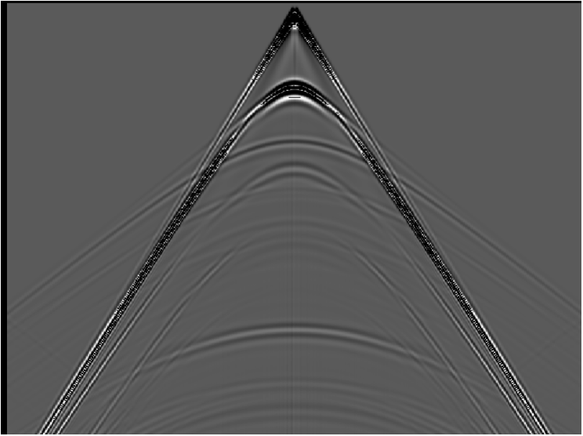
water
Example for
a synthetic
seismogram
shale
gas sand
shale

Slide 5
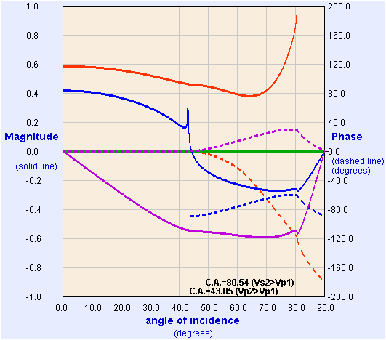
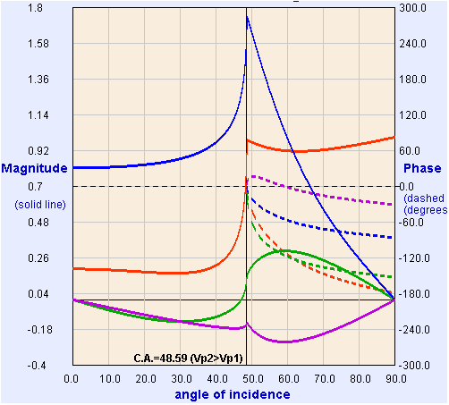
water
shale
gas sand
shale
Water/Shale
Shale/Gas Sand
R_{p}
T_{p}
R_{s}
T_{s}

Slide 6
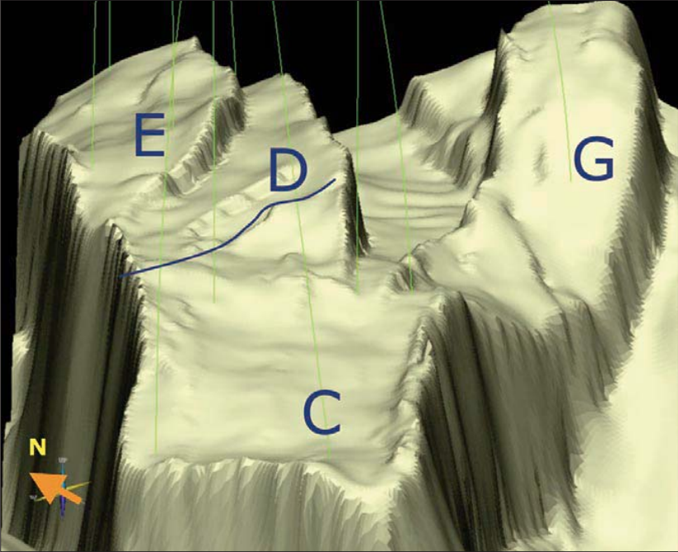
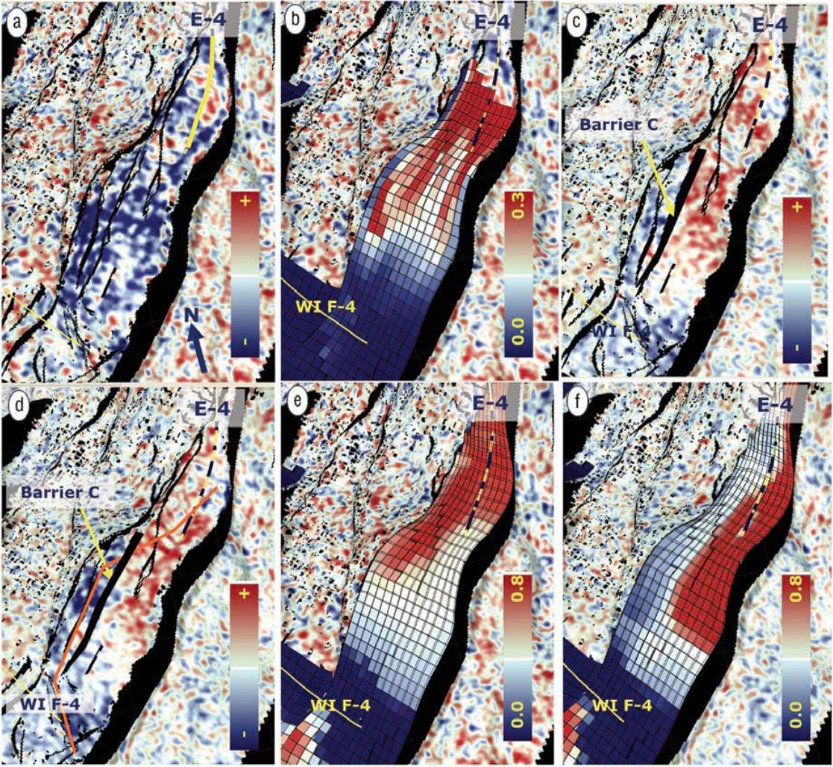
2001-2003
2001-2004
Model
w/out
seismic
Model
with
seismic
4D: imaging
changes in
impedance:
From Osdal
et al., The
Leading
Edge, 2006
Red = gas cap over oil (neutral colors); blue = ⬇ Z from injected water

Slide 7
Amplitude versus offset (AVO) methods
give information about deep layers that you can’t get
from travel-times or reflection migration alone, and
are especially useful for evaluating fluid types &
pressures…

Slide 8
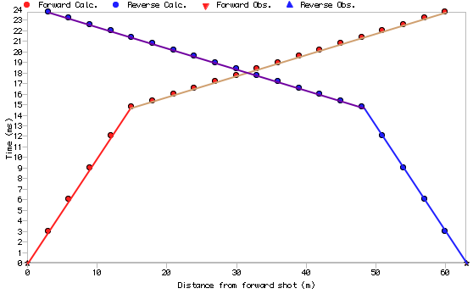
The Refraction Method:
Recall first arriving seismic wave is the direct wave near
the source, and refracted (head) waves further out:
Problem:
We start knowing little
or nothing about the
subsurface, and our
objective is to use the
observations to
learn what’s under our
feet.

Slide 9
Direct arrival
h
a
V₁
i_{c}
Refracted arrival
b
V₂
Consider the simple case of one horizontal layer over a
half-space with higher velocity:
Direct wave travels horizontally at velocity V₁. On a plot of
time vs distance, arrivals are a straight line with
slope Δt/Δx = 1/V₁ and intercept t = 0, i.e., t = x/V₁.
Refracted wave travels horizontally at velocity V₂ at the
top of layer 2, so a line with slope 1/V₂. The intercept
now adds the time traveled in the first layer (& subtracts the
time not traveled in the second layer), i.e., t₀ = 2a/V₁–2b/V₂.
This wave has incident angle i_{c} = sin⁻¹(V₁/V₂), so
(Exercise)

Slide 10

The mathematical
simplicity of finding
structure from slope &
intercept of a line made
refraction the tool of
choice in early imaging
studies!
So, can fit lines t = m_{i} x + b_{i} to the first arrival travel-times…
Then V₁ = 1/m₁ , V₂ = 1/m₂ , and
In the plot above, m₁ = 0.001 s/m, m₂ = 0.0002 s/m,
b₂ = 0.0118 s. What are the velocities & depth?
(Exercise)

