Slide 1
Geology 5660/6660
Applied Geophysics
31 Jan 2024
(Lab 2)
This Week’s Lab:
• Estimate attenuation structure from observed
seismic amplitudes
Due 7 Feb at 2:30 pm
© A.R. Lowry 2008-2024

Slide 2
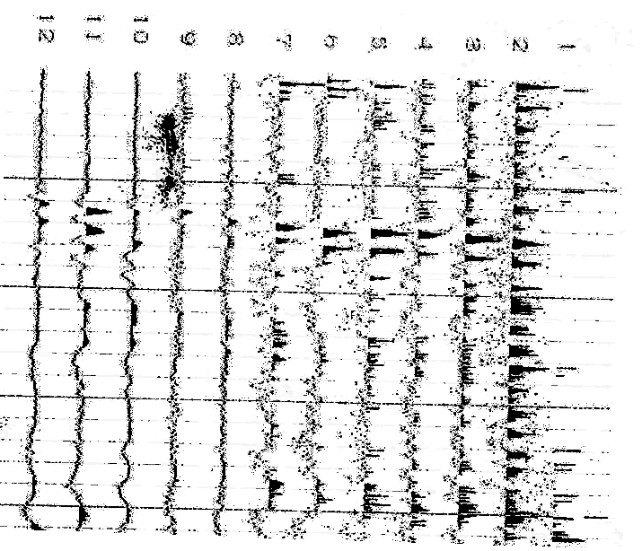
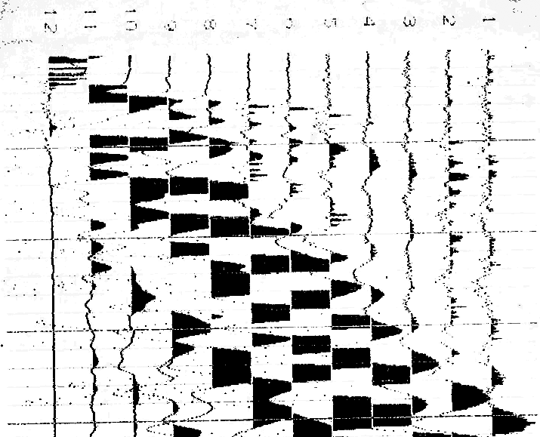
0.01 s
0.02 s
0.03 s
0.04 s
0.05 s
The seismic data above were collected on a farm near Gosport, IN. The
faint lines demark 0.01 s intervals; darker lines are at 0.05 s. The
geophones were placed at distances of (0,4,8,12,16,20,26,32,38,44,50
56,62,68,74,80,86,92,96,100,104,108,112,116) m from the source.

Slide 3
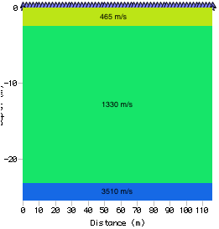
Lab 2: Attenuation, Gosport Indiana
0.01 s
0.02 s
0.03 s
0.04 s
0.05 s
The seismic data were used to create the
1D velocity model at right (with layer 1
thickness h = 2.3 m, layer 2 h = 20.6 m).
(1)a. Calculate the crossover distances
between the direct arrival and layer 1,
and between layer 2 and layer 3. (1)b.
Estimate the frequency, f, for a first arrival
from each of the three layers.

Slide 4
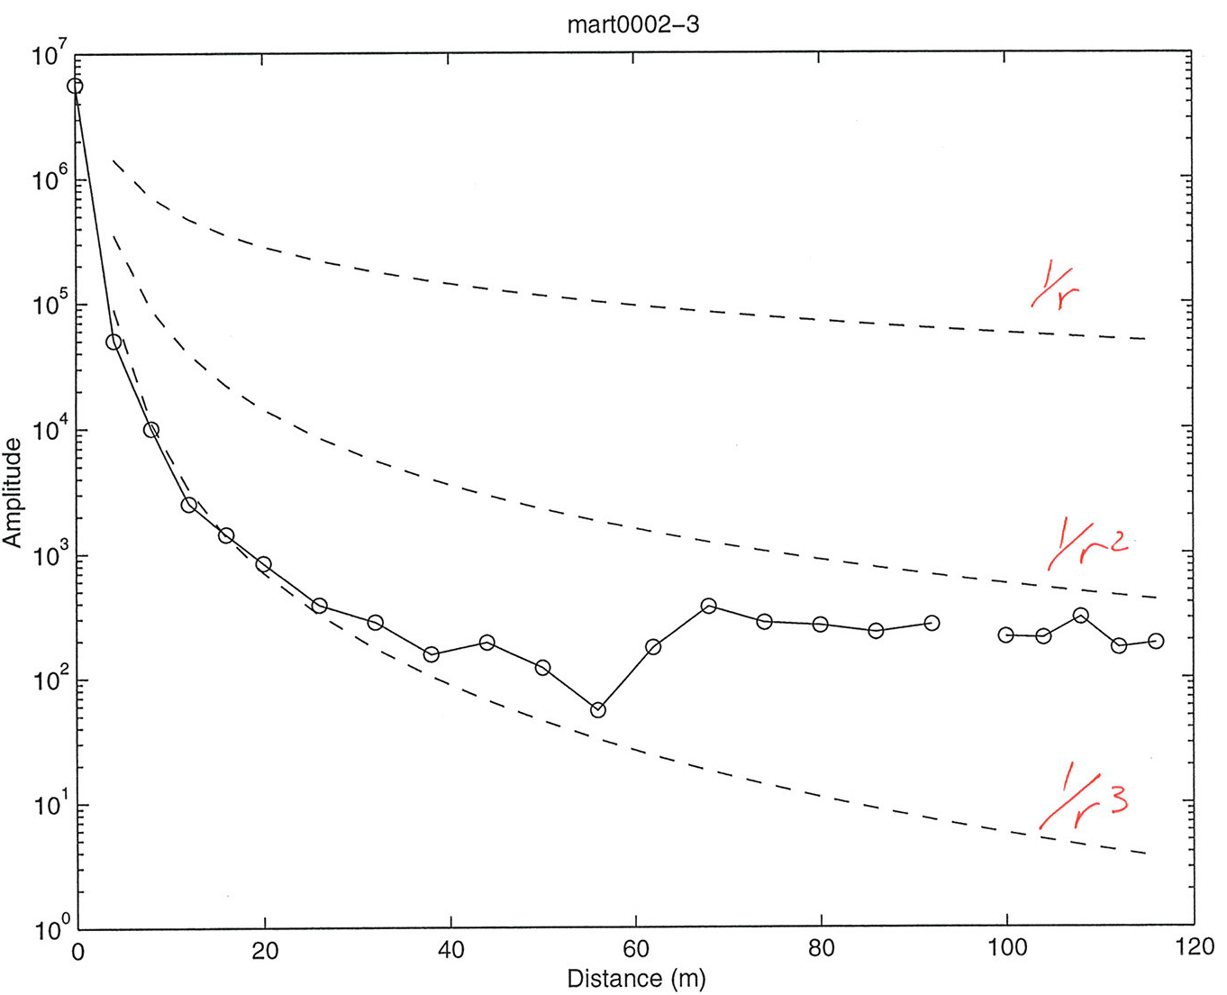
Lab 2: Amplitudes from observations
The amplitudes of each first arrival were measured and are shown below.
(2)a. Are these amplitudes consistent with what you might expect given
the crossover distances? Why or why not?
The amplitudes are given to you
in an Xcel spreadsheet on the
course website. (2)b. In column
D of the spreadsheet, calculate
the geometrical spreading for
each arrival, assuming A₀ is the
amplitude required to get the
observed amplitude at the
distance r of the first (nearest to
the source) geophone that
measures a first arrival from a
given layer.

Slide 5
Lab 2: Amplitudes from observations
(2)c. In column E, calculate a correction for the amplitudes for the effects of
geometrical spreading. For the direct arrival (layer 1) correction, use
to calculate the correction; for layers n (= 2, 3) use
(2)d. In column f, add the
geometrical spreading
correction to the original
amplitude to get an approximate
“plane wave” amplitude.
Then, recognizing that
→
Use linear regression of the
corrected amplitudes to estimate
the P-wave attenuation Q for
each layer!
(Hint: Don’t correct for geometrical spreading if
r = 0!)
(Hint: Try to compare nearer and further
arrival amplitudes for similar travel paths!)

Slide 6
You should include plots of your model and your data, and don’t
forget to discuss the RMS misfit! Plotting can be done in Xcel,
Matlab, or whatever else you feel comfortable with, but
remember that the plot image must be ported into a single-
document write-up of the lab.
(d) Assuming that both the velocity structure and your
attenuation estimates are correct, look through your text (and
whatever other literature you may be able to find, but be sure
to include references!) for examples of soils/sediments/rocks
that match your estimates of V_{P} and Q_{P}. Does the combination
of these two properties reduce the ambiguities in possible
interpretations? What interpretation of the data would make
the most geological sense given the location (farm country
near the terminus of Laurentide glaciation)?

