Slide 1
Geology 5660/6660
Applied Geophysics
17 Apr 2024
Final Project
Final Project Assignment
Blacksmith’s Fork River
Pasture (Hyrum) Data
Due 5:00 pm, Thur May 2
© A.R. Lowry 2024

Slide 2
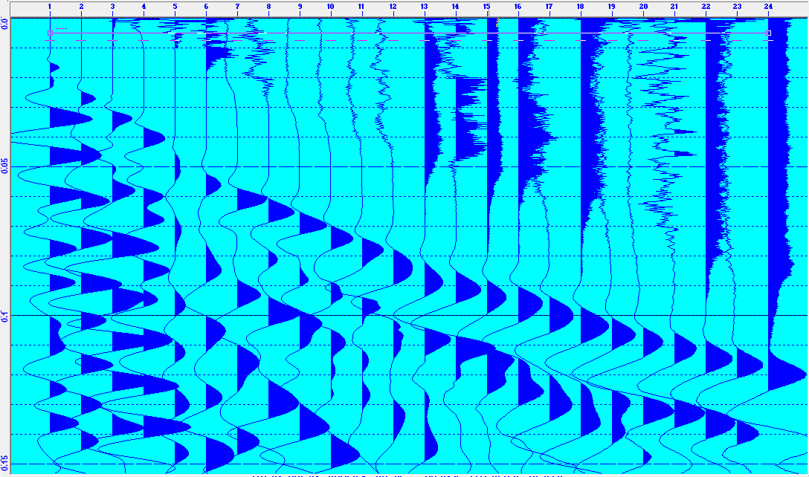
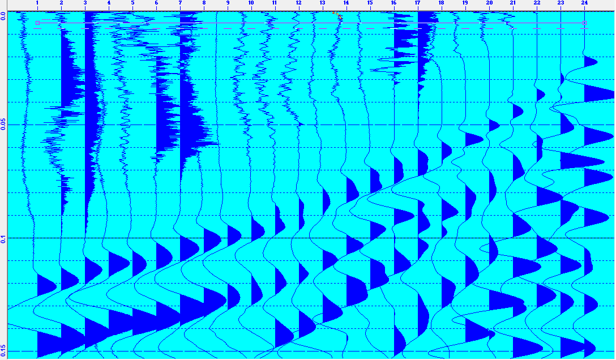
Hyrum Project Assignment
Part I: Seismic Investigation
(I.1) Data files are posted on the course website! Use the RAS-24 software to
pick the first arrivals from each trace of the data. Note: The direct arrivals
(nearest traces) are subtle, so you must go to the highest magnification to see
them. The negative bump on the furthest ~3 traces is also difficult to pick out;
you can vary the magnification for an individual trace by selecting the trace and
using the right-hand “+₁” button, while consider arrivals on neighboring traces.
W to E (Forward)
E to W (Reverse)

Slide 3
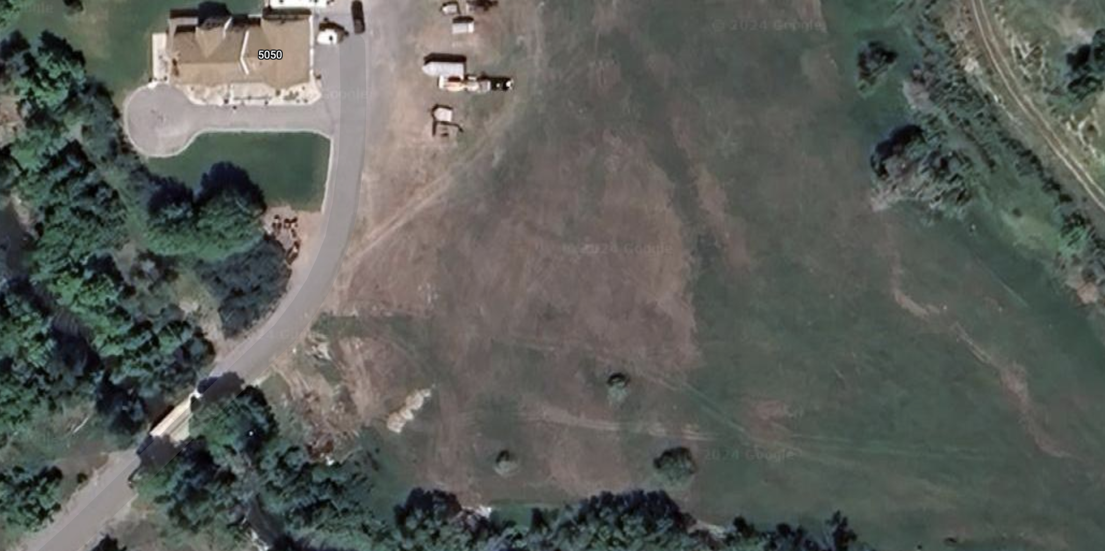
Hyrum Project Assignment
Part I (continued): Seismic Investigation
(I.1) While picking, I recommend looking at both forward and reverse sections
(remembering reciprocity!) before finalizing & modeling your picks. Remember
that you don’t need to populate every pick in Refract… Model only the picks
you are confident in! And it’s reasonable to go back and redo your picks
if individual times look out of place once you’ve plotted them in Refract.
(I.2) Model the data in Refract. Your project report should include screenshots
of all four of the Refract windows for completeness.
(I.2.i) The approximate positions of
the profiles are shown at right.
Based on your recollection of the
context and other non-geophysical
information, what are some possible
features you might expect to see
represented in the seismic structure?
Magnetic
Seismic
DC Resistivity

Slide 4
Hyrum Project Assignment
Part I (continued): Seismic Investigation
(I.3.i) Is there unequivocal evidence for dip on the layer interfaces
generating your arrivals?
(I.3.ii) If the model has one or more “dipping” interfaces, what are
some possible interpretations of why the layers dip?
(I.3.iii) Is there misfit in your best-fitting model of your picks that
can’t be reduced by changing the model parameters?
(I.3.iv) If so, how might you interpret that misfit?
(I.3.v) Use ray theory and a simple calculation of how a velocity
change or nonplanar thickness change within your top layer might
produce the observed misfit.

Slide 5
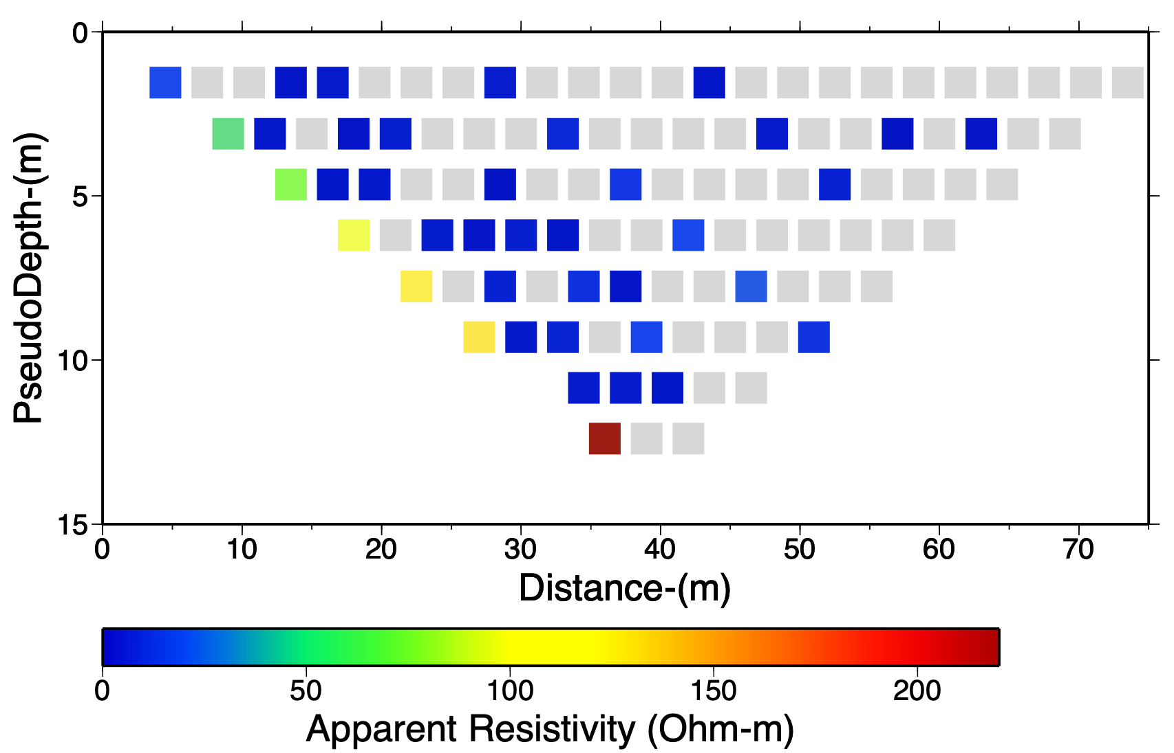
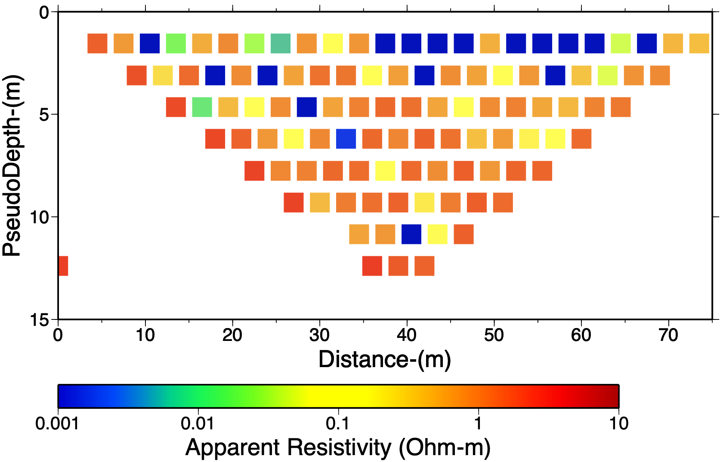
Hyrum Project Assignment
Part II: DC Resistivity Investigation
(II) Our resistivity survey had a lot of negative
apparent resistivity measurements that cast
doubt on the results… But measurements that
included electrode 1 for current injection
(along the left-hand side of the pseudosection)
show an interesting decrease that might be
real. We will assume a 1D structure and model
using a two-layer model.
(II.1) Download the Excel model spreadsheet,
2LayerRes.xls, from the course website. This
spreadsheet already has the measurements
of ρ_{app} that involved electrode 1 entered in
the column labeled “Observed”. Vary the
model parameters at upper left (ρ₁, ρ₂, depth
of interface) to minimize the misfit.
Grey =
Negative
Rho-app

Slide 6
Hyrum Project Assignment
Part II (continued): DC Resistivity Investigation
(II.1) Your write-up should include screenshots of the model box (cells
B2:C6), the Modeled and Observed columns, and the graph
comparing model results to the observations.
(II.2) Does your depth match that of a layer interface seen in modeling
of the seismic investigation? If not, specify a layer interface depth
from your seismic model, and again vary resistivities to minimize
the misfit (and include screenshots of the results).
(II.3) What, if anything, do the measurements and models imply about
the properties of layering in the site? Is there evidence for a third
layer that was unmodeled in the spreadsheet? What might that
imply about the results of this resistivity model?

Slide 7
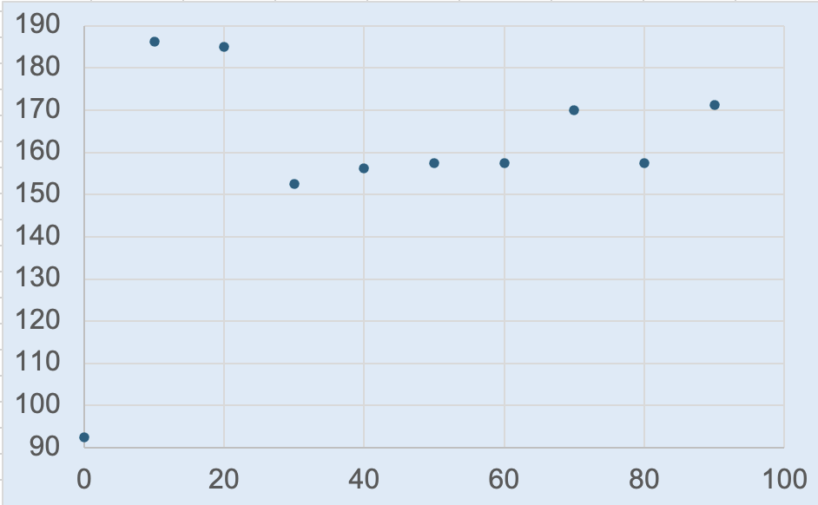
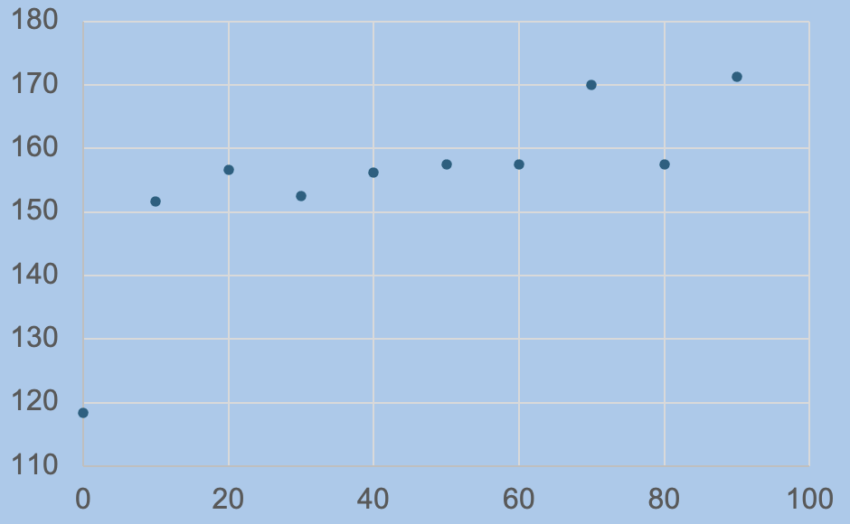
Hyrum Project Assignment
Part III: Magnetic Data Investigation
(III) Download the Excel spreadsheet of the magnetic data from the course
website. The file contains all raw data in the upper left (light grey) cells,
and the averaged data (along with uncertainties) can be found to the
right (light blue cells are with all of the data included, and darker blue
cells are with the first three outlier measurements removed).
West
East
West
East
With (Yukon-related?)
outliers
Without early outliers

Slide 8
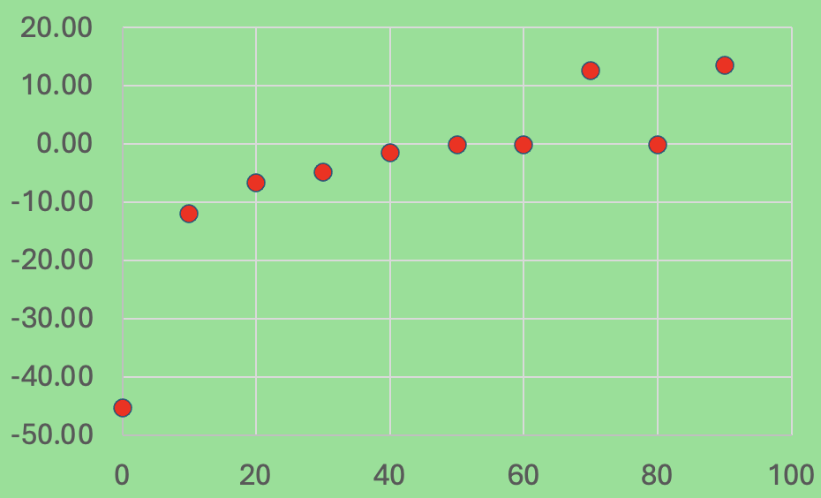
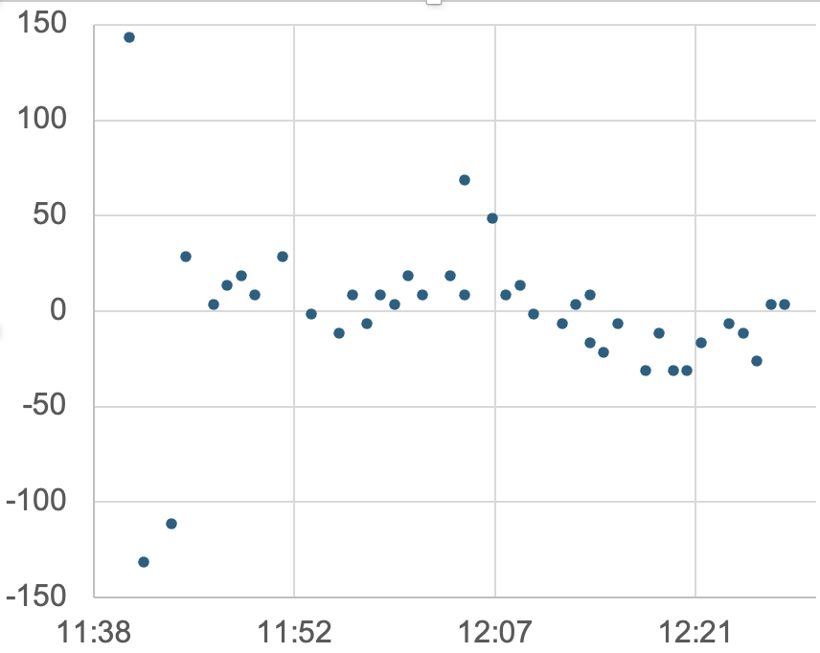
Hyrum Project Assignment
Part III (continued): Magnetic Data Investigation
(III.1) The measurements were repeated four times at each site, and
this allows for a drift estimate. Means and standard deviations after
drift correction are given in the green cells in the spreadsheet.
Discuss how the drift correction changes the means and standard
deviations of the measurements. Does it seem like a significant
improvement?

Slide 9
Hyrum Project Assignment
Part III (continued): Magnetic Data Investigation
(III.2) We did not take GPS positions for any of our surveys, but you can find
approximate longitude/latitude positions of the endpoints of the survey by
clicking google maps at the link here (and look at the image on slide 3 of
this assignment to see approximately where our profiles were). Using those
lat/lons and assuming an elevation of 1415 m, find (and report!) the vertical
components of the World Magnetic Model at the eastern and western
endpoints of the profile. Does it make sense to correct for variations in the
WMM along this profile? Why or why not?
Note that the profile distance is positive toward the ~east, and the profile
appears to be oriented approximately 5°N of true east (or 85°clockwise
from true north). You will need to enter this information along with the WMM
inclination, declination and total field magnitude for the profile when you
model the data in GravMag. We measured the vertical field anomaly, so
you also will need to set to “Vertical Field” for the RMS misfit options in
the data window!

Slide 10
Hyrum Project Assignment
Part III (continued): Magnetic Investigation
(III.3) Use the structure you derived from the seismic refraction
modeling to create one or two bodies in GravMag. (Your write-up
should include images of all windows). In preferences, check the
boxes labeled “Use uncertainties” & “Enter magnetic field”. All of
these values (azm, main field, etc) should be reported in your
write-up. Systematically vary the magnetic susceptibility of the
seismically derived structure to best match the measurements.
Does the anomaly from a simple induced-magnetization
structure matching the seismic structure look similar to the
measurements?
(III.4) Now systematically vary the magnetic susceptibility, polygon
position, & shape (and remanent magnetization, if you can
make a case for why this might matter) to minimize the misfit.
(III.5) Does your best-fit model support the idea that this is real
signal caused by subsurface properties? Why or why not?

Slide 11
Hyrum Project Assignment
Part IV: Synthesis
Now, from the combination of all of the data (and your
visual observations of the site, and any additional
resources you have that pertain to the problem:
(IV.1) What (if anything) do the combined measurements
tell us about the site that we could not glean from one
type of geophysical measurement alone?
(IV.2) What is your final combined interpretation of the
subsurface at the field site? Does it match your
expectations of what you thought we’d find before
you worked up the data?
(IV.3) One reason we chose this location is that it is near
where we might expect East Cache fault splays to
intersect the surface. Do you think we found possible
evidence of faulting, and why or why not?

