Slide 1
Geology 5660/6660
Applied Geophysics
17 Apr 2026
Final Project
Final Project Assignment
Smithfield Dry Canyon Fault
& Dayton-Oxford Fault Data
Due 5:00 pm, Tues April 28
© A.R. Lowry 2026

Slide 2
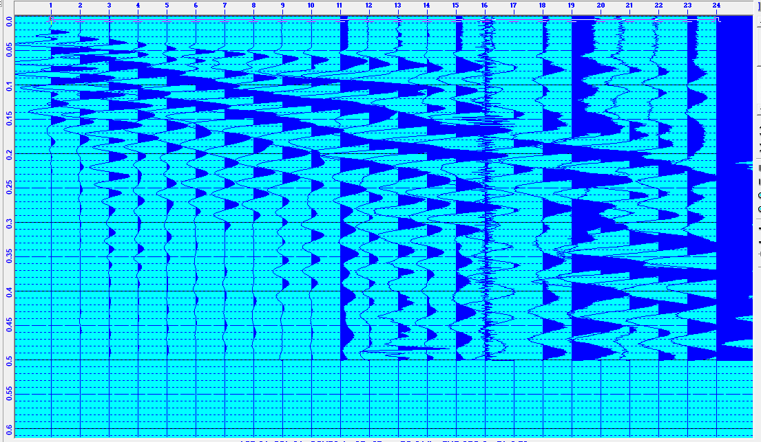
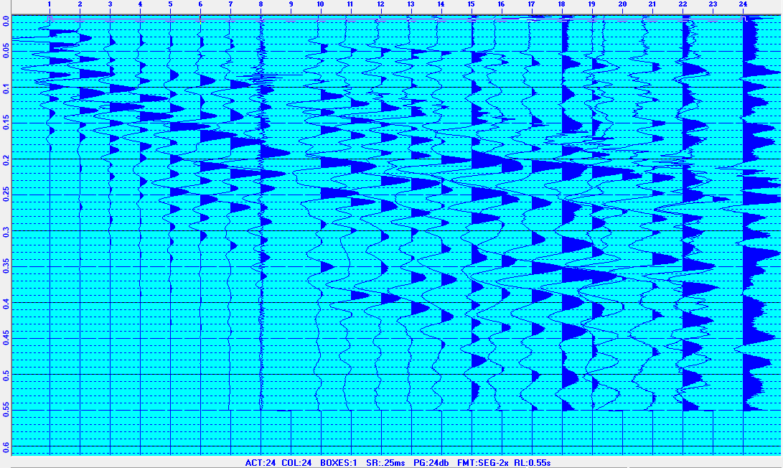

Final Semester Project Assignment
Part I: Dayton-Oxford Fault Seismic Investigation
The data shown above were collected on a hillslope above a dairy farm
near Clifton, Idaho in 2022. Owners were interested in knowing where
the fault was, and where the best location might be to drill a water well.
Data files are linked on the course website! You’ll want to use the RAS
software to redisplay and pick the first arrivals from individual traces of
the data. Picks will be saved in ascii text files!
W to E (Forward)
E to W (Reverse)

Slide 3
Final Semester Project Assignment
Part I: Dayton-Oxford Seismic Investigation (Continued)
(I.1) Pick first arrivals for each record. I recommend looking at both forward
and reverse sections (remembering reciprocity!) before finalizing &
modeling your picks. Remember you don’t need to populate every pick in
Refract… Model only the picks you are confident in!
(I.2) First, model the data in Refract assuming a 3 m spacing and 3 m shot
offset. Your project report should include screenshots of all four of the
Refract windows.
(I.2.i) Topographic elevation
along the profile was
estimated from a DEM.
What effect do you
expect topography to
have on arrival times
and/or your model?
(Profile distances
are relative to the
East shot point)
Elevation (m)
(geophone 24)
Profile Dist (m) | Elev (m)
66.12 | 1725.17
41.38 | 1718.16
2.46 | 1701.70
(geophone 1)
Profile distance (m)

Slide 4
Final Semester Project Assignment
Part I: Seismic Investigation (Continued)
(i.2.ii) Also implicit in the GPS
positions is that the
horizontal distances are
slightly different than the
3 m we tried to measure
using a tape measure (and
the reasons are hinted at
in nearby magnetic positions).
What effect do you
expect position errors
to have on arrival
times and/or your
model?
(Seismic)
Note: Profile distance calculations use the azimuth from the E shotpoint to magnetic site 12 (near the west shotpoint)!
(Profile distances
are relative to the
East shot point)
Elevation (m)
(geophone 24)
Profile Dist (m) | Elev (m)
66.12 | 1725.17
41.38 | 1718.16
2.46 | 1701.70
(geophone 1)
Profile distance (m)
N position (m)
(Magnetic)
W position (m)

Slide 5
Final Semester Project Assignment
Part I: Seismic Investigation Continued
(I.2.iii) Is there unequivocal evidence for dip on the layer interfaces
generating your arrivals?
(I.2.iv) If the model has a “dipping” layer, is it consistent with what
you’d expect for a normal fault dipping to the east?
(I.2.v) Is there misfit in your best-fitting model of your picks that
can’t be reduced by changing the model parameters?
(I.2.vi) If so, how might you interpret that misfit?
(I.2.vii) One “on-the-ground” observation was that the soil near
central parts of the seismic profile was wet (to the point of
saturation) while soil near the endpoints appeared to be dry.
Use ray theory and an algebraic calculation of how a velocity
change within the top layer might contribute to the misfit.

Slide 6
Final Semester Project Assignment
Part I: Dayton-Oxford Seismic Investigation Continued
(I.3) Our target should have travel-times somewhere along the
spectrum between a layer over a vertical contact and an
offset layer boundary, on the fault-perpendicular line:
There are no Xcel spreadsheet models of these in the Burger
codes, but I’ve created one (on the website; E-W_Seismic.xlsx).
m = 1/V₂
m = 1/V₂
m = 1/V₃
m = 1/V₂
m = 1/V₃
m = 1/V₂
m = 1/V₂
m = 1/V₂
m = 1/V₁
m = 1/V₁
m = 1/V₁
m = 1/V₁
V₁ = 500 m/s
B
V₁ = 500 m/s
A
z
V₂ = 2000 m/s
V₃ = 1000 m/s
V₂ = 2000 m/s

Slide 7
Final Semester Project Assignment
Part I: Dayton-Oxford Seismic Investigation Continued
(I.3) Use the spreadsheet to model both “fault-like” cases. Start out
using the E-side parameters for V₁, thickness & V₂ from your
Refract model; then vary all five parameters as needed to fit.
(I.3a) Which of the three models is most successful (given RMS)?
(I.3b) Do your fault model residuals suggest anything else?
m = 1/V₂
m = 1/V₂
m = 1/V₃
m = 1/V₂
m = 1/V₃
m = 1/V₂
m = 1/V₂
m = 1/V₂
m = 1/V₁
m = 1/V₁
m = 1/V₁
m = 1/V₁
V₁ = 500 m/s
B
V₁ = 500 m/s
A
z
V₂ = 2000 m/s
V₃ = 1000 m/s
V₂ = 2000 m/s

Slide 8
Final Semester Project Assignment
Part II: Smithfield-DC Magnetic Investigation
(II) Download the Smithfield-Dry Canyon Excel spreadsheet of
magnetic measurements from the website. The file contains the raw
data and various calculations, but you will only need the data
highlighted in the salmon color for this assignment.
(II.1) Find (and report!) the X, Y, Z components and inclination,
declination, magnitude of the WMM at the two extremal (E, W-most)
points in the profile. Does it make sense to correct for variations in
the WMM along this profile? Why or why not?
(II.2) Calculate the azimuth of the profile for modeling in GravMag
using the physical compass reading. The compass was set at a
magnetic declination of 11.75°, so if the WMM declination was
different, you should correct the compass reading for that. Note
that the azimuth entered into GravMag must be the positive (+)
direction of the profile, measured as an angle (positive in the
clockwise direction) from true north.

Slide 9
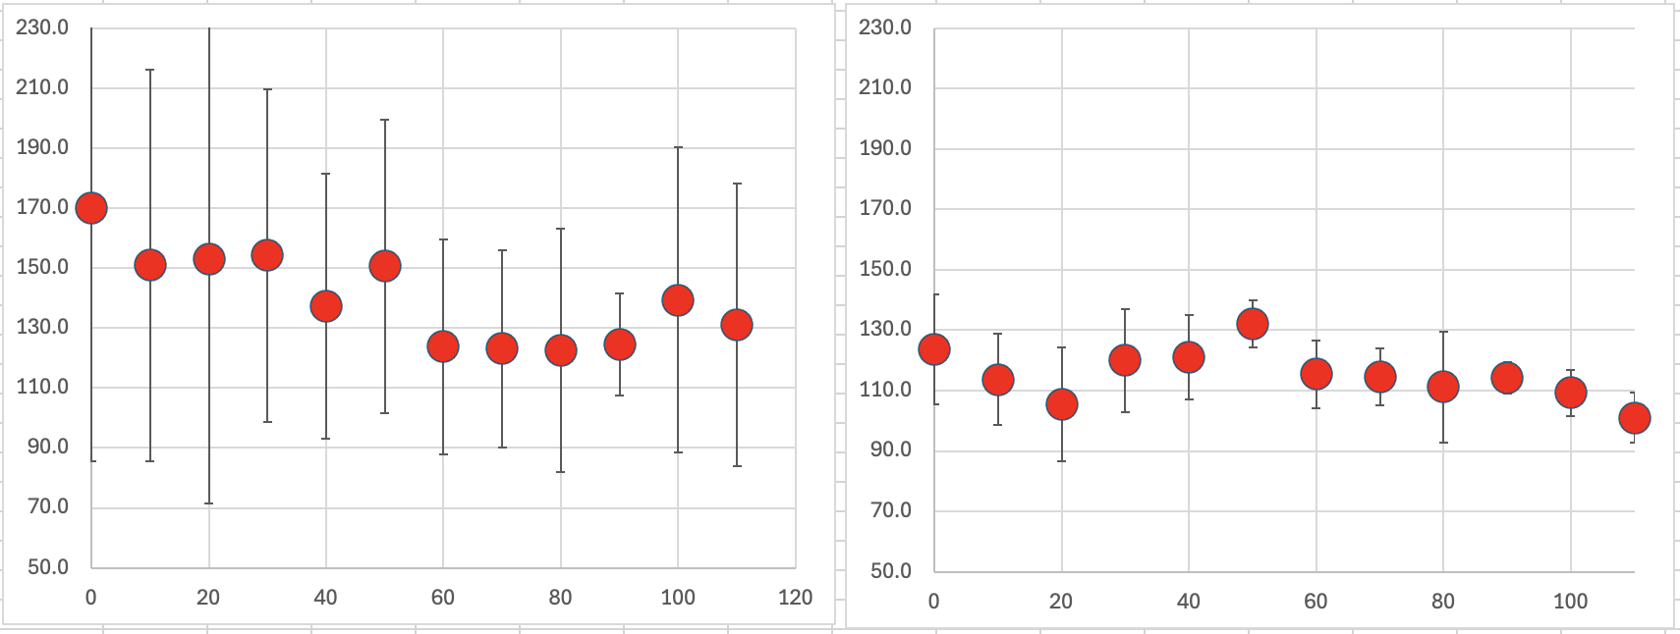
Final Semester Project Assignment
Part II: Smithfield-DC Magnetic Investigation
(Note:
Profile
distance is
positive-~E;
zero is at
magnetic
station 1!)
ΔH (γ)
Profile Distance (m)

Slide 10
Final Semester Project Assignment
Part II: Smithfield-DC Magnetic Investigation
(II.3) Model the data as a simple three- or four-vertex polygon using
GravMag. The polygon should look like what you would expect from a low-angle
normal fault hanging-wall, with either a positive or negative susceptibility
anomaly. (Your write-up should include images of all windows). We measured
the vertical field anomaly, so you need to set to “Vertical Field” for the RMS
misfit options in the data window! Also you need to enter the azimuth of the
profile you calculated in part III.2. In preferences, check “Use uncertainties” &
“Enter magnetic field”. All of these (azm, main field, etc) should be reported in
your write-up. Does the shape of a simple induced magnetization polygon look
similar to the variation of the measurements?
(II.4) Systematically vary magnetic susceptibility, polygon position, & shape
(and remanent magnetization, if you can make a case for why this might
matter) to minimize the misfit.
(II.5) Does your best-fit model support the idea that this is real signal caused
by subsurface properties? Why or why not?

Slide 11
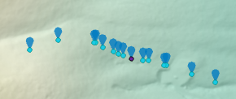
Final Semester Project Assignment
Part III: Dayton-Oxford Magnetic Investigation
(III) Download the Excel spreadsheet from the website. The file
contains all raw data below the black bar, except that
the longitude positions were adjusted slightly to ~correct
errors at sites 4 & 13.
(III.1) Find (and report!) the vertical components of the WMM at
the four extremal (N, E, S, W-most) points in the profile.
(Elevations were derived from calculations
in ESRI using a DEM). Does it make sense
to correct for variations in the WMM along
this profile? Why or why not?

Slide 12
Final Semester Project Assignment
Part IV: Oxford-Dayton Magnetic Investigation
(Note:
Profile
distance is
positive-~W;
zero is at the
reverse (E)
shotpoint
of the seismic
profile!)
ΔH (γ)
Profile Distance (m)

Slide 13
Final Semester Project Assignment
Part III: Dayton-Oxford Magnetic Investigation
(III.2) Model the data as a simple four-vertex polygon using
GravMag. (Your write-up should include images of all windows). We
measured the vertical field anomaly, so you need to set to “Vertical
Field” for the RMS misfit options in the data window! The azimuth
of this profile was –65°from true north, which should be entered in
the model window. In preferences, check “Use uncertainties” &
“Enter magnetic field”. All of these (azm, main field, etc) should be
reported in your write-up. Does the shape of a simple induced
magnetization polygon look similar to the variation of the
measurements?
(III.3) Systematically vary the magnetic susceptibility, polygon position,
& shape (and remanent magnetization, if you can make a case for
why this might matter) to minimize the misfit.
(III.4) Does your best-fit model support the idea that this is real signal
caused by subsurface properties? Why or why not?

Slide 14
Final Semester Project Assignment
Part IV: Synthesis
Now, from the combination of the magnetic and seismic data with
any additional resources you have that pertain to the problem:
(IV.1) Does the Smithfield Dry Canyon magnetic data appear to
reflect differences in magnetic susceptibility of Paleozoic and
Tertiary seds across a low angle normal fault? Why, or why not?
(IV.2) What (if anything) do the combined measurements tell us
about the Oxford-Dayton site that we could not glean from one
type of geophysical measurement alone?
(IV.3) What are your combined interpretations of the subsurface at
the field sites? Do they match your expectations of what you
thought we’d find before you worked up the data?
(IV.4) The Dayton-Oxford site landowners were particularly interested
in whether the data could be used to inform where best put a water
well for cabins they were building nearby. Where would you
recommend drilling, and why?

