Slide 1
Geology 6690/7690
Geodesy & Crustal Deformation
1 Dec 2023
Last time: Fault Slip Dislocations (& Slow Slip Events)
• Slow fault slip events are observed nearly everywhere that strain
rates are high and continuous GPS networks are present (mostly
subduction zones, but also other thrusts & some strike-slip faults)
• Associated non-volcanic tremor is sometimes (not always!)
observed; narrow-band harmonic shaking is located on the
slipping fault and has radiation pattern consistent with fault slip
• Slip (and sometimes tremor) localizes near transitions from
velocity-strengthening to velocity-weakening frictional behavior
(but appears to require the latter) and can be used to map
frictional properties
© A.R. Lowry 2023

Slide 2
Read for Mon (4 Dec):
Mey et al. (2016) Glacial isostatic uplift of the
European Alps. Nature Communications 7:#13382,
https://www.nature.com/articles/ncomms13382

Slide 3
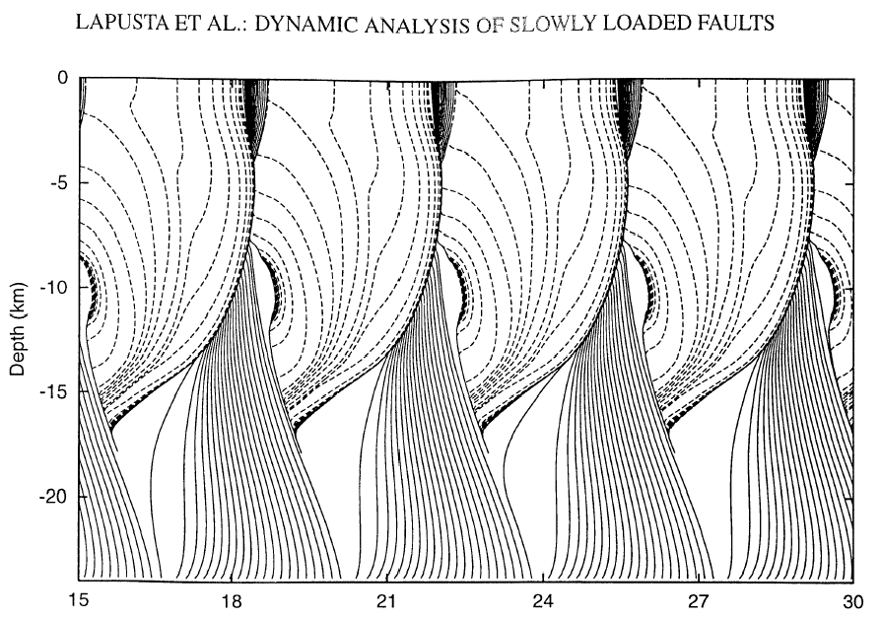
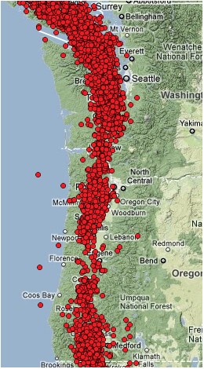
Look closely here at where interseismic & slow slip would be located
in relation to where earthquake rupture terminates down-dip…
What does that imply about the likely extent of a future Cascadia
megathrust earthquake?
Lapusta et al., JGR 105(E10), 2000
b – a > 0
b – a = 0
b – a < 0
b – a = 0
b – a > 0
Cumulative Slip (m)

Slide 4
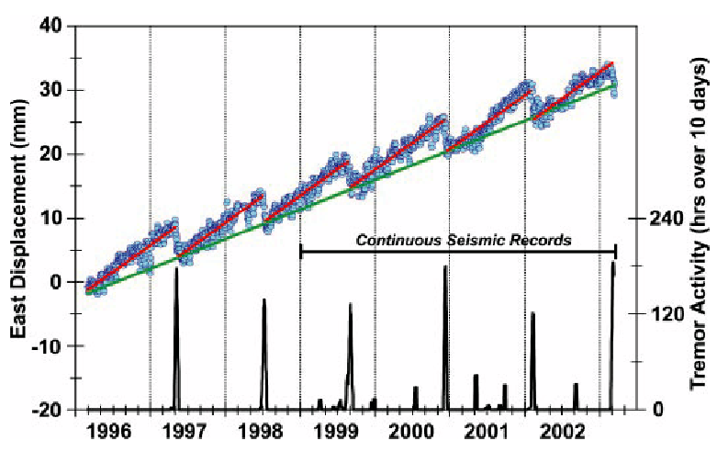
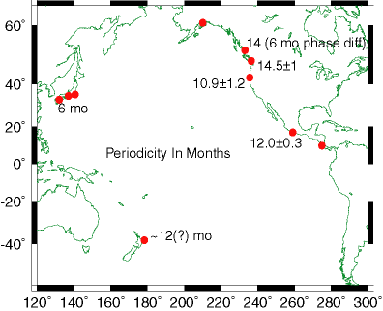
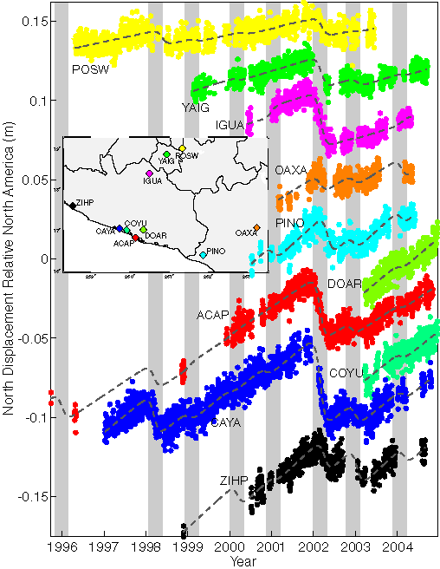
Some common observations (3):
18±1
• Many locations
exhibit quasi-
periodic behavior!
with 6 month to 6
year recurrence…
25.4±0.2
A Pacific symphony (one note at a time)!

Slide 5
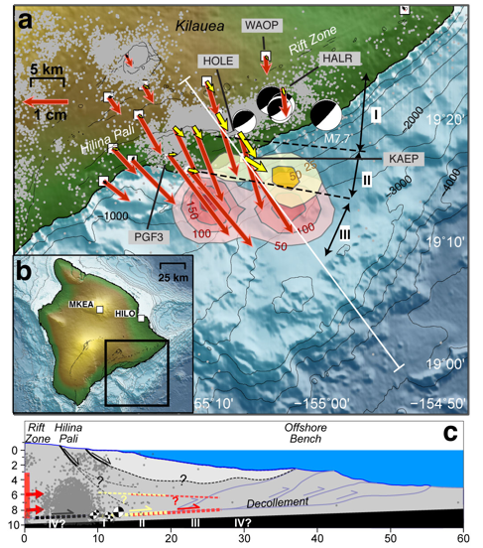
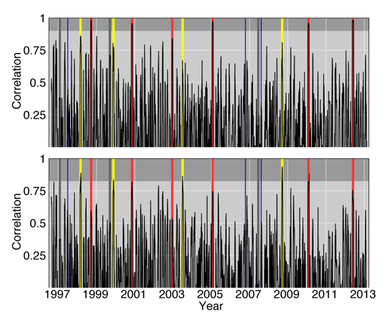
Hypothesis testing: Does simple frictional modeling such as
this yield predictions of physical properties that match
laboratory & geophysical measurements?
Foster et al., GRL 2013

Slide 6
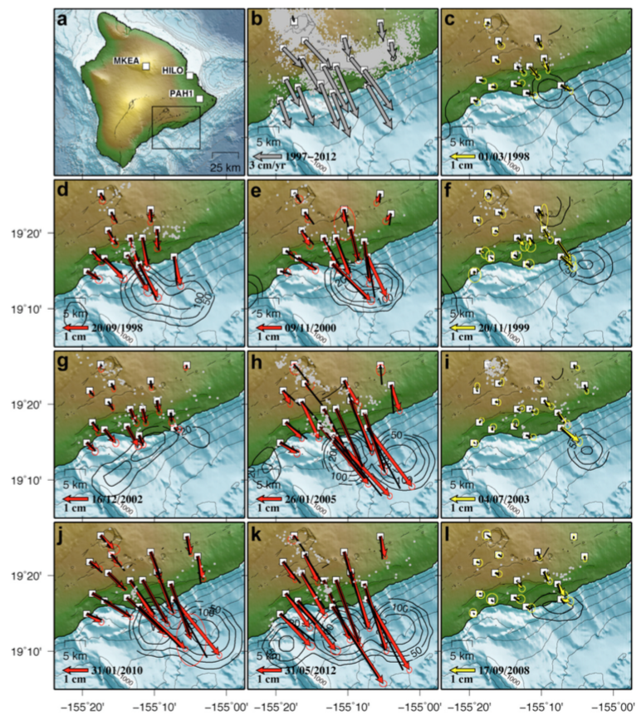
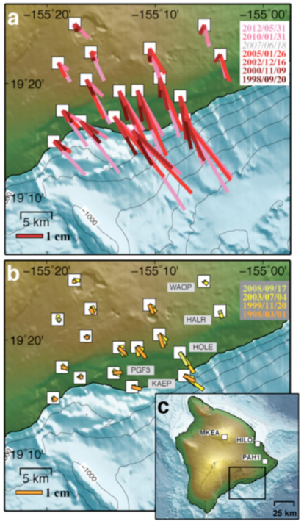
Foster et al., GRL 2013

Slide 7
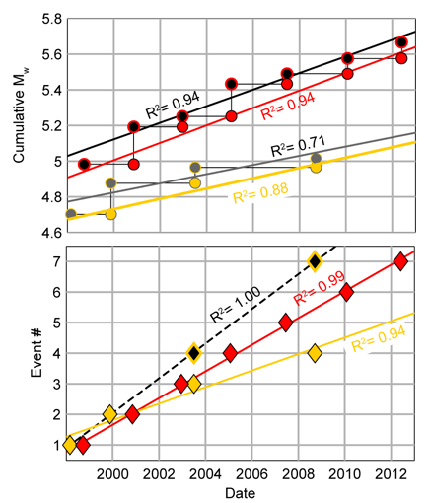
Some complexity: There
appear to be beat patterns
(in moment release for
western family shown in
red; recurrence for
eastern family shown in
yellow). Recurrence rate
and patch size have
implications for rate- &
state-dependent fault
frictional properties…

Slide 8
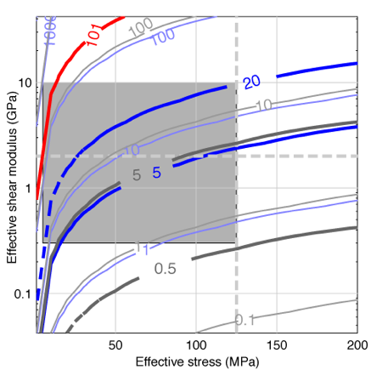
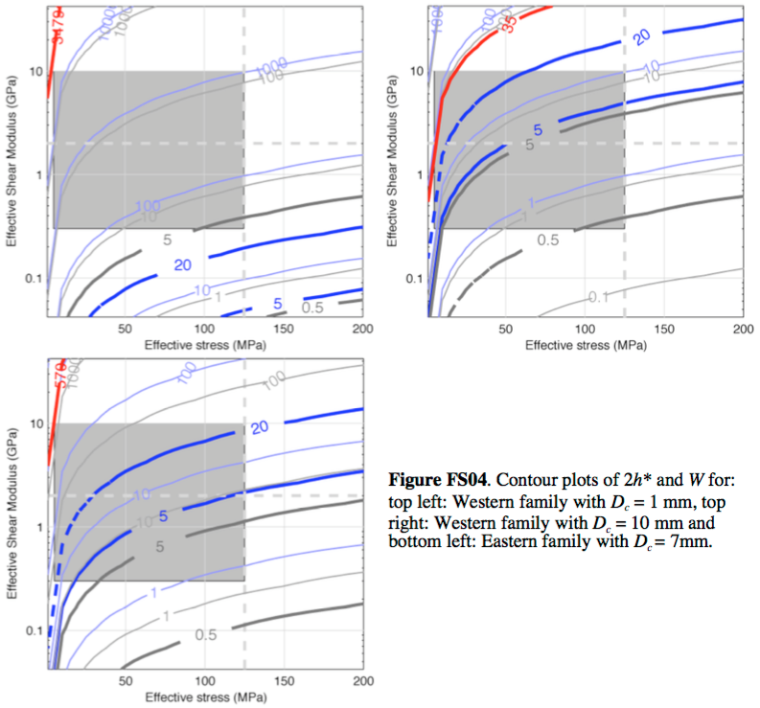
West: D_{c} = 1 mm
West: D_{c} = 7 mm;
(b – a) = 5.9x10⁻⁵
Important aside!
Both the frequency and the scale of slip events are predicted by frictional properties of that region of fault slip… And these predictions are testable.
West: D_{c} = 10 mm
East: D_{c} = 7 mm
Note: “effective stress” is effective normal stress and shear
modulus is the elastic parameter μ… So the grey box is what
is physically plausible. The patch-size in length (grey) and
dip-direction width (blue) is measured at between the two thick
contours... Interestingly implies pore fluid pressure ~hydrostatic!

Slide 9
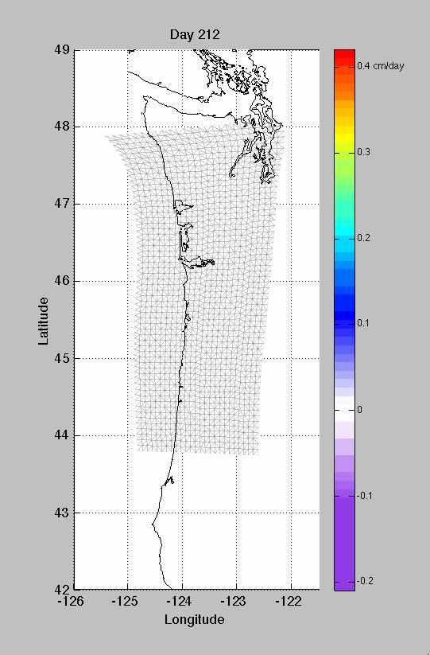
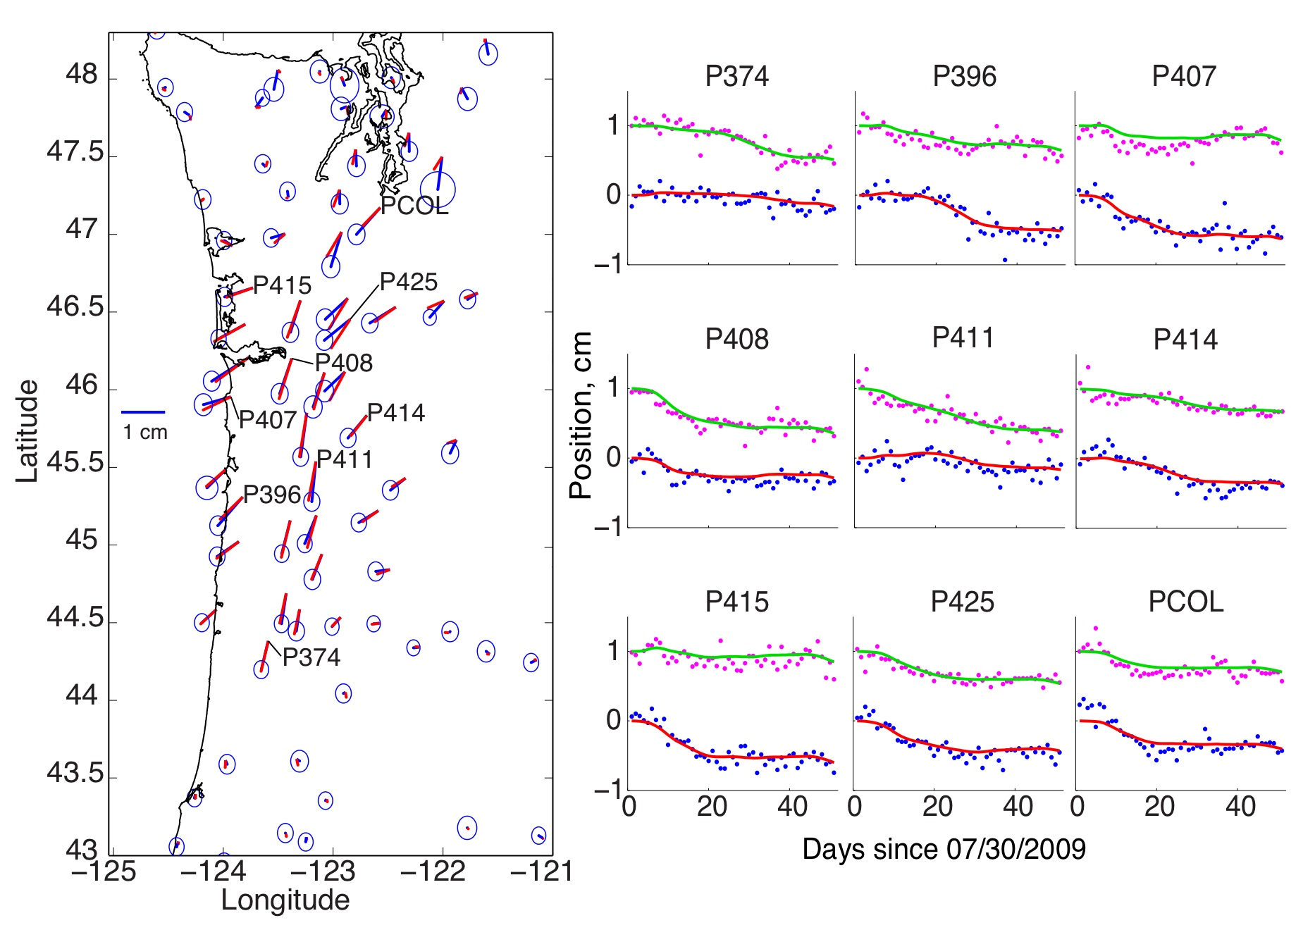
Bartlow et al., Geophys. Res. Lett., 2011
Animation of Cascadia ETS:
Slip inverted from GPS data
during the 2009 Siletzia
event, using a Network
Inversion Filter: Kalman
filter of GPS time series piped
through a slip inversion (Segall &
Matthews, JGR 1997).

Slide 10
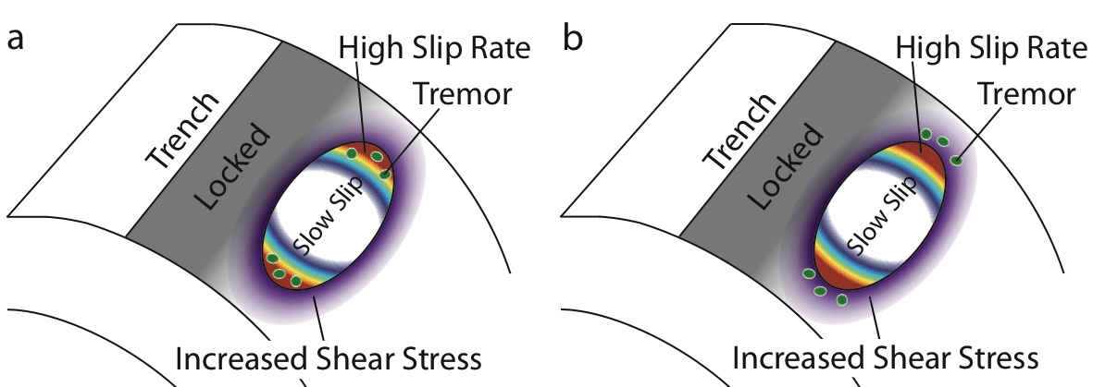
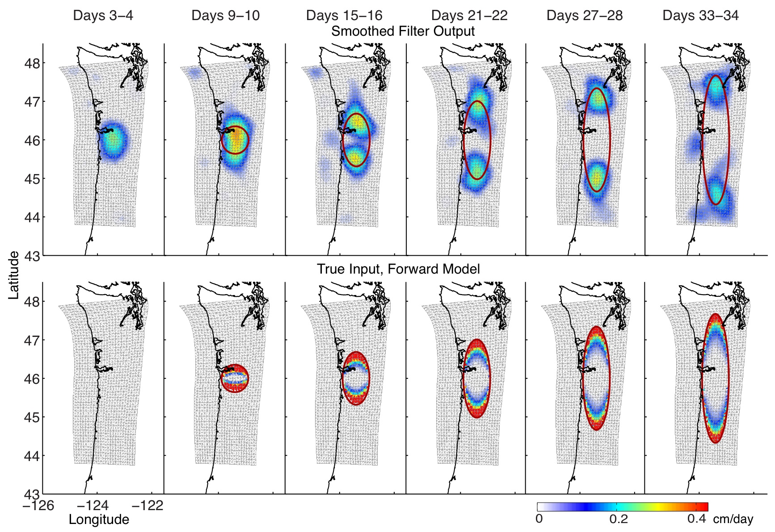
Can use to
examine more
interesting
questions
relating to the
phenomena
(with
implications
for frictional
rheology) but
resolution
properties of
geodetic
inversion is a
limitation…

Slide 11
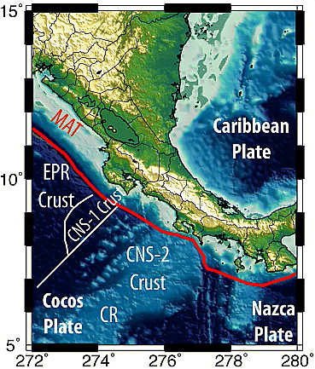
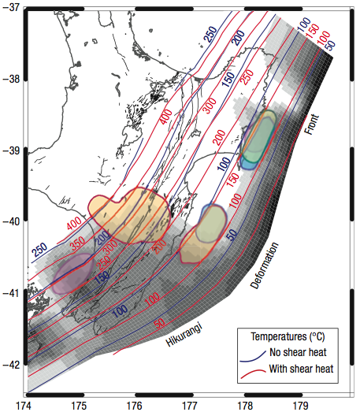
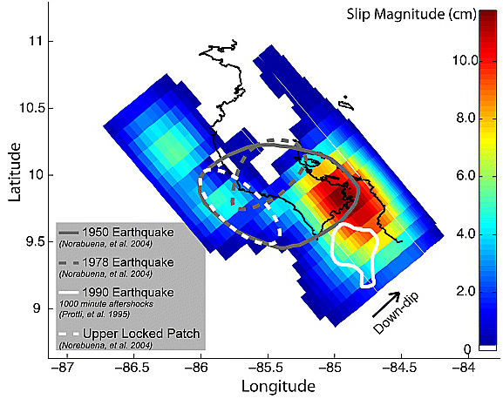
McCaffrey et al. (NatGeo 2008)
Things we know now that we didn’t know then:
Slip events can
also occur on
the shallow
frictional transition
~125°C!
Outerbridge et al. (2010) J. Geophys. Res.
Red patch is a subsequent
(2012) earthquake!

Slide 12
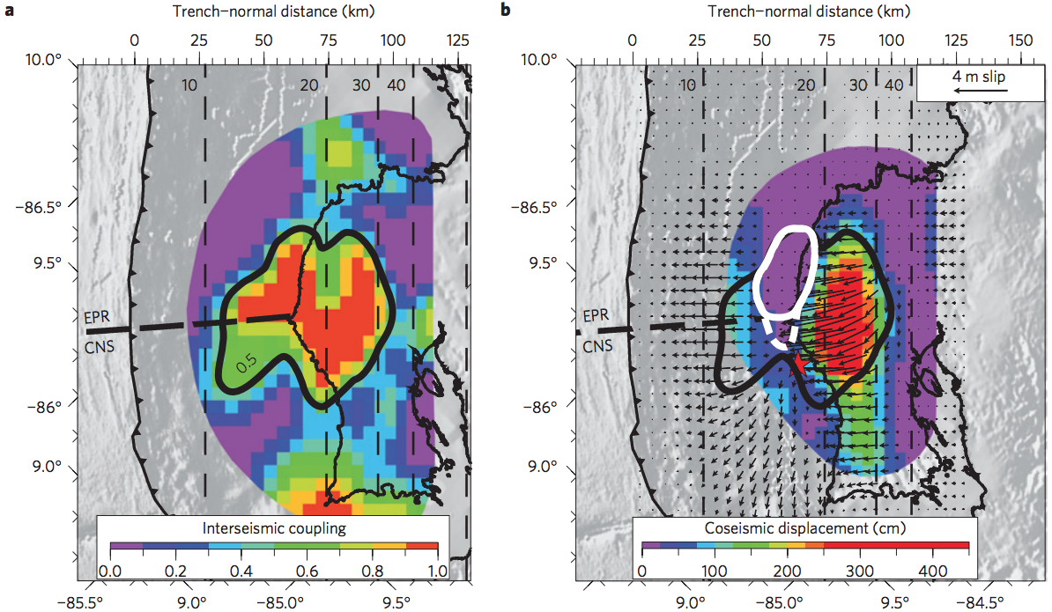
Subsequently had a megathrust event:
The 2012 M_{w} = 7.6 Nicoya Peninsula earthquake
Protti et al. (2014) Nature Geoscience

Slide 13
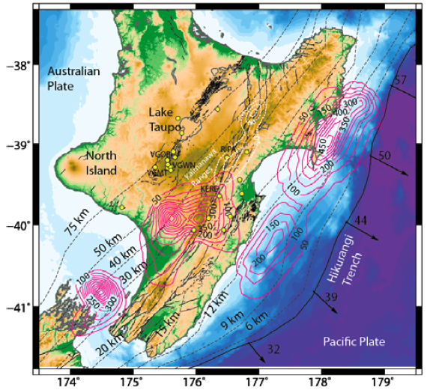
McCaffrey et al. (NatGeo 2008)
Things we know now that we didn’t know then:
Baxter, MSc Thes., 2015
Deeper slow slip events, plus tremor, occur in the Gisborne
Bay area too!

Slide 14
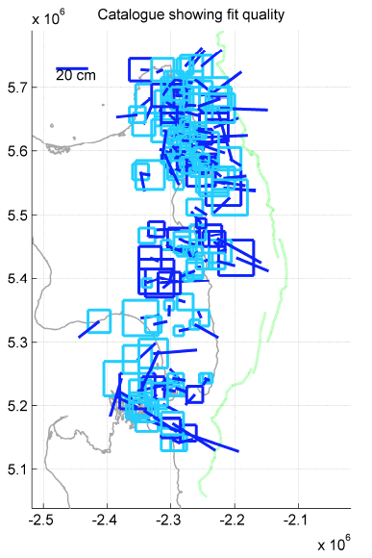
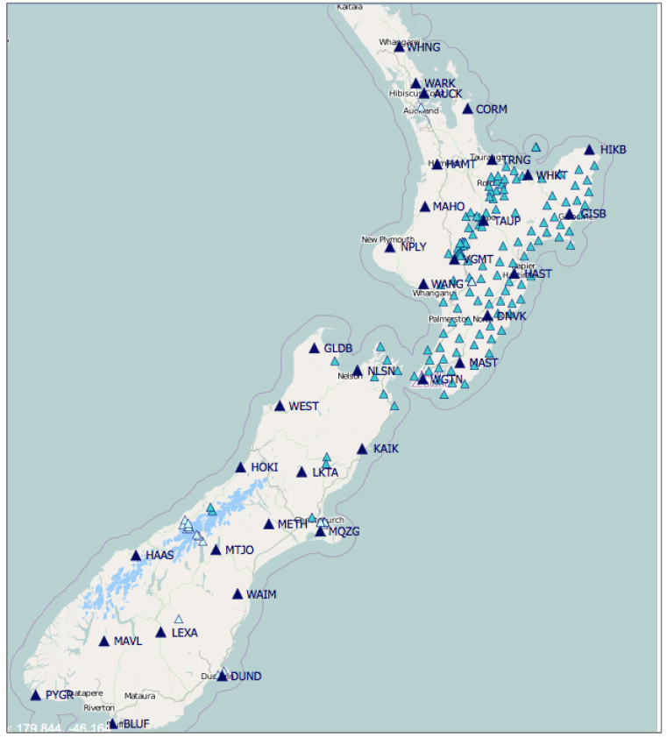
McCaffrey et al.
Things we know now:
With many more sites, systematic analysis (Baxter VUW M.Sc.)
see some interesting things (including transient locking events)

Slide 15
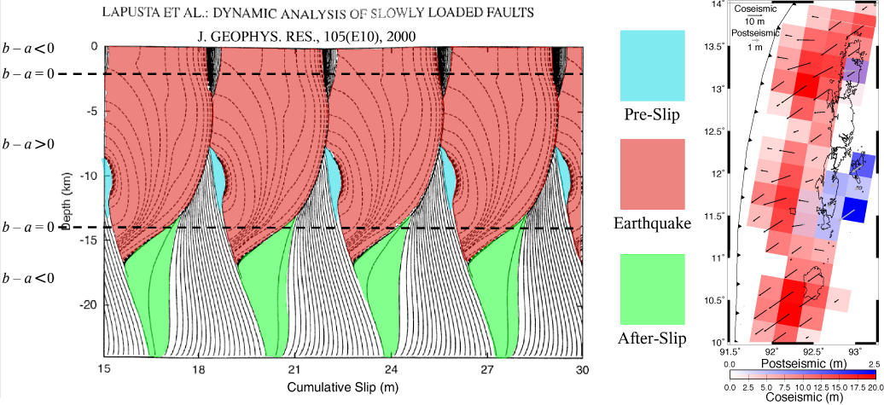
Postseismic slip?: Deformation in the first few years after the
Sumatra-Andaman earthquake was initially modeled as slip,
and focused in the region just downdip of the earthquake
rupture zone (as expected based on rate-state slip models!)

Slide 16
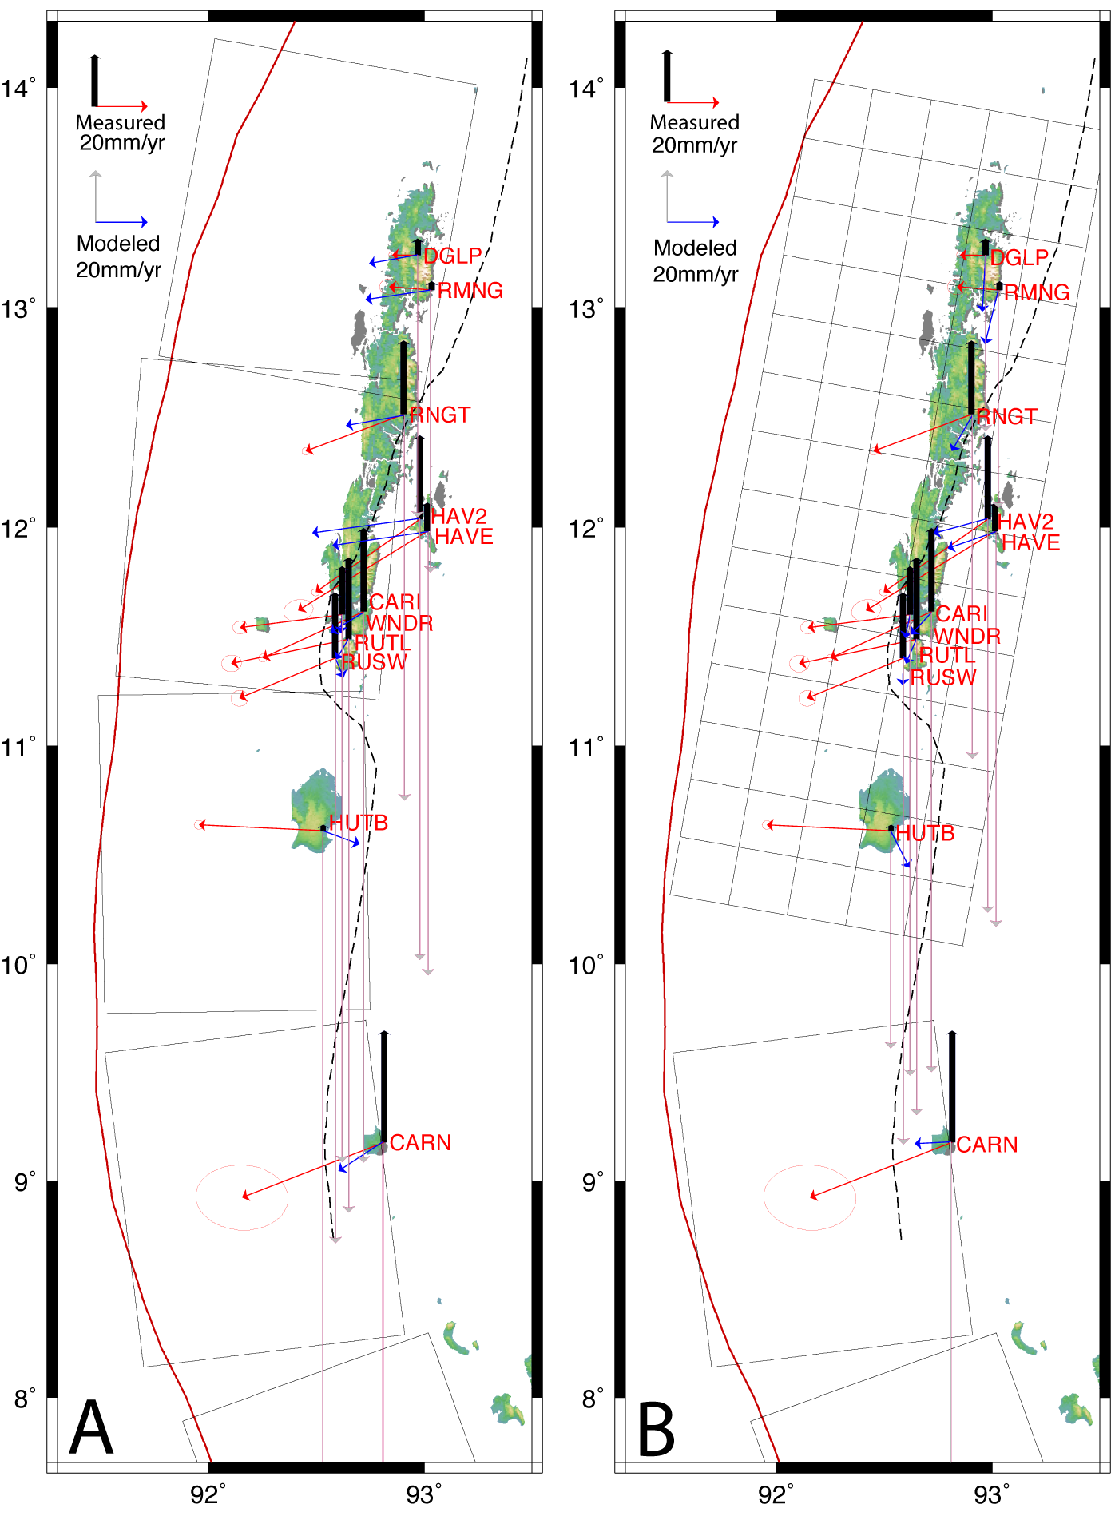
Post-seismic deformation:
This shows (red vectors + black
vertical) transient velocities for
the 2008-2010 two-year epoch
of GPS data from Andaman…
Most studies infer that slip
anomalies ended by this time,
and the transient deformation is
all due to viscoelastic flow, but
vertical motions directly over the
base of coseismic rupture are
opposite viscoelastic model
predictions.

Slide 17
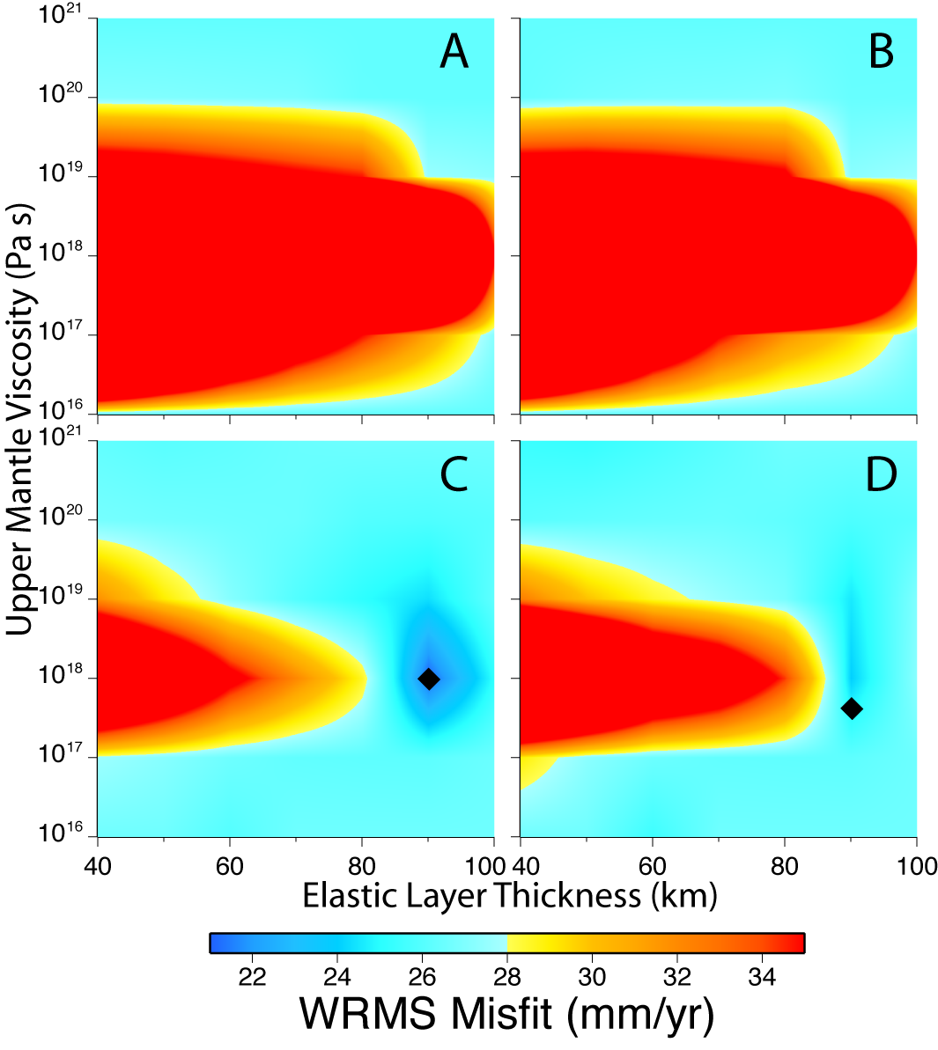
Horizontal plus vertical
Postseismic
modeled as only
viscoelastic
flow :
WRMS is
reduced relative to
that of a “zero
displacement”
model only if the
vertical
displacements are
neglected…
Horizontal only
Coarse coseismic
Fine coseismic
Paul et al.,
BSSA 2012

Slide 18
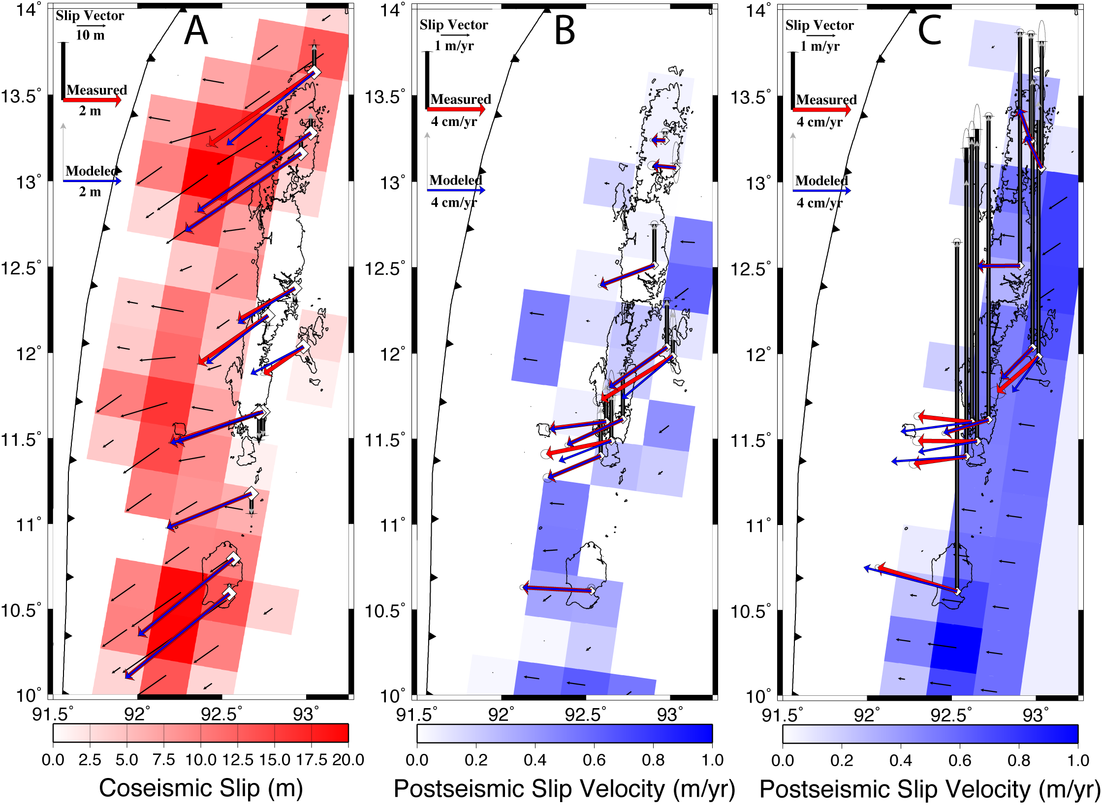
Modeled as afterslip only
Modeled as afterslip plus viscoelastic flow
Paul et al.,
BSSA 2012

Slide 19
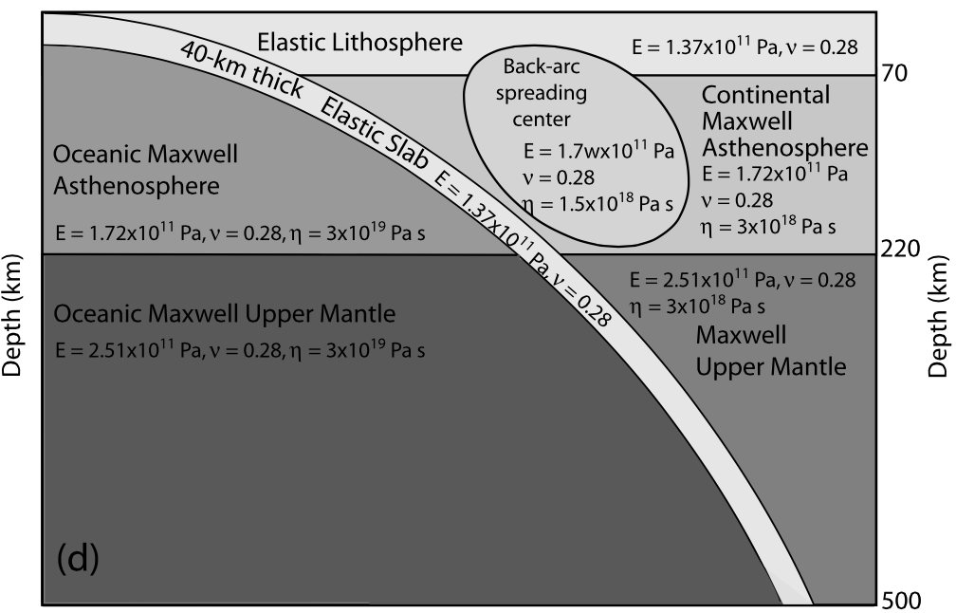
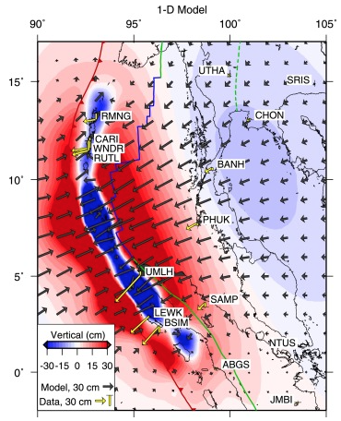
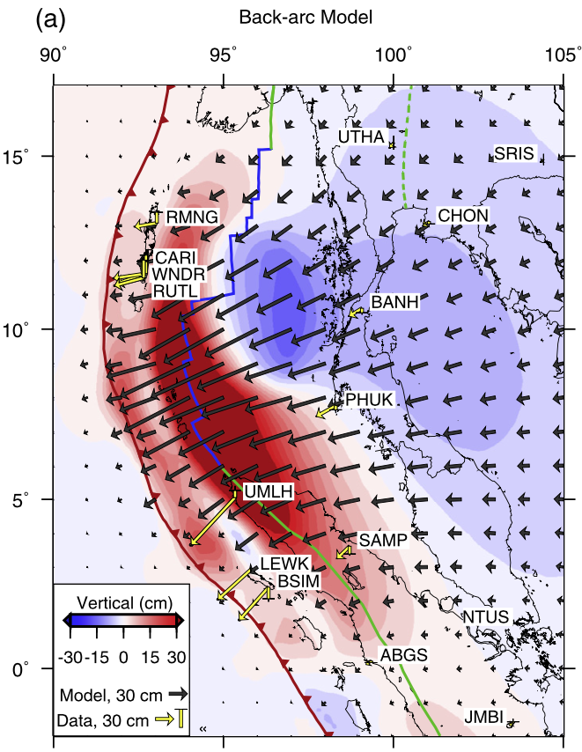
Wiseman et al. (EPSL 2015) show
importance of 3D structure though
(somewhat anticipated!) Choice of
rheology is probably also important
(here Maxwell) & must be explored

