Slide 1
Geology 6690/7690
Geodesy & Crustal Deformation
1 Sep 2023
Geodesy is the measurement and representation of the
shape of the Earth and its gravity field
• Synthetic aperture radar (SAR) is also used for altimetry
of oceans/rivers/lakes, much more accurately than with
gauges. (This was among its original planned uses!)
• GPS and InSAR show surprising strong seasonality of ice
sheet flow, indicating surface water percolates to base
and lubricates glacial flow in summer; icequakes are
used to extend the record of frequency back in time!
• Sea level altimetry provides info on sea level rise, current
dynamics, and the static geoid
• GRACE time-variable gravity has revolutionized understanding
of the Earth’s fluid envelopes
Read for Wed 6 Sep: Wahr §1 (1-3); §2.5 24-75
© A.R. Lowry 2023

Slide 2
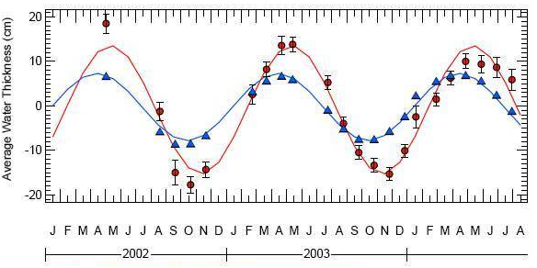
Example: Hydrology
Gravity And Climate Experiment (GRACE) measurements of
surface mass change in the Amazon basin indicated ~100%
greater amplitude and a phase delay in annual storage of
water mass relative to hydrological models based on surface
measurements of precipitation and river outflow

Slide 3
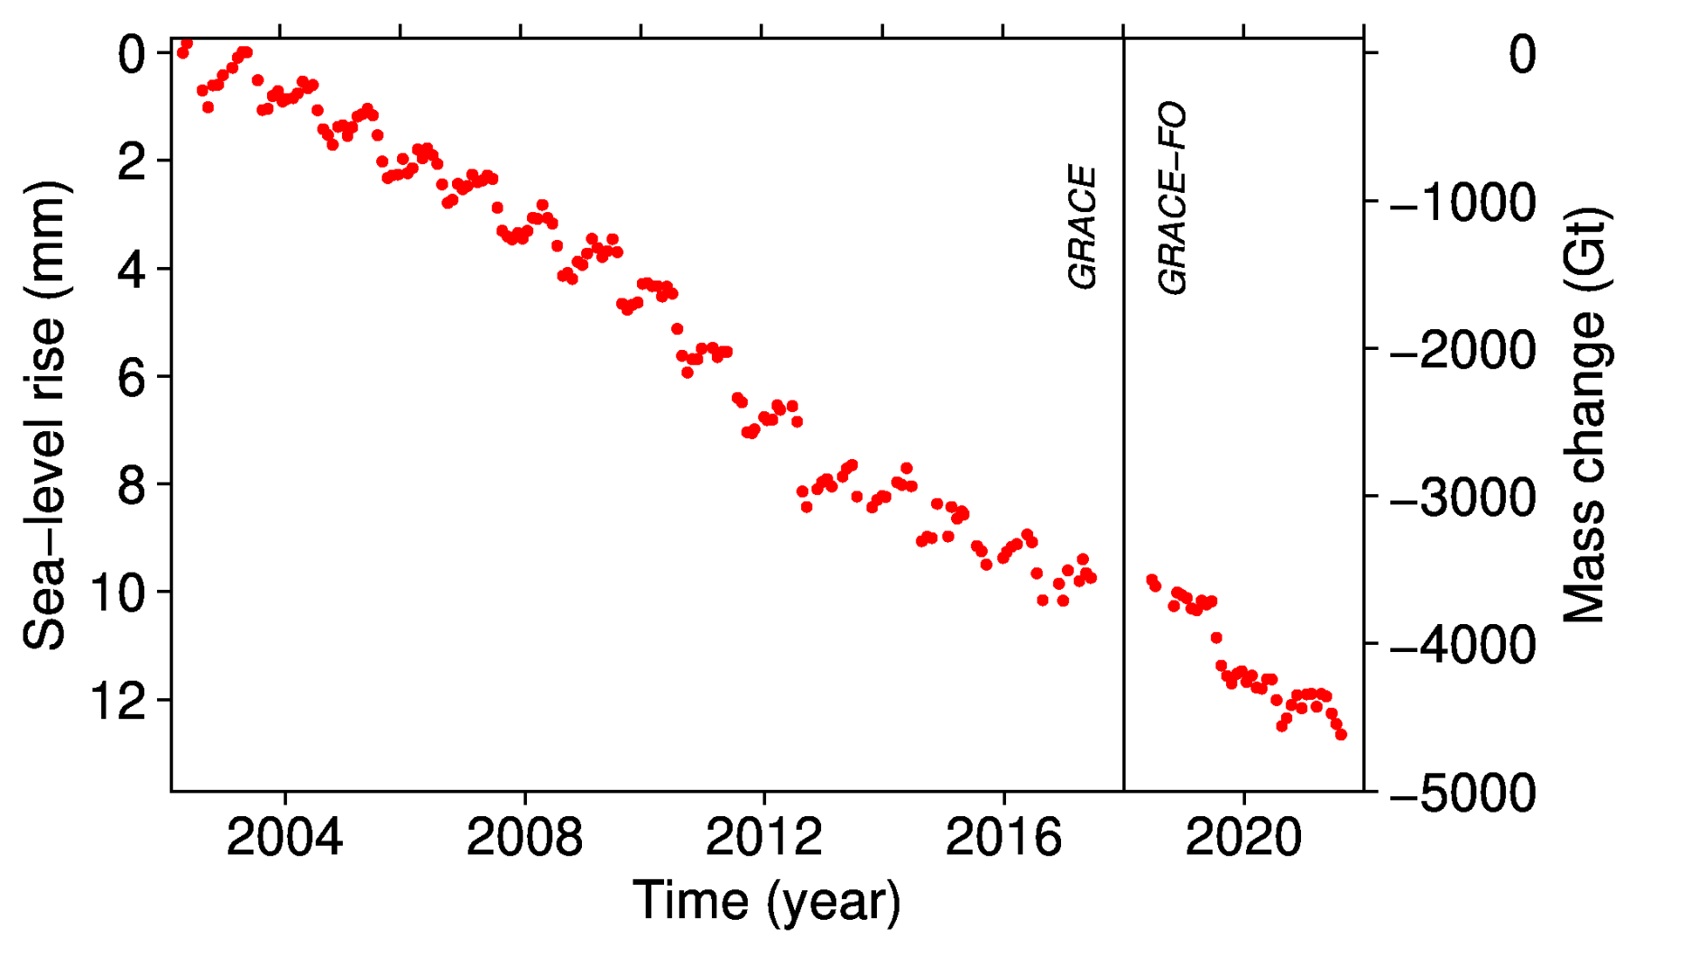
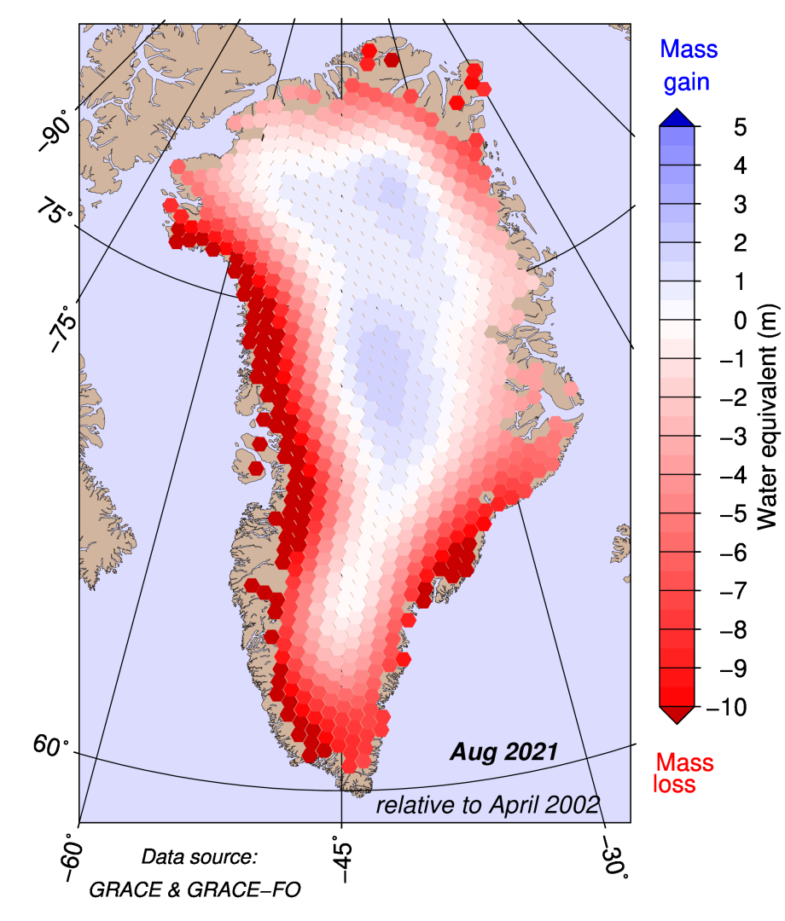
Example: Cryosphere (Greenland)
Barletta et al., Cryosphere,
2013 (via polarportal.dk)
GRACE shows ~200 km³/yr
decrease in ice mass from
2002 to 2020, mostly from
coastal areas
0.6 mm/yr of sea level
change

Slide 4
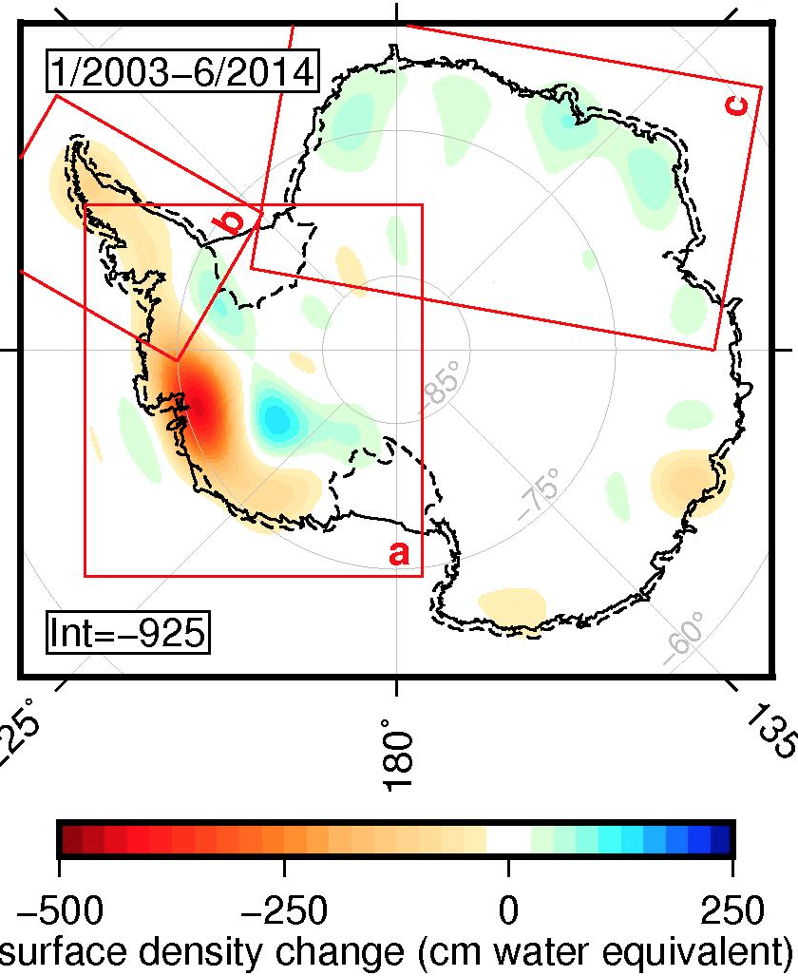
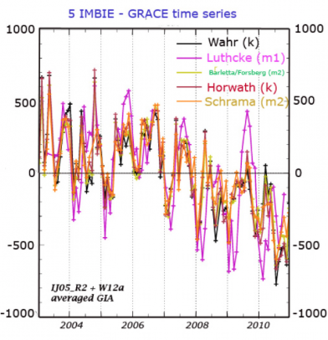
Example:
Cryosphere
(Antarctica)
GRACE measurements of
mass change in Antarctica
indicate –165±71 km³/year
2002 to 2010 (from W Ant)

Slide 5
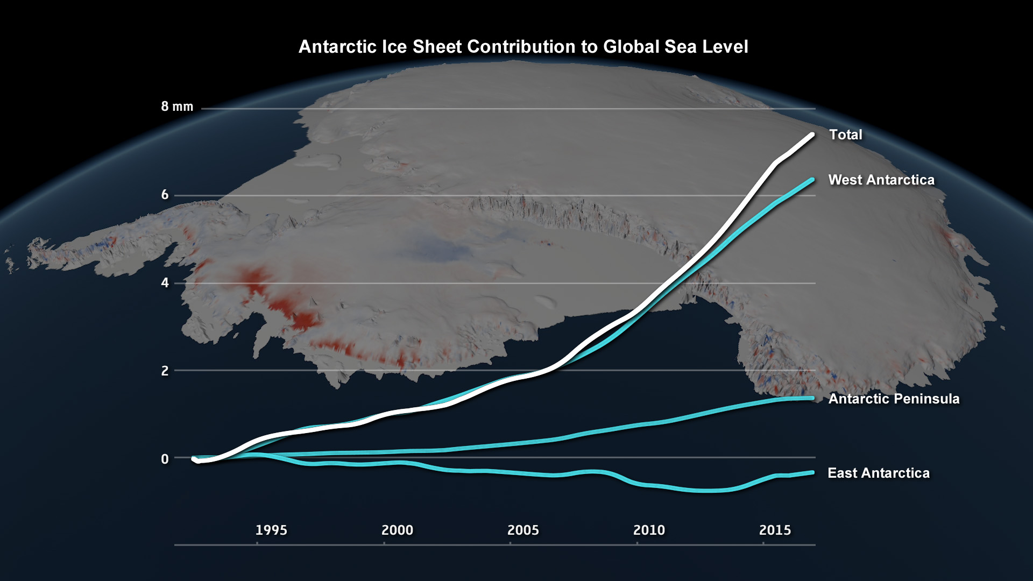
Example: Cryosphere (Antarctica)
Courtesy
NASA
The concern however is that Antarctica’s contribution seems to
be growing…

Slide 6
The devil’s in the details. In this course
we’ll examine:
How geodetic measurements are made, with emphasis
on modern (mostly, space-based) geodesy
Pitfalls in geodetic measurement when we try to push
to the limits of the methodology
The crustal deformation processes and mass flux
processes that produce our desired (or in some
cases, undesired) signal
And we will skew the course topics toward a focus on
your individual interests…

Slide 7
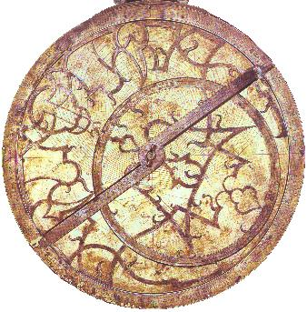
Surface (“Terrestrial”) Geodesy
Wahr’s notes identify four types of positioning from:
• Measurements of horizontal angles between points
• Measurements of elevation differences between points
• Measurements of distances between points
• Measurements referenced to stars or other extraterrestrial
bodies.
Earliest navigation used the latter;
we’ve since come
back full circle!
(Astrolabe inclination
i to stars, plus an
accurate clock, gives
position!)
i

Slide 8
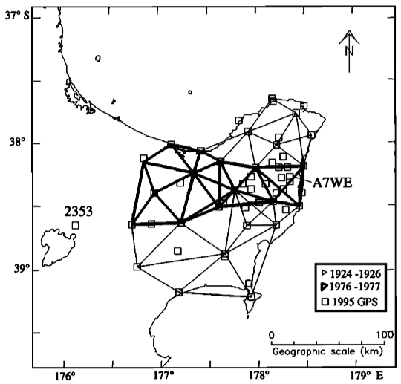
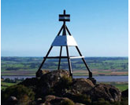
Triangulation was a common surveying approach
until ~1990s…
Used a transit (telescope on a swivel, with very accurate
measure of angular change, plus level)
Can use to “triangulate” location, but accurate distance
required “chaining” or another measurement of distance
along at least one leg of a triangle within a network.
Raukumara
peninsula (NZ)
geodetic network
(triangulation,
EDS, GPS!)
from Arnadottir
et al. (JGR,
1999).
Beacon marking a NZ triangulation
control point (courtesy LINZ)

Slide 9
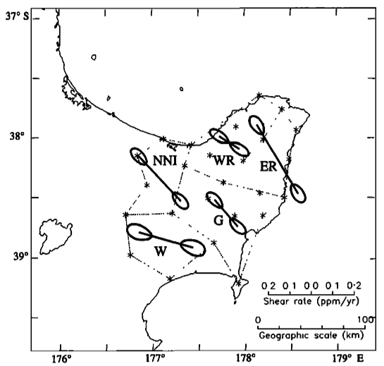
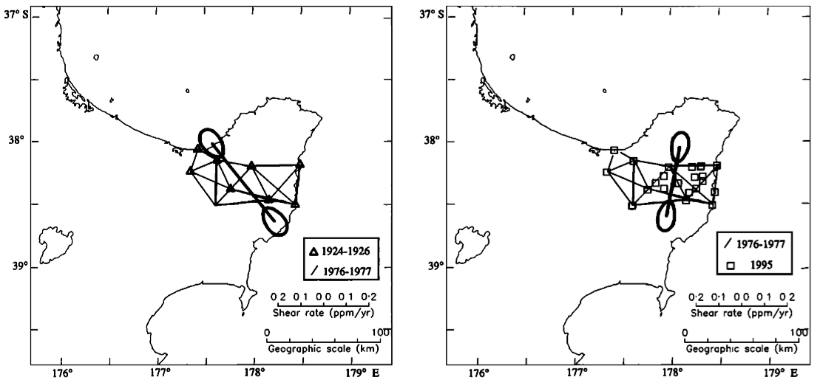
Still, highest-quality surveys (US,
New Zealand, India) could be
accurate to ~cms… Good enough
to look at strain and strain changes.
Here, strain changes interpreted to
result from afterslip excited by three
M7+ EQs in Hawkes’ Bay (1931-32)
(bar direction is max extension).
From
Arnadottir
et al. (JGR,
1999).

Slide 10
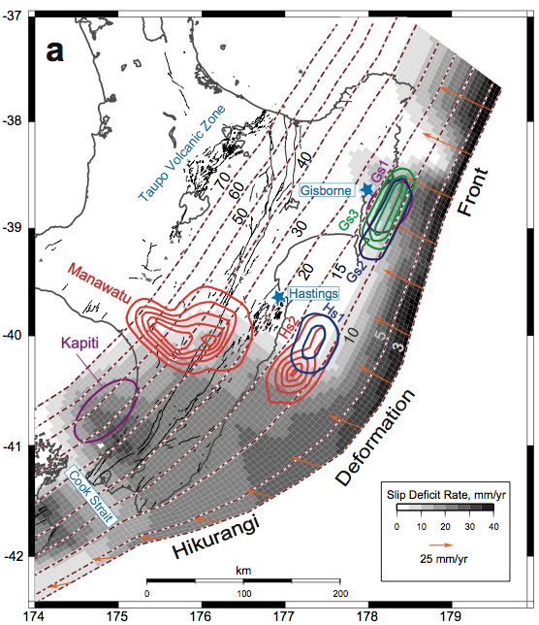
GPS measurements
made later show
offshore Raukumara
peninsula turns out
to be a very
anomalous location
of shallow locking
depth and shallow
slow slip events…
Targeted for a drilling
project in 2018!)
From McCaffrey et al.
(Nature Geoscience,
2008).

Slide 11
Leveling measures height differences referenced to
the Geoid (i.e., a surface representing equipotential
gravity!)
Topography
}
h₁
h₂
}
{
h₀
Geoid
Measures the difference in height from instrument to level
staff, Δh = h₀ – h … Note that “vertical” is defined by local
orthogonal to the geoid at instrument and staff.

Slide 12
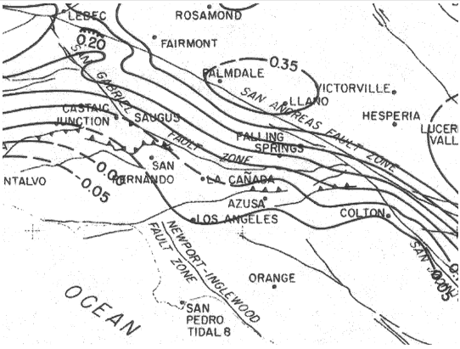
There were early hiccups in applying to surface deformation…
But they figured out the errors (rod calibration & refraction
effects) & improved on the methodology
Palmdale bulge, ca. 1975
Uplift positive, in meters
Courtesy USGS

Slide 13
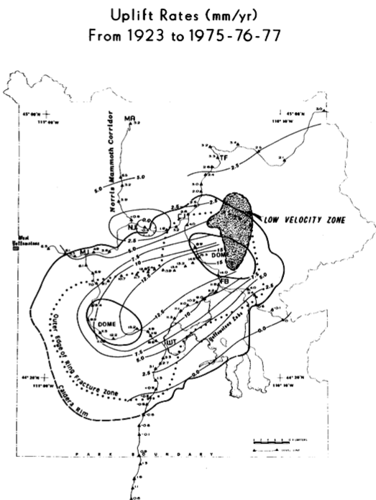
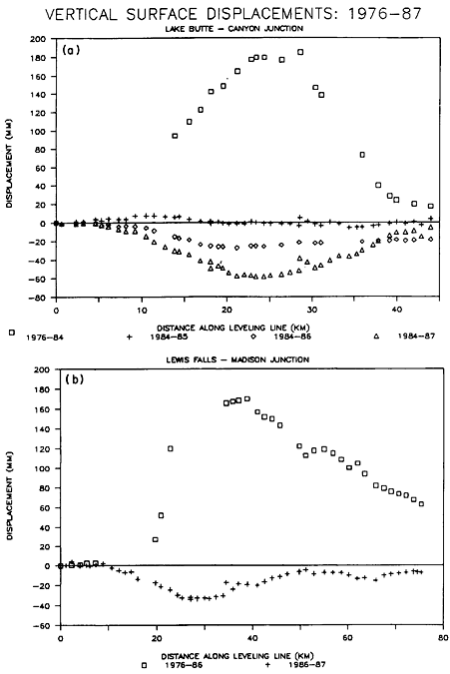
Now accurate to mms or less… Enough to see e.g. 0.8 m uplift
of Yellowstone from 1923-75, and <1 cm changes subsequent!
From Smith et al.,
Eos, 1989.

Slide 14
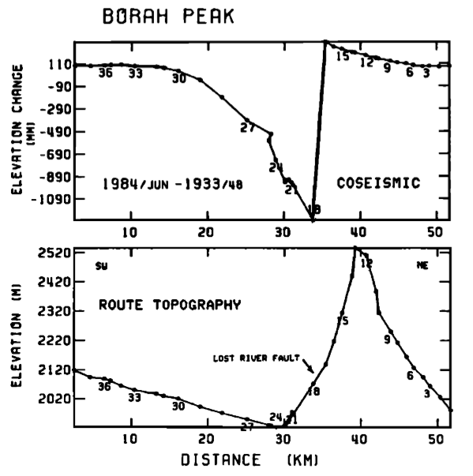
From Stein and Barrientos,
JGR, 1985.
And > 1 m
height changes
for the 1983
M_{w} 6.9
Borah Peak (ID)
earthquake

Slide 15
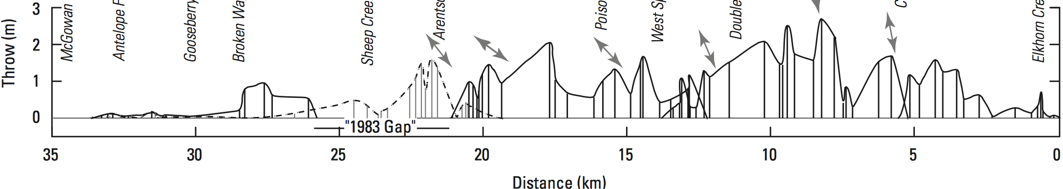
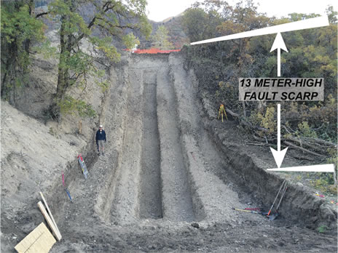
Comparison of the > 2 m average slip indicated by geodesy
to surface rupture mapping highlights a limitation of
paleoseismic estimates of hazard…
?
?
?
Crone et al., BSSA, 1987
M_{w} 6.9 Borah Peak earthquake
Trench of
the Wasatch
fault scarp

Slide 16
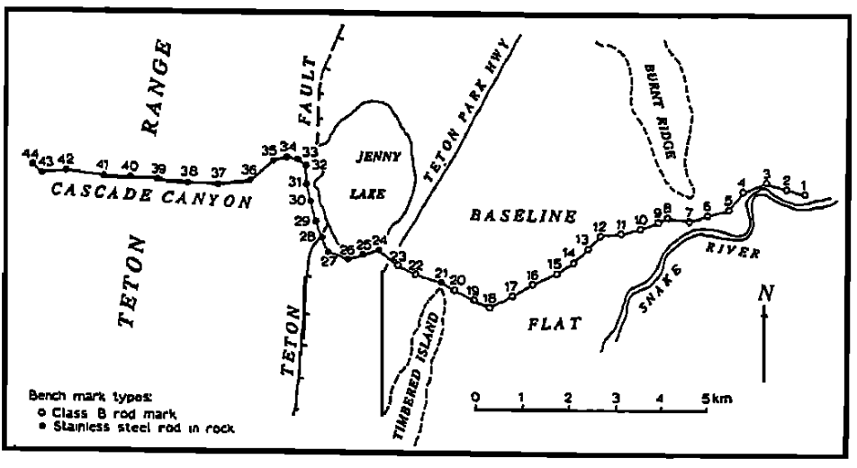
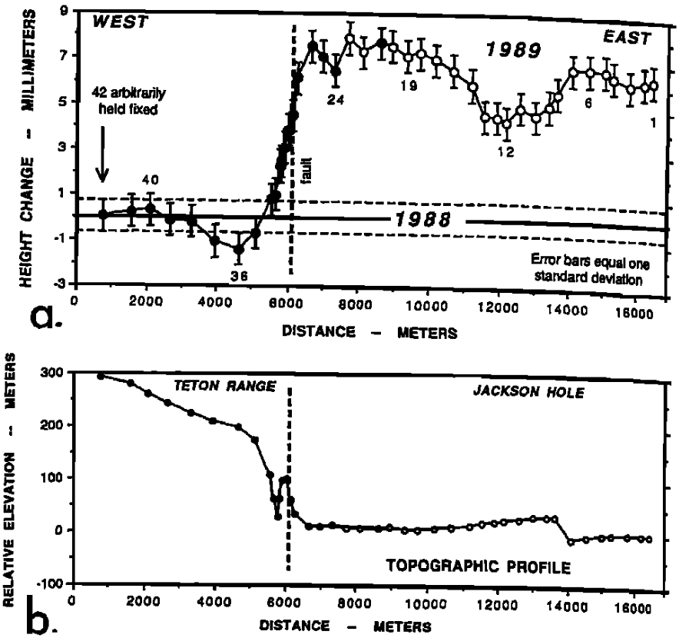
Leveling has been used to study interseismic deformation. This
study of the Teton fault achieved precision of tenths of a mm!
These authors
interpreted basin-side
uplift as reverse
aseismic creep, but
more likely an elastic
or poroelastic
response to hydrology
(probably poroelastic
because groundwater
levels increased!)
Sylvester et al., GRL, 1991

Slide 18
Geodesy is the measurement and representation of the
shape of the Earth and its gravity field
Motivation: Most active processes that are of interest to
Earth scientists change the shape of the planetary
surface and change the gravity field.
Applications of geodesy include tectonics & the
earthquake cycle, hazard analyses/modeling (landslide &
mass wasting, volcano studies & monitoring), climate
studies (sea level, water & ice mass), and water monitoring
Read for Wed 6 Sep: Wahr §1 (1-3); §2.5 24-75

