Slide 1
Geology 6690/7690
Geodesy & Crustal Deformation
3 Nov 2023
Last time: Satellite Gravity:
• Time-variable gravity is especially important for
understanding surface redistribution of water, ice mass...
But also has solid Earth contributions that must be
addressed!
• Glacial isostatic adjustment’s (solid Earth mass change)
dependence on an unknown ice mass history &
poorly-known rheological structure is one of the largest
sources of error in ice mass change (the other being
leakage from adjacent water mass changes)
• Geoid over oceans and other large water bodies is well-
determined by >25 years of satellite laser altimetry,
and is also a dominant source of info about bathymetry
(with assumptions…)
© A.R. Lowry 2023

Slide 2
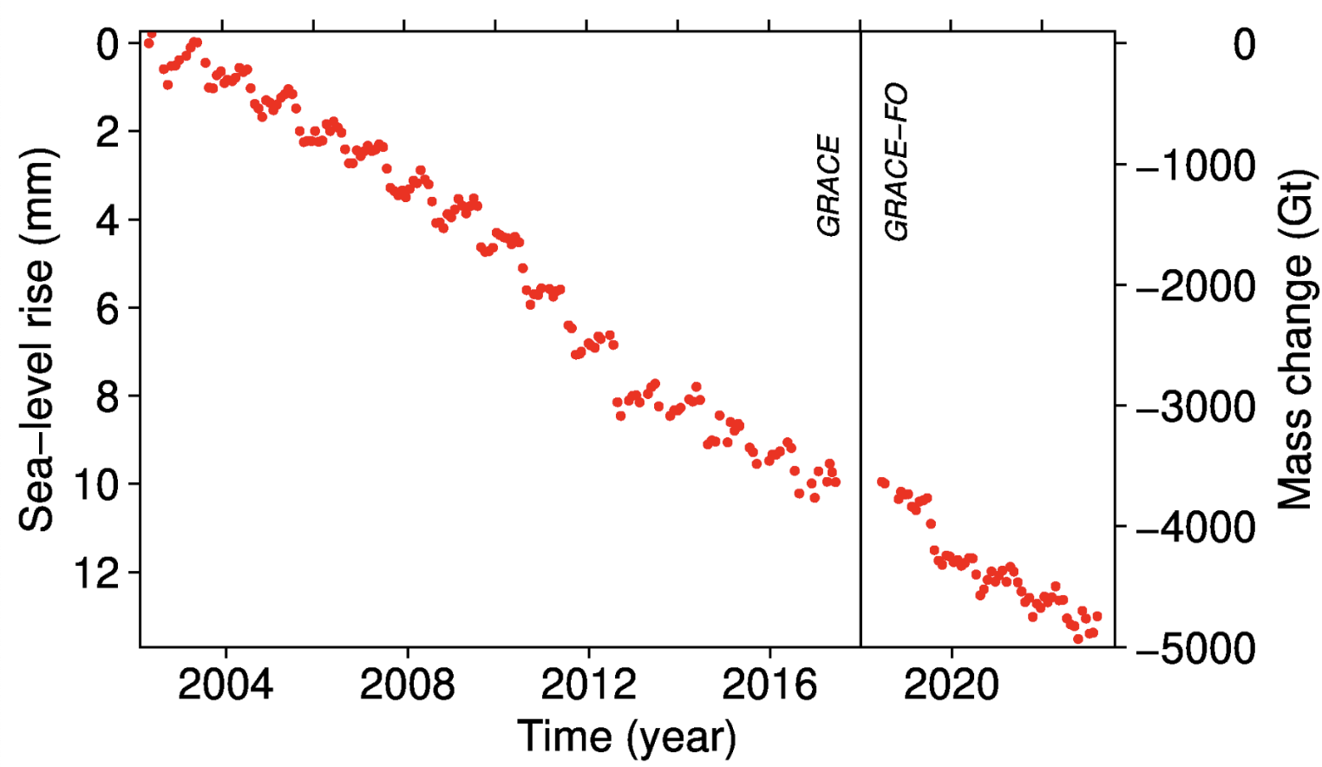
Note interannual variability is not just high-precipitation years!
GRACE
Greenland
Ice Mass
Change
(Jacob et al. time frame)
(Papers after
2012 melt
season)
From polarportal.dk
Still ~235 km³ yr ⁻¹ for this period, only slightly more than Jacob et al…

Slide 3
Both terrestrial and satellite measurements require
corrections:
Recall:
Terrestrial measurement means setting a gravimeter down on
the Earth’s surface; satellites are at various altitudes… So
the measurements include effects from differing distances to
Earth’s center of mass, mass attraction of (known) topography,
and mass attractions of (unknown) interior density… Generally
we are only interested in the last so correct for the other stuff.

Slide 4
Corrections include:
• Tidal attractions from
nearby sun/moon/planets
(dominated by distance to moon, sun, Jupiter)
• Associated solid Earth tidal deformation
• Mass of atmosphere above (related to atmospheric
pressure)
For these corrections, record time of measurement and
atmospheric pressure.

Slide 5
Corrections include:
• Earth’s ellipticity and spin
Distance r from Earth’s
center of mass is a function
of latitude, so we subtract
gravity at a specified
ellipsoidal height from
total.
Earth’s rotation induces
an outward (centrifugal)
acceleration as a function of
radial distance from axis of
rotation (i.e., latitude), so we
correct for this also.
6356 km
6378 km
Latitude correction:
(1 μGal accuracy ⇒
1.25 m latitude accuracy!)

Slide 6
Corrections include:
• Altitude (“free air correction”)
Following topography also results in differences in radial
distance to the center of mass. Correction for that change
in distance due to topography is called “free air”
(On a sphere… A bit
more complicated on
the ellipsoid)
Plugging in numbers for equator ⇒ –0.3086 mGal/m
(1 μGal accuracy ⇒ 3 mm height accuracy!)

Slide 7
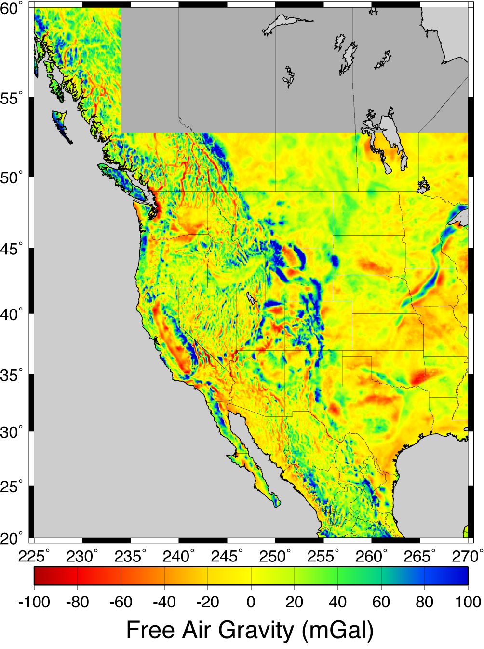
After observed gravity
measurement is corrected
for free air and other
effects talked about so far,
we call it the
free air anomaly
At right, millions of
terrestrial free air relative
measurements have been
referenced to a small
network of absolute
gravity stations and
adjusted to a common
reference.

Slide 8
Corrections include:
• Topographic mass (“Bouguer correction”)
z
Simple Bouguer: Approximate topography as a slab with
thickness h
For standard ρ = 2.67 g/cc, simple Bouguer correction is
0.11195 mGal/m.
Complete Bouguer: Further correct for upward attraction
of mass above; “negative attraction” of missing mass
below that was assumed in slab correction…

Slide 9
Note what this implies though! “Free-air” terrestrial gravity
has both positive & negative contributions from topography…
Terrain correction (mGal)
East
West
Distance from Mouth of Green Canyon (m)
Whereas free-air from satellites sees topographic mass
only below the level of the satellite…

Slide 10
This also has implications for the altimeter-height derived geoid…

Slide 11
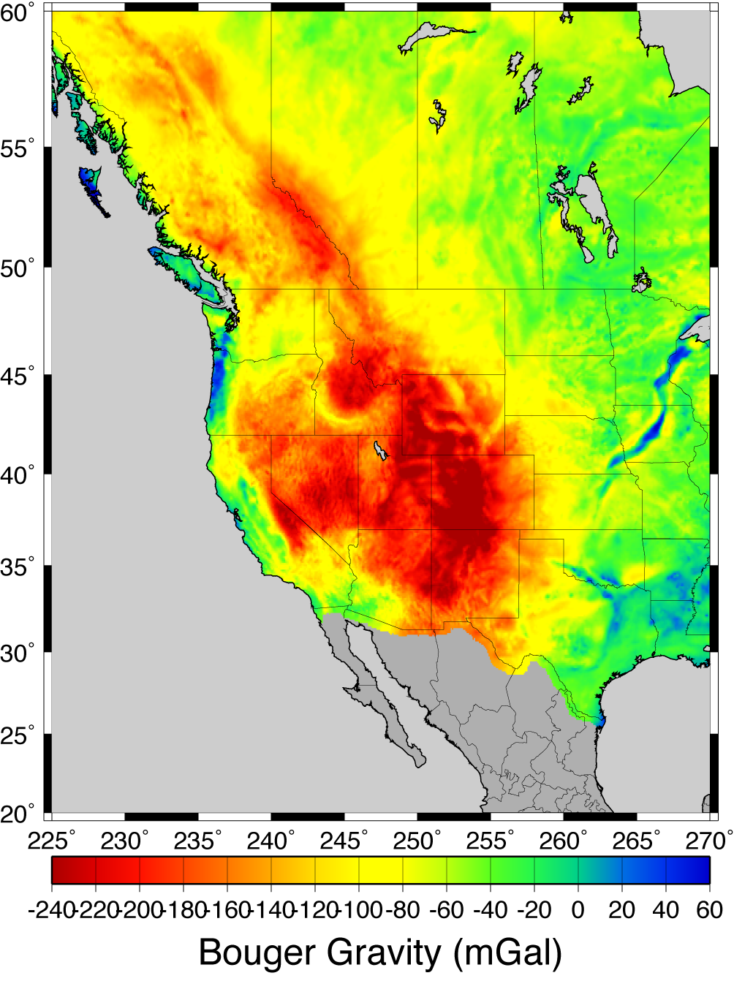

Slide 12
Some applications take a
further step and calculate
a correction for mass that
isostatically compensates
topography…
Implicitly assumes that all
loading is topographic mass
“piled on” at the surface,
and also assumes a
lithospheric plate strength
(usually local isostasy ⇒
no strength)
Explicitly wrong– there are
better ways to address this.

Slide 13
This brings us to the
Crustal Deformation
part of the course!

