Slide 1
Glacial isostatic uplift of the European Alps
Mey, M.G., et al.

Slide 2
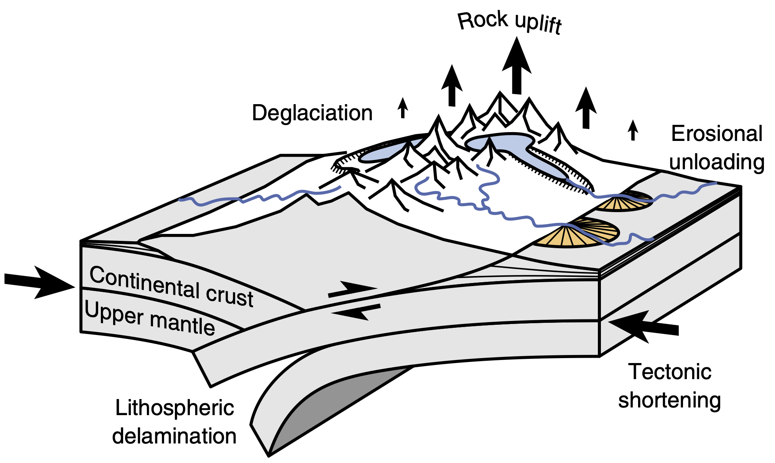
Figure 1
Processes contributing to rock uplift in a contractional orogen.
The individual components are interdependent and their relative contribution to rock uplift changes over time. Blue and orange polygons indicate glaciers and alluvial fans, respectively.

Slide 3
Figure 2
Seismotectonic setting.
Seismicity (grey dots, NEIC, 1973-2008), focal plane solutions and seismogenic faults (black solid lines) superimposed over a DEM of the study area. Red arrows depict the horizontal velocity field of permanent GPS stations in a Europe-fixed reference frame. Error ellipses show 1-sigma (67%) confidence level. Stars indicate locations of the reference points for the Swiss and Austrian precise levelling data, respectively. 'I' and 'Z' are the locations of the permanent GPS stations used to adjust the levelling data to the global reference frame IGb08. Fr., Friuli; Lo., Lombardy; TW, Tauern Window.

Slide 4
Figure 3
Valley-fill thickness and postglacial erosion rates
(a) Present-day ice cover (white), LGM ice extent (black outline), distribution of sedimentary valley fills and locations of fill-thickness measurements (see legend). (b) Map of postglacial erosion rates derived from the sediment distribution in a and an additional 10% of exported material (see text for details). Data from catchments 1 to 6 (highlighted with red boundaries) are provided in d. The eroded mass in catchments 7 and 8 was manually increased to smooth abrupt changes in erosion rates across the corresponding basin boundaries.
(c) Comparison of estimated and measured valley-fill thicknesses (see key in panel a for symbol details). See Supplementary Table 1 for data sources. (d) Comparison of the derived erosion rates with data from modern river loads, cosmogenic nuclides and thermochronology. On each box, the central red mark is the median, the edges of the box are the 25th and 75th percentiles and the whiskers extend to the minimum and maximum values. Rivers and corresponding marginal lakes are indicated. L., Lake.

Slide 5
Figure 4
Alpine LGM ice cap
(a) Steady-state ice geometry and location of trimline measurements (orange circles). (b) Comparison of trimline elevations with modelled ice-surface elevations. Model resolution is 3 km.

Slide 6
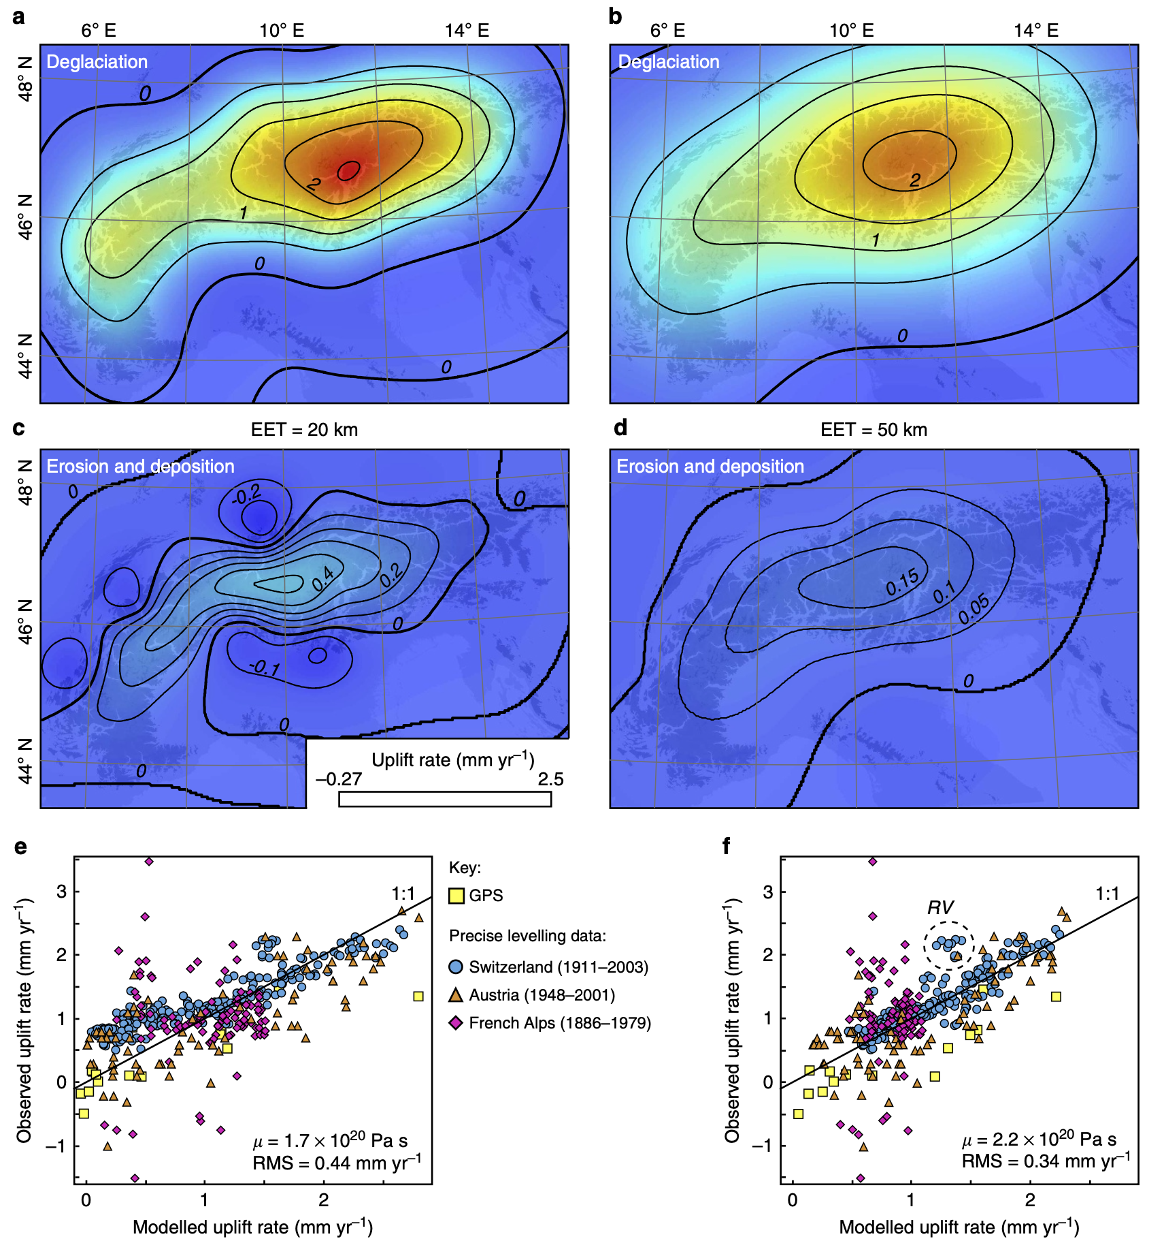
Figure 5
Uplift rates caused by deglaciation and postglacial erosion and deposition
(a) Deglaciation component, (c) erosion and deposition component and (e) comparison of the combined signal with geodetic measurements computed for an average EET of 20 km. (b,d,f), same as (a,c,e) but for an average EET of 50 km. Location of highlighted data cluster in f is shown in Fig. 6. French data were not used in the optimization (see text for details). RV, Rhône Valley.

Slide 7
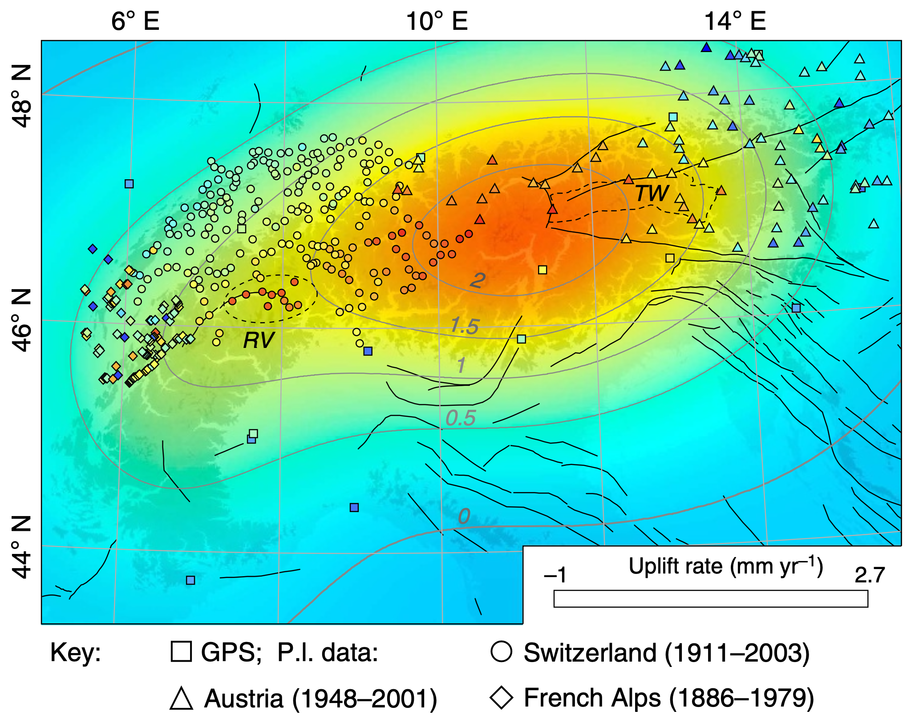
Figure 6
Observed and modelled uplift rates
Modelled uplift rate for an average EET of 50 km with the adjusted geodetic measurements superimposed. Black solid lines indicate seismogenic faults. Dashed ellipse indicates cluster of excess uplift in the Rhône Valley (RV). TW, Tauern Window (dashed outline).

Slide 8
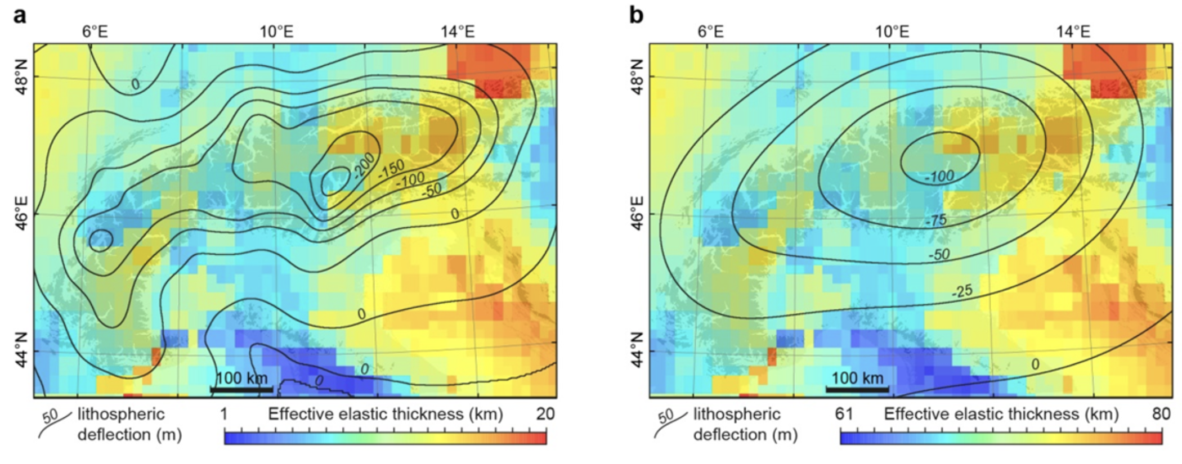
Supplementary Figure 1
Deflection of a heterogeneous Alpine lithosphere.
Subsidence due to the load of the LGM icecap for (a), a low rigidity1 (avg. EET for the Alps is 10 km) and (b), a high rigidity lithosphere (avg. EET = 70 km). avg. = average.

Slide 9
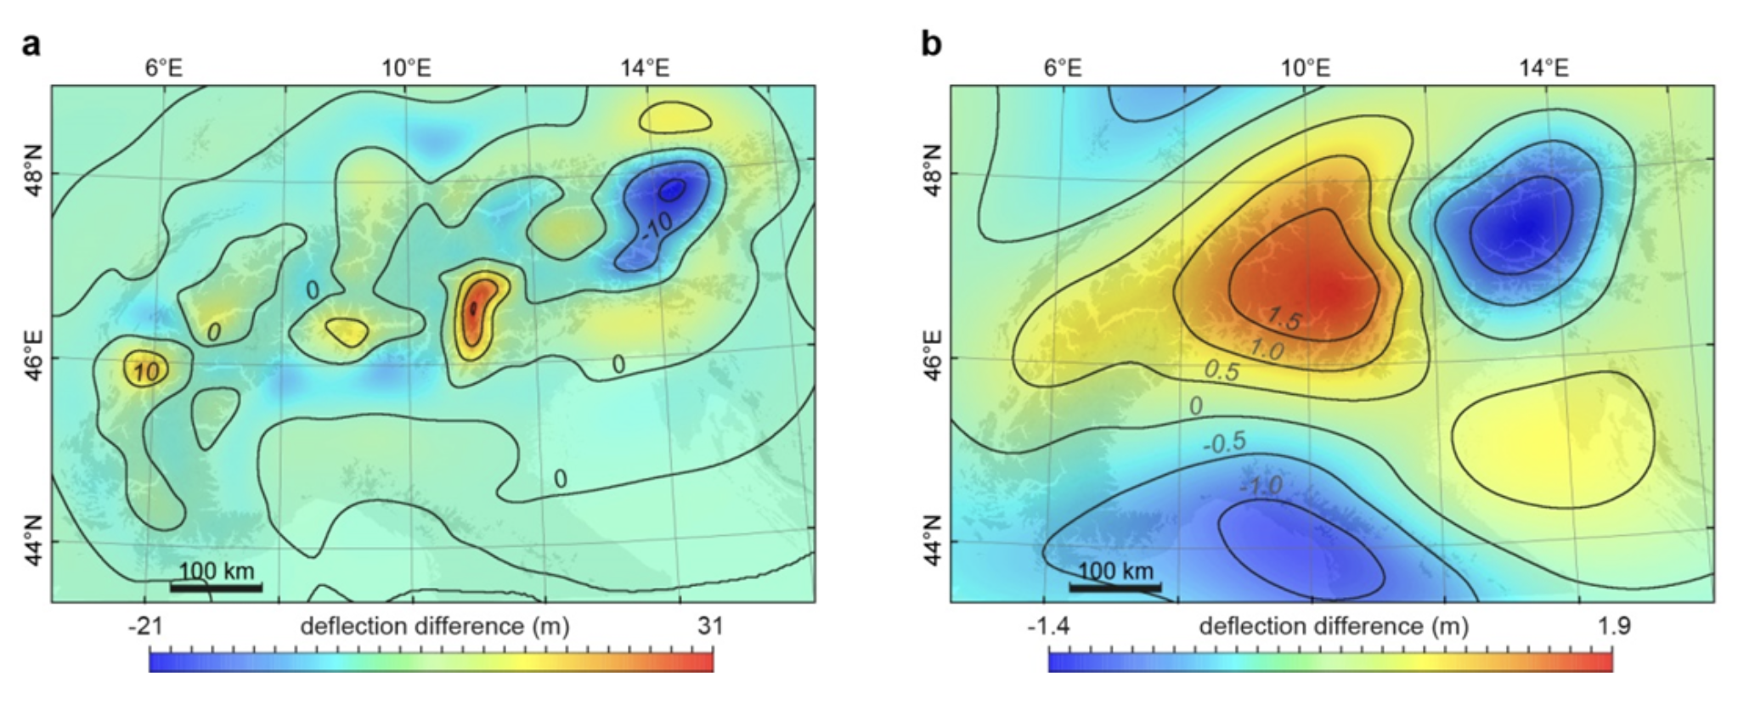
Supplementary Figure 2
Effect of spatial variations in EET
Difference in lithospheric deflection, relative to a lithosphere with a uniform EET of a, 10 km and b, 70 km.

Slide 10
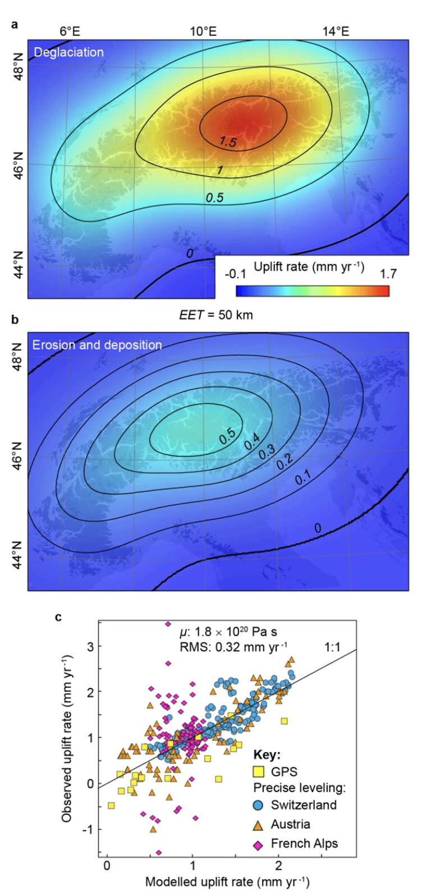
Supplementary Figure 3
Results for increased erosional unloading
a, Deglaciation component. b, Uplift rate due to erosional unloading assuming that 90% of the postglacially eroded material has been exported. c, Comparison of the combined signal with the geodetic observations. Note that the French leveling data was not used in the optimization (see main text for details).

Slide 11
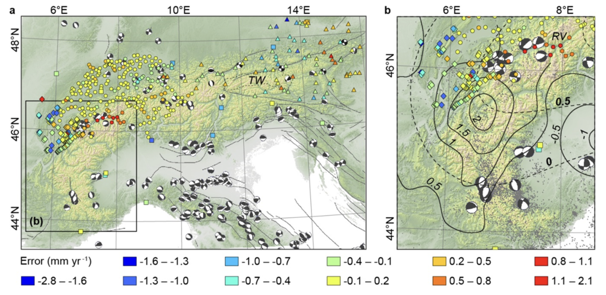
Supplementary Figure 4
Model error in a seismotectonic context
a, Seismogenic faults (black solid lines, http://diss.rm.ingv.it/share-edsf/), and focal plane solutions from the global Centroid-Moment-Tensor catalogue superimposed on a DEM of the study area. Negative errors indicate overestimation. b, Inset focusing on the Western Alps. Grey dots: seismicity after NEIC, 1973-2008. Thin solid lines are uplift contours modified after (ref. 7) and given in mm yr⁻¹. Dashed lines show the uplift contours derived in this study (see Fig. 6). RV = Rhône Valley, TW = Tauern Window.

Slide 12
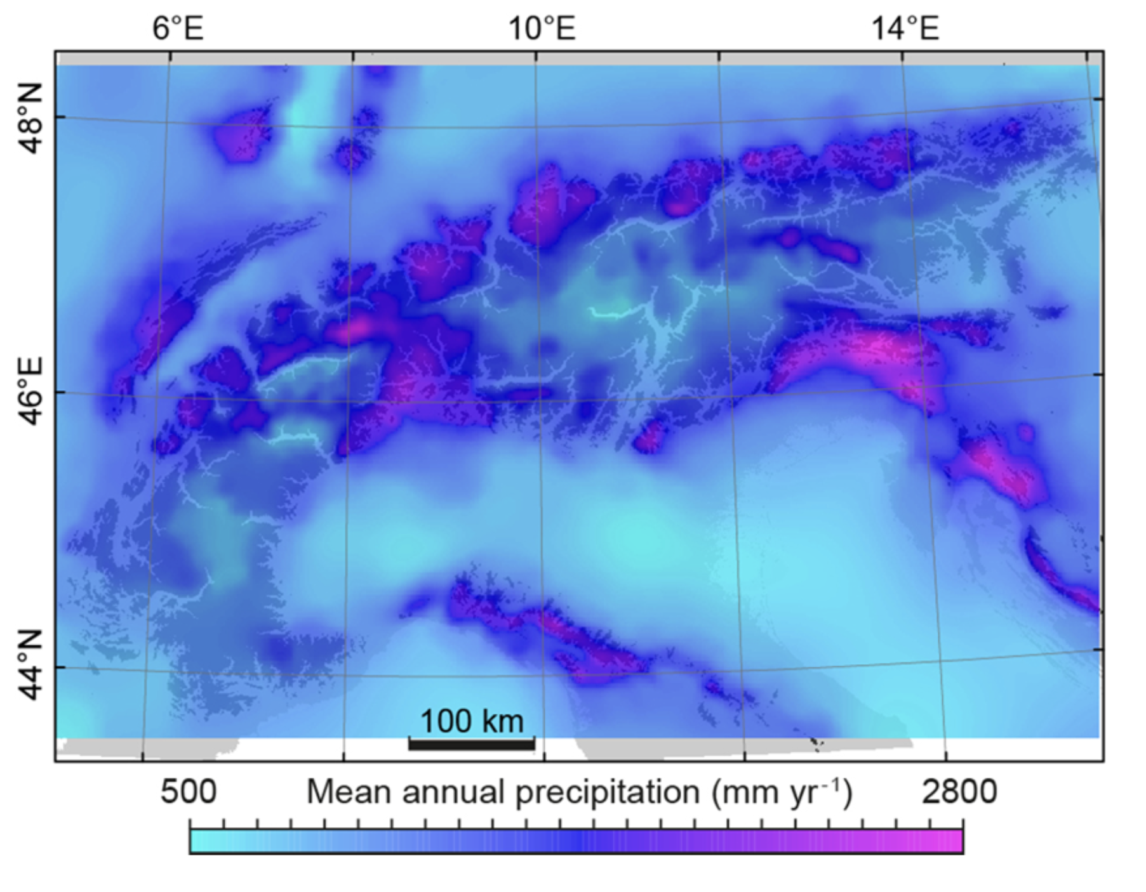
Supplementary Figure 5
Map of mean annual precipitation.
Mean annual precipitation was determined from rain-gauge measurements from 1971–2008, which were used to impose spatially variable maximum accumulation rates in the ice model.

Slide 13
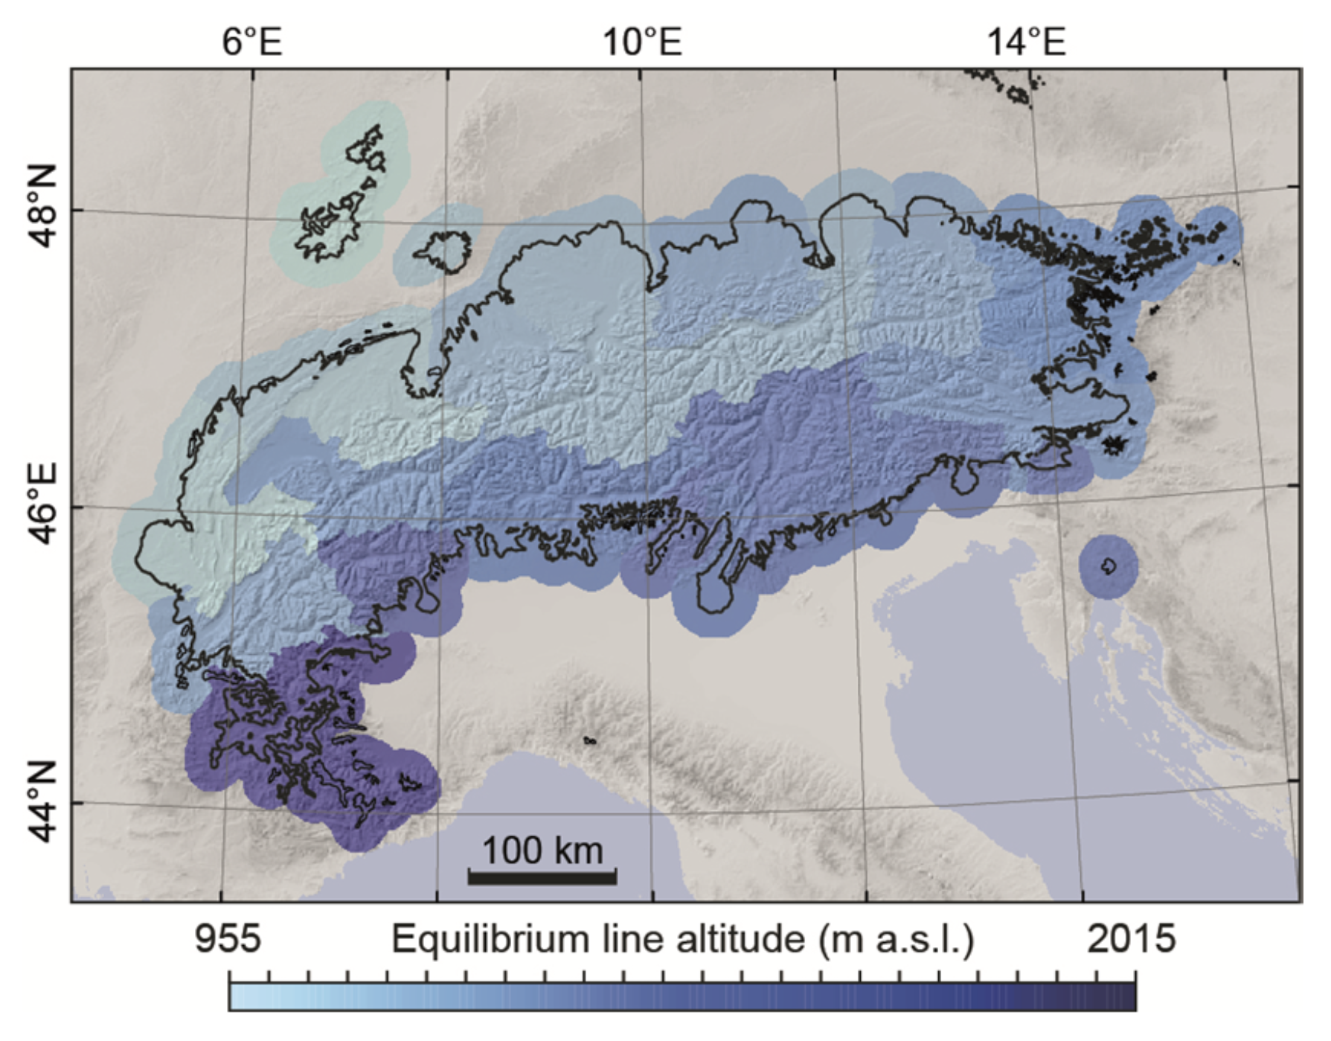
Supplementary Figure 6
Map of equilibrium line altitudes
Distribution of equilibrium line altitudes for the ice model, which best fits LGM ice-geometry indicators, i.e., moraines and trimlines.

Slide 14
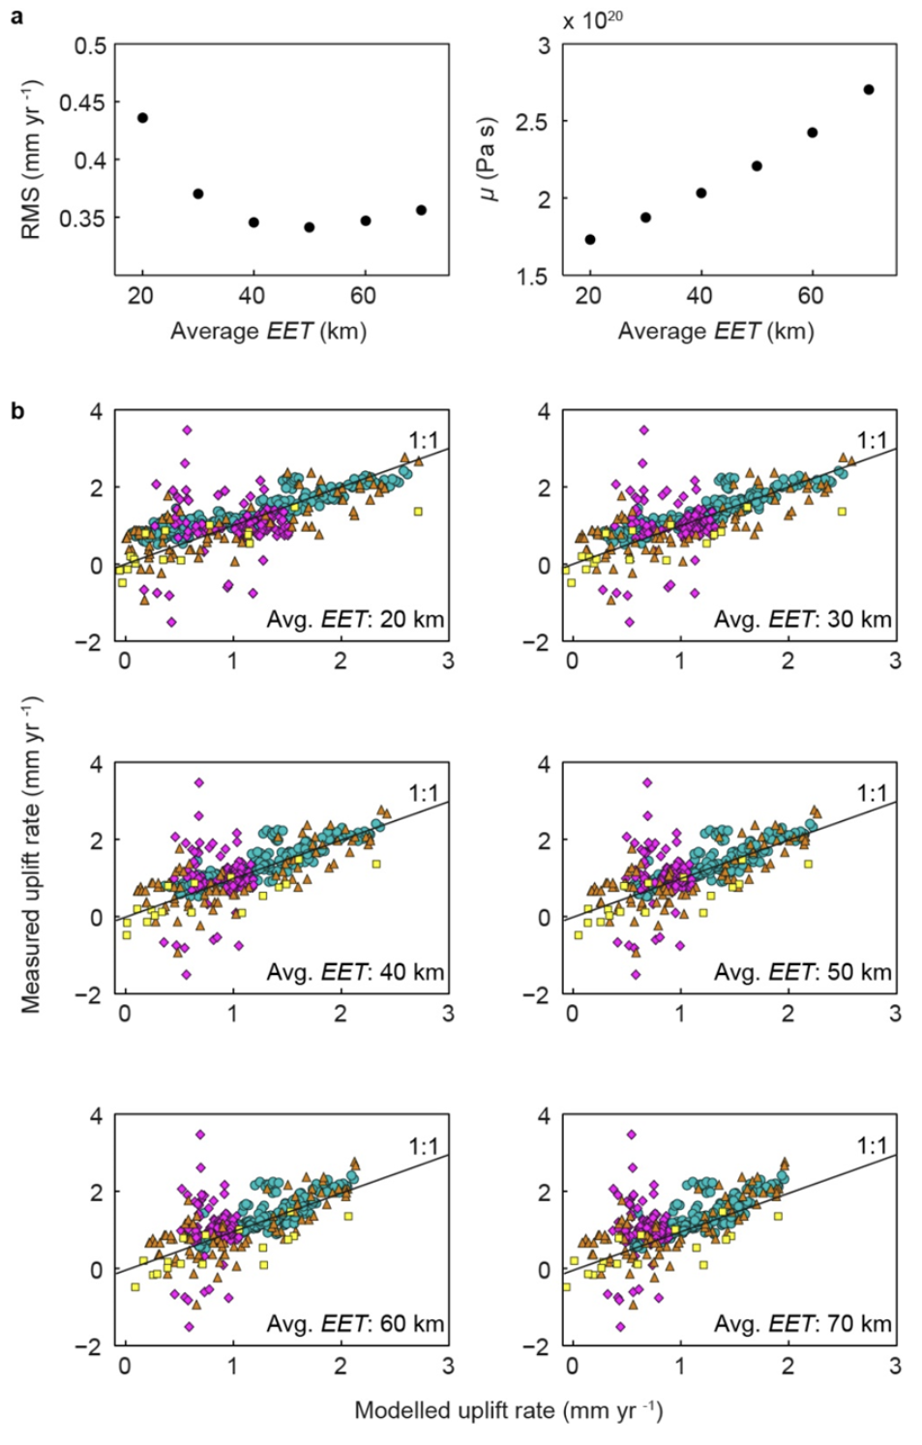
Supplementary Figure 7
Sensitivity of viscosity and modelled uplift rates to changes in EET
a, Root mean squared error (RMS) and viscosity (μ) as a function of the average EET. A minimum error occurs at 50 km with μ = 2.2 × 10²⁰ Pa s. b, Modelled versus measured uplift rates for 20, 30, 40, 50, 60, and 70 km of EET. Blue circles = Swiss levelling data. Orange triangles = Austrian levelling data. Magenta diamonds = French Alps levelling data. Yellow rectangles = permanent GPS data. Avg. = average

Slide 15
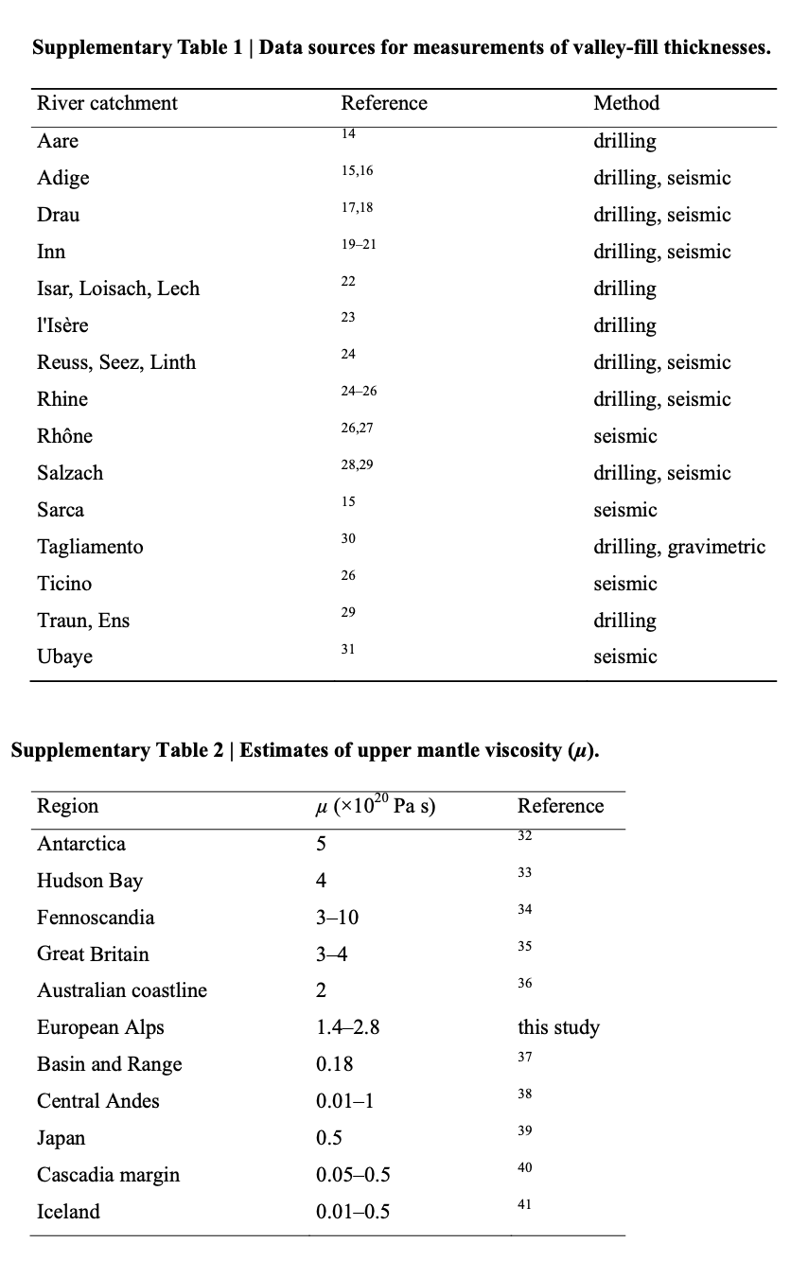
Supplementary Tables 1 & 2

