Slide 1
Geology 6690/7690
Geodesy & Crustal Deformation
4 Oct 2023
Last Time:
A bit more discussion of Herring et al. (2016) Rev. Geophys.
on analysis of PBO products…
• The North America reference frame is defined by
minimizing velocities in “stable” North America; find large
(sometimes surprising) velocities in deforming zones…
• Global reference frame is time dependent and changes
with global CGPS site sampling, new satellites, …
• Early GPS reference frames were updated annually; now ~2x
per decade… Still find small adjustments to plate motion rates
• Monument stability is slightly greater for drilled-braced
monuments (but perhaps not enough to justify price-tag
of deep-drilled-braced monuments)
• Site selection is important for both multipath reduction and
to mitigate effects of soil deformation
© A.R. Lowry 2023

Slide 2
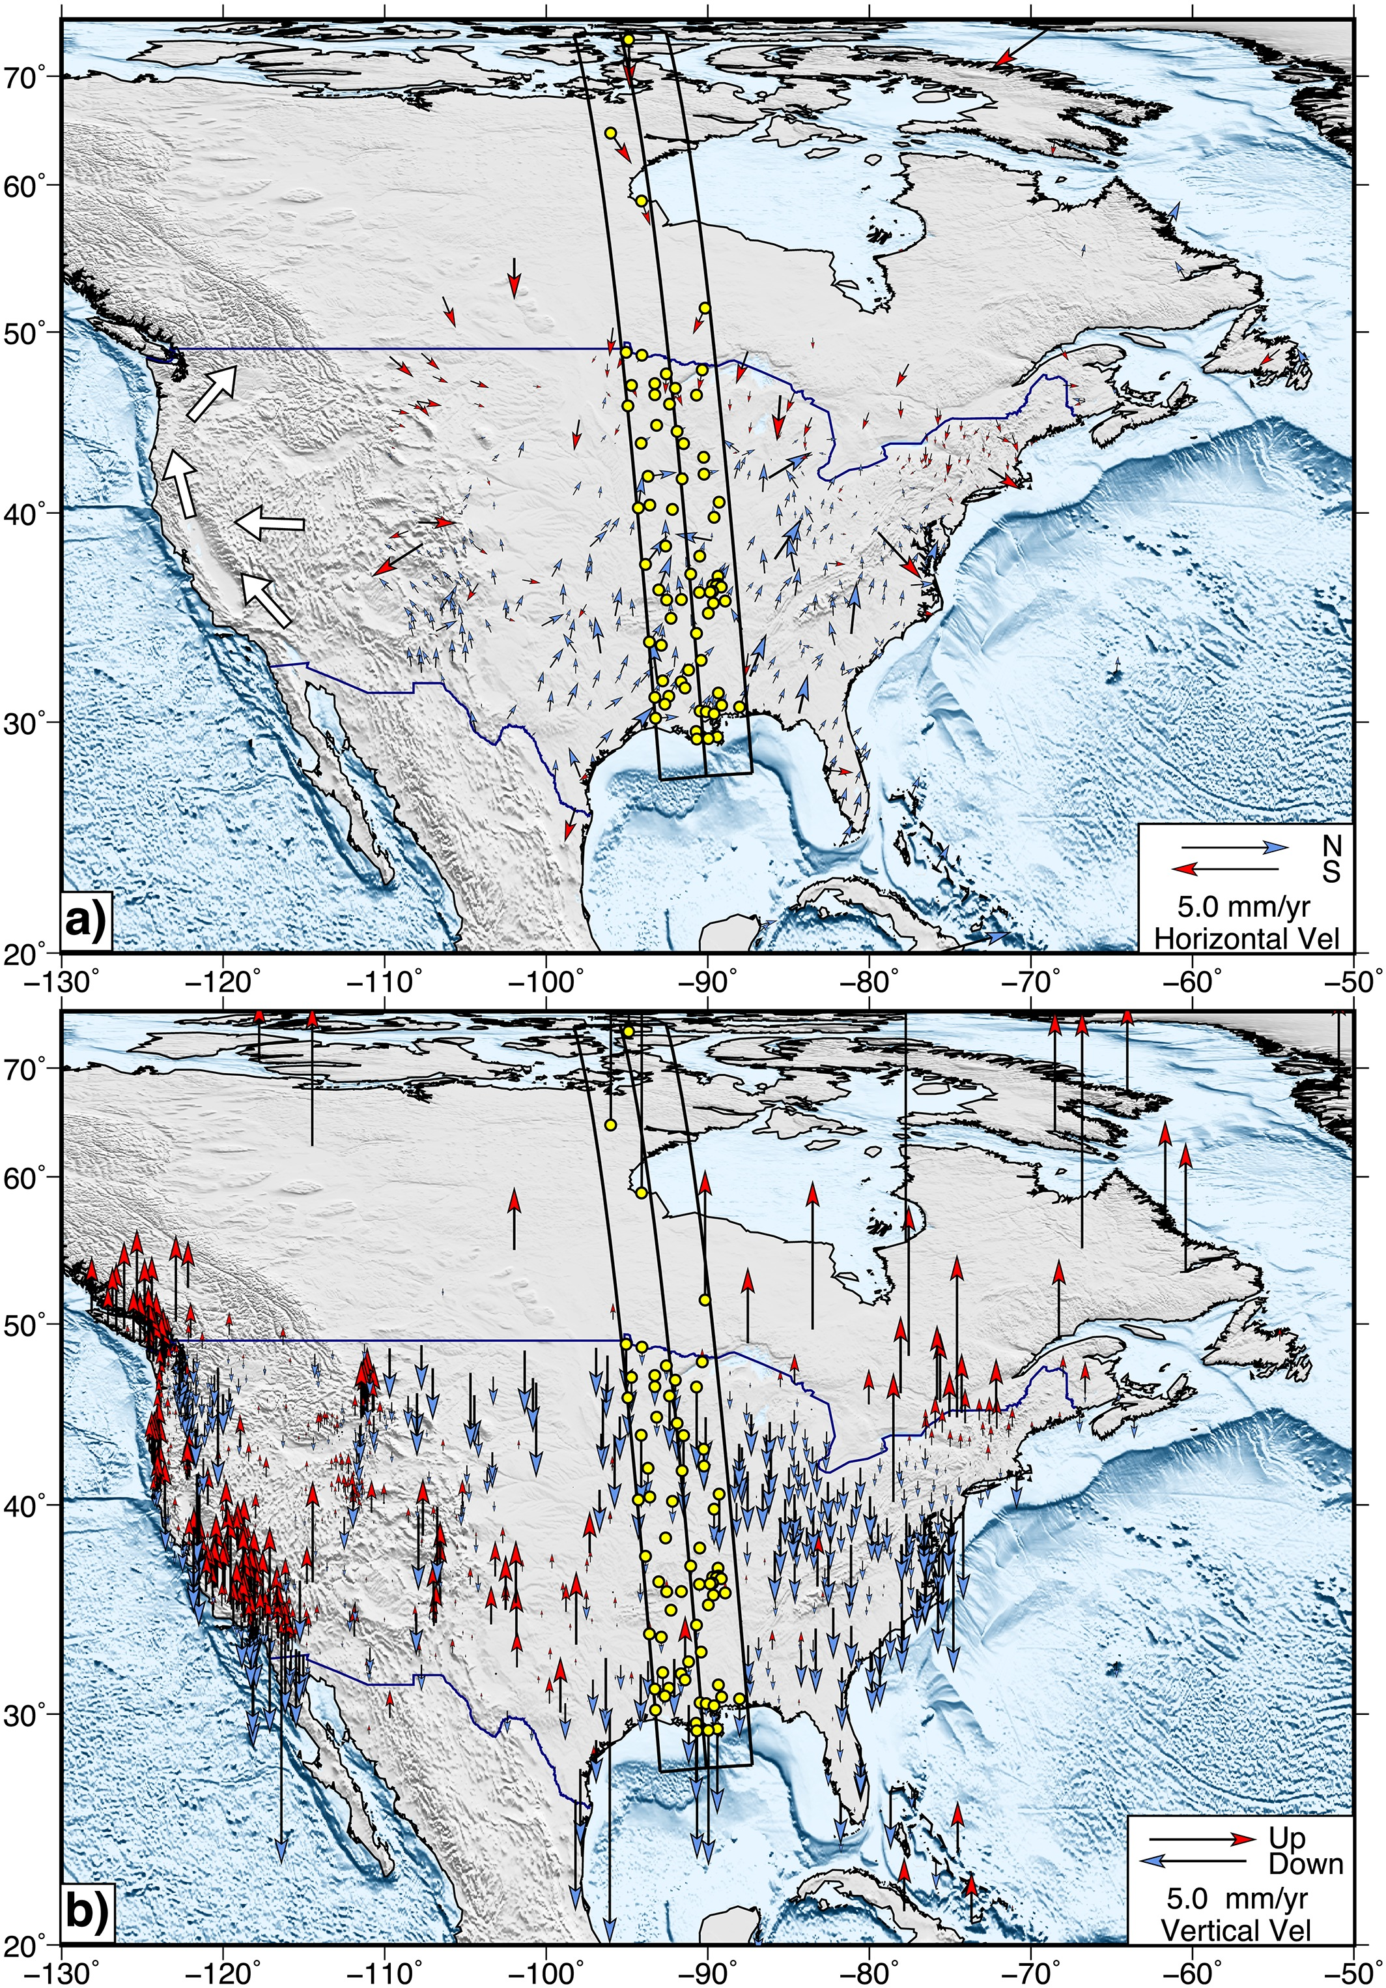
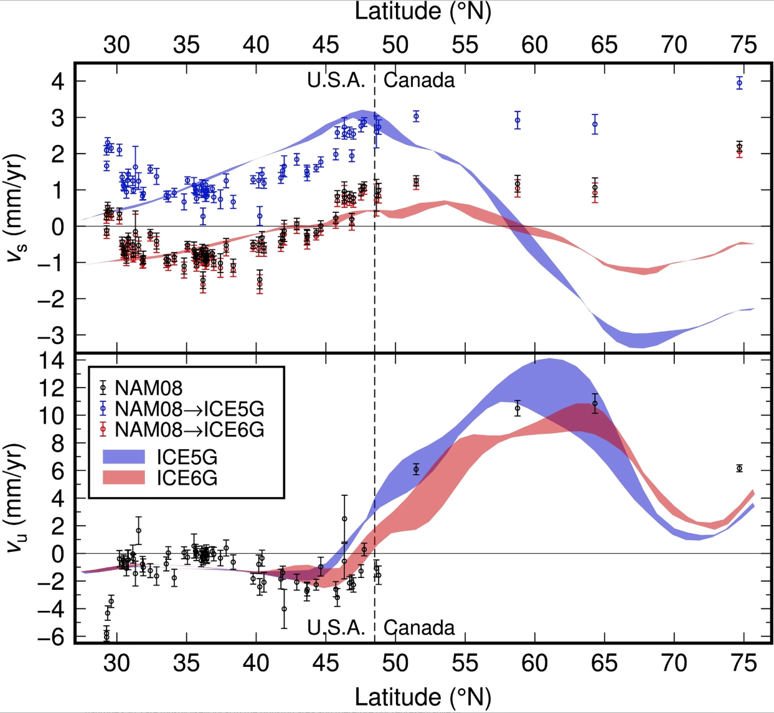
Post-glacial rebound appears to
dominate most of cratonic North
America…

Slide 3
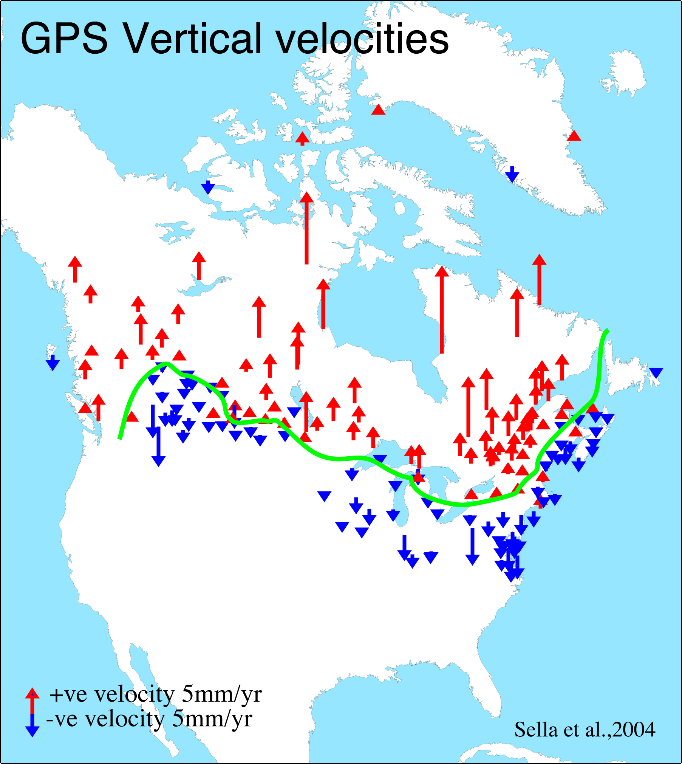
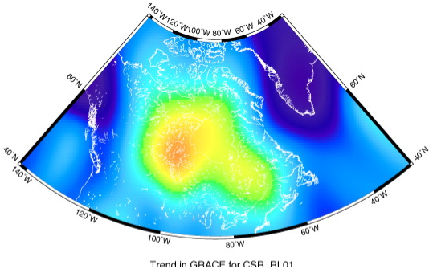
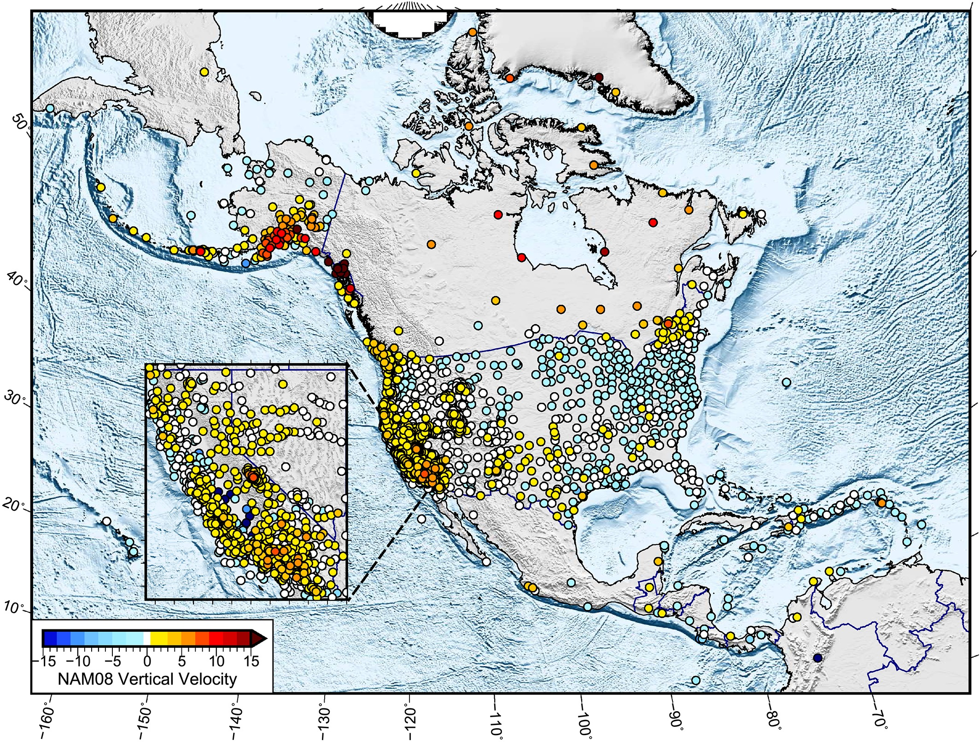
GRACE geoid rate (Detlef &
Ivins, J. Geodynamics, 2008)
Sella et al. (GRL, 2004) used both campaign and continuous GPS data; get better spatial sampling than continuous….
Herring et al.
(RG 2016)
GPS vertical velocities show
some general correspondence
to GRACE measurements…
Difficult to see given differences
in map projections here and
point vs continuous sampling,
but these are comparable!

Slide 4
Arguably though
it’s just as/more
interesting to
consider the
patterns evident
in regions where
it’s not dominated
by Laurentide ice
sheet post-glacial
rebound!

Slide 5
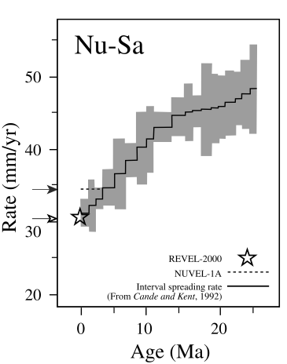
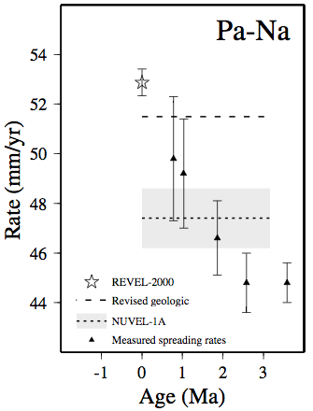
Given current data accuracy, it is possible to assess how
plate motions have changed over time in some locations!
Pacific-North America
Nubia-South America
Sella et al. (2002)

Slide 6
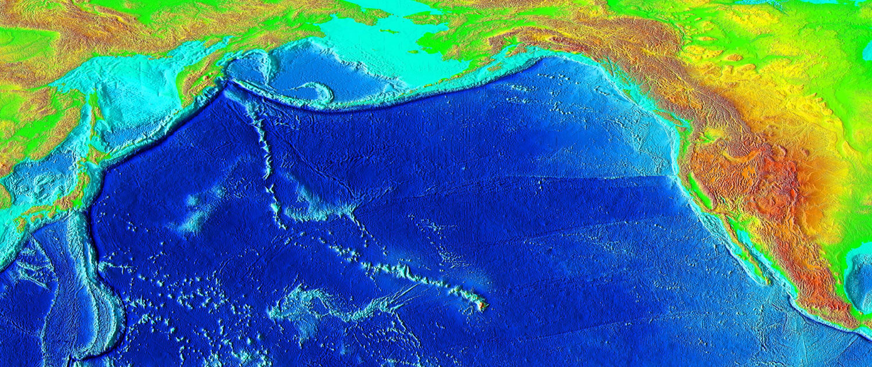
Changes in absolute plate motion can be inferred from
seamount chains (on much longer timescales)

Slide 7
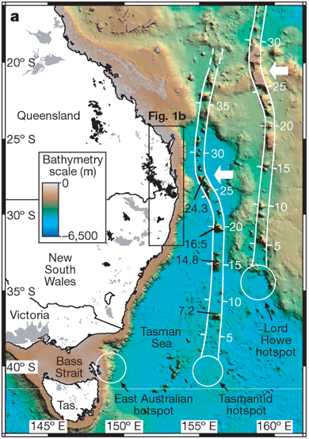
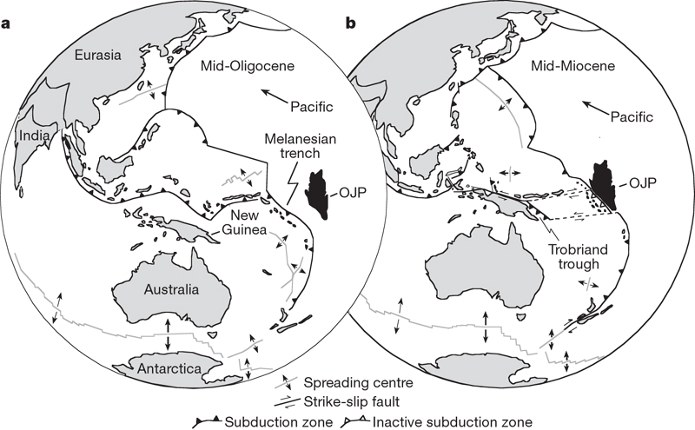
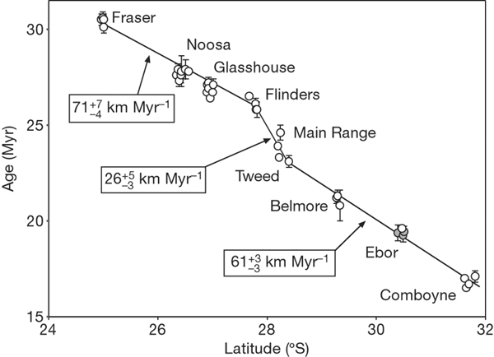
~30 Ma
~15 Ma
Geological evidence for such past
changes suggests collisions…
Knesel et al., Nature, 2008

Slide 8
*Introduction to InSAR: Borrowed from Agram’s presentation

Slide 10
