Slide 1
Geology 6690/7690
Geodesy & Crustal Deformation
6 Dec 2023
Last time: Fault Slip (Slow & Postseismic Slip)
• Slow fault slip events are consistent with rate-state friction
dynamics and generally occur near the frictional stability transition
• SSEs can occur at both the deep (~350°C) & shallow (~125°C)
frictional stability transitions, with important hazard implications for
possible rupture in future earthquakes
• SSE recurrence is quasi-periodic, and the periods + patch sizes
provide insight into effective normal stress & other parameters
• Postseismic slip usually is focused in the stable frictional regime
downdip of an earthquake rupture. Viscoelastic relaxation
following a large-magnitude earthquake can both accelerate deep
postseismic slip and mask its effects (because the sense of vertical
is opposite for the two), and both quickly reload shallow earthquake
strain potential energy
© A.R. Lowry 2023

Slide 2
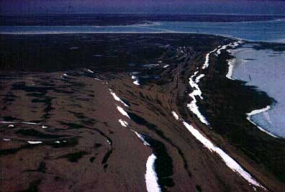
Isostasy in a viscoelastic fluid
(“Rebound”)
Given some initial sinusoidal deflection of the Earth’s
surface:
where k is wavenumber = 2π/λ
what is the evolution of w through time?
Elevated beaches or
“strandlines” in Hudson’s
Bay region of Canada…

Slide 3
We impose:
(1) Conservation of fluid: (2D)
v
x + δx
x
z
Where:
u and v are flow
in x, z
directions...
Note this implies
the fluid is
incompressible
u
z + δz

Slide 4
We impose:
(2) Elemental force balance:
includes pressure forces,
viscous forces, and
body force (= gravity).
For pressure forces, the
imbalance is given
by the pressure
gradients: (2D)
p(z)δx
x + δx
x
z
p(x+dx)δz
p(x)δz
z + δz
p(z+δz)δx

Slide 5
We impose:
(2) Cont’d: viscous forces:
The net viscous forces are
given by
(to first
order).
For a
Newtonian
fluid with
viscosity η,
τ_{zz}(z)δx
τ_{zx}(z)δx
x + δx
x
z
τ_{xz}(x)δz
τ_{xx}(x+δx)δz
τ_{xx}(x)δz
τ_{xz}(x+δx)δz
z + δz
τ_{zx}(z+δz)δx
τ_{zz}(z+δz)δx

Slide 6
The body force is simply ρδxδz in the z direction. Typically
we simplify pressure by subtracting a hydrostatic:
P = p – ρgz
Then (after some algebra; see T&S) we have the force
balance equations:

Slide 7
We can define a stream function ψ (= potential of the
flow field) such that (for an incompressible fluid):
is flow velocity in the x-direction;
is flow velocity in the z-direction (vertical).
Solutions ψ must satisfy:
Substituting for u and v, we find the biharmonic equation has
(eigenfunction) solutions of the form:
and

Slide 8
Solving (with boundary conditions) we find that:
where the decay constant
Note: This solution is specific to the case of a viscoelastic half-
space! To zero-^{th} order, would be better approximated by an
elastic layer over a viscoelastic halfspace, in which case one
would “filter” the viscoelastic response (multiply in the
spectral domain) by the amplitude response for the elastic
layer.

Slide 9
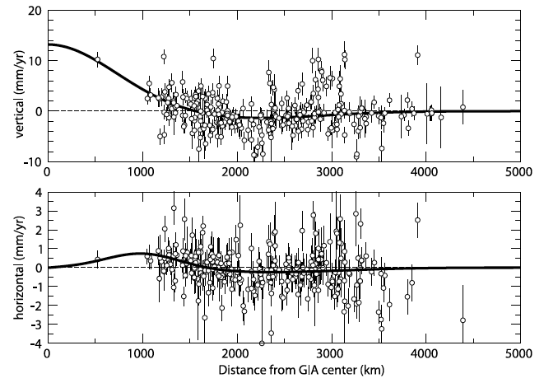
Calais et al. examined GPS velocities in the “stable” NoAm plate
interior with main result: Patterns are broadly consistent with GIA.
Calais et al., J. Geophys. Res. 111 2006

Slide 10
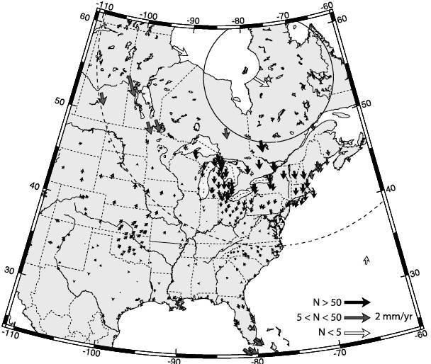
Looking closer
though there
are some
interesting
patterns

Slide 11
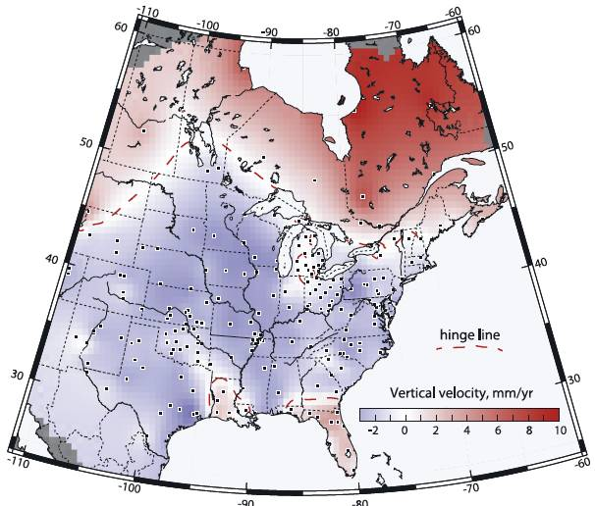

Slide 12
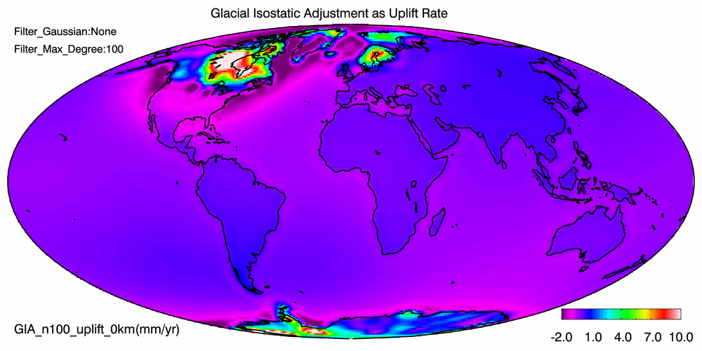
This from Wahr & Zhong on the GRACE website…
The Gulf Coast has slightly less subsidence than nearby
regions (offset by ocean mass GIA?) but not that much…

Slide 13
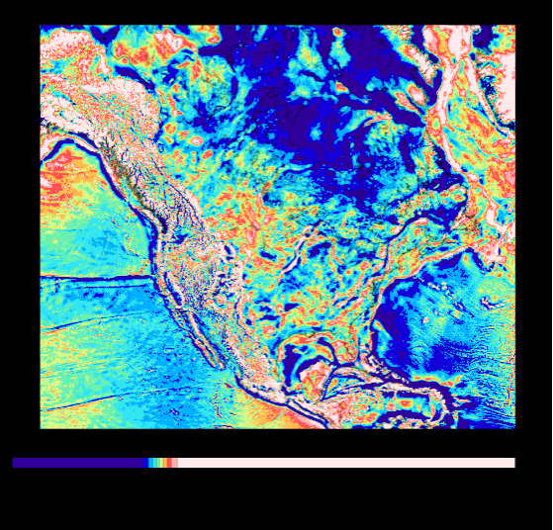
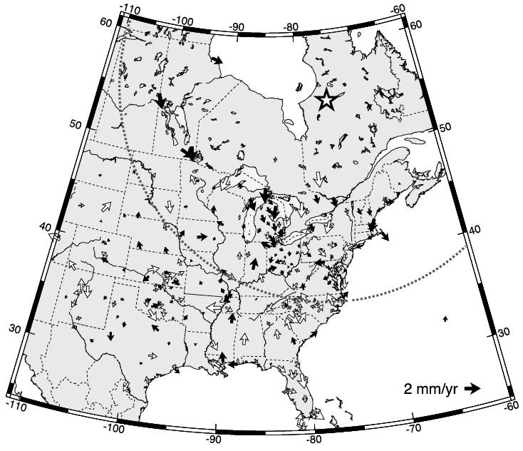
On the likely depocenter of Pleistocene ice: Some past
studies identify it with a free-air gravity anomaly throughout
eastern Canada…
For practical purposes, probably further west than where they
put it.

Slide 14
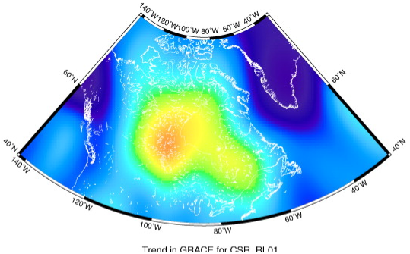
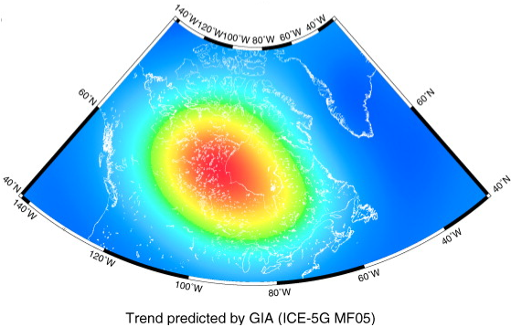
Secular (i.e., linear)
change in the GRACE
geoid is less
ambiguous about
where uplift is
occurring than earlier
data such as shorelines,
tide gauges and lake
levels…
(Detlef & Ivins, J.
Geodynamics, 2008)

Slide 15
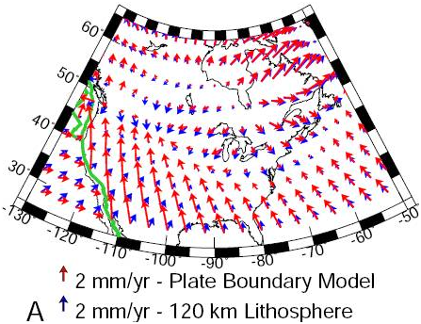
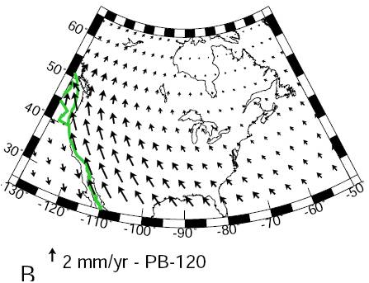
Recall also that the strain response depends on assumptions
about rheology of the lithosphere!
Expect to see significant focusing of strain in zones of
rheological weakness, even if those zones are far from
the edges of the ice sheet. Note plate-like behavior and
strain focusing along San Andreas for this model…

Slide 16
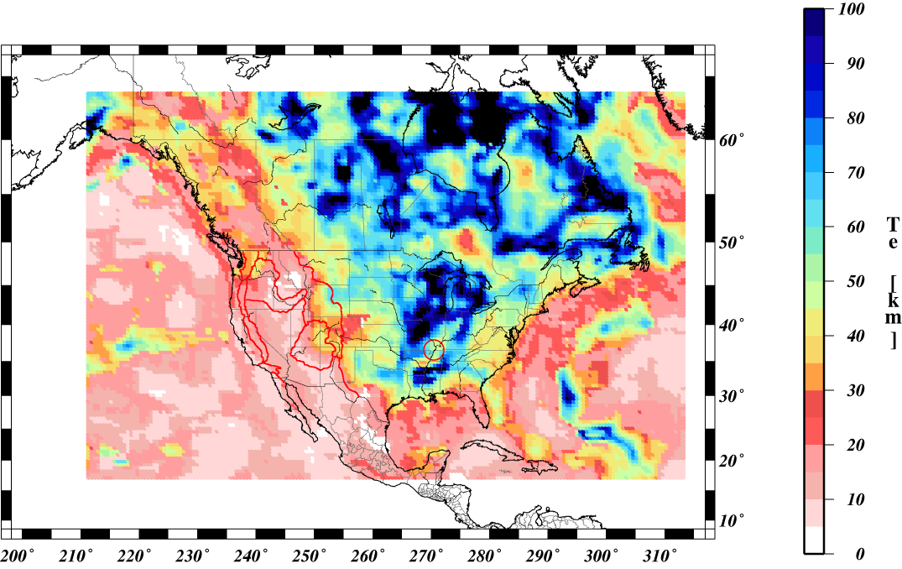
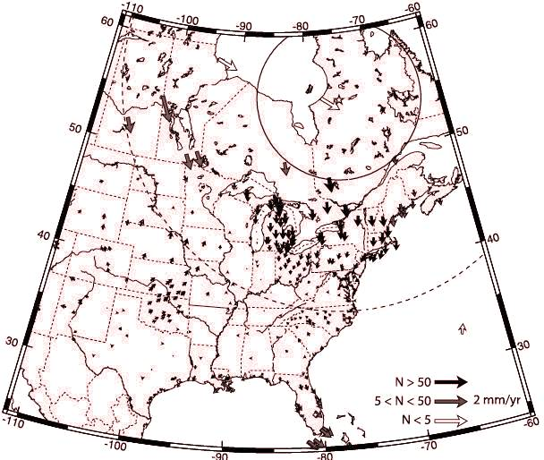
Rheological variations of course are much more complicated…
T_{e} proxy for lithospheric strength from Marta’s mapping

Slide 17
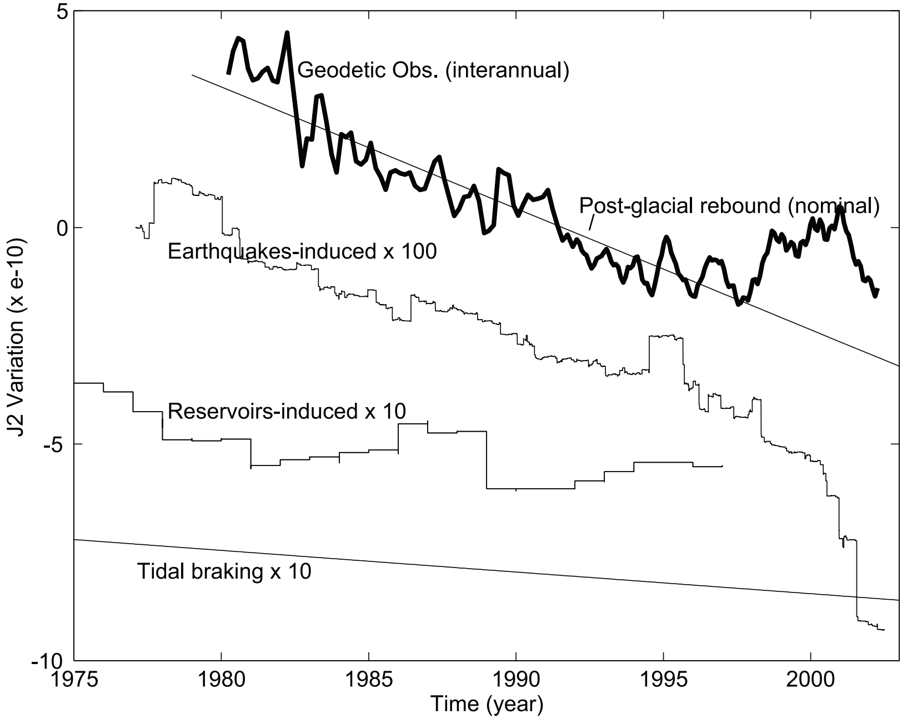
However it is clear that GIA deformation biases earthquake
deformation. Here, we see the Earth’s change in oblateness
(“flatness” of the
ellipsoid) is
dominated by GIA
flow, and large
earthquakes that
decrease
oblateness are
much more likely
than large
earthquakes that
don’t! GIA has been
postulated to have
accelerated, or be
entirely responsible for, seismicity in the Wasatch front, the
Wabash-Reelfoot midcontinent, St Lawrence seaway and
elsewhere near Laurentide glaciation depocenters!
Chao, Eos 2003

