Slide 1
Geology 6690/7690
Geodesy & Crustal Deformation
6 Sep 2023
Geodesy is the measurement and representation of the
shape of the Earth and its gravity field
Motivation: Most active processes that are of interest to
Earth scientists change the shape of the planetary
surface and change the gravity field.
Applications of geodesy include tectonics & the
earthquake cycle, hazard analyses/modeling (landslide &
mass wasting, volcano studies & monitoring), climate
studies (sea level, water & ice mass), and water monitoring
Read for Fri 8 Sep: Wahr §1 (1-3); §2.5 24-75
© A.R. Lowry 2023

Slide 2
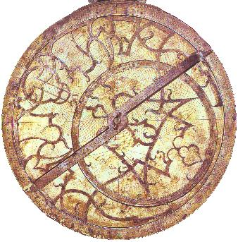
Surface (“Terrestrial”) Geodesy
Wahr’s notes identify four types of positioning from:
• Measurements of horizontal angles between points
• Measurements of elevation differences between points
• Measurements of distances between points
• Measurements referenced to stars or other extraterrestrial
bodies.
Earliest navigation used the latter;
we’ve since come
back full circle!
(Astrolabe inclination
i to stars, plus an
accurate clock, gives
position!)
i

Slide 3
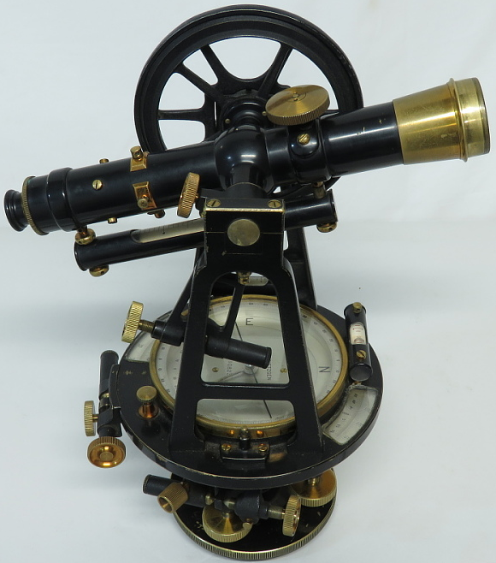
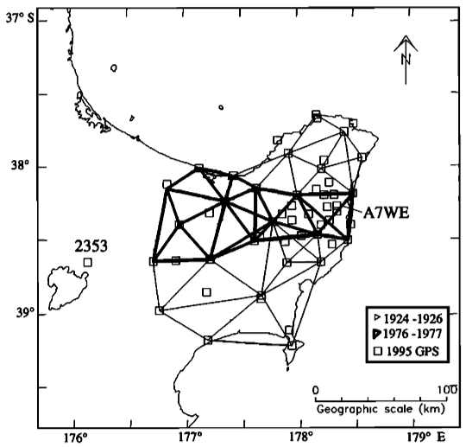
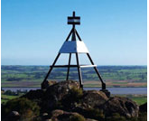
Triangulation was a common surveying approach
until ~1990s…
Used a transit (telescope on a swivel, with very accurate
measure of angular change, plus level)
Can use to “triangulate” location, but accurate distance
required “chaining” or another measurement of distance
along at least one leg of a triangle within a network.
Courtesy Smithsonian Institution
National Museum of American History
Raukumara
peninsula (NZ)
geodetic network
(triangulation,
EDS, GPS!)
from Arnadottir
et al. (JGR,
1999).
Beacon marking a NZ triangulation
control point (courtesy LINZ)

Slide 4
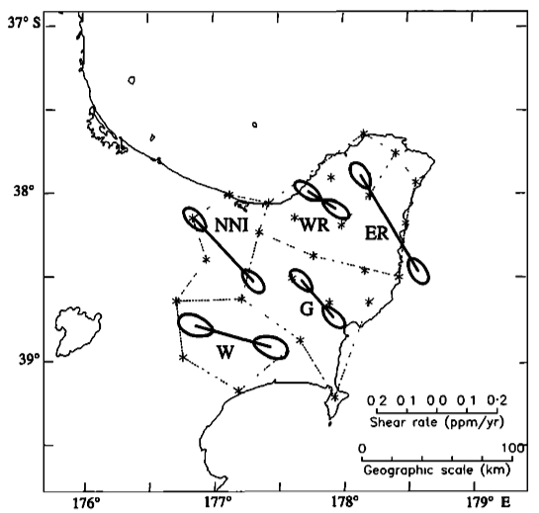
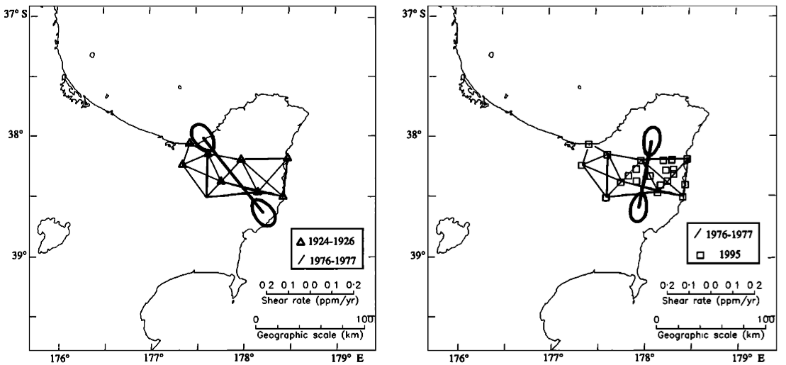
Still, highest-quality surveys (US, New
Zealand, India) could be accurate to ~cms…
Good enough to look at strain and strain
changes over timescales of decades.
Here, strain changes are interpreted to result
from afterslip excited by three M7+ earthquakes
in Hawkes’ Bay (1931-32) (bar direction is max
extension).
From
Arnadottir
et al. (JGR,
1999).

Slide 5
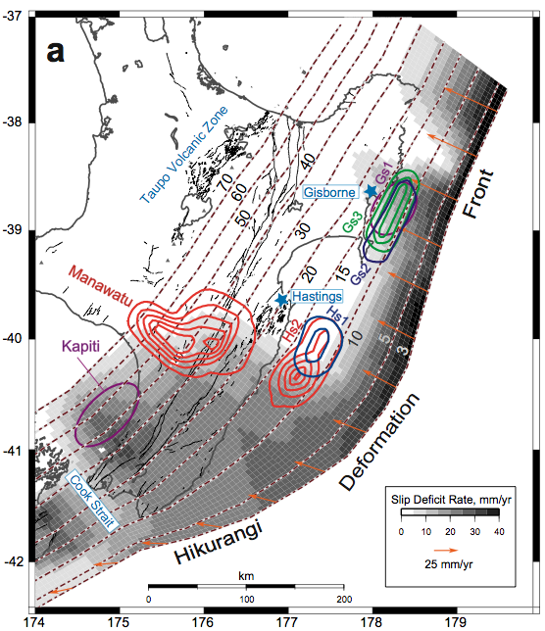
GPS measurements
made later show
offshore Raukumara
peninsula turns out
to be a very anomalous
location of (possibly)
shallow locking
depth and shallow
slow slip events…
This phenomenon
was targeted for a
drilling project in 2018!
From McCaffrey et al.
(Nature Geoscience,
2008).

Slide 6
Leveling measures height differences referenced to
the Geoid (i.e., a surface representing equipotential
gravity!)
Topography
}
h₁
h₂
}
{
h₀
Geoid
Measures the difference in height from instrument to level
staff, Δh = h₀ – h … Note that “vertical” is defined by local
orthogonal to the geoid at instrument and staff.

Slide 7
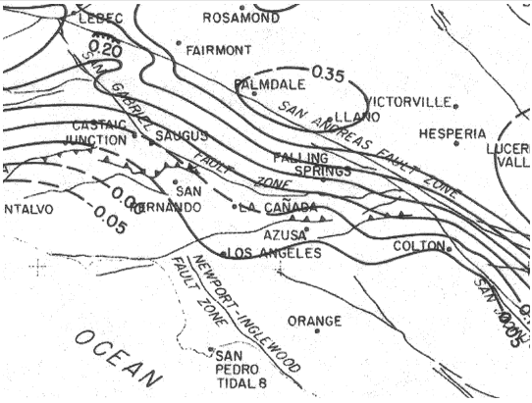
There were early hiccups in applying to surface deformation…
But they figured out the errors (rod calibration & refraction
effects) & improved on the methodology
Palmdale bulge, ca. 1975
Uplift positive, in meters
Courtesy USGS

Slide 8
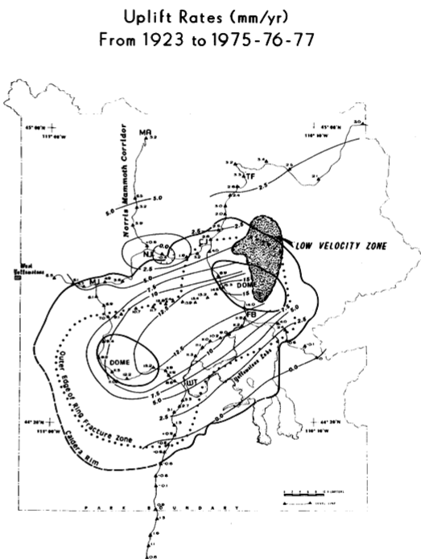
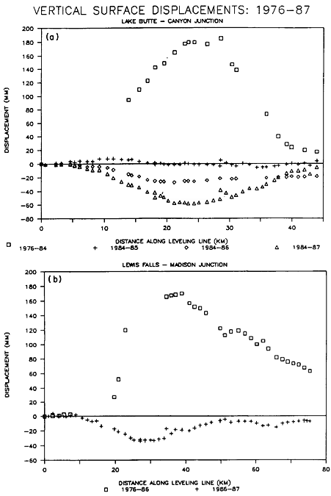
Now accurate to mms or less… Enough to see e.g. 0.8 m uplift
of Yellowstone from 1923-75, and <1 cm changes subsequent!
From Smith et al.,
Eos, 1989.

Slide 9
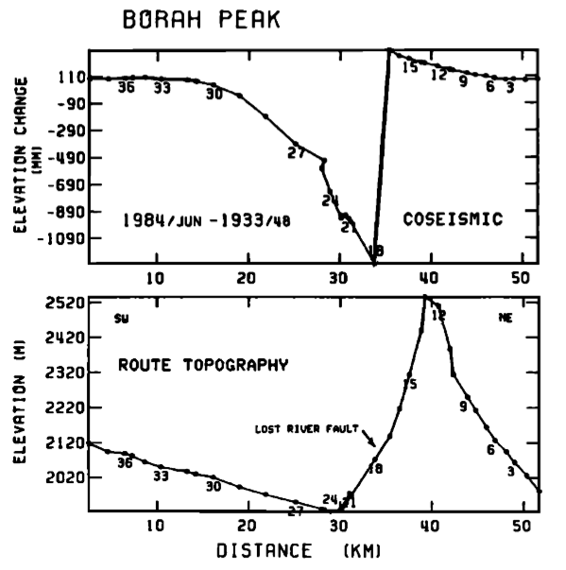
From Stein and Barrientos,
JGR, 1985.
And > 1 m
height changes
for the 1983
M_{w} 6.9
Borah Peak (ID)
earthquake

Slide 10
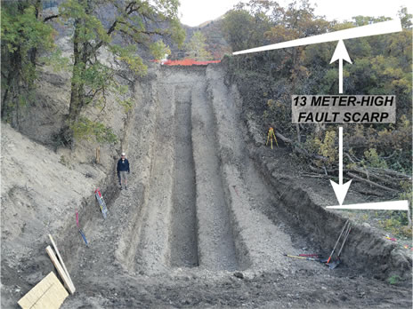
Comparison of the > 2 m average slip indicated by geodesy
to surface rupture mapping highlights a limitation of
paleoseismic estimates of hazard…
?
?
?
Crone et al., BSSA, 1987
M_{w} 6.9 Borah Peak earthquake
Trench of
the Wasatch
fault scarp

Slide 11
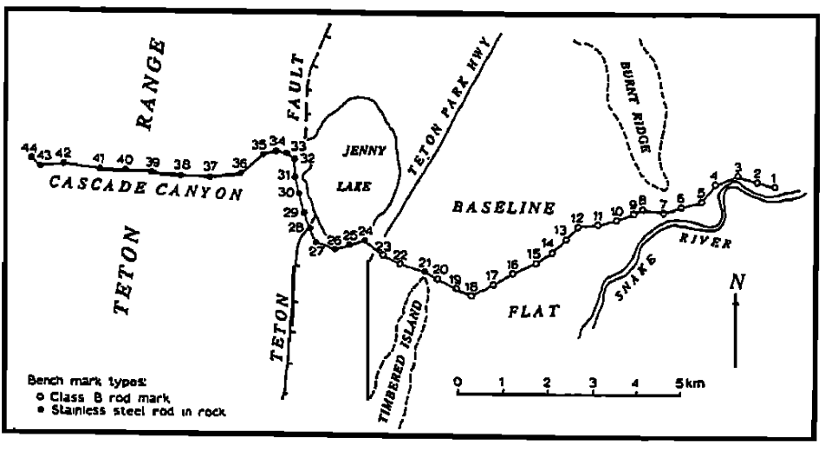
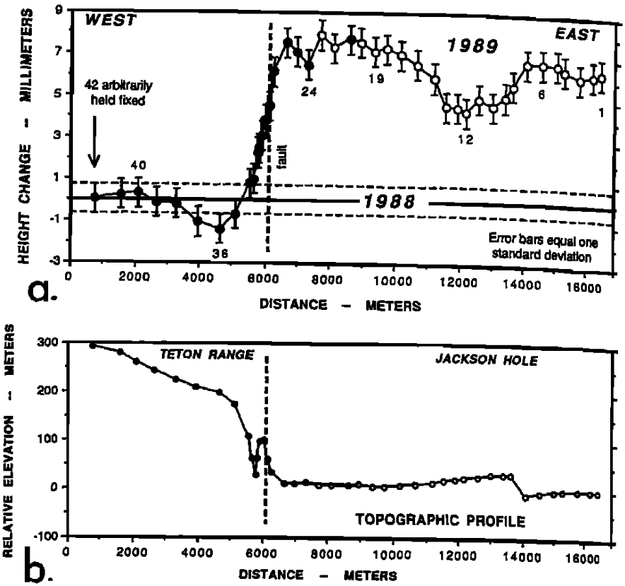
Leveling has been used to study interseismic deformation. This
study of the Teton fault achieved precision of tenths of a mm!
These authors
interpreted basin-side
uplift as reverse
aseismic creep, but
more likely an elastic
or poroelastic
response to hydrology
(probably poroelastic
because groundwater
levels increased!)
Sylvester et al., GRL, 1991

Slide 12
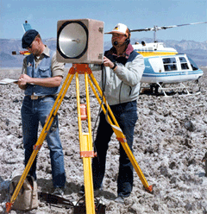
Distance measurements by latter-half of the 20th
century generally used light interferometry (geodimeters)
Using phase difference between
transmitted & reflected mono-
chromatic light, can get very
accurate distance (subject to
errors in unknown refractivity
along propagation path).
Courtesy USGS

Slide 13
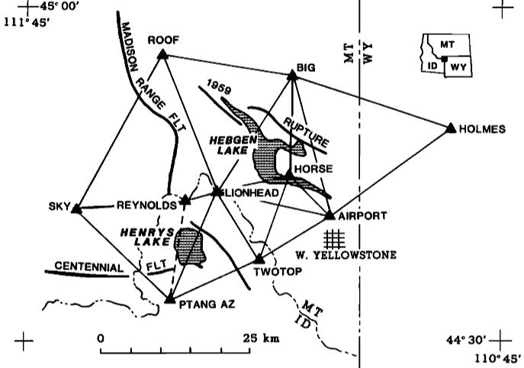
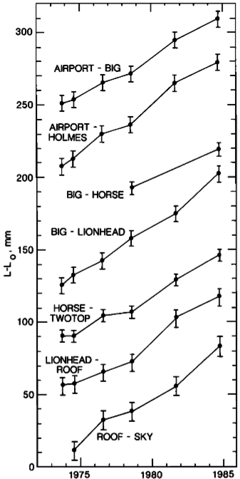
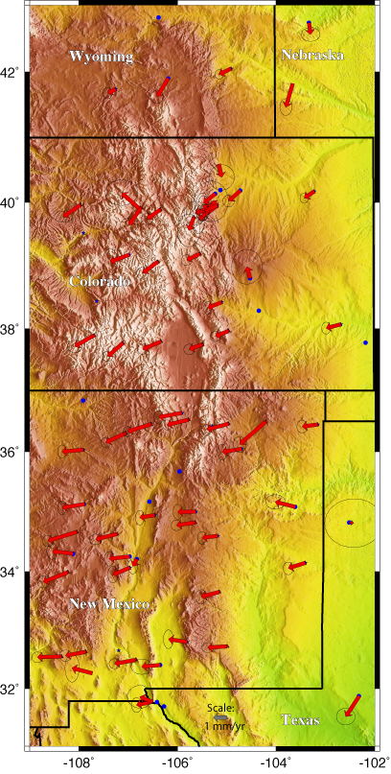
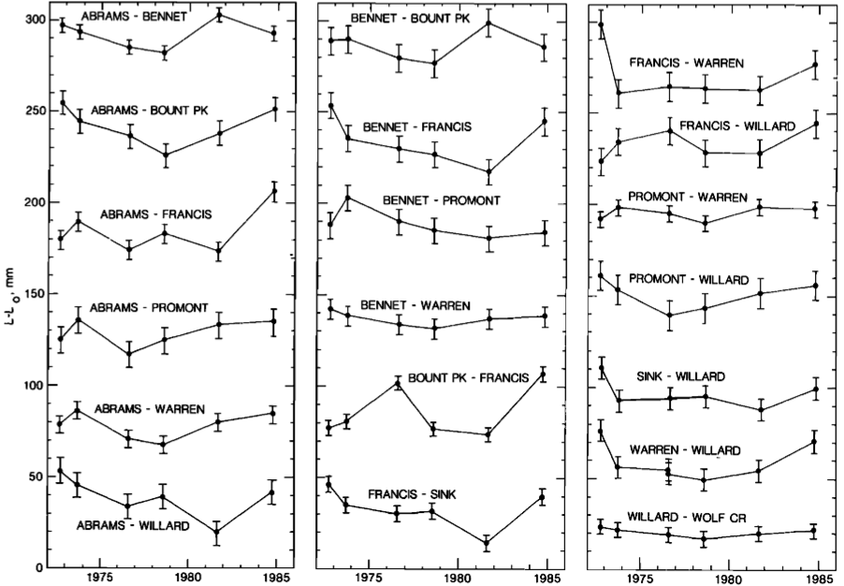
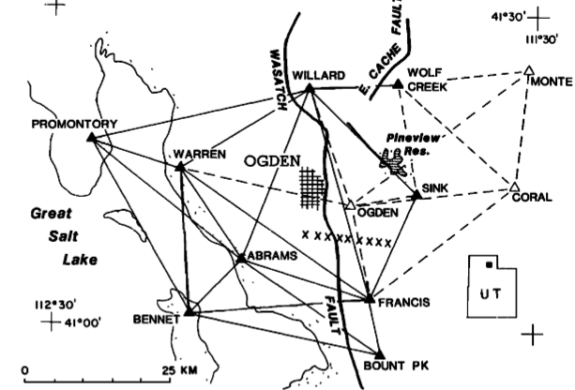
EDM studies over a >10-yr
timespan found strain in the
Hebgen Lake area, but no
Rio Grande Rift or Wasatch strain above
uncertainties (observable after only a few
years of GPS campaigns)

Slide 14
Terrestrial measurement techniques are rarely used for hazard studies
post-2000 because GNSS measurements are more accurate (with
the possible exception of leveling), much cheaper (leveling is very
expensive and GNSS is approaching that height accuracy), and pose
less mortal danger (more than a dozen volcano scientists died in the
1980s-90s, several while collecting geodetic monitoring data).
Optical/radar/lidar methods sample more densely, and these as well
as GNSS can be measured remotely (reducing risk).
Other important terrestrial geodetic measurements that still provide
(research-grade) information we can’t duplicate with GNSS include
• long-baseline tiltmeters,
• borehole strainmeters
• borehole tiltmeters
All of these are much more sensitive to deformation than is GNSS
positioning, which also makes them somewhat more finicky/problematic
to include in deformation modeling studies…

