Slide 1
Geology 6690/7690
Geodesy & Crustal Deformation
10 Nov 2023
Last time: Kinematic modeling of GPS velocities
• Kinematic strain modeling assumes two-dimensional
strain compatibility (i.e., strain behaves like 2D flow):
⇒ Interpolates velocity between measurements to calculate
a strain field
⇒ Assumes however that all strain is horizontal strain…
so when velocity is divergent, imposes unrealistic
assumptions (that require a balancing “source” or
“sink” of strain somewhere nearby).
⇒ Will reflect surface horizontal velocity but may not
represent actual surface strain…
© A.R. Lowry 2023

Slide 2
Read for Monday, Nov 13:
Bato et al. (2021) The 2020 eruption and large lateral
dike emplacement at Taal volcano, Philippines: Insights
from satellite radar data, Geophys. Res. Lett., 48(7),
#e2021GL092803

Slide 3
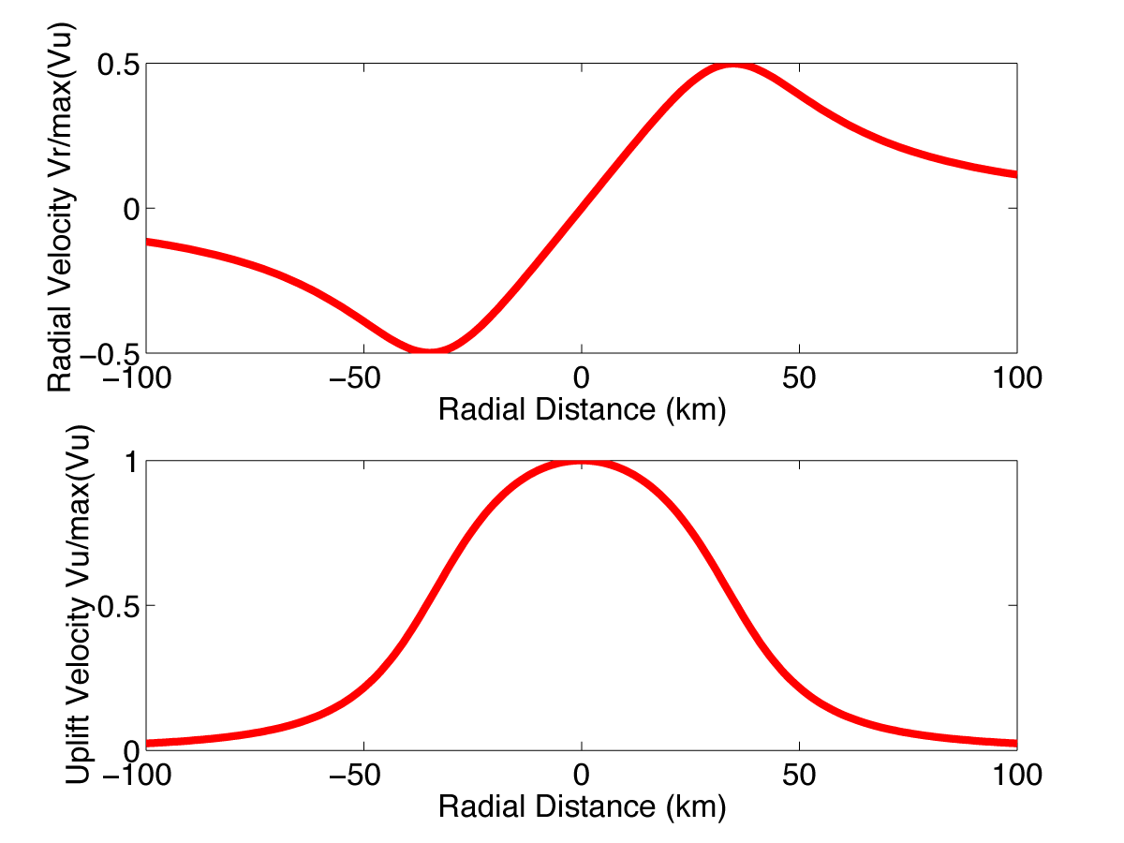
Model displacements from an intruded sill:
contraction
extension
contraction
(Strain inferred
from horizontal
velocity only…)
extension
(Surface strain
from a Mogi
model…)
If one infers strain from only horizontal velocity, would infer
contraction to balance extension… But in reality the surface
strain is all extensional. Difference is the vertical!

Slide 4
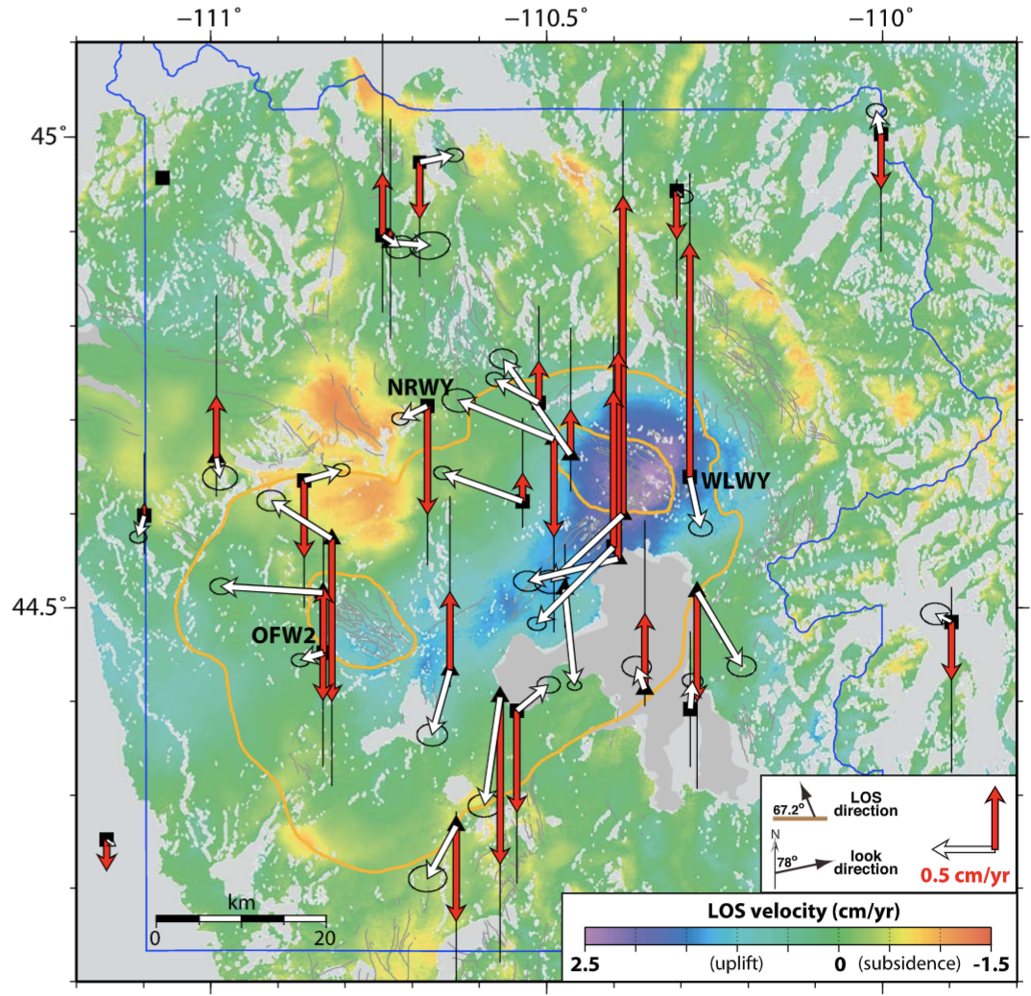
Courtesy University of Utah ATRG
Crust
Mantle
BUT, of course inflation does not occur in isolation… Melt
comes from somewhere! However superposed deep-seated
deflation will be broadly distributed instead of localized

Slide 5
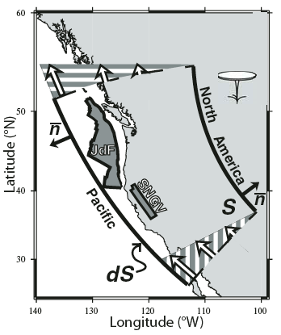
Nevertheless strain
compatibility, horizontal
flow assumptions are
(arguably) okay if one
is considering only the
kinematic velocities,
and not really
concerned about
knowing the true strain
rate or stress state
(which also depends
on rheology)…

Slide 6
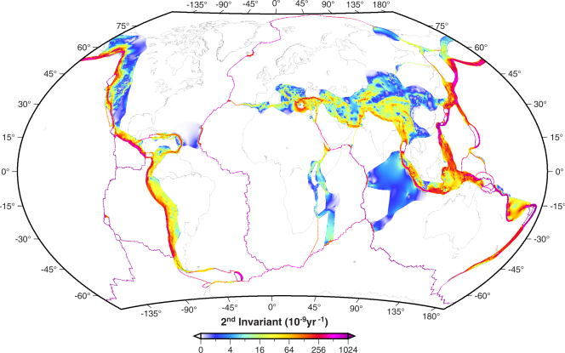
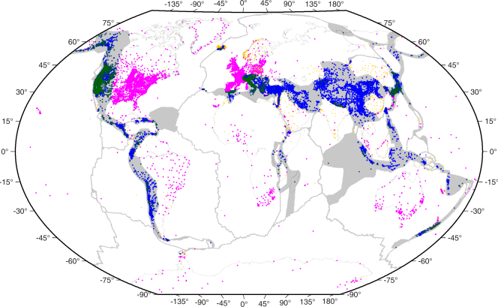
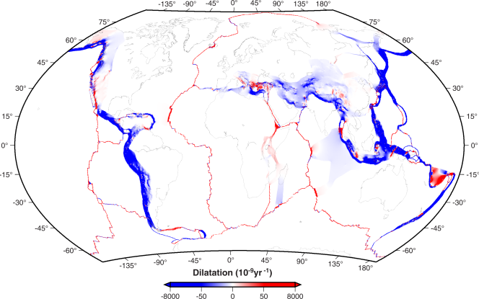
More recent global
strain rate model from
Kreemer et al. [G³, 2014]
(still imposes constraints
on where there is and is
not strain occurring)

Slide 7
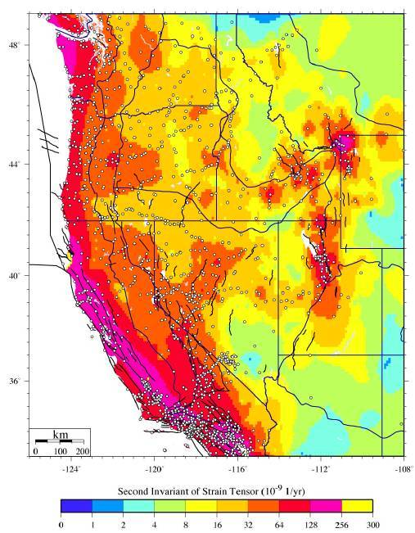
Sampling bias is an
issue in strain modeling,
and in other contexts as
well:
Look closely. Where’s
the strain rate greater
here?
(Puskas, PhD Dissertation, 2008)

Slide 8
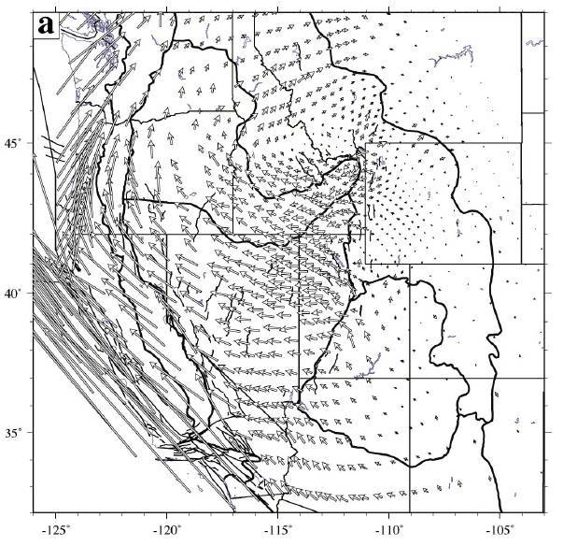
Despite
problematic
assumptions
and
“nonphysicality”
kinematic strain
modeling
reveals some
interesting
behavior of
surface
velocity…
Puskas & Smith JGR 2009

Slide 9
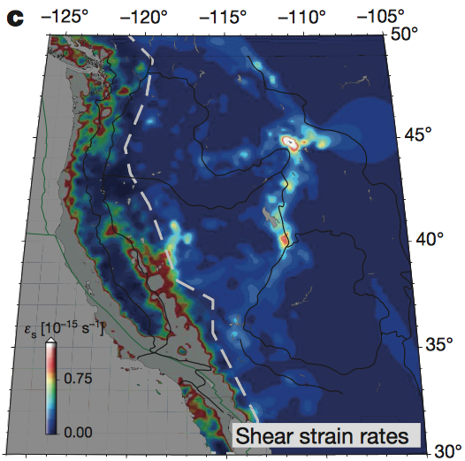
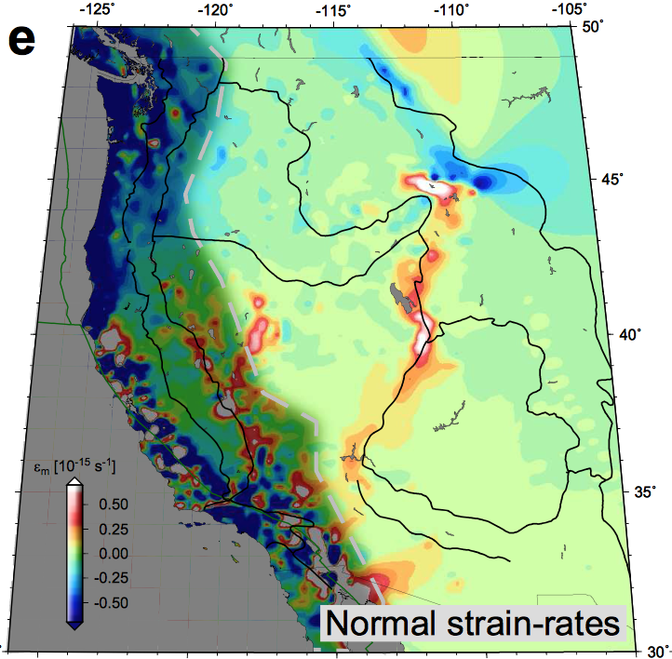
Becker et al., Nature, 2015 using strain rates from Kreemer et al., G³, 2014
Including the apparent contraction across the northern arm of
the Intermountain seismic belt…

Slide 10
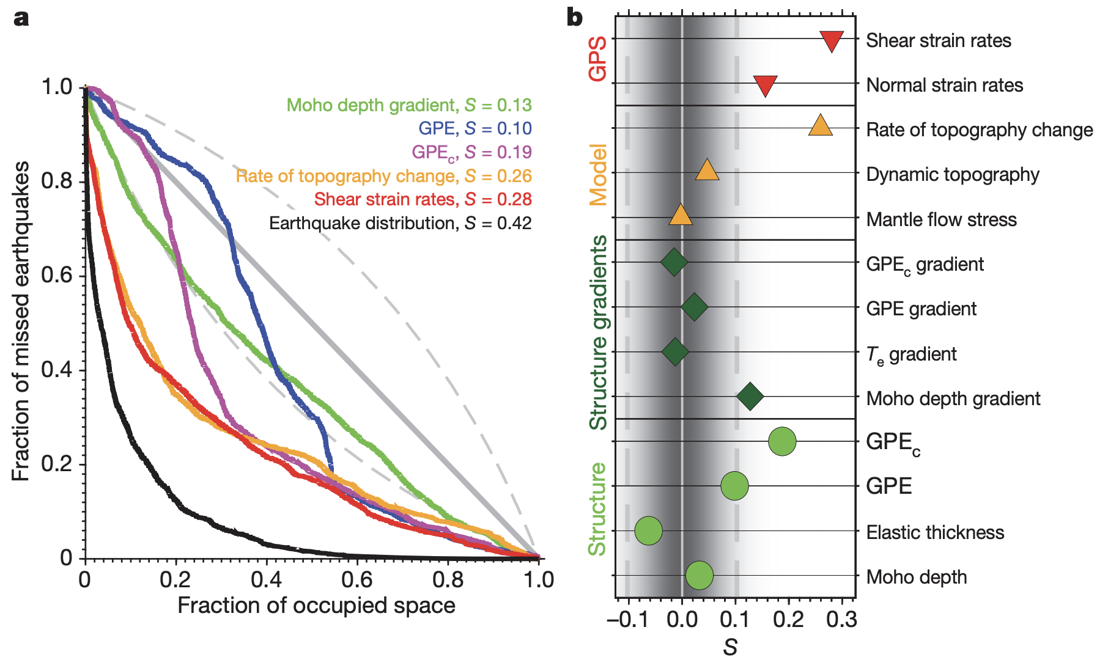
Becker et al., Nature 2015
The Molchan skill scores for shear versus dilatation (normal)
strain rates might have been more similar if |ε | were used!
.

Slide 11
Modeling GPS Velocities
An approach discussed earlier : Block Modeling
Assumes rigid “blocks” (or “plates”) move independently
relative to one another across the Earth’s surface.
GPS reference frame plate models are an example
application of this.
Each block will have an Euler Pole: For the p’th block,
means the block rotates at angular velocity ω_{p} around the
pole at latitude λ_{p}, longitude φ_{p}. Then the velocity at any
point on the block is given by:
Assumes? How small a “plate” can we reasonably expect?

Slide 12
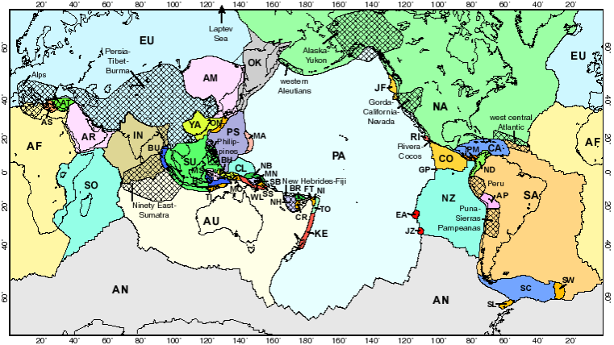
Example: Peter Bird’s (G³, 2002) digital plate model
increases the number of tectonic plates from 14 (ca. NUVEL-1A)
to 52…

Slide 13
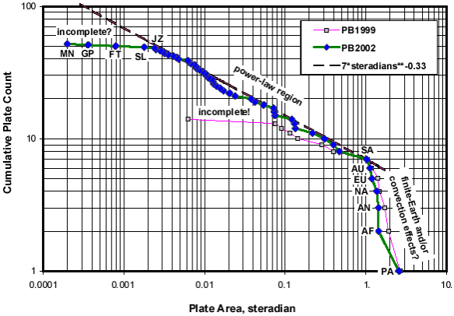
… And further suggests a fractal (power law) distribution…

Slide 14
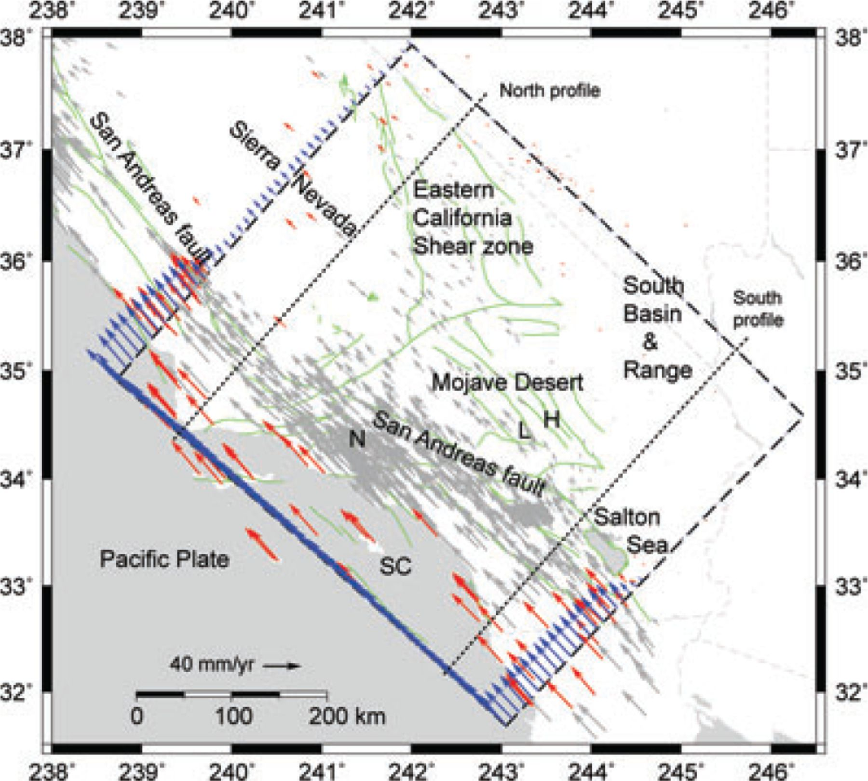
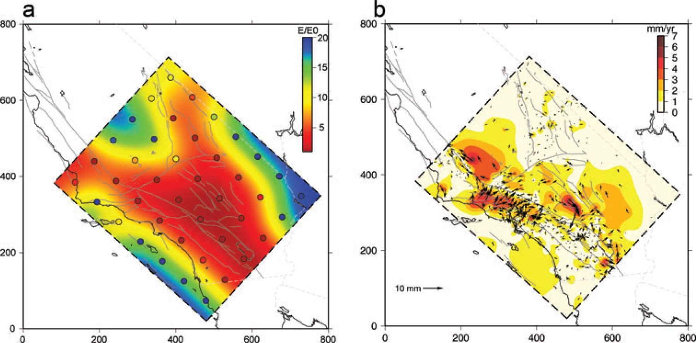
Modeling GPS Velocities
Another Approach: Thin elastic plate
Assumes an elastic plate overlying inviscid asthenosphere;
inverts velocities for variable velocity boundary conditions
and elastic properties of the plate (e.g., Chery et al. GJI
2011; Furst et al. Tectonophysics 2018).
Young’s modulus
Chery et al., GJI 2011

Slide 15
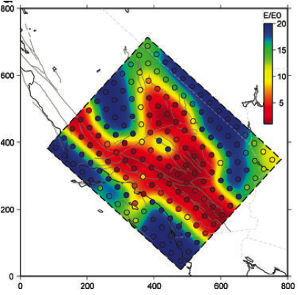
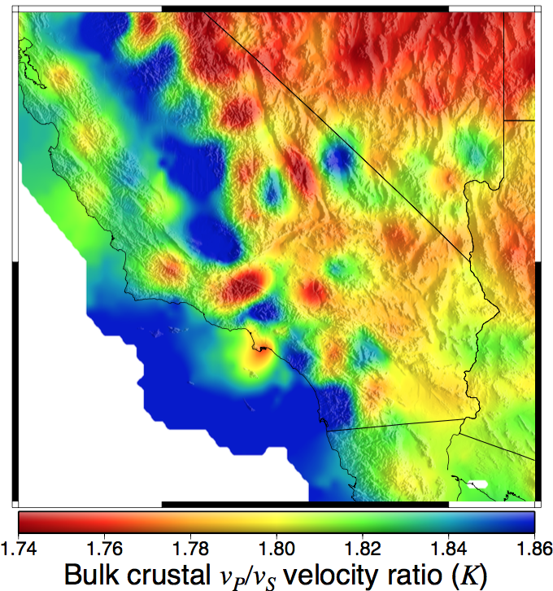
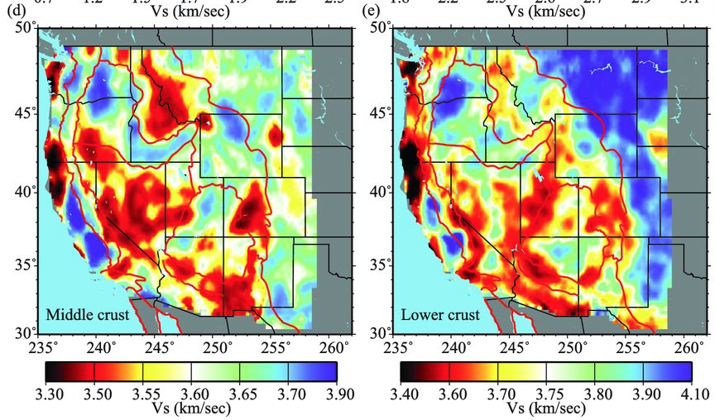
Young’s modulus E relates to
seismic velocity as:
For these numbers implies
E = 7.98x10¹⁰ to 1.18x10¹¹ Pa,
or max a factor of 1.5 change!

Slide 16
So now we’ve looked at:
• Kinematic velocity modeling…
(often modeled as a thin viscous sheet)...
• Block Modeling ...
• Thin elastic plate...
Thought Exercise:
What is the single most significant difference
in assumptions inherent in the various
velocity modeling approaches that we have
discussed thus far?
And if all of these various modeling approaches
can be used to model horizontal velocities
~equally well, does that assumption really
matter?

