Slide 1
Geology 6690/7690
Geodesy & Crustal Deformation
11 Oct 2023
Last Time: InSAR
• A Synthetic Aperture Radar (SAR) image consists of
(complex-valued) amplitudes of the returns from a radar
(electromagnetic) pulse in the microwave band…
• Interferograms combine two images with small spatial
separation (tandem or time-separated), multiplying one times
the complex conjugate of the other to calculate a
phase difference
• Simultaneous tandem images are used to get topographic
DEMs (e.g., SRTM → GTOPO30)
• Interferograms separated in time (after removing small,
predictable phase variations from interaction of the baseline
difference with topography) can be used to infer changes
in surface topography
© A.R. Lowry 2023

Slide 2
Last Time Continued: InSAR
• Repeat-pass Interferograms combine two images with
small spatial separation.
• Requires precise orbits (&/or coregistration); accurate DEM to
simulate effects of topographic parallax; various other steps
to remove atmosphere/geometric/timing effects and isolate
surface deformation
• Random changes in scatterers, changes in look angle or
orbital vector, or wide baseline-perpendicular separation of
images can cause decorrelation of scatterers (hence no
deformation image recovery)
• Different wavelengths (L-band = 24, C = 6, X = 3 cm) have
different pixel resolution but also interact with different
scatterers!

Slide 3
Read for Monday, Oct 16:
Bletery & Nocquet (2023) The precursory phase of
large earthquakes, Science, 381, 297-301
&
Substack comments by Bradley & Hubbard

Slide 4
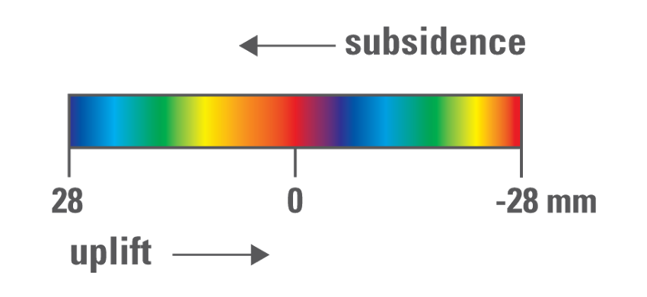
Important to note the color convention
for displaying InSAR fringes!!!
Courtesy
USGS
The order of the rainbow palette indicates the sign
of the range-change:
ROYGBIV is positive (increase in range) → subsidence
VIBGYOR is negative (decrease in range) → uplift!

Slide 7
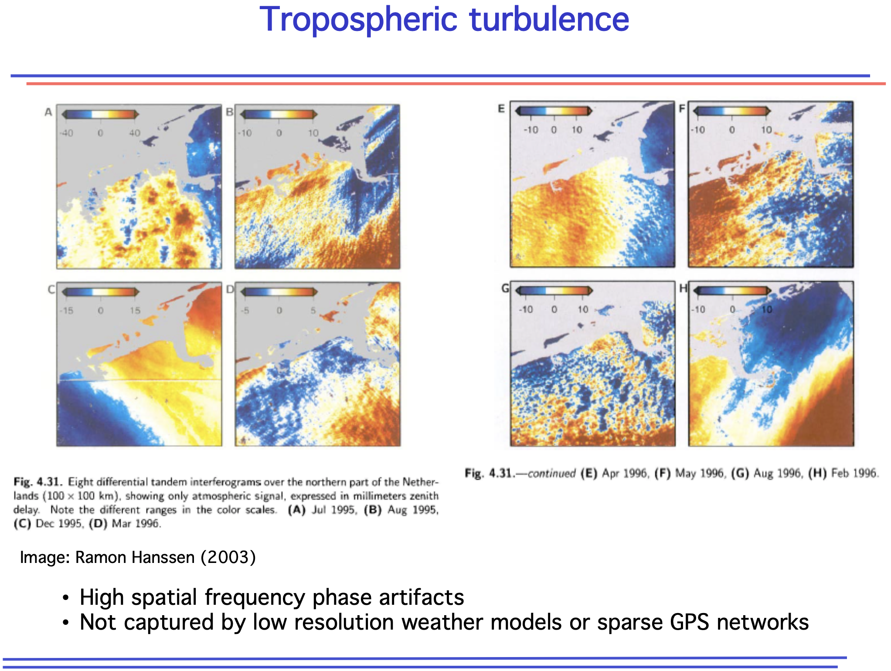
(ERS 1 and 2 satellite orbits
were about 1 day apart)

Slide 8
(Because TEC effects are dispersive!)

Slide 9
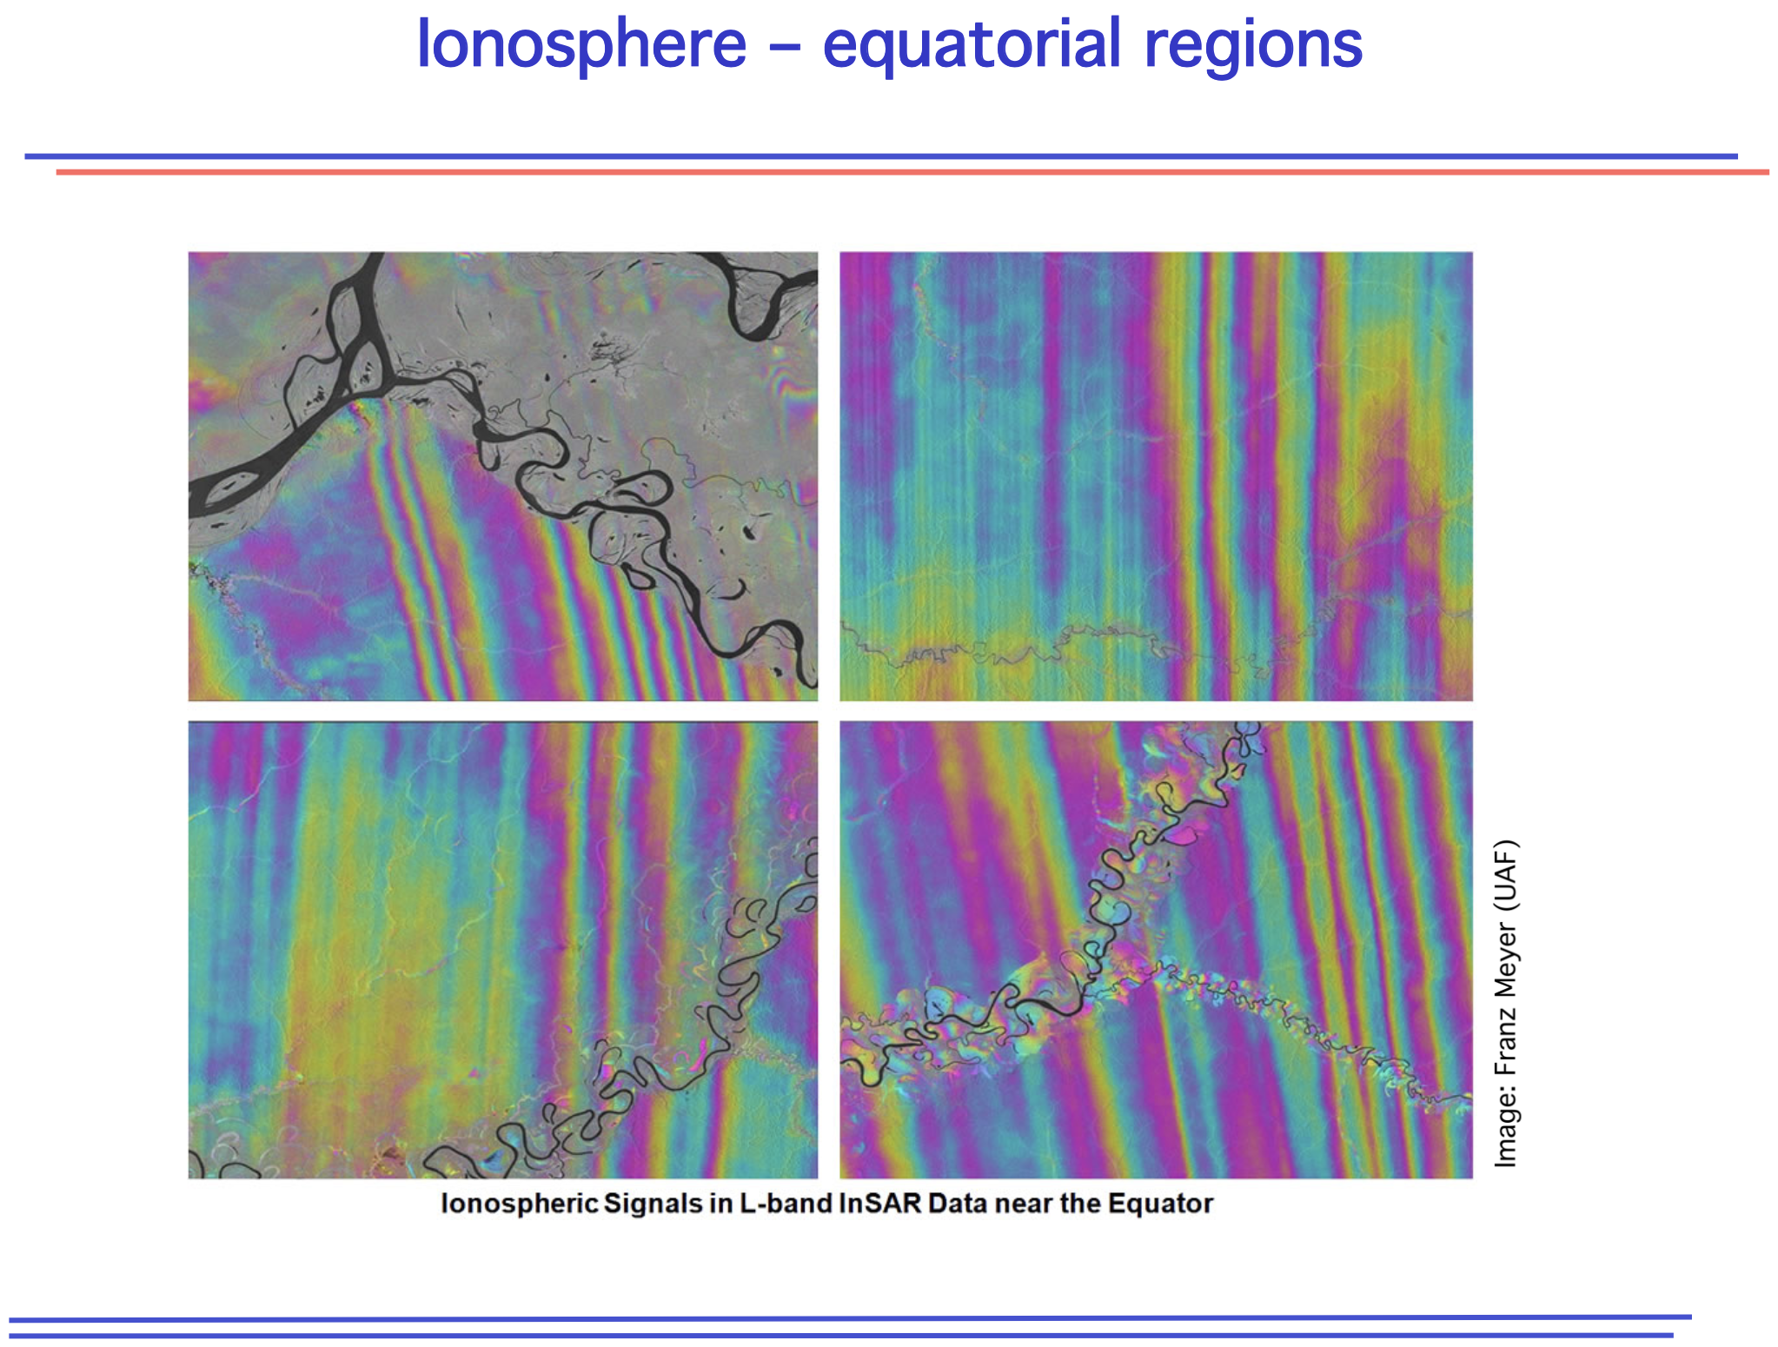

Slide 12
