Slide 1
Geology 6690/7690
Geodesy & Crustal Deformation
11 Sep 2023
Borehole Strainmeters:
• Measure changes in length in an instrument cemented into
a borehole
• Extremely sensitive to small strains, but directions may
reflect local variability in the elastic continuum!
GPS/GNSS Positioning
• Resection (location of intersecting ranges, or
pseudoranges if we acknowledge receiver clock error,
to solve for x, y, z, Δt of the receiver)
Read for Wed 13 Sep: Luttrell et al (GRL 2013)
© A.R. Lowry 2023

Slide 2
Read for Wed (13 Sep)
Luttrell, K., Mencin, D., Francis, O., & Hurwitz, S. (2013).
Constraints on the upper crustal magma reservoir beneath
Yellowstone Caldera inferred from lake‐seiche induced
strain observations. Geophysical Research Letters 40(3)
501–506.
Morgan will lead! Will need :
• Slides with each of the important figures from the paper
Also helpful :
• Summary slides of the observations, methodology,
& results
• Supporting slides from other sources that help to illustrate
important or unfamiliar tools, concepts, ideas
Everyone bring :
• Critical thinking skills switched to “ON”

Slide 3
Critical Thinking Skills (I):
When reading ANY paper, it’s helpful to back up &
first understand the terminology being used, along
with any concepts that underlie them, e.g.:
• Seiche
• Borehole strainmeter
• Load
• Spectrogram

Slide 4
Critical Thinking Skills (II):
Always Look Carefully at the Observations:
• What is the core kernel of observational constraint?
• Is there a better way to describe observations?
• Is there a potential for other signals in that type
of observation?

Slide 5
Science is a process of discovery by which
we increase knowledge…
Inductive Reasoning
Deductive Reasoning
begins with
begins with a
Observations
Hypothesis
used to generate a
predicts testable
Hypothesis
Observations
The
Scientific
Method
Additional observations/
experiments
If well supported, may become
Theory

Slide 6
All hypotheses (& theories)
are models…
Some models involve numbers.

Slide 7
Critical Thinking Skills (III):
Look Carefully at the Data Analysis:
• Is there a better way to quantify the data?
• Is there a potential for multiple signal sources?
• Is there an approach to analysis that might remove
signals that aren’t relevant for processes you wish
to understand?
• Are there quantitative tools that could be
used to extract more information from the data?

Slide 8
Critical Thinking Skills (IV):
When reading a paper that involves modeling,
it’s also helpful to think about:
• What are the assumed boundary conditions (and do
they matter?)
• What are the assumed initial conditions (and do they
matter?)
• What physical processes are being modeled (and are
physical processes neglected that might be important?)
• What observations are being modeled (and how are
they related to the model? Qualitative or quantitative?
Comparison or inversion? What is the criterion for a
“Good Match” to the observations? Are there other
observations that might be relevant?)
• Does the model make other testable predictions that
are not addressed by the data to hand? How might
you test these?

Slide 9
Critical Thinking Skills (V):
Assumptions matter!
• What was assumed about the system being studied in
order to simplify or approximate the dynamics? Are
these assumptions reasonable?
Numbers matter!
• What are the assumptions of rock material properties?
Do they gibe with laboratory measurements?
Do they gibe with geophysical measurements of
in-situ properties?
• What are the numerical values of other physical
properties? Are they reasonable? Is there
observational support?

Slide 10
(An Even Briefer Overview…)
GNSS location is done via
Resection: Similar to how we
locate EQ hypocenters!
Treat satellite locations as
“known”
Determine distances (“ranges”)
from satellites to receiver
Antenna location corresponds
to the intersection of spheres of
radius centered at !
(But the details are a bit tricky…)
ρ
i
→
s
ρ
i
→
s
ρ
→
i
ρ
R
ρ
i
→
ρ
R
→
ρ
s
ρ
i
i

Slide 11
Components I. GPS Space Segment
(Courtesy US DOD!)
GPS constellation is 27+ satellites (24
navigational plus 3+ active spares) in
~12-hour circular orbits at 20,200 km
(31 operational satellites; 24 full-time)
Six planes (4+ space vehicles– SV’s–
each) inclined 55°from equatorial
Six to twelve satellites in view from
anywhere on Earth, at any given time
SV’s transmit low-level microwave
signals
Four atomic clocks each (2 cesium;
2 rubidium)

Slide 12
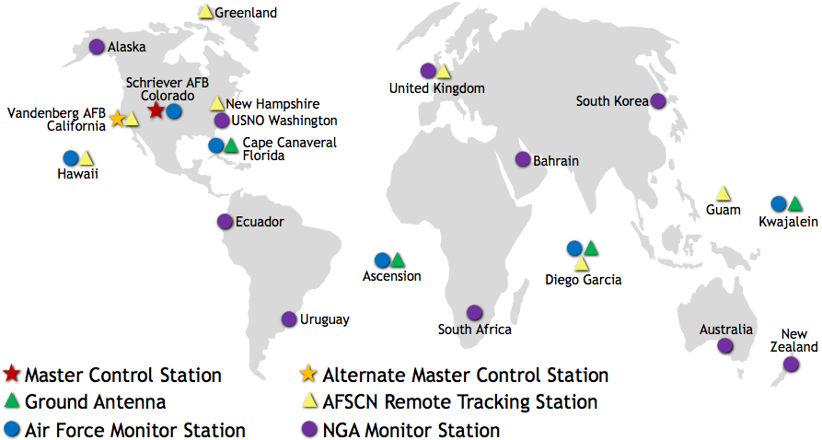
Components II. GPS Control Segment
GPS satellites are controlled by US Air
Force satellite command near
Colorado Springs + 11 C&C antennae
Sixteen global monitoring stations track
SV’s, calculate ephemerides
(SV orbital position and velocity)
Master control facility in CO transmits
ephemerides, clock corrections,
almanac to SV’s (so that these
can be relayed to GPS
receivers) & performs
maneuvers

Slide 13
Components III. GPS User Segment
Receivers have codes to recognize GPS
signals; use ranges to calculate (x, y, z)
location + time (1 m of range = 3 ns!)
Commonly used for:
Navigation (e.g., air traffic, trucks, ships,
autos, hikers, mobile phone users!)
Surveying (property boundaries, GIS,
crustal deformation)
Time-keeping (e.g. seismo stations)
Meteorology (trop. water vapor, space
weather, soil moisture)
⇒ Civilian users have now wrested some
control away from military…

