Slide 1
Geology 6690/7690
Geodesy & Crustal Deformation
15 Nov 2023
Last time(s): GNSS velocity modeling
• Kinematic strain modeling assumes two-dimensional
strain compatibility (i.e., strain behaves like 2D flow):
⇒ Assumes all strain is horizontal strain… divergent velocity
requires a balancing “source” or “sink” of strain nearby).
⇒ Will reproduce surface horizontal velocity but may not
represent actual surface strain…
⇒ Sampling bias also introduces errors in models of strain
• Revisit of block modeling : Can linearly invert for three
parameters (lat, lon of Euler pole and rotation rate) from
velocities of sites lying on a block:
© A.R. Lowry 2023

Slide 2
Last time continued: Velocity Modeling
• Thin elastic plate modeling assumes an elastic plate;
finds horizontal boundary velocities and elastic properties
that minimize misfit… Inconsistent with seismic properties
(because it neglects the strain effects of slip on faults!)
All velocity modeling approaches reproduce
horizontal velocities ~equally well using different
rheologies, different parameters… Implying
fundamental ambiguity in using velocities to
model dynamics or sources...
Unless the correct rheology is used!

Slide 3
Modeling of volcanic and fault slip displacements commonly use
Dislocation Green’s Functions:
Assume:
Elastic half-space with uniform elastic properties
Stress, strain and displacement vanish at infinite distance
Then find the analytical solution for stress, strain,
displacement at the surface and/or within the volume.
Most commonly-used solutions for dislocations include:
(Less Complex) (More Complex)
Point Source Rectangular Source
Δ-Pressure/Volume Full Moment Tensor
Note however that one can create any arbitrary
geometry using combinations of point sources!

Slide 4
Fluid Inclusion Point Source:
(Mogi, Bull. Earthq. Res. Inst., Univ. Tokyo, 1958)
Increase in volume ΔV (or pressure ΔP) of an infinitesimally
small circular inclusion located at produces a surface
displacement at j^{th} location

Slide 5
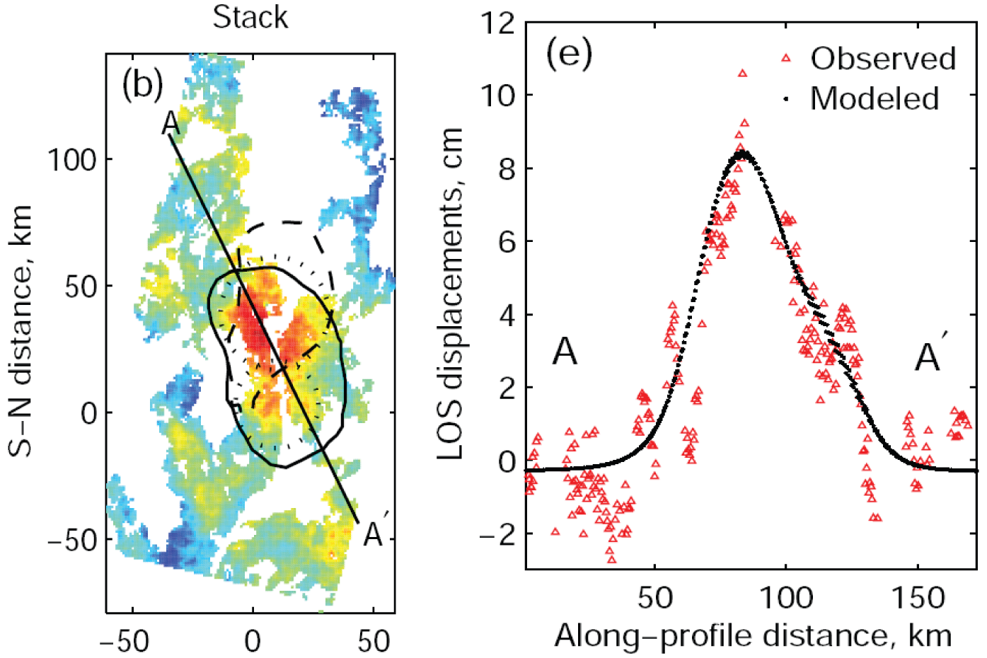
Fialko & Simons, Geophys. Res. Lett., 2001
The Soccoro magma body…
InSAR stack 1992–99 (7 years at ~ 1 cm/yr)

Slide 6
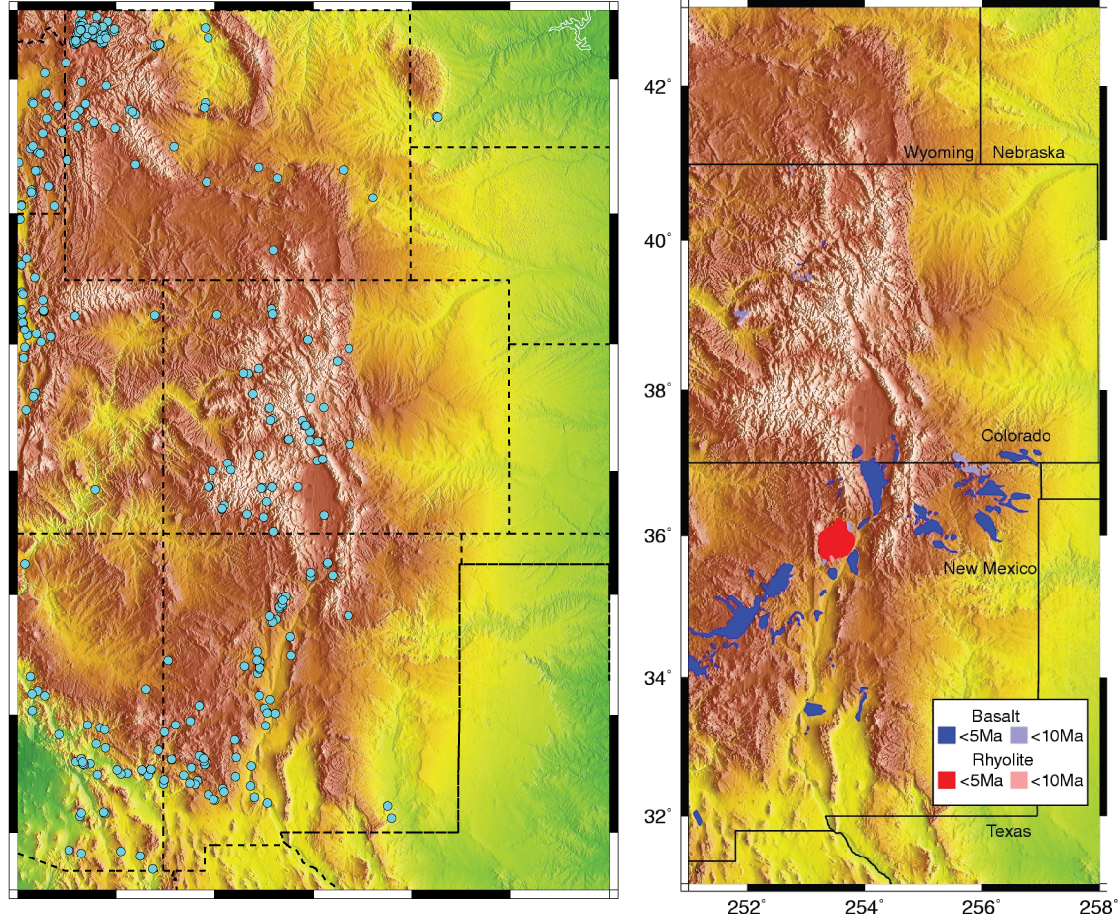
RGR Hot Springs
RGR Volcanics
Valles
Caldera
Socorro
magma
body

Slide 7
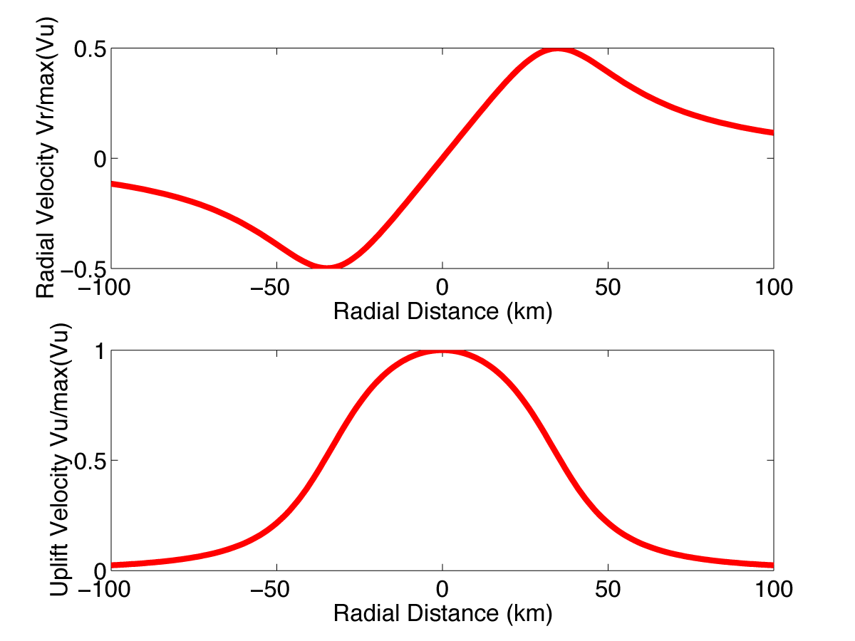
Model displacements from an intruded sill:
This estimate of displacement with distance was calculated
by summing Mogi sources to approximate Fialko et al.’s (2001)
geometry of the Soccoro magma body (derived from InSAR)

Slide 8
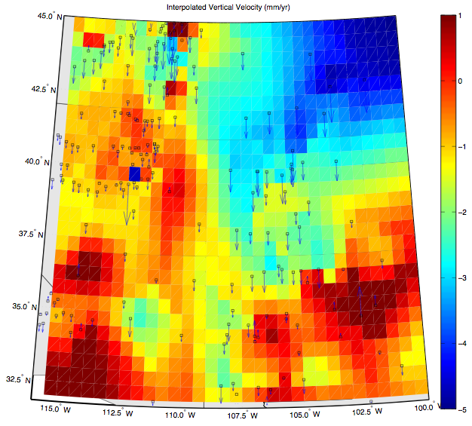
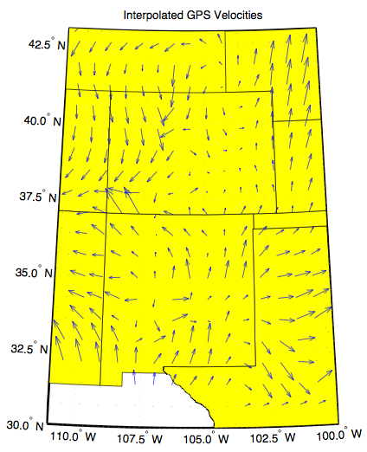
PIE1
Interpolated vertical and horizontal velocities from our
Rio Grande Rift network (courtesy Henry Berglund)

Slide 9
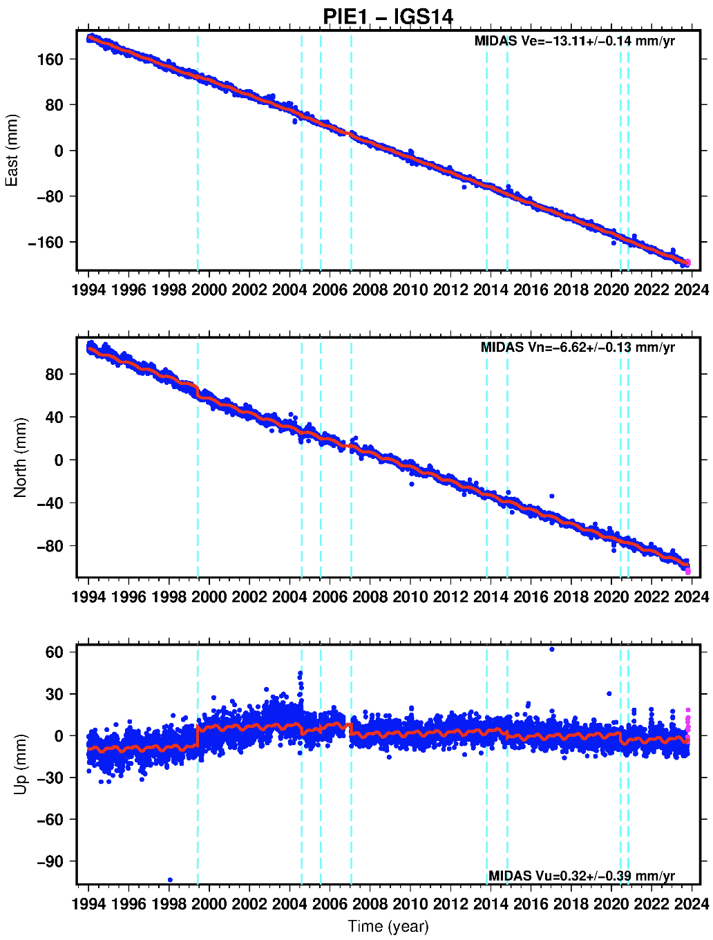
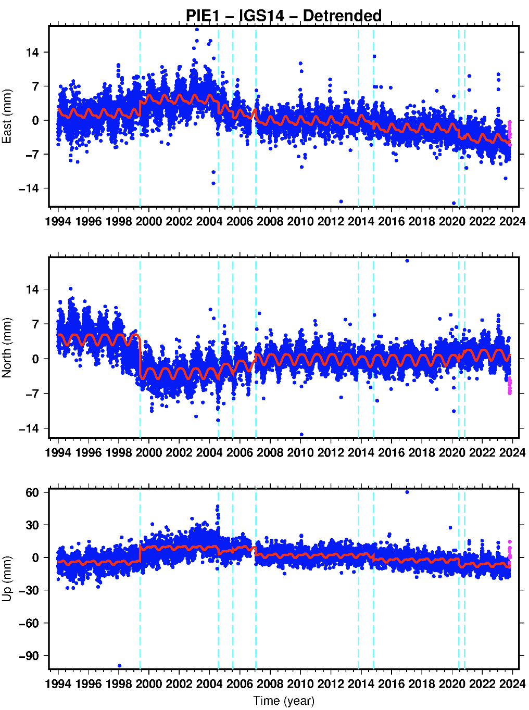
Note we invert for shifts at time of antenna changes, but this
may misinterpret real transient (magmatic) displacements

Slide 10
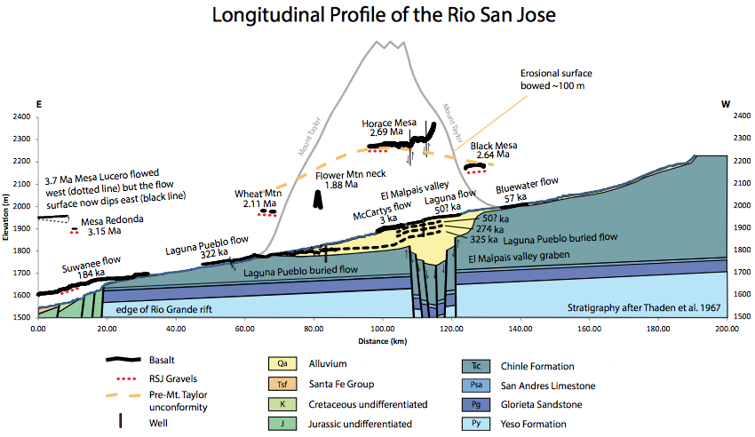
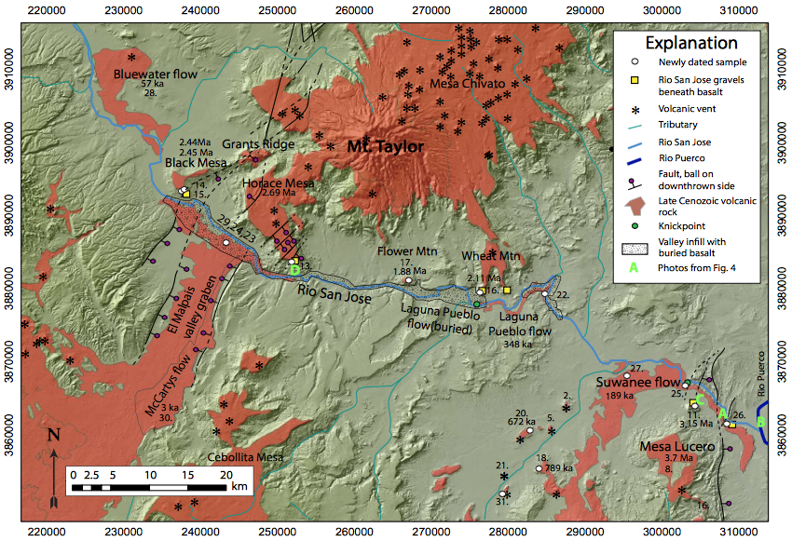
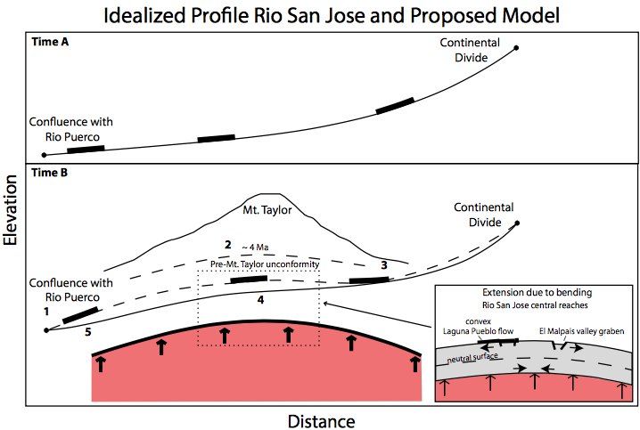
Channer et al. (2015)
Geosphere…
Co-author wanted so badly for
this to be mantle-sourced uplift!

