Slide 1
Bletery & Nocquet (2023) and Bradley & hubbard (2023)
Kitri Spencer (in spirit)
Fall 2023

Slide 2
Bletery & Nocquet (2023)
B&N
The precursory phase of large earthquakes

Slide 3
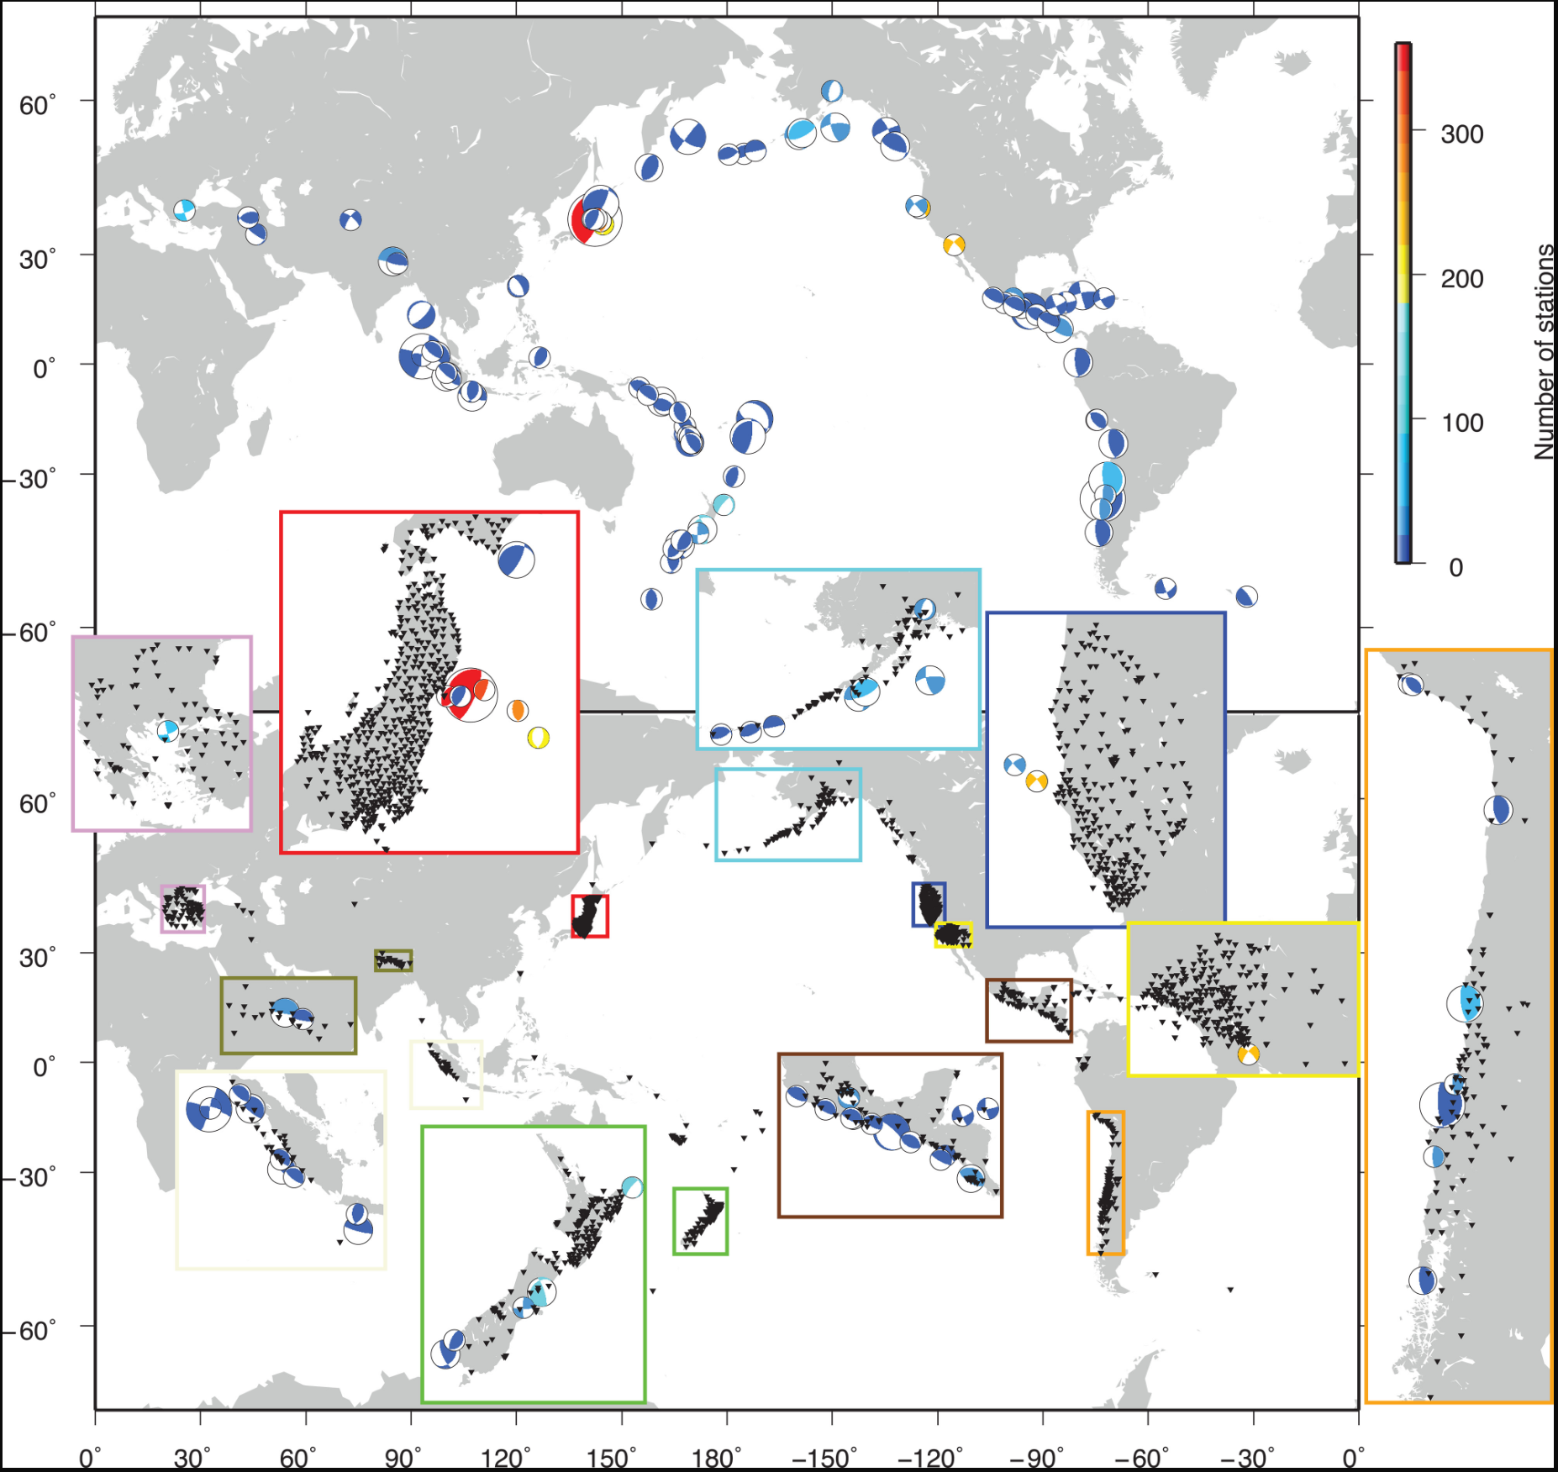
B&N Figure 1
Earthquake and GPS stations used in the study
TOP: Distribution and focal mechanisms of the 90 Mw ≤ 7 earthquakes with 2 days of 5-min GPS records (no gap and no noticeable foreshock) available within 500-km radius of epicenters. Mechanism sizes are indicative of event magnitudes. Colors indicate the number of time series available for each event.
BOTTOM: distribution of 3026 GPS stations with complete records in the 2 days preceding the 90 earthquakes shown. Subpanels show areas of high station concentration

Slide 4
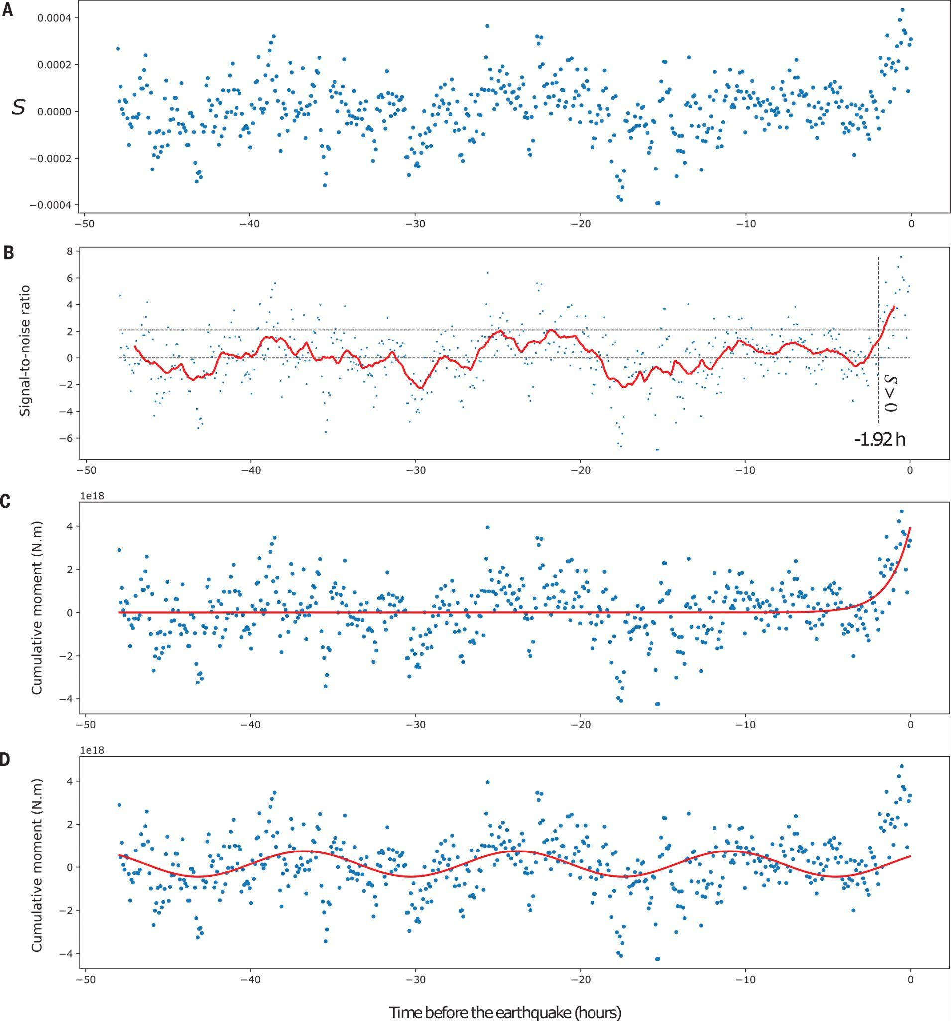
B&N Figure 2
B) 1-hr-and-50-min moving average of S normalized by its standard deviation on the [48-hr and 1-hr-and-50-min] time period. Upper dashed line indicates maximum of moving average. Lower horizontal dashed line indicates the time after which the stack gives only positive values
A) Global stack S of 3026 time series recorded before 90 earthquakes as a function of time relative to earthquake origin time
Global stack in direction of expected slip
C) Stack converted into moment with the best exponential fit superimposed (time constant = 1.3 hrs)
D) Stack in moment with best sinusoidal fit (period T = 1.9 hrs)

Slide 5
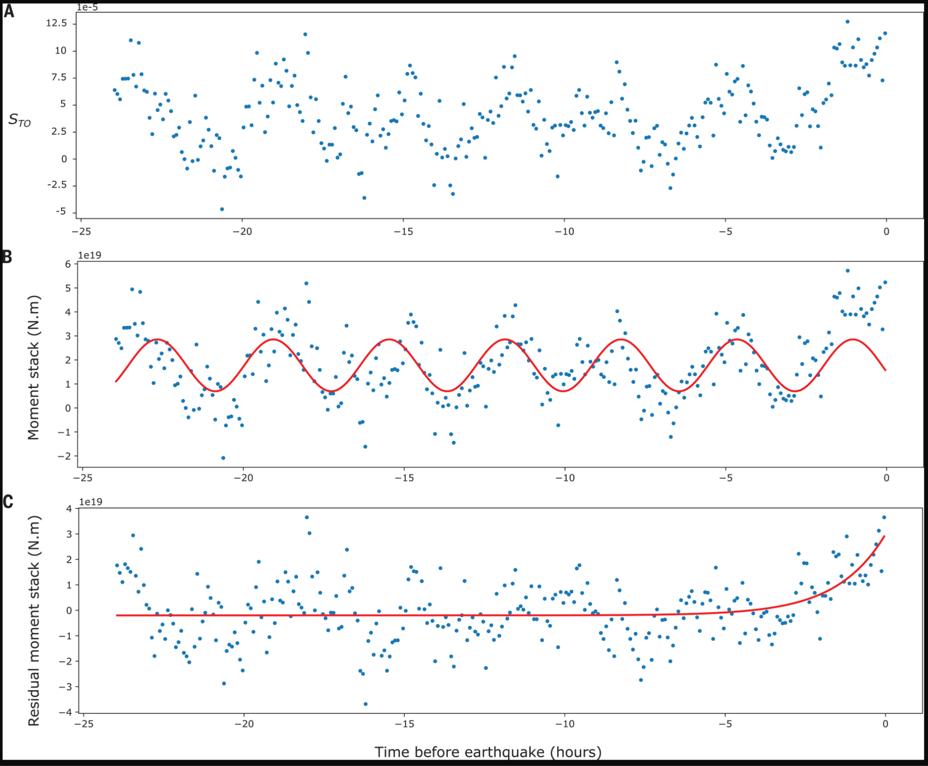
B&N Figure 3
Stack in the direction of expected slip for Tohoku
A) Stack of 355 time series recorded before the Tohoku-Oki earthquake
B) Same as (A) converted in moment release with best sinusoidal fit superimposed (period T=3.6 hrs)
C) Residual of the moment-release stack with the sinusoidal fit (blue dots) and best exponential fit (red curve, time constant T=1.5)

Slide 6
Bradley & Hubbard (2023)
B&H
Update on apparent GPS detection of earthquake precursors

Slide 7
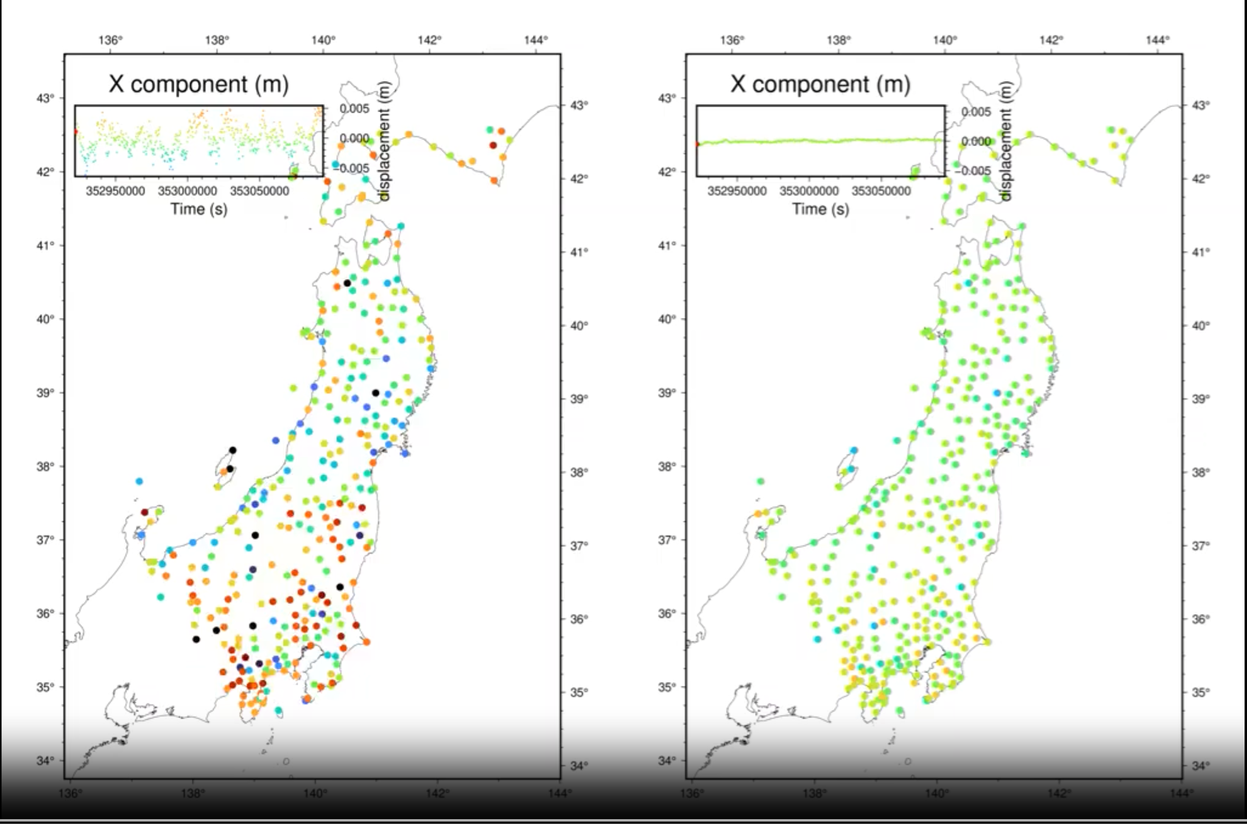
B&H Figure 1
Movie of X (East) component for Japanese GPS network in the two days before Tohoku-Oki Earthquake
Left panel shows original time series data where mean displacement for each component has already been subtracted from each time series (each component centered on 0).
Right panel shows same data after removal of common mode noise, which is the average signal of all sites > 200 km from eventual hypocenter location

Slide 8
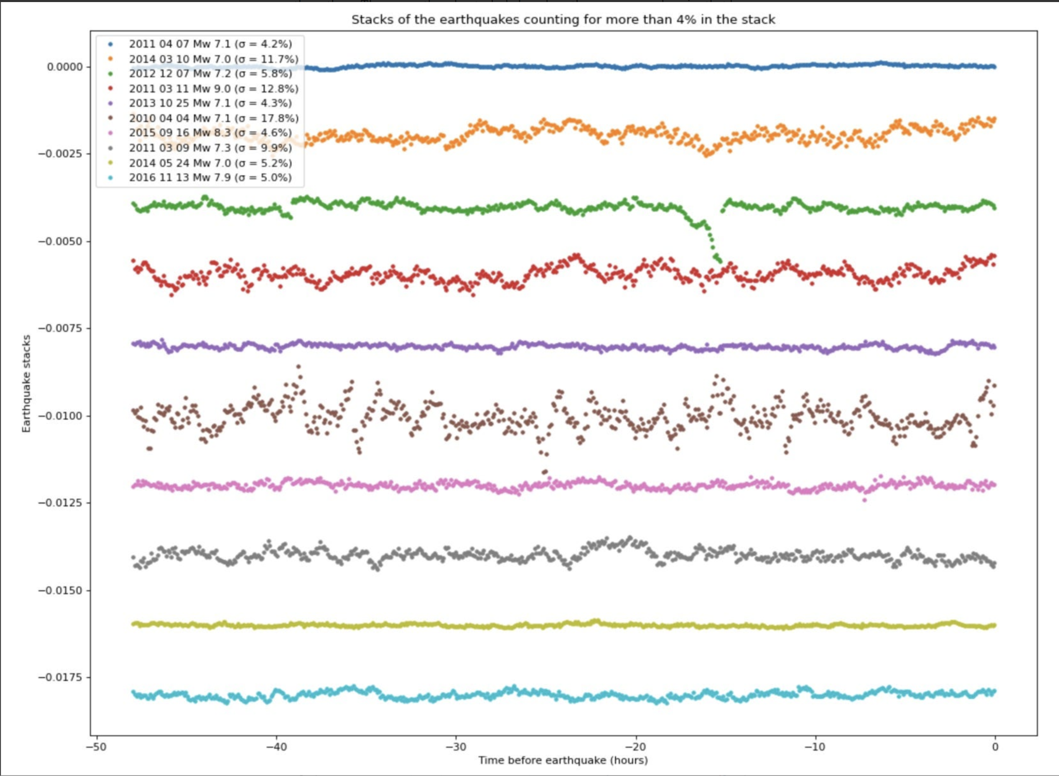
B&H Figure 2: Dot-product stack of revised data including ONLY common mode noise for each earthquake/network

Slide 9
B&H Figure 3: Global stack of revised data, including ONLY common mode noise for each earthquake/network

Slide 10
Bletery & Nocquet (2023)
B&N Supplemental
Supplemental Figures

Slide 11
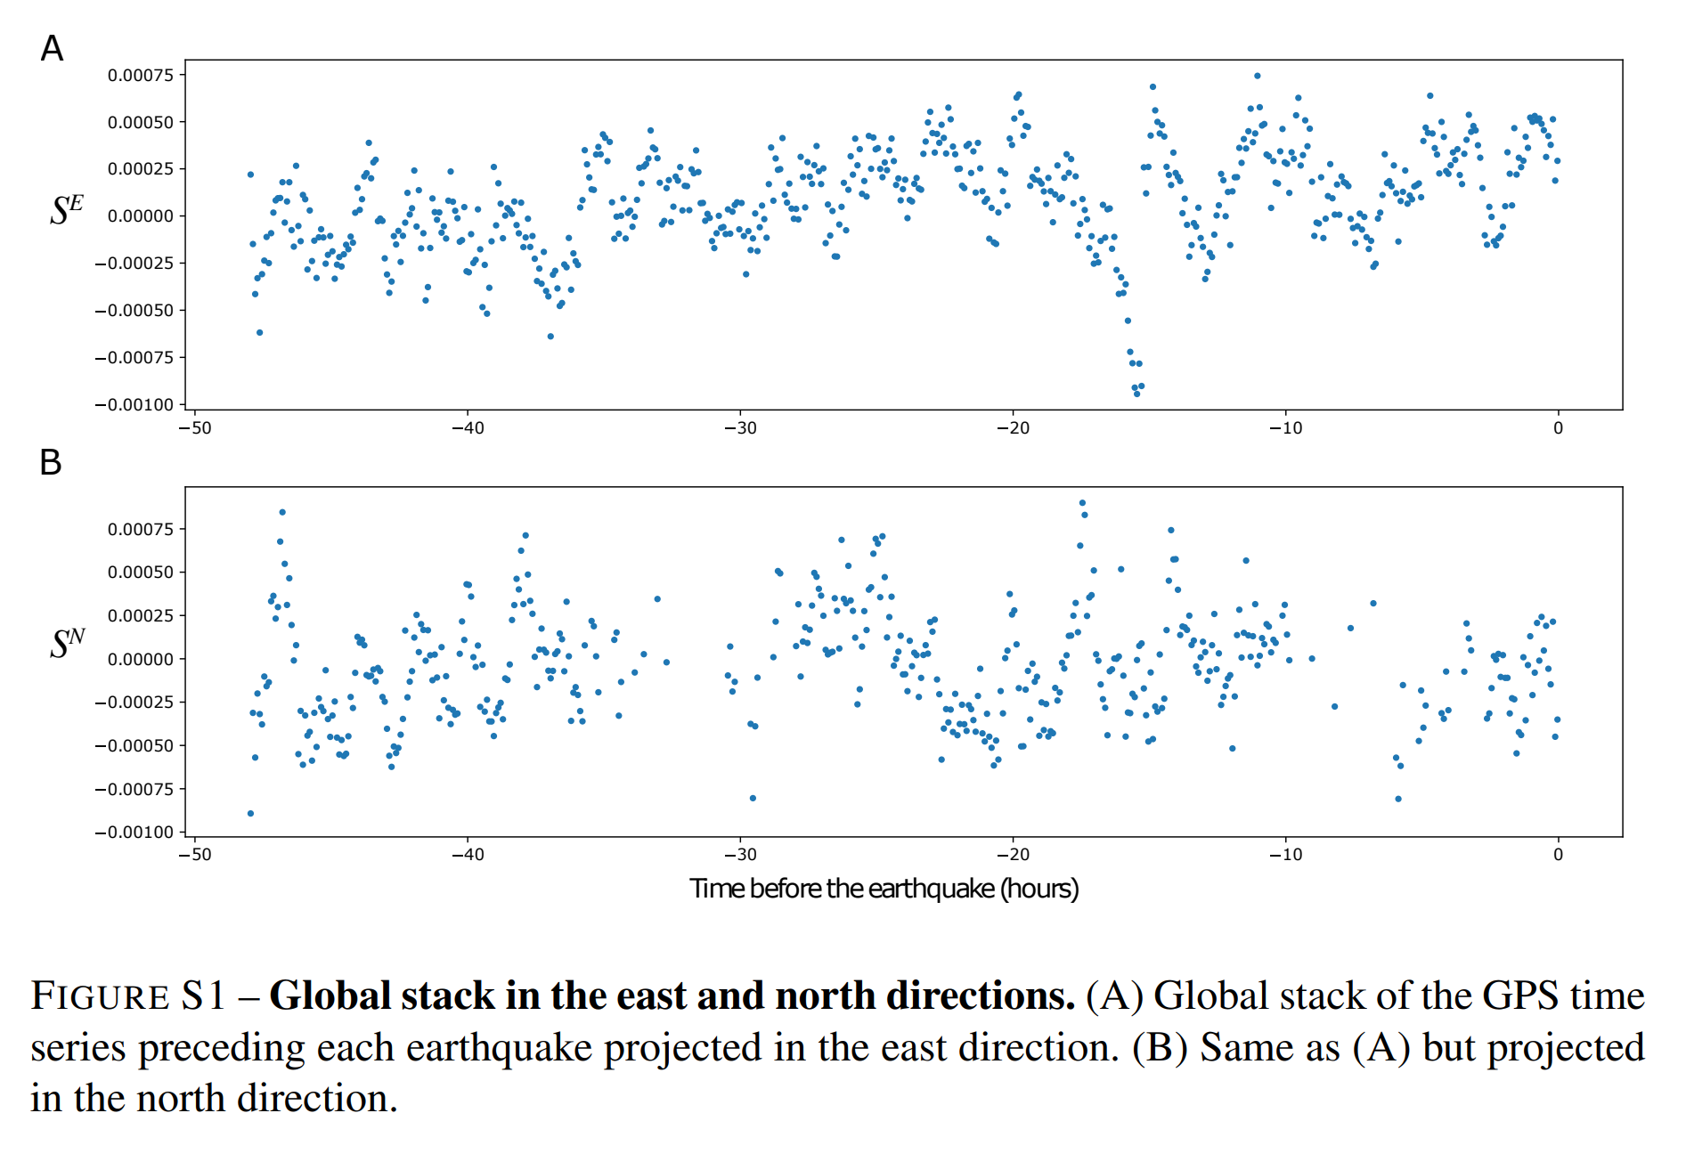
B&N Supplemental F1

Slide 12
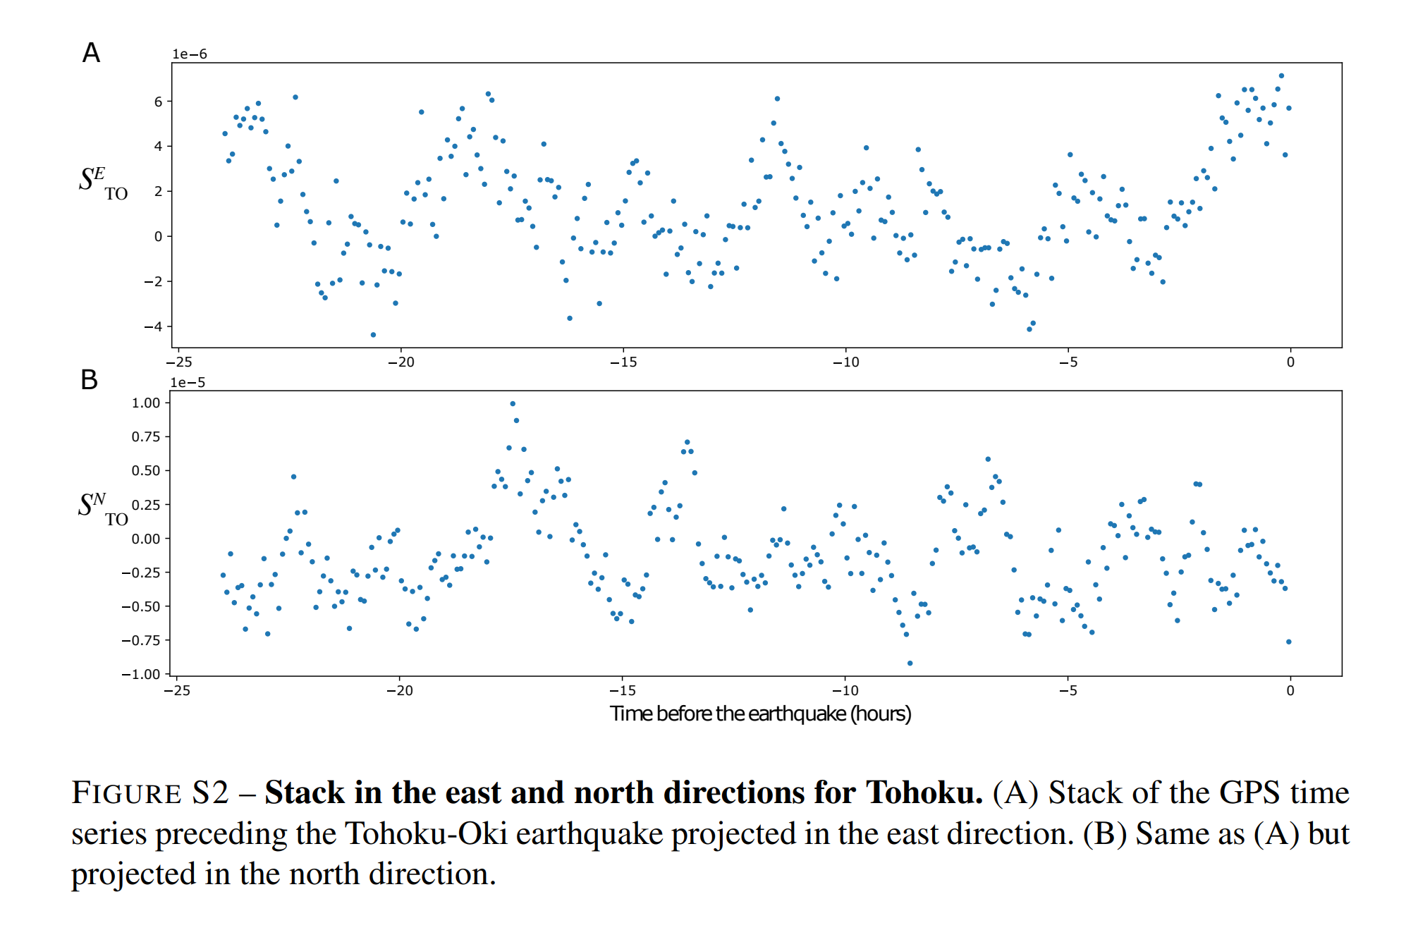
B&N Supplemental F2

Slide 13
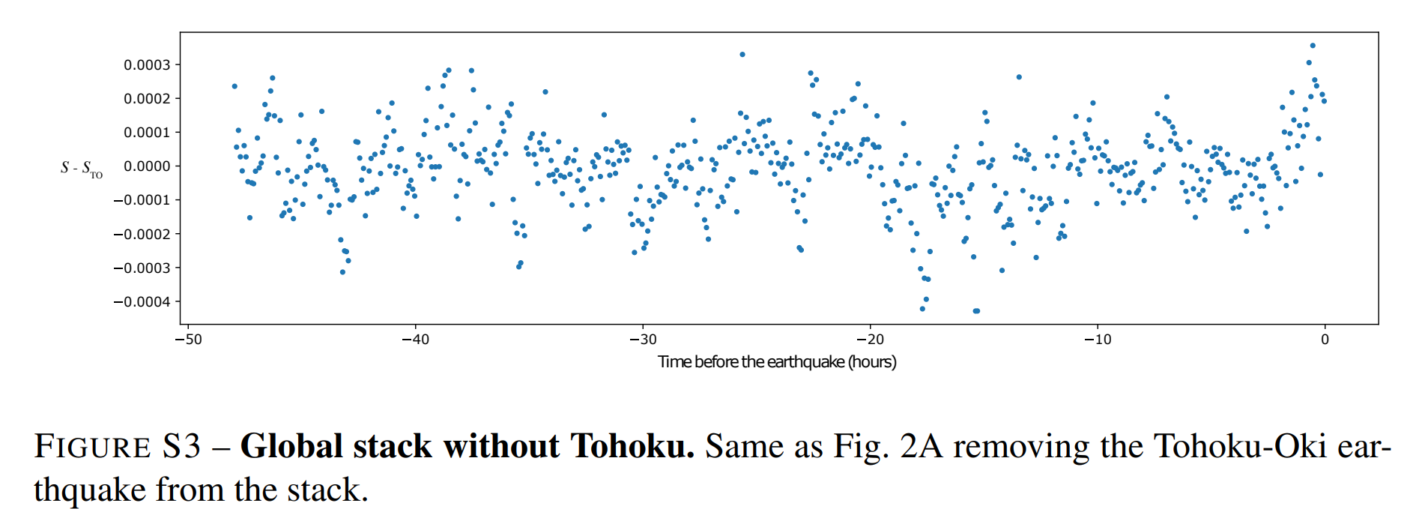
B&N Supplemental F3

Slide 14
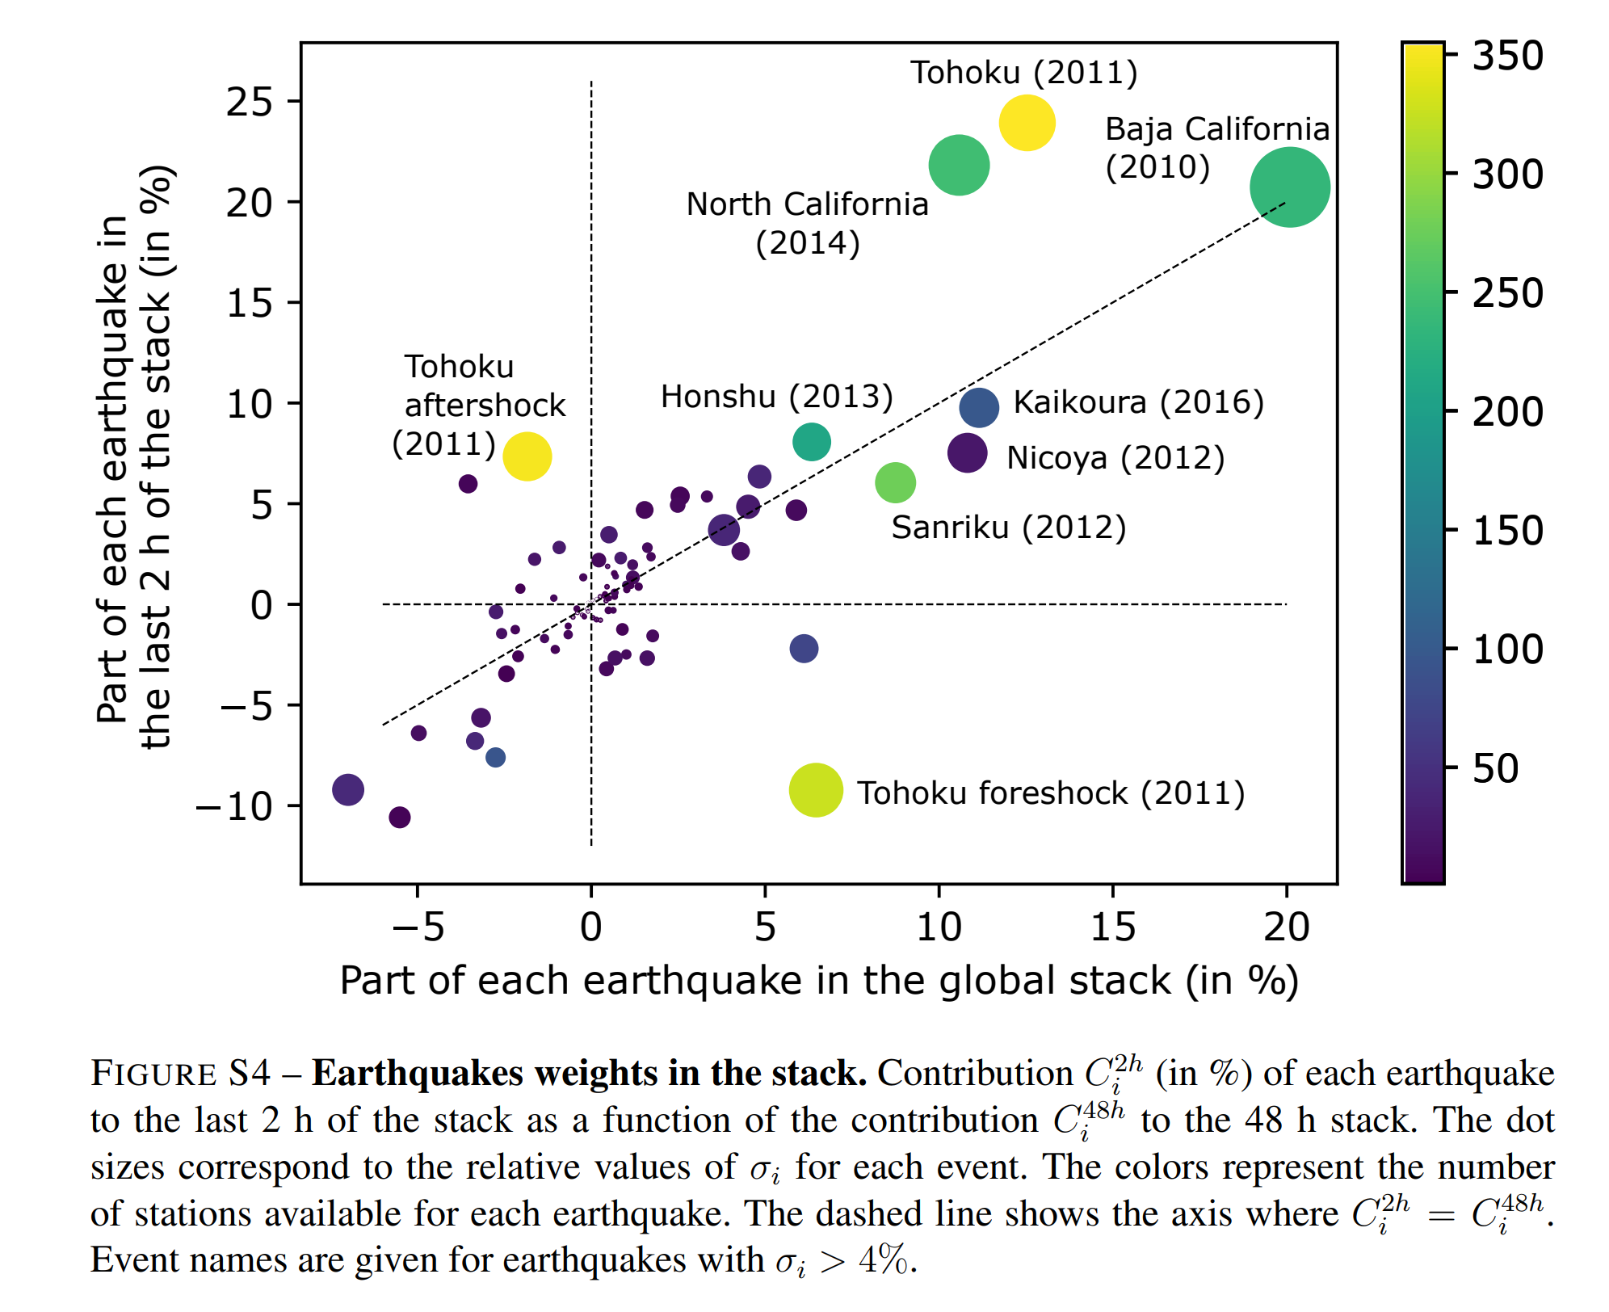
B&N Supplemental F4

Slide 15
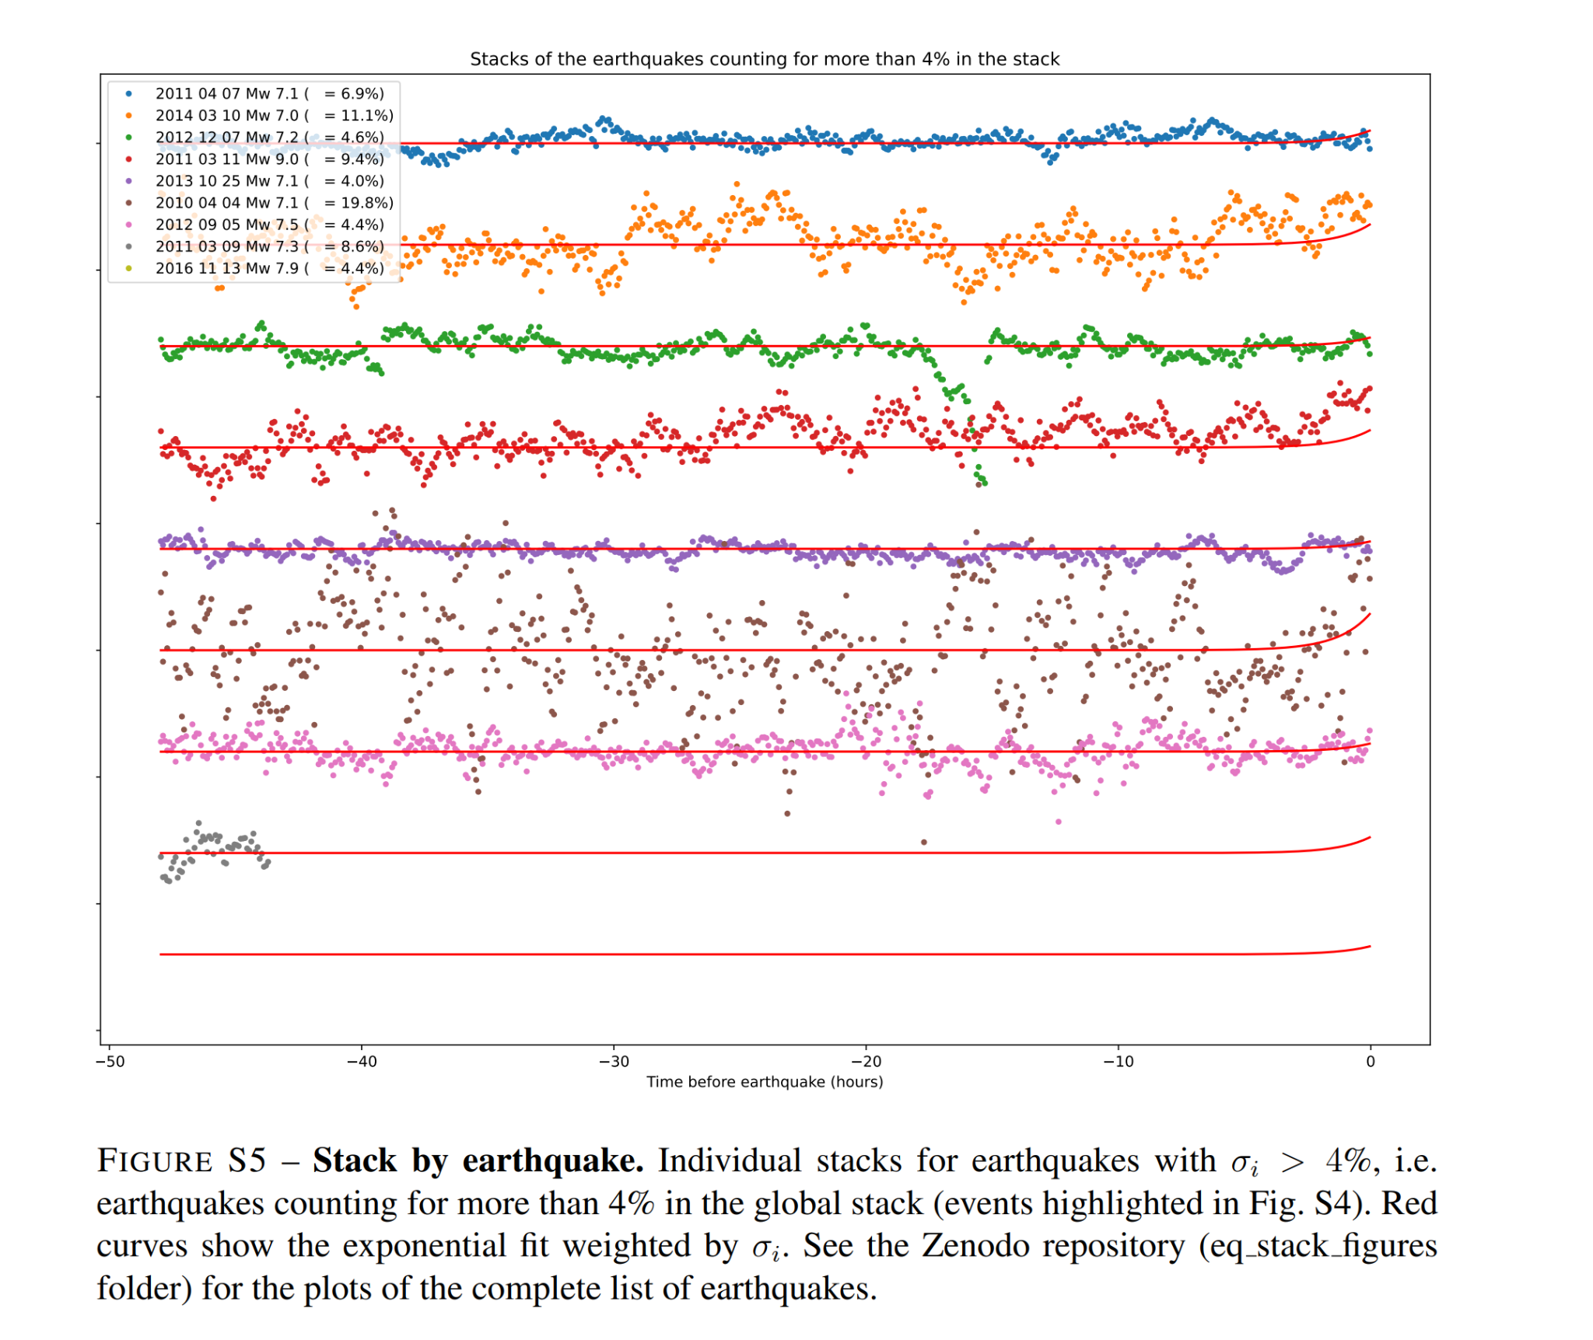
B&N Supplemental F5

Slide 16
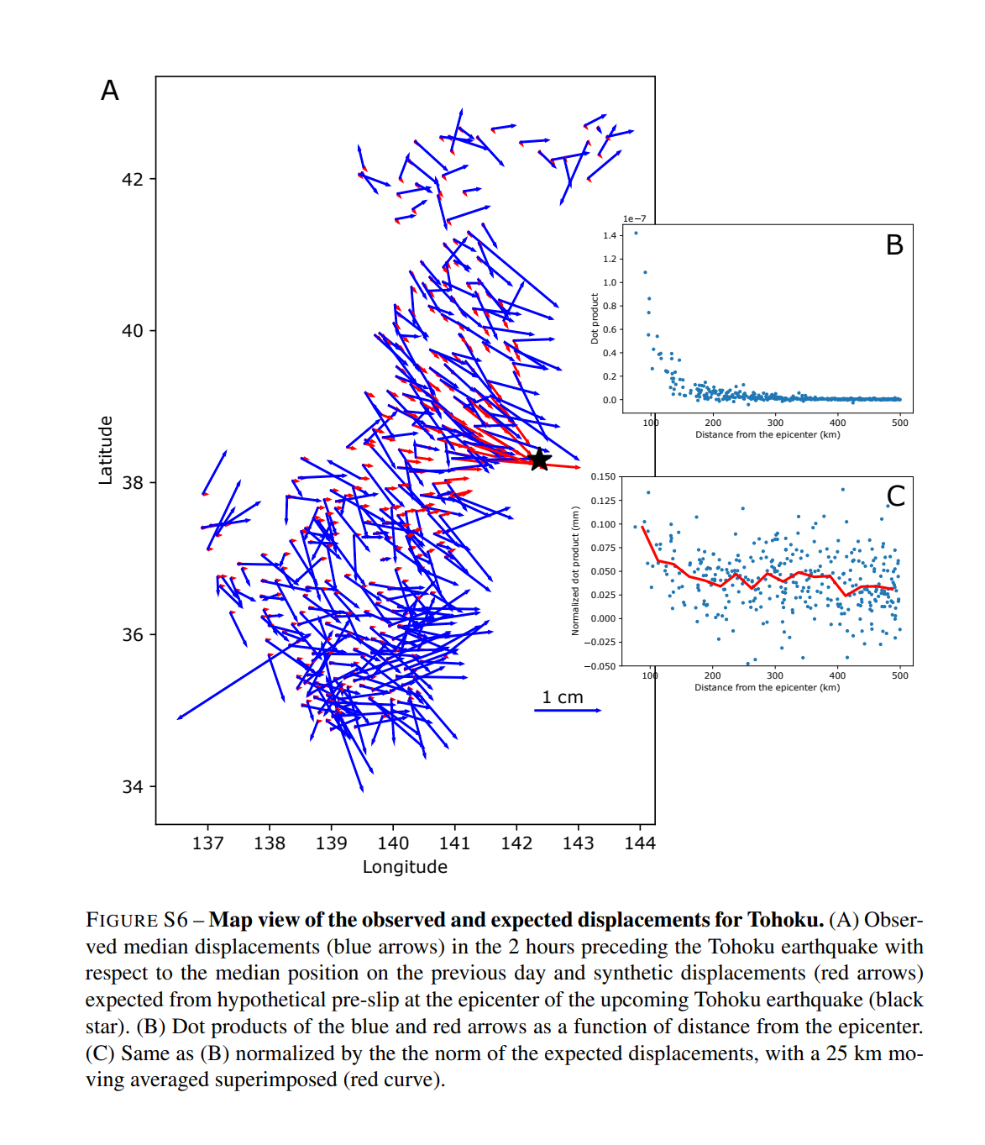
B&N Supplemental F6

Slide 17
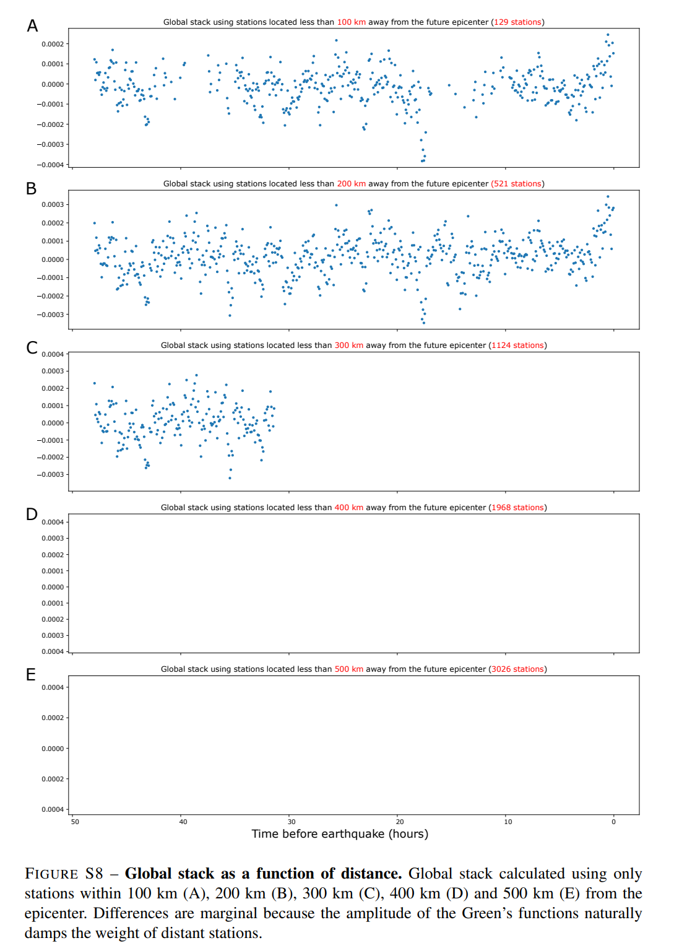
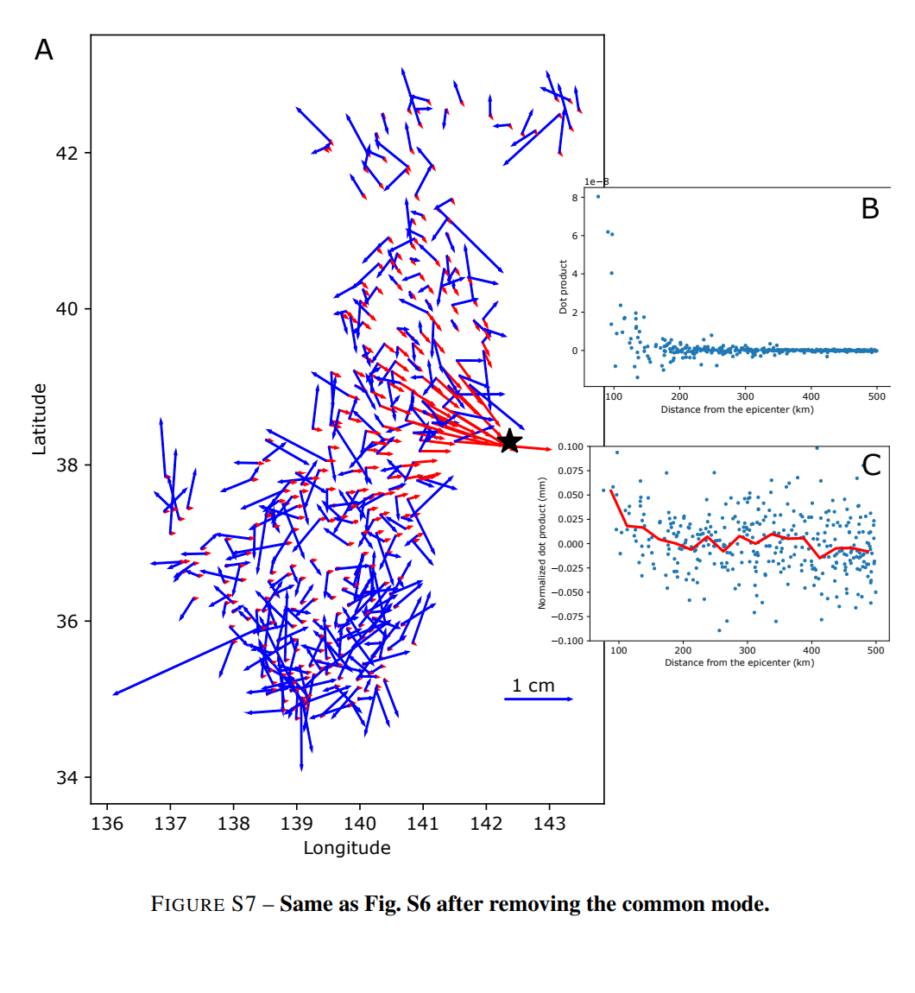
B&N Supplemental F7 and F8

Slide 18
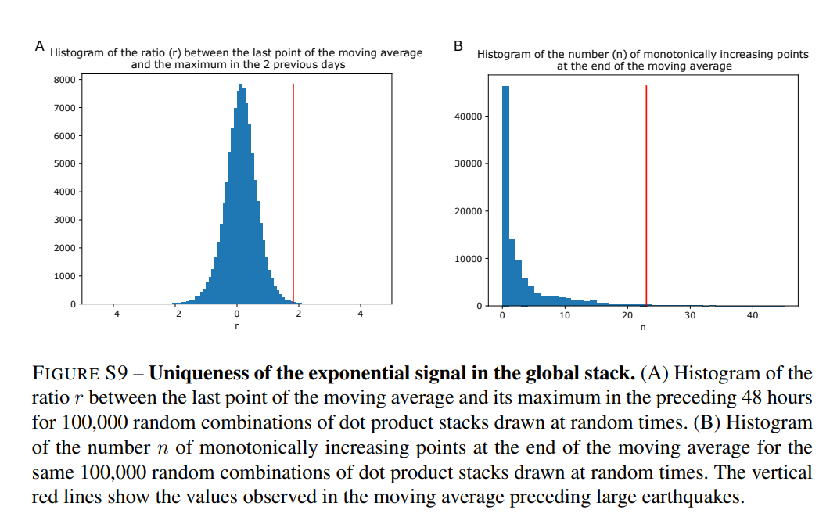
B&N Supplemental F9

Slide 19
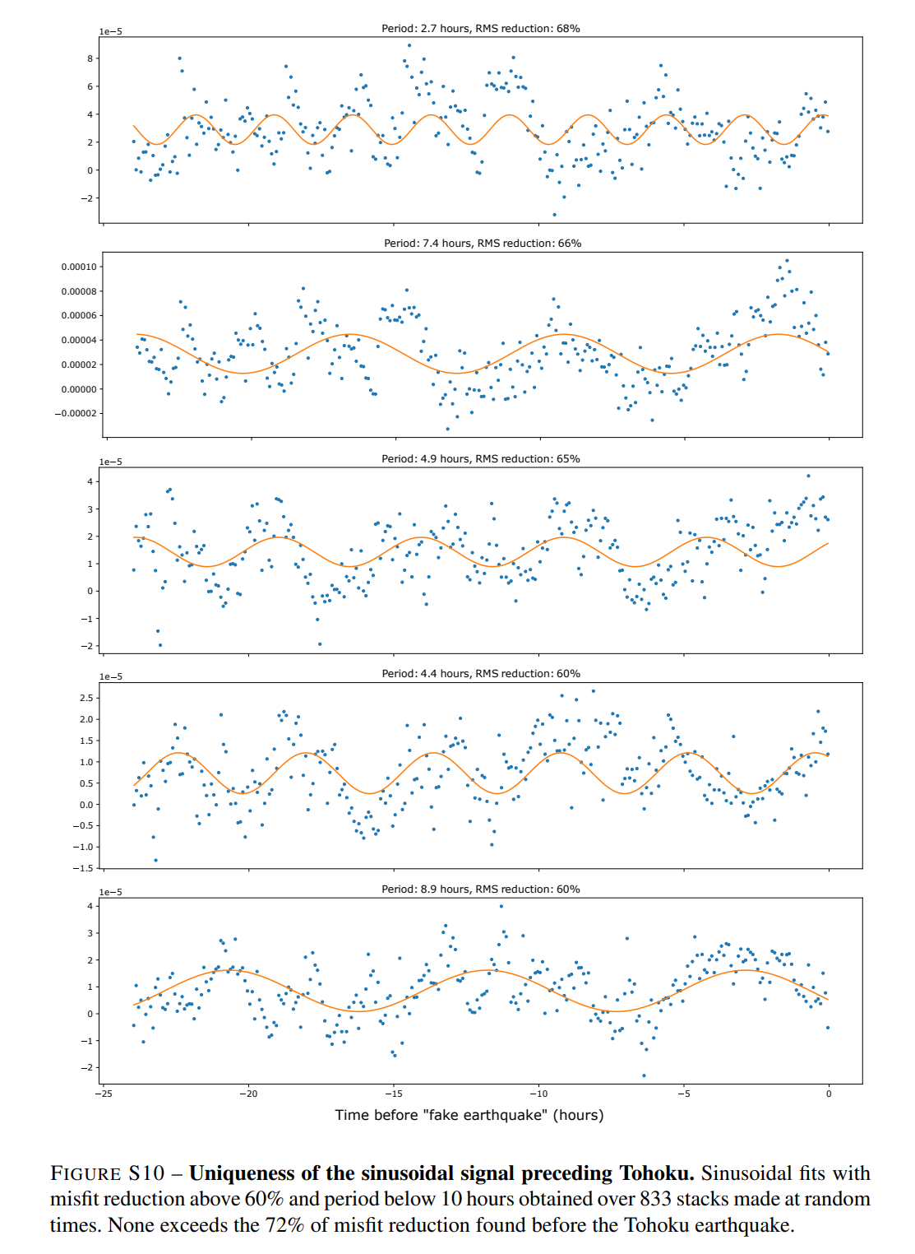
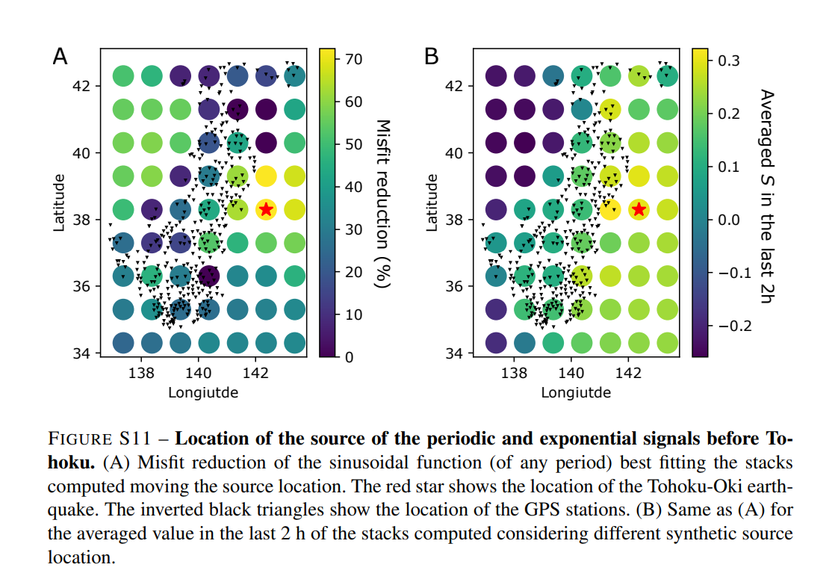
B&N Supplemental F10 & F11

Slide 20
Credits
Special thanks to all the people who made and released these awesome resources for free:
Presentation template by SlidesCarnival
Photographs by Unsplash

Slide 21
Presentation design
This presentation uses the following typographies:
Titles: Walter Turncoat
Body copy: Nunito
Download for free at: https://www.fontsquirrel.com/fonts/walter-turncoat https://www.fontsquirrel.com/fonts/nunito
You don’t need to keep this slide in your presentation. It’s only here to serve you as a design guide if you need to create new slides or download the fonts to edit the presentation in PowerPoint®

Slide 22
Extra graphics
Change the color of gray shapes with the “Recolor image” functionality. Draw your own feet, hands and mouths to create unique characters and have fun!

