Slide 1
Geology 6690/7690
Geodesy & Crustal Deformation
17 Nov 2023
Last time: Dislocation Green’s functions
• Point source (simpler) or e.g. rectangular
• Pressure/volume change (simpler) or full moment tensor
(I) Mogi model…
• Inflation/Deflation of a fluid inclusion point source in an
elastic half-space produces displacements:
• Deformation from Soccoro magma body (no surface
extrusives!) during 1992-1997 was large enough to
overwhelm tectonic signal out to >100 km radius; Rio
Grande rift GPS data 2005-2012 show divergence
from several locations
© A.R. Lowry 2023

Slide 2
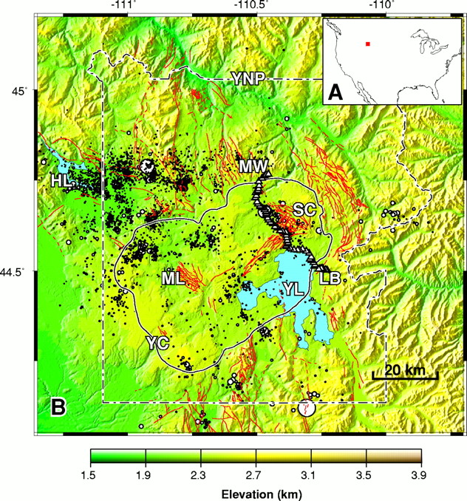
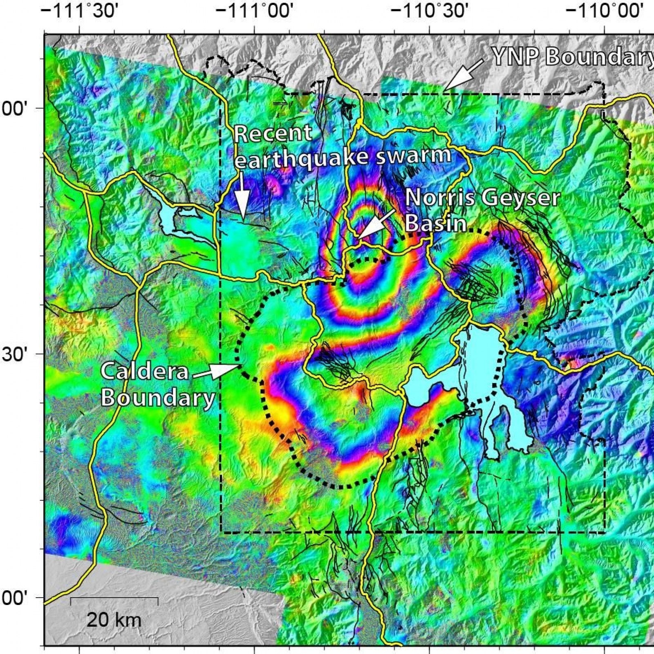
Consider: Why are the Sour Creek and Mallard Lake
domes…. Domes?

Slide 3
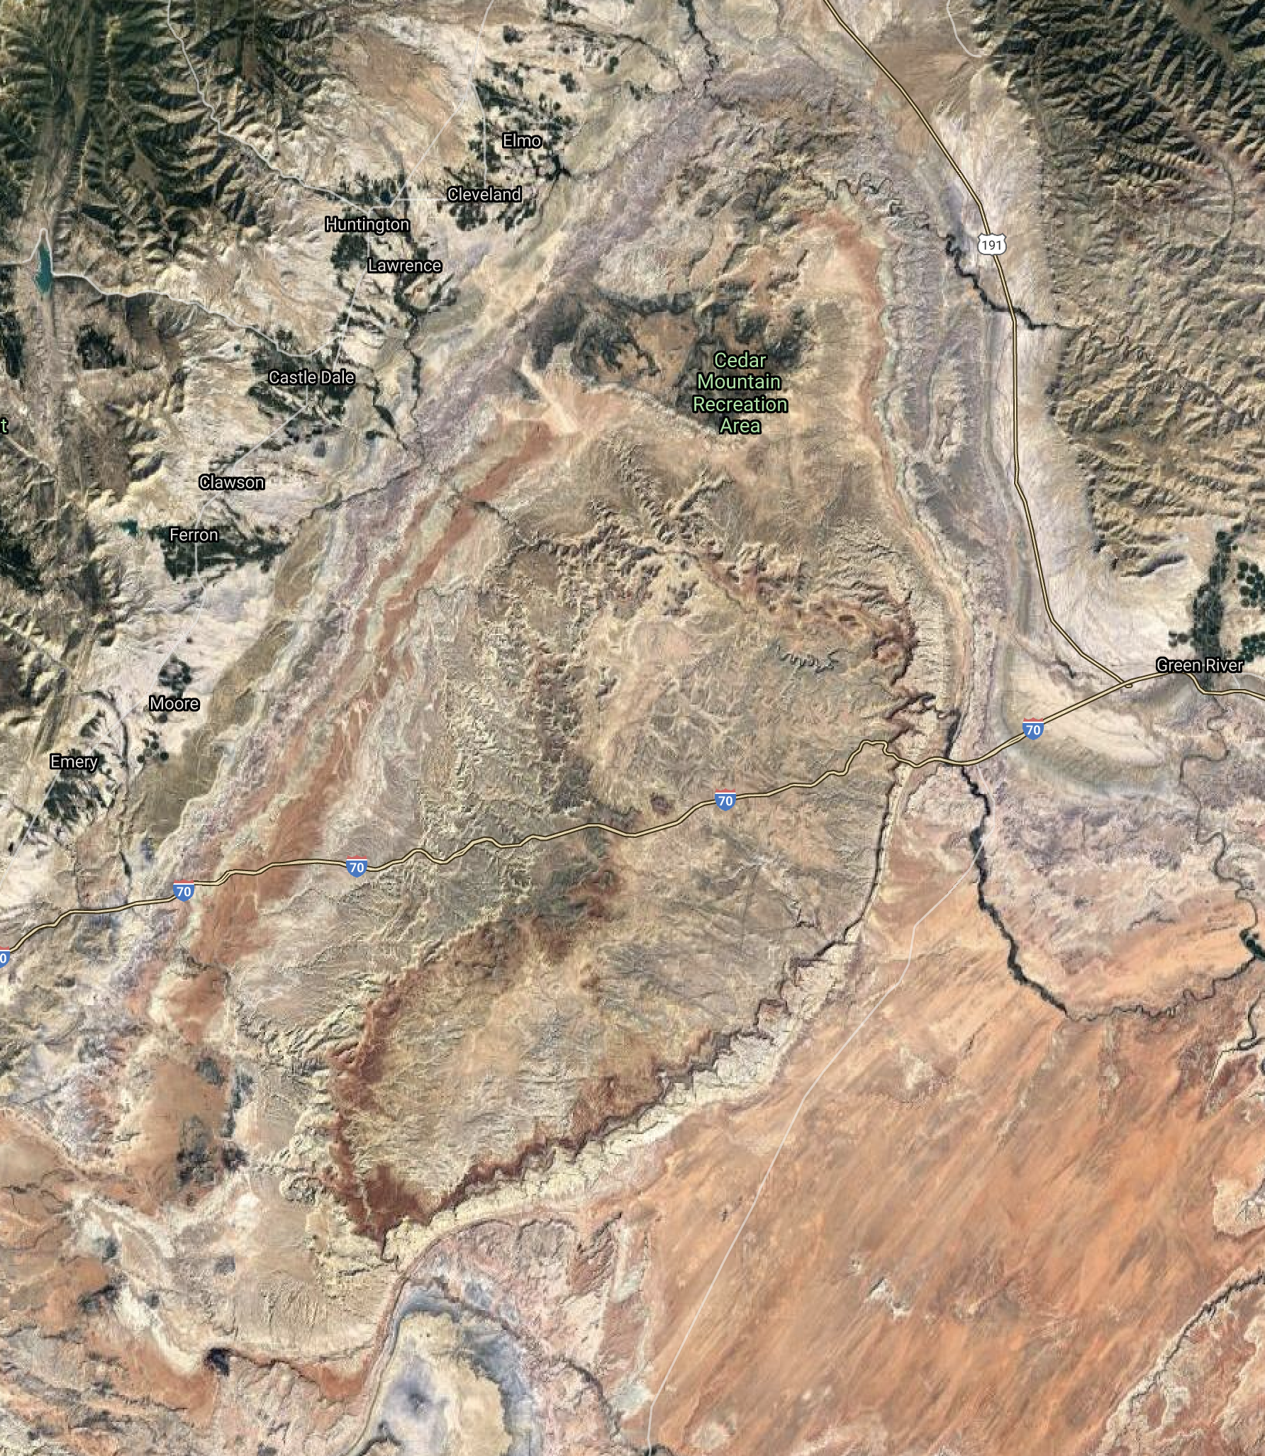
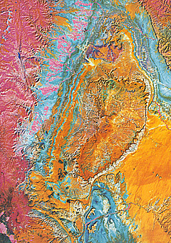
And what about other structures (such as
Colorado Plateau “monoclinal uplifts”?)
(Consider e.g. “San Rafael Swell” in Utah…)

Slide 4
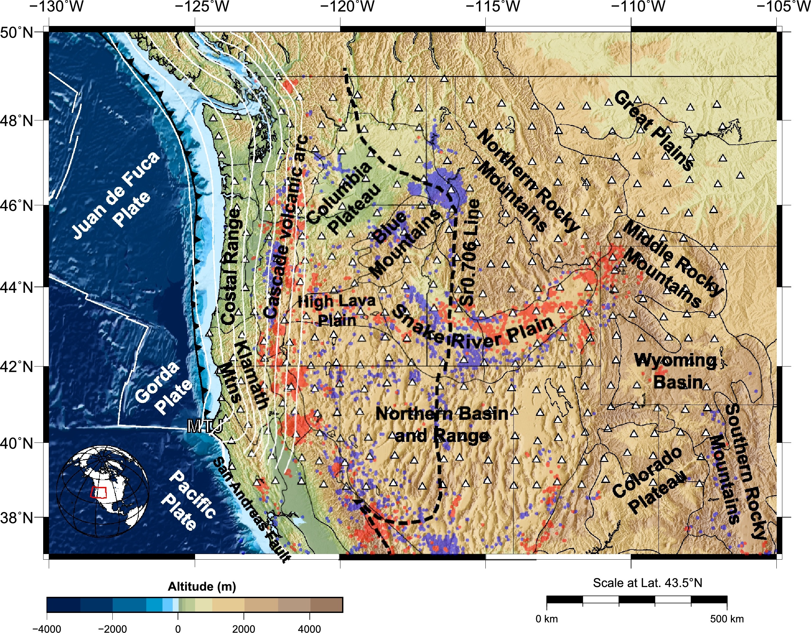
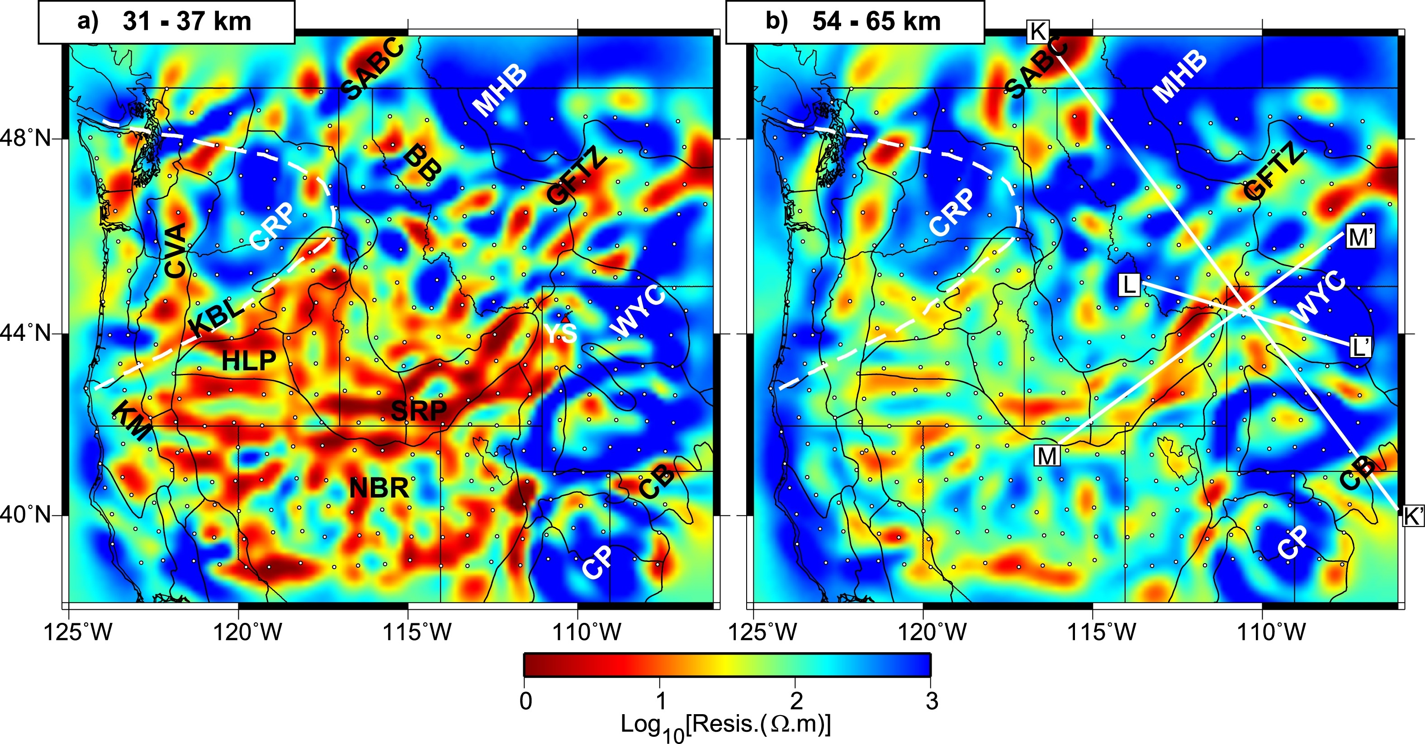
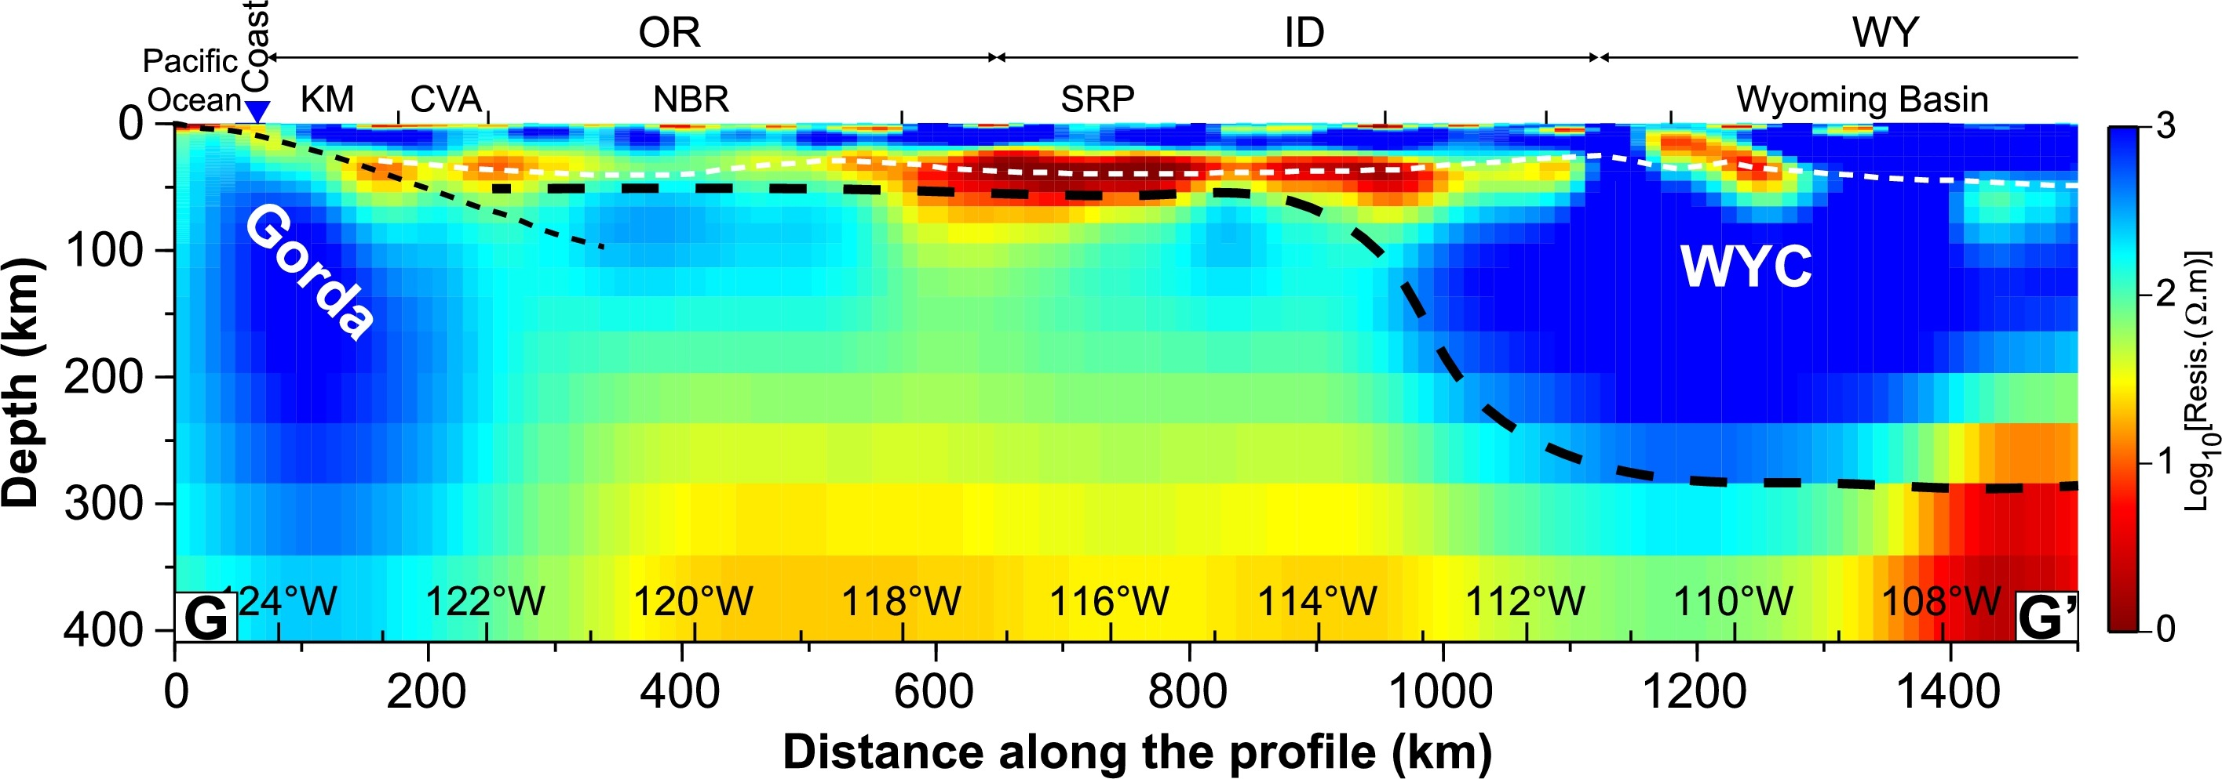
Magnetotelluric imaging of
electrical conductivity structure
by Meqbel et al. (EPSL 2014)...
Resistivity less than ~10 Ohm-m
in the lower crust “could be”
graphite and/or sulfides, but is
much more probably partial
melts...
How might we expect
deformation to behave
in the presence of a
widespread low-viscosity
layer?

Slide 5
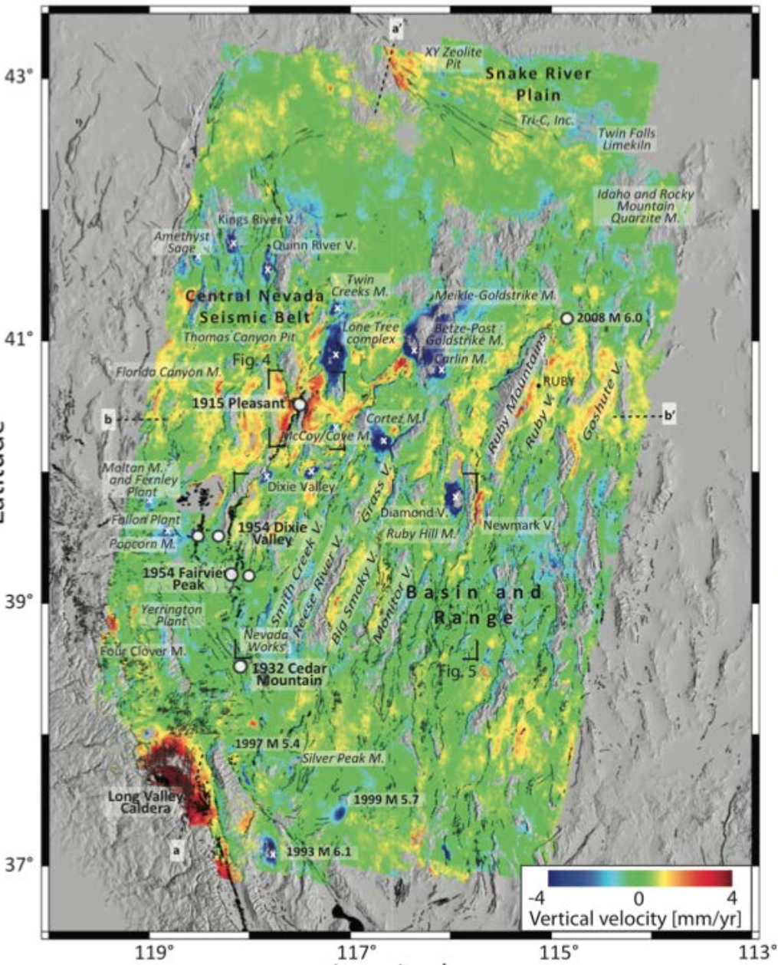
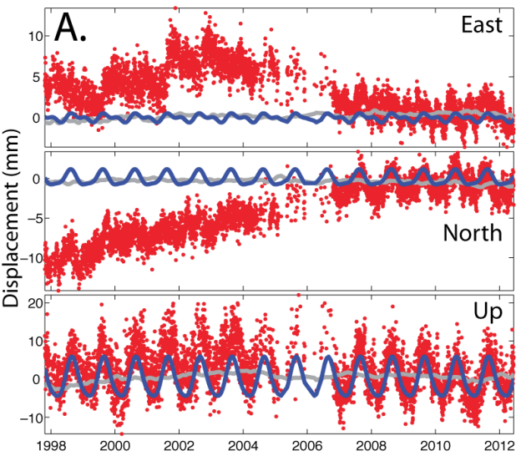
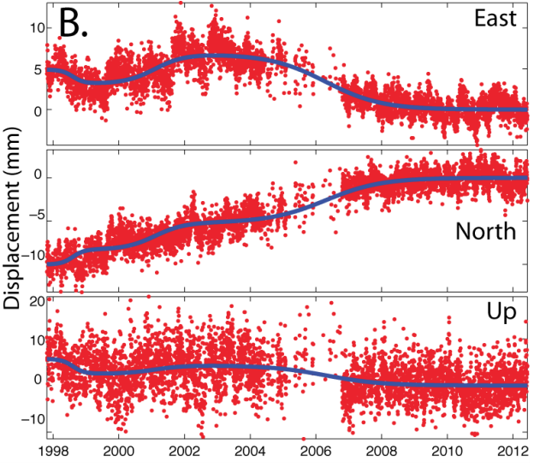
Greene, Amelung et al.
(2014) stack of 1600
InSAR interferograms
from 1992-2001…
Chamoli et al.,
JGR 2014

