Slide 1
Geology 6690/7690
Geodesy & Crustal Deformation
20 Sep 2023
GPS Position Error (& Mitigation)
• Largest error source in post-processed, phase+code,
daily-averaged positions is atmospheric mis-modeling
• Differencing helps to remove this, but does not completely
take care of it!
• Ionosphere TEC is dispersive and removed by linear
combination of two or more carrier frequencies… TEC
measurements used for space weather/ionosphere
dynamics & hazard studies
• Tropospheric error includes (1) pressure-temperature-
water vapor, & (2) scattering (dispersive)
© A.R. Lowry 2023

Slide 2
Read for Fri (22 Sep)
Borsa, A. A., Agnew, D. C., & Cayan, D. R. (2014). Ongoing
drought-induced uplift in the western United States. Science,
345(6204), 1587-1590.
Ethan will lead!

Slide 3
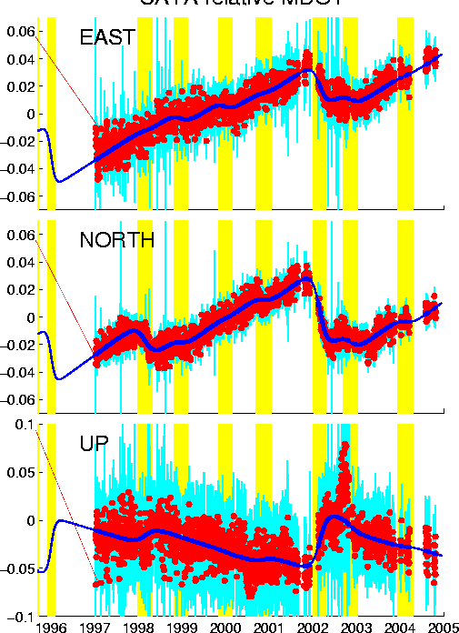
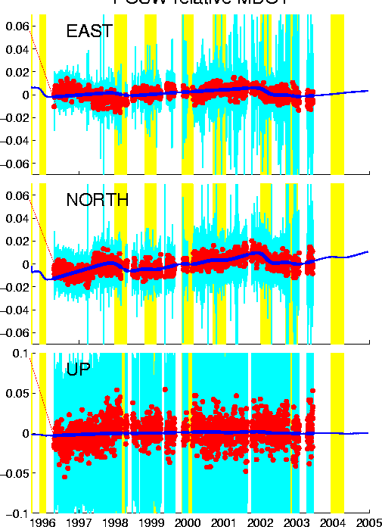
GPS Error Sources (and Mitigation)
Atmosphere II. The Troposphere:
CAYA (Elev 26 m) rel MDO1
POSW (Elev 3940 m) rel MDO1

Slide 4
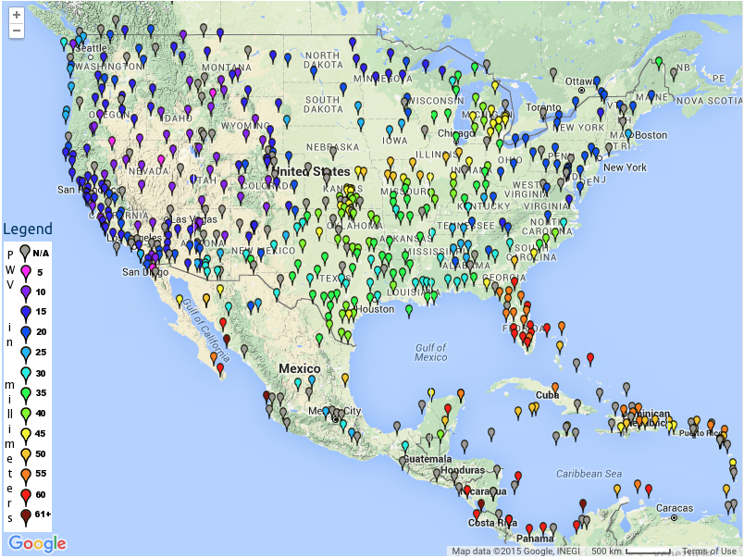
But again,
one person’s
noise is another’s
signal. This courtesy
of SUOMINET…

Slide 5
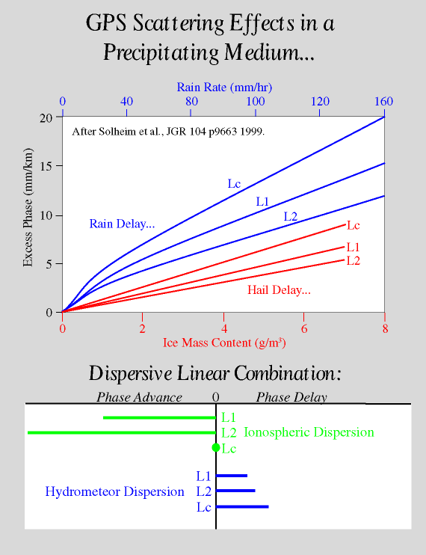
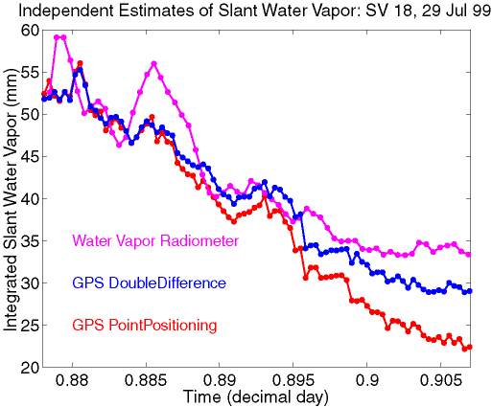
GPS Error Sources (and Mitigation)
Atmosphere II. The Troposphere:
Cumulonimbus
cloud
Scattering: Worth being aware of
for met applications, but little we
can do to mitigate (for now)!

Slide 6
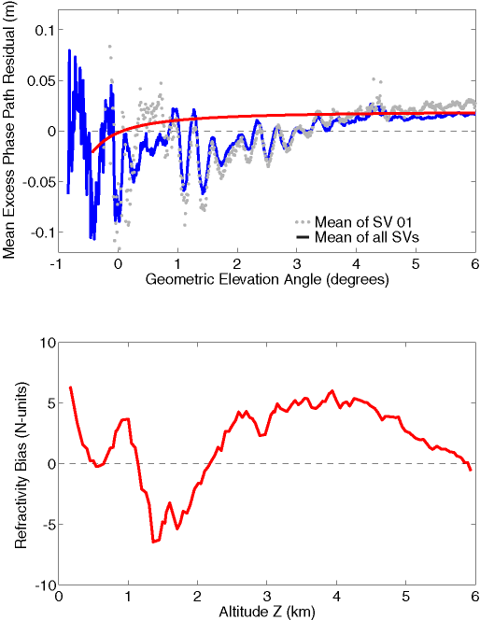
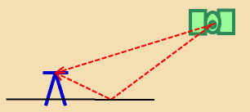
GPS Error Sources (and Mitigation)
Lowry et al., Radio Sci., 2001
Multipath results from the
microwave energy that
reflects off of the ground or
other nearby objects and
thus arrives with a slightly
different path. This energy
constructively/destructively
interferes with amplitude,
and changes the observed
phase by up to half a cycle…

Slide 7
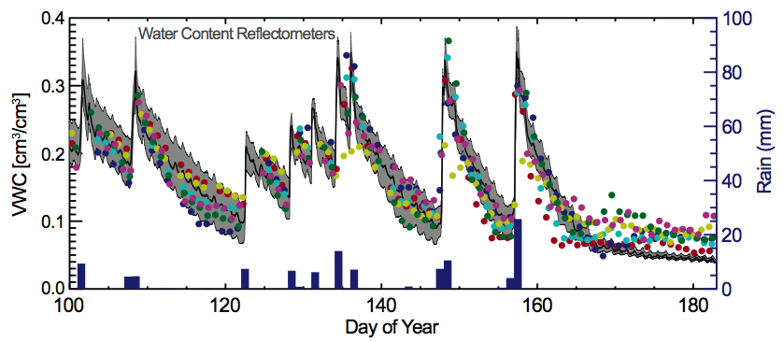
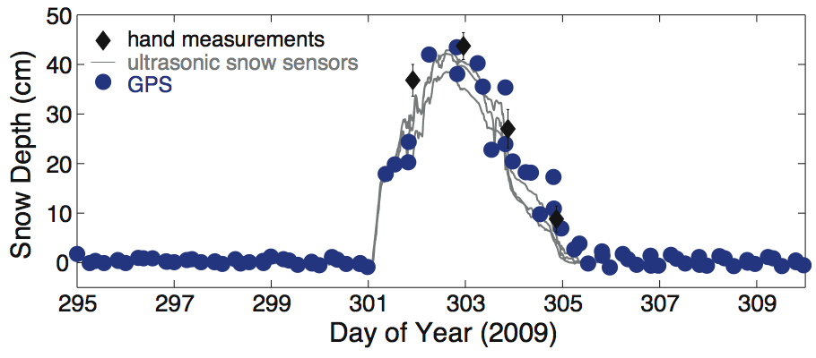
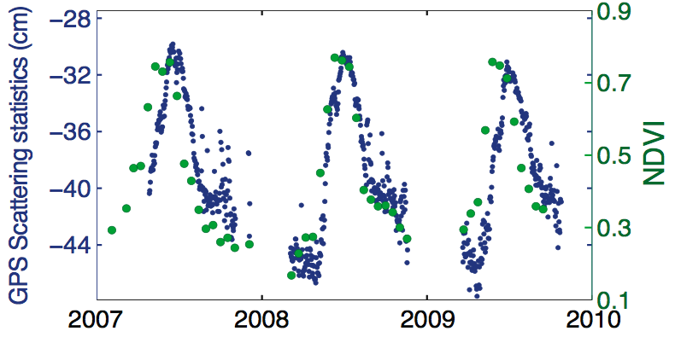
GPS Error Sources (and Mitigation)
Since reflecting surfaces don’t
change much, multipath can
be reduced with an elevation/
azimuth-dependent correction.
But can also use for sensing!
Soil Moisture
Here, the multipath primarily affects the amplitude. More water = stronger reflections! But snow depth also changes the distance, & thus the phase!
Larson et al., GRL 2008
Snow Depth
Larson et al., GRL 2009
Vegetation
Small et al., GRL 2010

Slide 8
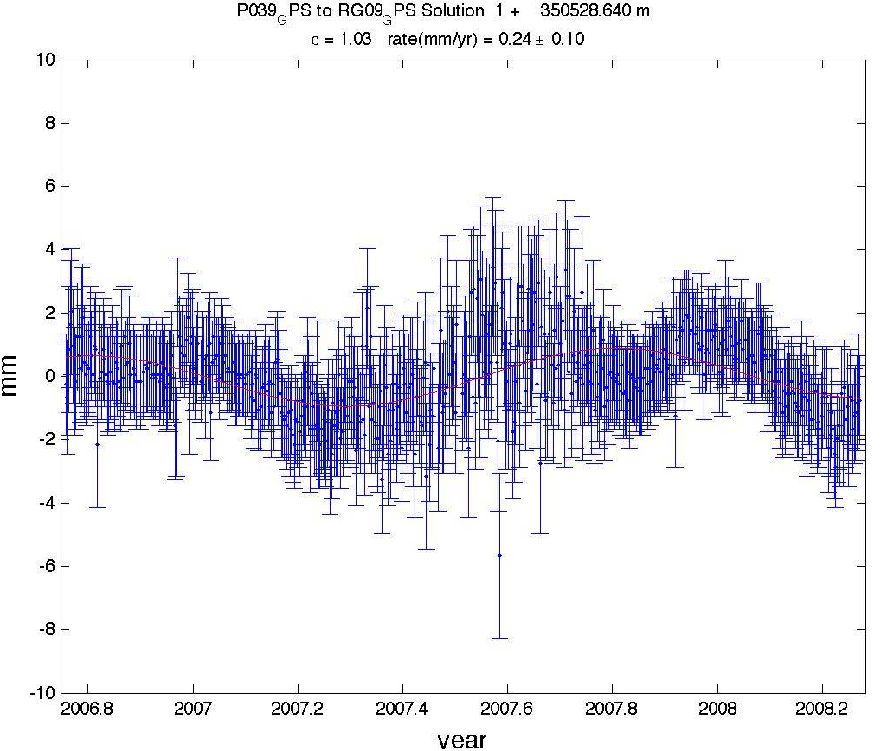
Example: Total baseline length for two sites in the RGR…
What’s this?
What’s this?

Slide 9
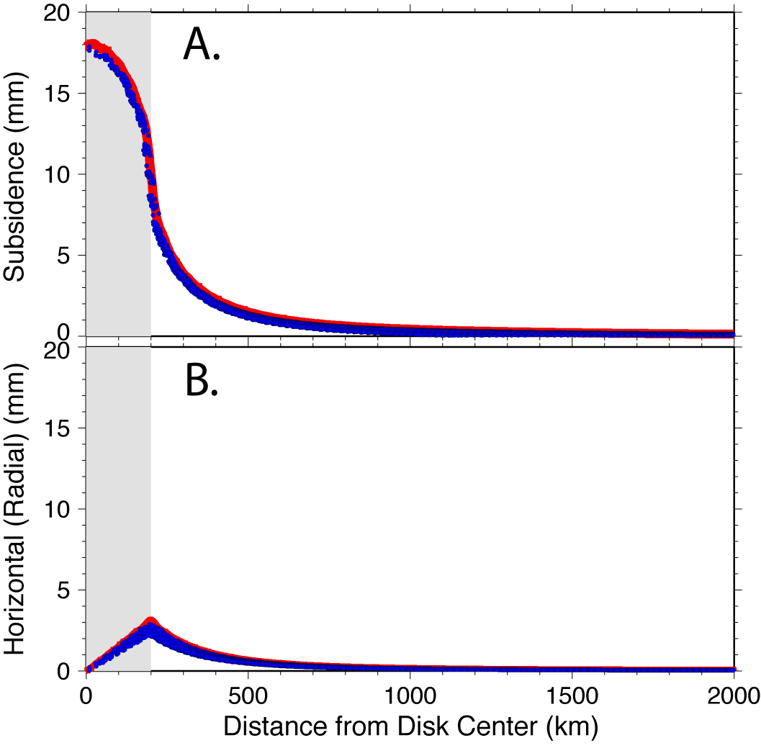
Chamoli et al., JGR 2014
Here modeled
response of an
elastic Earth to
a 200-km radius
disk of water,
1-m in height…
At < 1 mm
precision,
hydrologic
mass becomes
a large signal.

Slide 10
Example: Total baseline length for two sites in the Rio Grande
Rift network.
Note the scatter
& uncertainties
are (generally)
very small (~1 mm);
effects of elastic
a response to
hydrologic mass
loading is clear;
however both scatter
and departure from
a seasonal loading
model increase
during the
summer months. This was anticipated!

