Slide 1
Geology 6690/7690
Geodesy & Crustal Deformation
23 Oct 2023
Last Time: Assessing GNSS Earthquake Precursors
• Bletery & Nocquet found non-negligible (sinusoidal and
exponentially increasing) signal in stacks of “apparent moment”
in time series of GPS data prior to large earthquakes, resolved
in the local direction of subsequent initial coseismic deformation
• Barnes & Hubbard interpreted as common mode “noise” after
the signals disappeared following removal of average
displacements of far-field sites, suggesting not precursory
• However common-mode may be errors (satellite orbits/clocks)
or signals (troposphere, ionosphere), or even deformation if
estimated the way B&H did! Plausible possibilities are orbit errors
(for exponential but not sinusoidal) induced by misestimation of
EQ displacements, or precursory ionosphere perturbations (both)
previously identified, e.g., by Heki (GRL 2011).
Read for Fri 27 Oct: Wahr §3.3-3.3.5 (75-101)
© A.R. Lowry 2023

Slide 2
Read for Wednesday (25 Oct)
Hamling et al. (2023) Complex multifault rupture during the 2016
M_{w} 7.8 Kaikōura earthquake, New Zealand. Science, 365(6334)

Slide 3
Introduction to Gravity
Gravity, Magnetic, & DC Electrical methods are all examples
of the Poisson equation of the form:
∇ ²u = f (sources),
Where u is a potential,
is the gradient operator
Notation: Here, the arrow denotes a vector quantity;
the carat denotes a unit direction vector.
Hence, the gradient operator is just a vector form of slope…
Because Poisson’s eqn always incorporates a potential u,
we call these “Potential Field Methods”.
→
^

Slide 4
Gravity
We define the gravitational field as
And by Poisson’s equation,
(1)
given a (spherical, symmetric) body of total mass M.
G is universal gravitational constant = 6.672x10⁻¹¹
Integrating equation (1), we have
(2)
Nm²
kg²

Slide 5
IF the body with mass M is spherical with constant (or
radially symmetric) density, equation (2) has a solution
given by:
Here r is distance from the center of mass (CoM);
is the direction vector pointing toward the CoM
Newton’s Law of gravitation:
So expresses the acceleration of m due to M!
has units of acceleration ⇒ Gal in cgs (= 0.01 m/s²)
On the Earth’s surface,
m/s²

Slide 6
HOWEVER, ρ is not radially symmetric in the Earth…
so is not constant!
Gravity methods look for anomalies, or perturbations,
from a reference value of at the Earth’s surface:
g_{obs}
gref
ρ₁
ρ₀

Slide 7
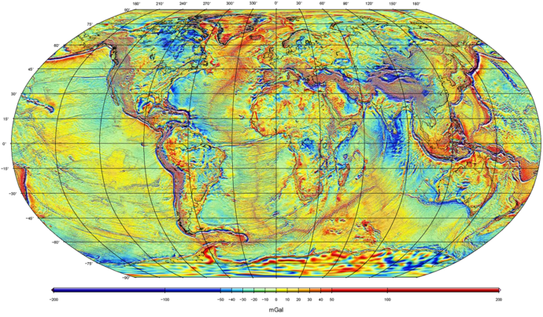
Example:
Global Free-Air Gravity Field from GRACE + GOCE + surface measurements…
WGM2012 model from Bureau Gravimetríque International

