Slide 1
Geology 6690/7690
Geodesy & Crustal Deformation
25 Sep 2023
GPS Position Error (& Mitigation)
• Largest error source in post-processed, phase+code,
daily-averaged positions is atmospheric mis-modeling
• Differencing removes part of this, but not all!
• Tropospheric error includes (1) pressure-temperature-
water vapor, & (2) scattering (dispersive)
• However, tropospheric precipitable water vapor (PWV)
useful for weather forecast modeling
• Multipath is signal that reflects off the ground or other
objects. Can be corrected (mostly) with an averaged phase
map, but amplitude/phase can also be used to sense local
soil moisture, snow depth or vegetation index
• Mass loading (by water, ice, atmosphere) introduces a real
deformation signal to GPS
© A.R. Lowry 2023

Slide 2
Read for Fri (29 Sep)
Herring, T. A., Melbourne, T. I., Murray, M. H., Floyd, M. A.,
Szeliga, W. M., King, R. W., ... & Wang, L. (2016). Plate
Boundary Observatory and related networks: GPS data
analysis methods and geodetic products. Reviews of
Geophysics 54(4), 759-808.

Slide 3
GPS Error Sources (and Mitigation)
Reference Frame Parameters:
We estimate the satellite positions and other orbital
parameters by tracking from the ground… But this only
works if the locations of tracking sites are in some sense
“known”. The reference frame includes transformations
from the Earth-based frame to space-based, e.g.,
• Earth rotation parameters: axis of rotation, length-of-day.
Note these change over time (because of changes in
shape/inertia of the Earth and its fluid envelopes) and
must be estimated from space-based geodetic data!
• Tidal and loading effects: solid Earth tide, ocean tidal
loading, mass of fluid envelopes
• Other assumptions regarding the motions of ground
tracking sites (including “plate” velocities, “other”
velocities, estimates of earthquake displacements)…

Slide 4
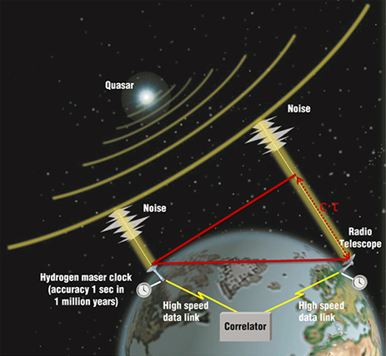
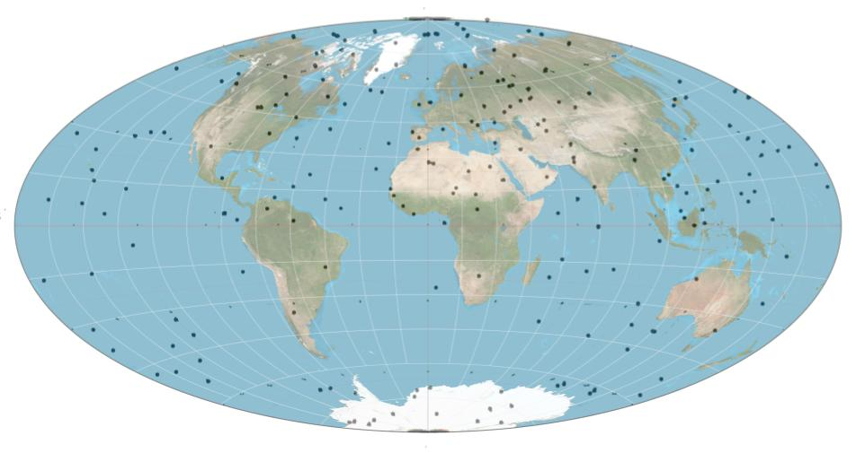
GPS Error Sources (and Mitigation)
Reference Frame Parameters:
• Earth rotation parameters: axis of rotation, length-of-day
are also tracked by other space-referenced systems
(e.g., Very Long Baseline Interferometry
→ VLBI from quasar random noise signals)…
Courtesy NASA…
Sky map of quasars (at a
particular time/date)

Slide 5
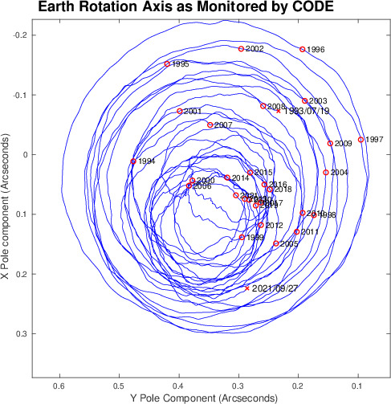
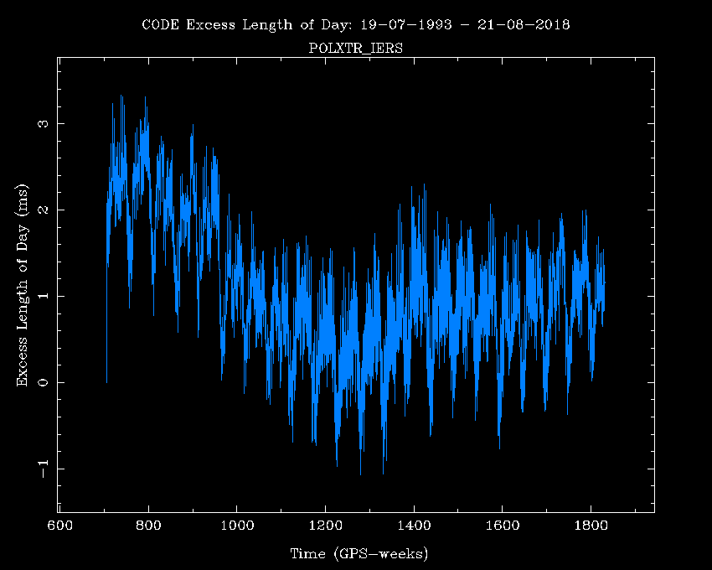
GPS Error Sources (and Mitigation)
Reference Frame Parameters:
• But we also estimate Earth rotation parameters directly
from the GPS/GNSS systems. These are CODE
(European orbital analysis center) estimates of changes
in the polar rotation axis and the length of day…
Note 0.1 arcsec = ~3 m!

Slide 6
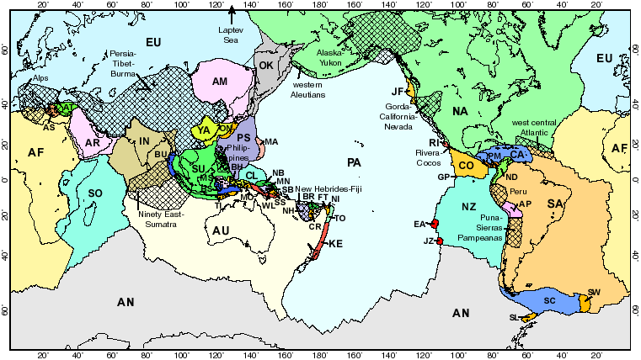
“Knowing” motions at all sites entails “knowing” Secular Velocities...
One common starting point for velocity is “plate motion”, which
assumes motion of a rigid plate on the surface of a spherical Earth
(⇒ no strain!)
Bird, Geochem. Geophys. Geosys., 2003

Slide 7
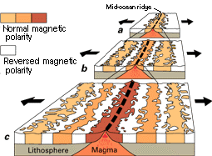
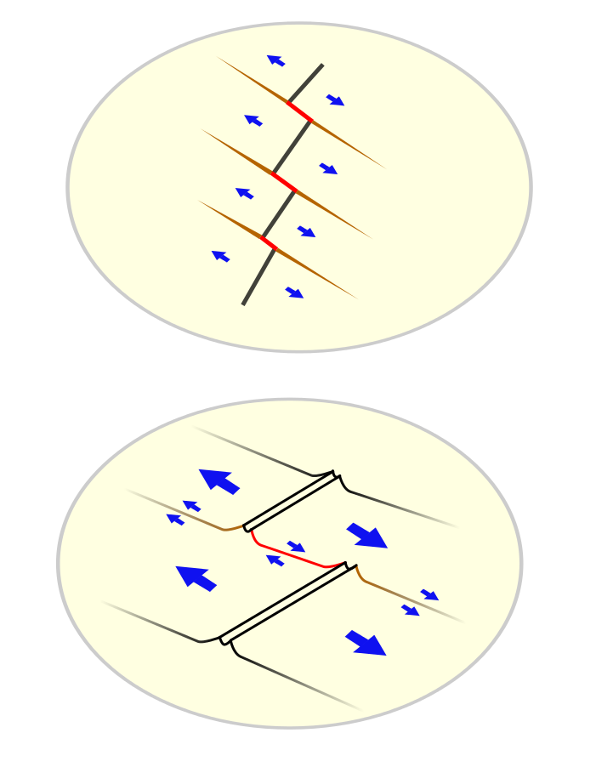
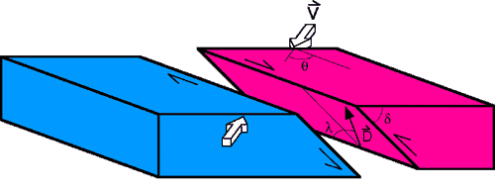
Secular Velocities...
• “Geologic” Plate Velocity Models use “geologic data”, including
oceanic ridge spreading rates derived from dated seafloor
magnetic anomalies; relative plate motion directions inferred
from transform faults; earthquake slip vectors…
• Effectively average over the past 3 million years (because
of the need for magnetic anomaly rate constraints)…
• No-Net Rotation (NNR) versions of plate models (comparable
to GPS frame) include NNR-NUVEL-1A by DeMets et al.
(1990; 1994); NNR-MORVEL56 by Argus et al. (2011)
Courtesy USGS
Courtesy USGS

Slide 8

Plate Velocity Modeling using Euler Poles:
Assumes rigid “blocks” (or “plates”) move independently
relative to one another across the Earth’s surface.
Each block will have an Euler Pole: For the p’th block,
means the block rotates at angular velocity ω_{p} around the
pole at latitude λ_{p}, longitude φ_{p}. Then the velocity at any
point on the block is given by:
Assumes? How small a “plate” can we reasonably expect?
Altamimi et al. (2012) adds an “origin rate bias” term:
which is really a reference frame issue related to inadequacy
of sampling & our poor knowledge of surface mass change.
Euler poles were first proposed as a tool for deriving plate tectonic motions in the 1960s by Tanya Atwater, then a graduate student at Scripps’ Institute of Oceanography

Slide 9
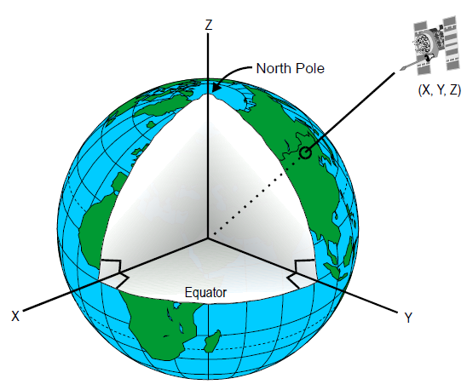
The ITRF20xx Reference Frames first and foremost define
global plate & deforming-zone GPS velocities. Note:
• X, Y, Z refers to the Earth-centered, Earth-fixed GPS coordinate
system. We use coordinate
transformations to convert
these to more familiar lat, lon,
height above an ellipsoid…
• “Origin rate bias” is translation
rate of the X, Y, Z = 0
origin of the coordinate
frame
• ITRF also find global
rotation-rates (primarily in
the X-axis) that describe
differences between IGS and other NNR frames
These are rooted in issues of inadequate sampling of the
global velocity field & neglect of global surface mass change.

Slide 10
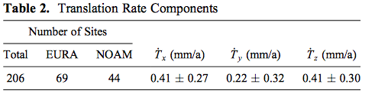
Altamimi et al., JGR 2012
The good news is (here, ITRF2008) estimates of translation rate
are not significant at 95% confidence (and can be thought of
more as just an expression of uncertainty in global motions
introduced by the sampling geometry!)
The most recent (ITRF2020) translated –1.4, –0.9 & 1.4 mm
relative to ITRF2014 (which remains statistically insignificant,
as one would hope given that the frames are defined to
minimize changes within uncertainty!)

