Slide 1

Geology 6690/7690
Geodesy & Crustal Deformation
28 Aug 2023
• Some important syllabus points
• Course website is at:
http://aconcagua.geol.usu.edu/~arlowry/Geod_CD/index.html
• 6690 differs from 7690 in the expectation that PhD-level grad student
projects will include new theoretical and/or algorithmic development
(discuss with me)
Semester projects should begin in the next three to four weeks; should
be related to your thesis topic if possible; should be interesting to you!
• Always feel free to ask questions! (It helps!)
• So, what do you want to know about Geodesy ?
Read for Wed 30 Aug: Wahr §1 (1-3); §2.5 24-75
© A.R. Lowry 2023

Slide 2
Geodesy is the study of the shape of the
Earth’s surface, and its gravitational field…
Most active processes that are of interest to
Earth scientists change the shape of the planetary
surface and change the gravity field.

Slide 3
Brief Overview of Geophysics:
A large discipline that includes:
Atmospheric Science (Meteorology, Climatology, Ionosphere)
Hydrology, Glaciology
Oceanography
Planetary Science
• Solid Earth Science
Solid Earth Geophysics Includes:
• Geophysical Imaging (Seismic velocity; electrical resistivity)
Geodynamics
Earthquake Seismology
Mineral Physics
• Geodesy
This course will emphasize the lattermost subdiscipline

Slide 4
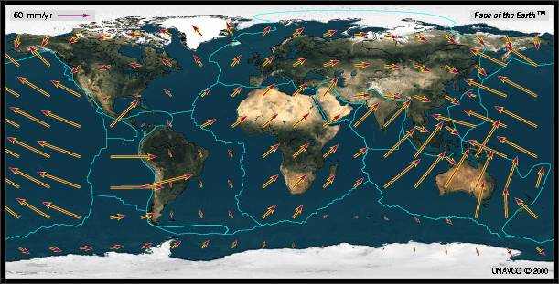
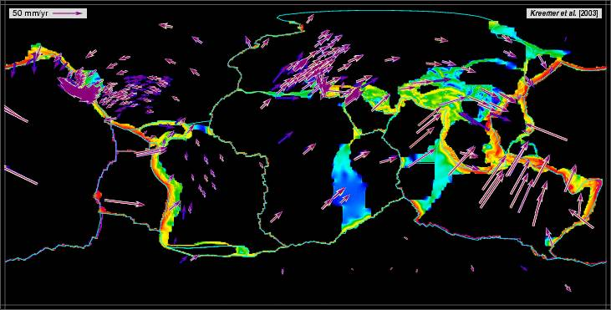
Example: Plate Tectonics
NUVEL-1A model of
plate motions from
magnetic lineations,
orientations of
transform faults,
earthquake slip
vectors
Motions measured by
GPS, repeated at
fixed locations over
periods of years

Slide 5
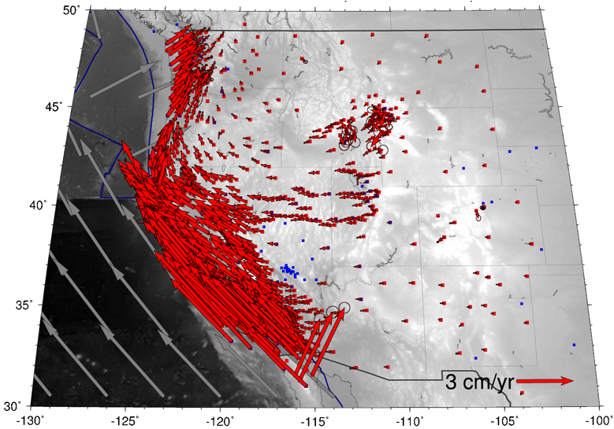
Example: Plate Boundary
Deformation
GPS velocities
relative to a
“North
America-fixed”
reference
frame, circa
August 2011
Credit: Thorsten Becker

Slide 6
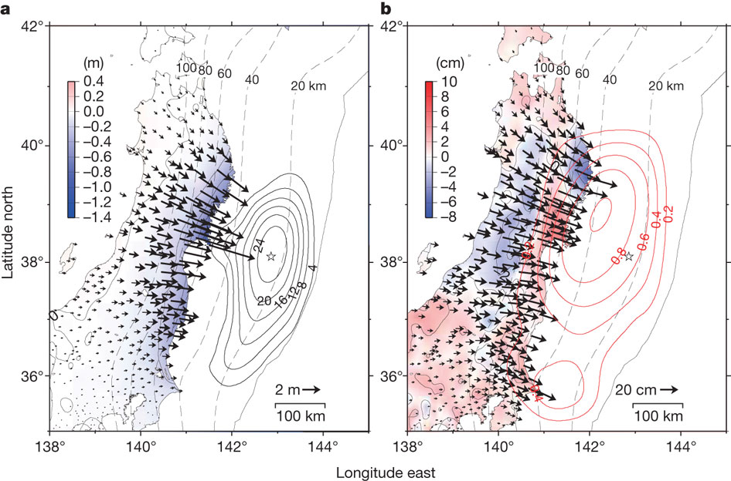
Example: The Earthquake Cycle
Coseismic slip
Afterslip (first two weeks)
Ozawa et al., Nature, 2011
2011 Tōhoku-oki M9.1

Slide 7
Example: Postseismic Deformation
Paul et al., GRL, 2007
2004 Sumatra-Andaman M9.3

Slide 8
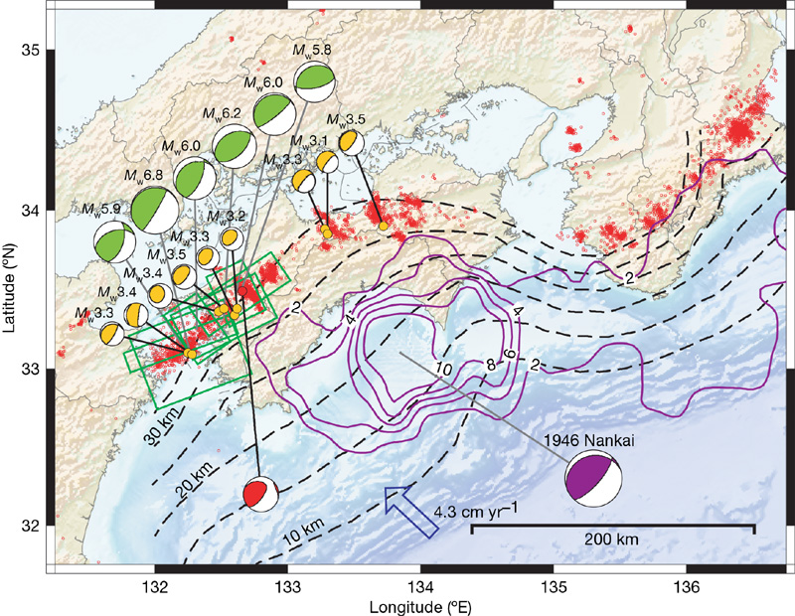
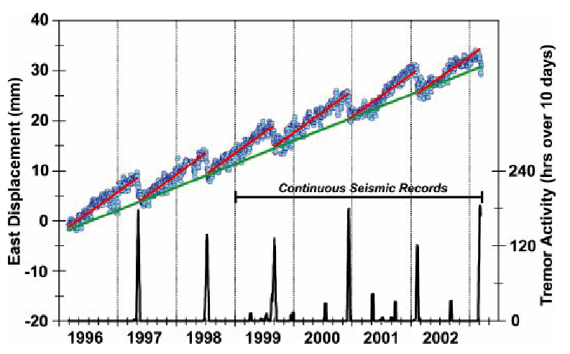
Example: Interseismic Deformation

Slide 9
Example: Magmatic Processes
YVO now monitors
with GNSS and InSAR
Early leveling showed
“volcanic unrest”

Slide 10
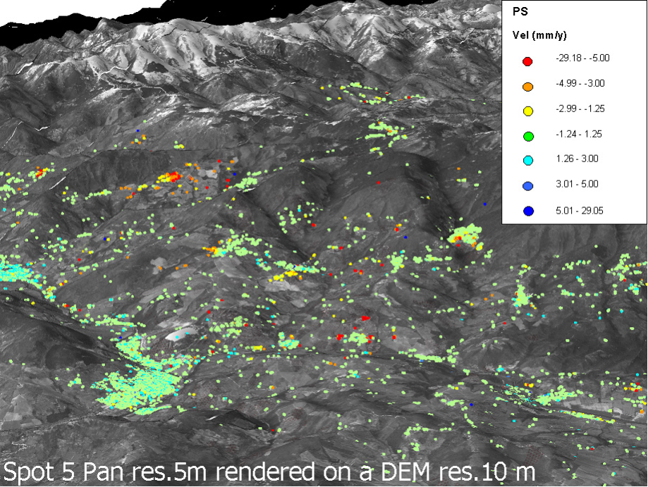
Example: Landslide Monitoring
Velocities of
“permanent
scatterers”
in the Arno
basin,
Tuscany,
from
multiple
Interfero-
metric
Synthetic
Aperture
Radar
(InSAR)
images.

Slide 11
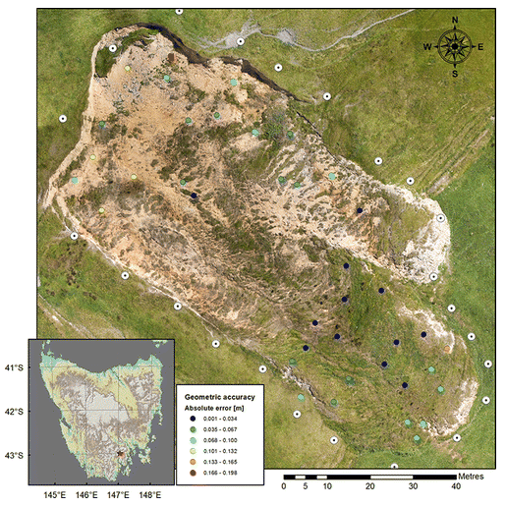
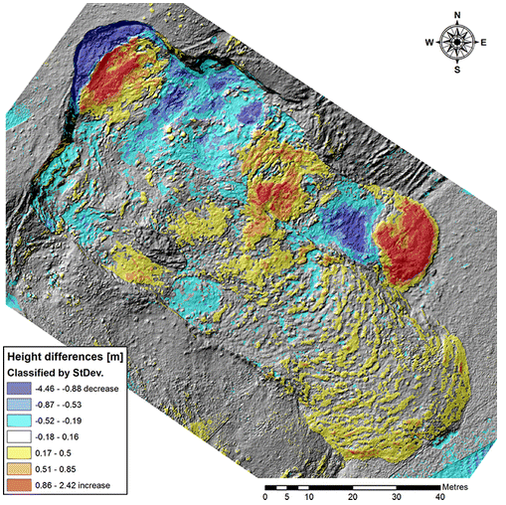
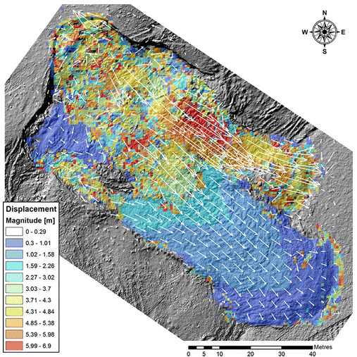
Example: Landslide Mapping
Lucieer et al. (2013) Prog. Phys.Geog. Earth Env.
Landslide mapping from aerial/UAV orthometric photos using
structure from motion/optical pixel correlation mapping (Tasmania)

Slide 12
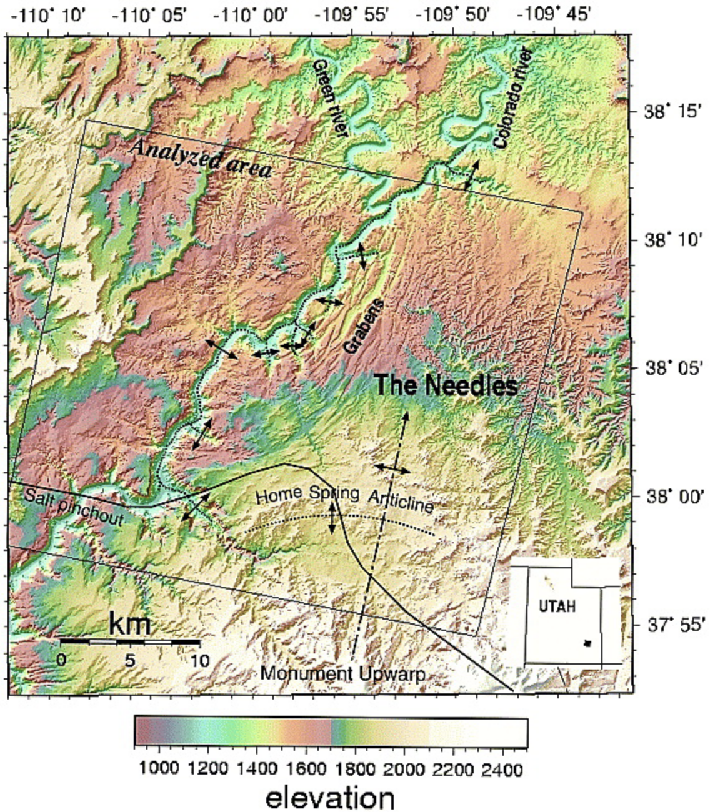
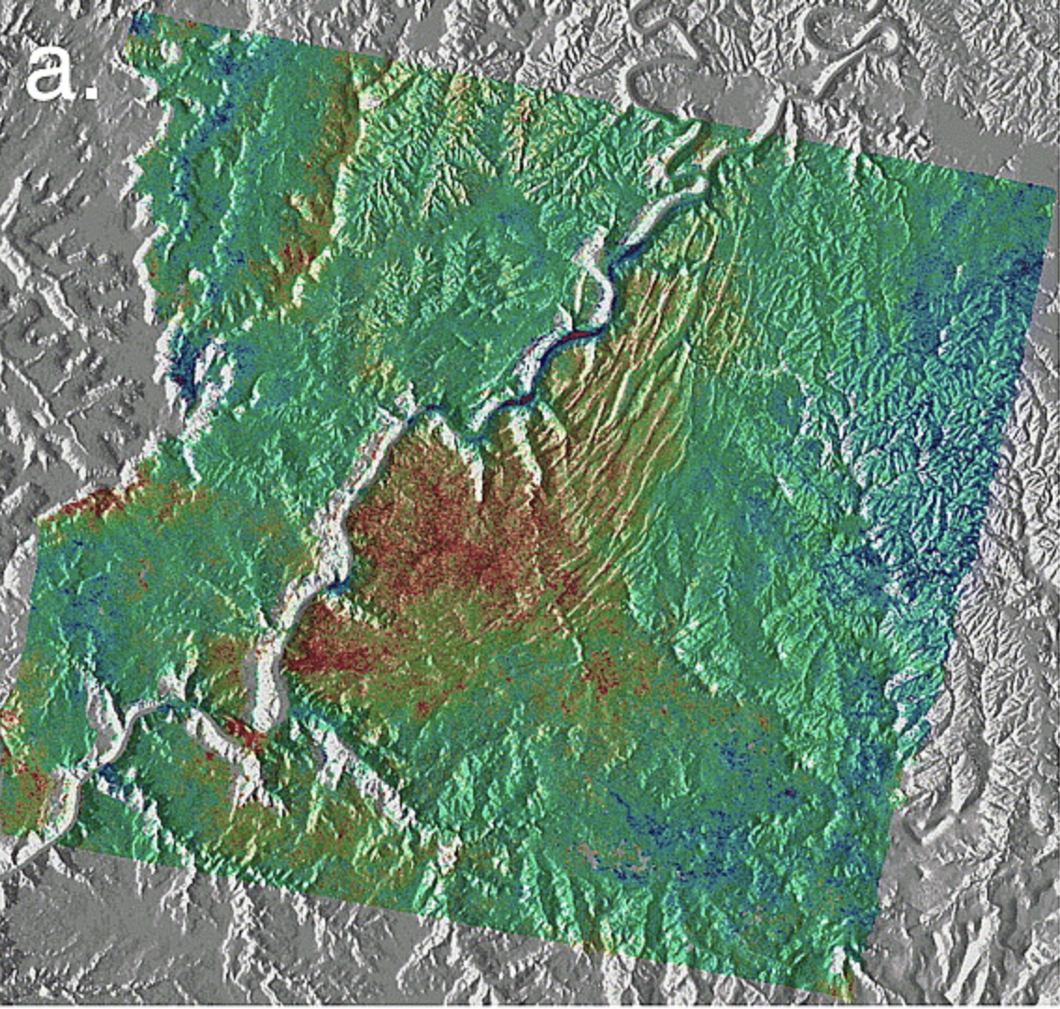
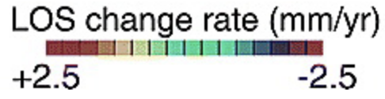
Example: Salt Tectonics
Furuya et al. (2007) J. Geophys. Res.
InSAR imaging of the Needles District in Canyonlands
National Park (SW of Moab)

