Slide 1
Geology 6690/7690
Geodesy & Crustal Deformation
29 Nov 2023
Last time: Fault Slip Dislocations (& Backslip…)
• Japan’s GEONET has >1200 GPS stations; supplemented
with marine geodesy and >1000 deep borehole seismometers
(Because 5% of spending goes to risk reduction/resilience!)…
Nevertheless, Tohoku-Oki earthquake was unexpected
• However, backslip models characterized the state of coupling
very well and thus indicated the hazard. Similar significant
hazard is apparent off Hokkaido
• GPS showed slow (but inconsistent) acceleration of transient
motion leading up to the event, corresponding to preslip within
the (velocity-weakening) future rupture patch of the event
© A.R. Lowry 2023

Slide 2
Read for Mon (4 Dec):
Mey et al. (2016) Glacial isostatic uplift of the
European Alps. Nature Communications 7:#13382,
https://www.nature.com/articles/ncomms13382

Slide 3
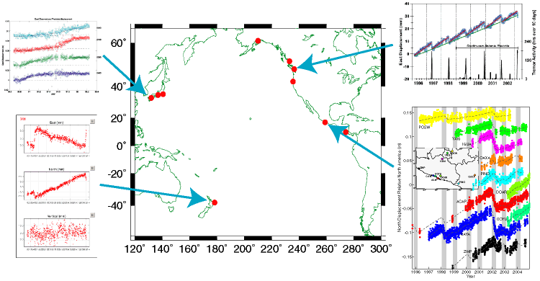
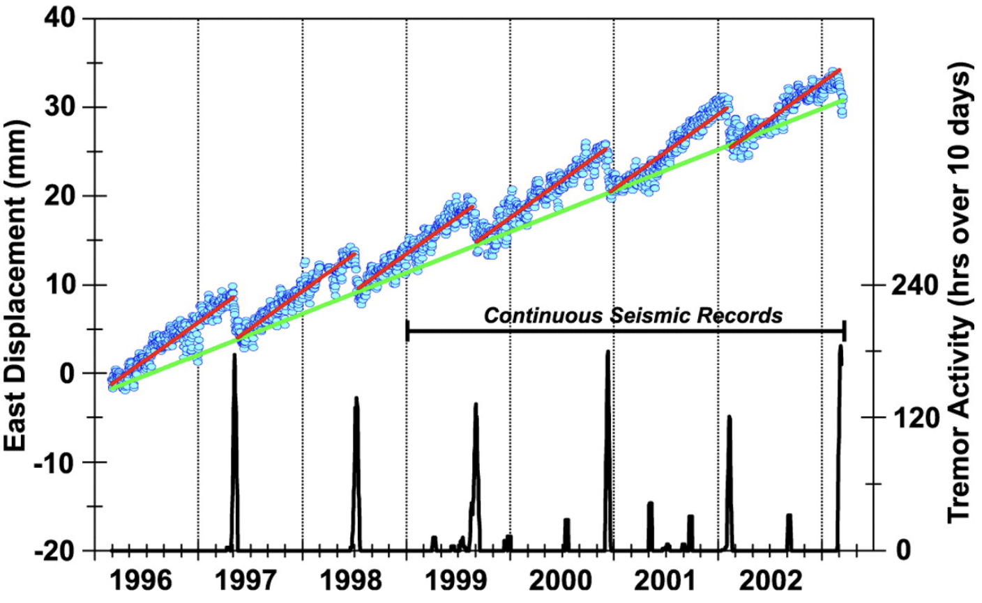
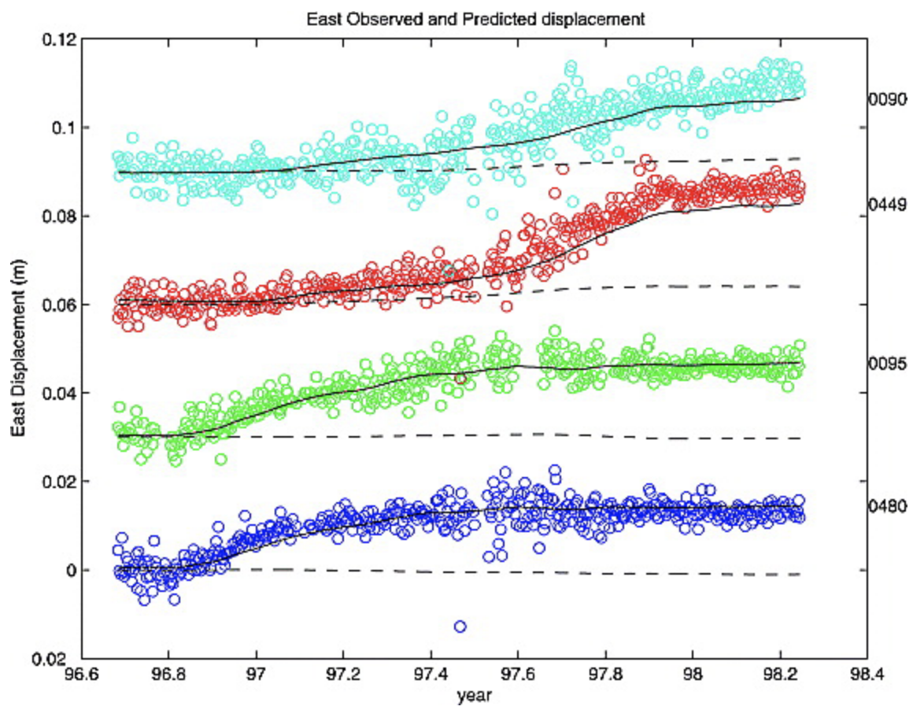
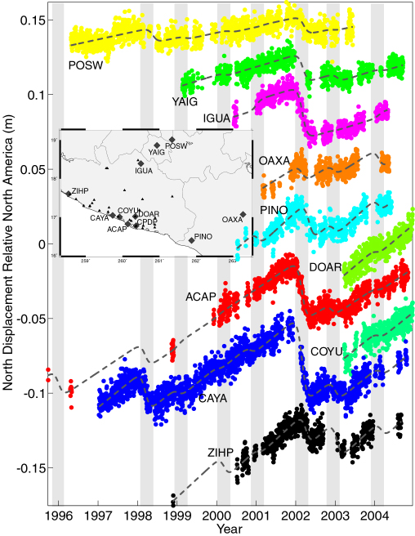
Slow Slip Events Around the Globe:
Some Common Observations…
Dragert et al. 2001; Rogers & Dragert 2003
Hirose et al. 1999; Miyazaki et al. 2003
Douglas et al. 2005
Lowry et al. 2001; 2006

Slide 4
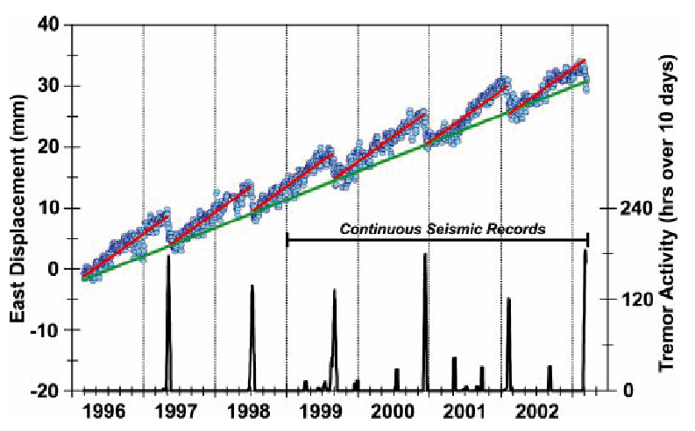
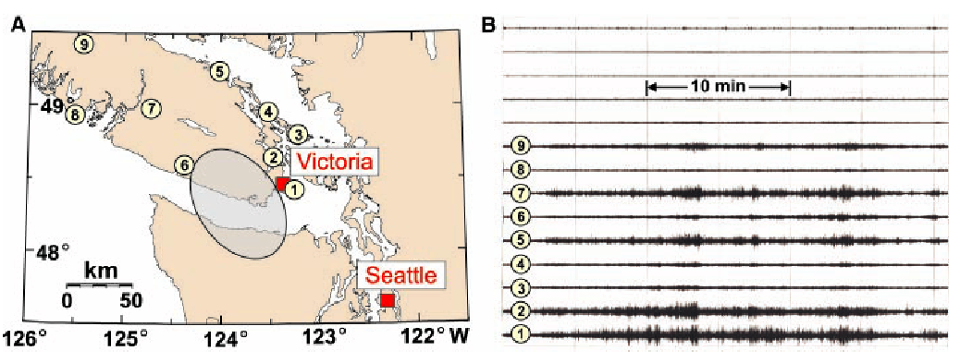
Some Common Observations (1):
• Seismic recordings exhibit
coincident 1–5 Hz tremor
in some (but not all)
locations (Cascadia,
Japan, Mexico)
Rogers and Dragert, Science, 300, 2003

Slide 5
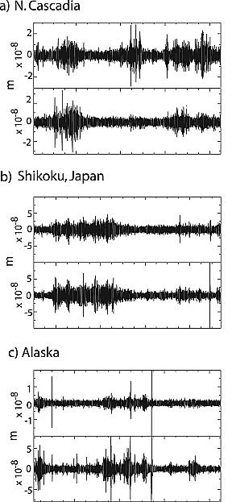
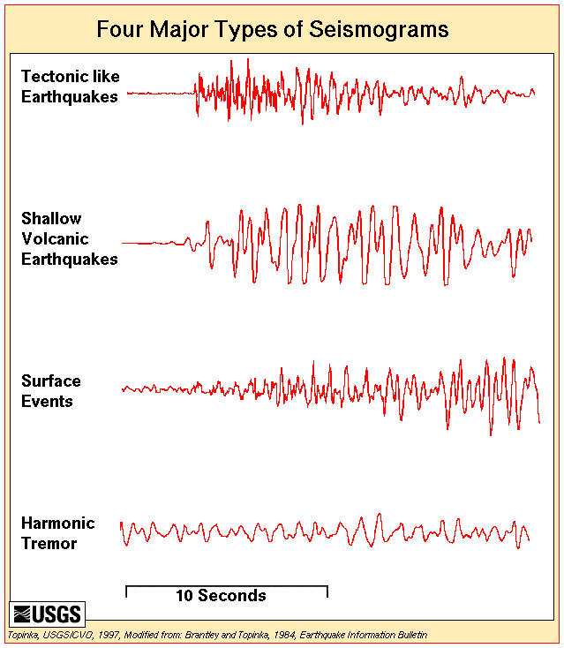
Tectonic tremor looks qualitatively similar to volcanic
tremor associated with magmatic/hydrothermal fluid flux

Slide 6
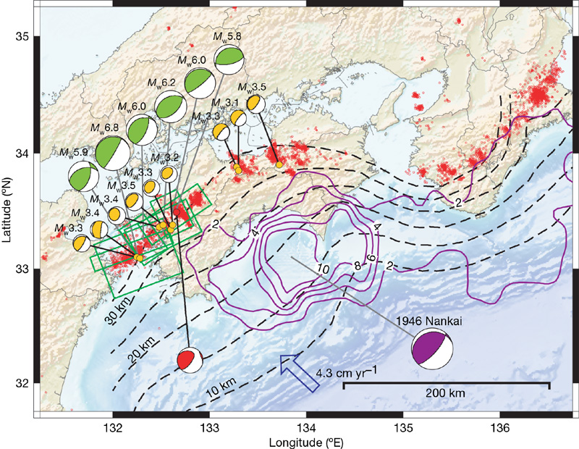
Ide et al, Nature (447) 2007
Tremor has radiation pattern & location consistent with
slip on the plate interface, occurring as a superposition
of many M_{w} 1.5–3.5 slow events

Slide 7
Cross-section of results: Small dots located with envelope
method (Kao et al.); large dots relocated with S-P lag times.

Slide 8
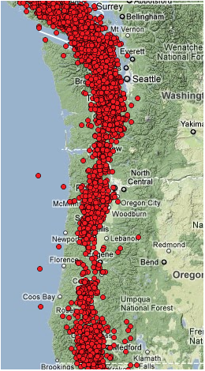
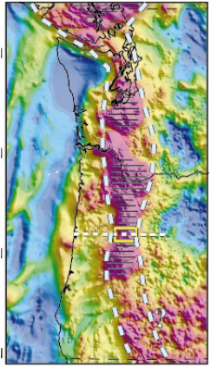
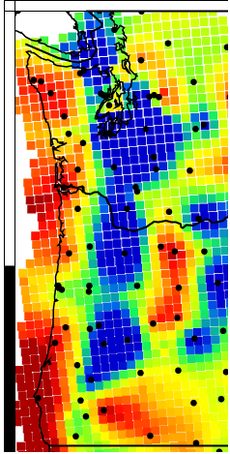
Magnetic anomalies!
Tremor locations
2009-2011
Serpentinized
Subduction Wedge
(Blakely et al.,
Geology, 2005)
Raw EARS
Crustal Thickness

Slide 9
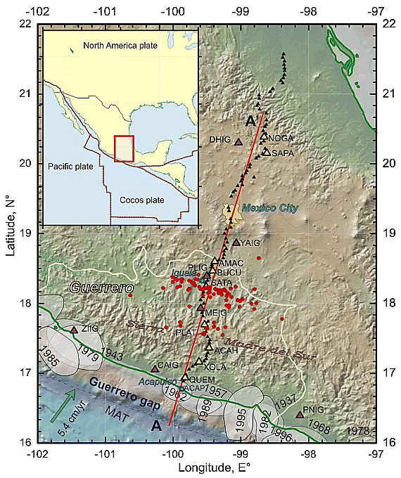
Tremor has also
been observed in
Guerrero, southern
Mexico (but limited
to a small fraction
of the area that
slips in SSEs)
Payero et al, GRL 2008

Slide 10
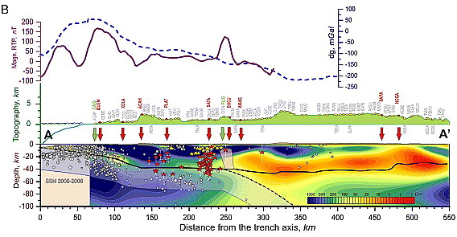
Hmmmm…
Payero et al, GRL 2008

Slide 11
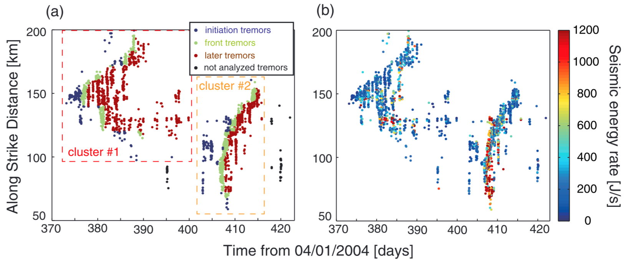
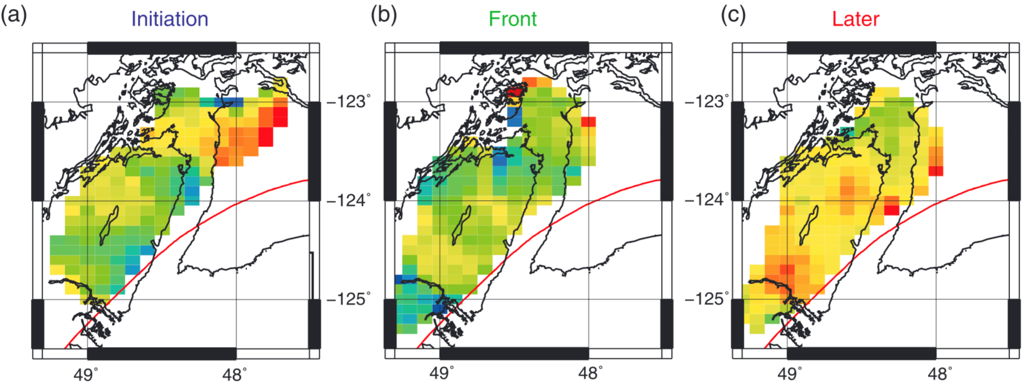
Tremor excited by tidal stress can be used to estimate friction coefficients
Yabe et al, JGR 2015
... And indicates that the friction is velocity weakening

Slide 12
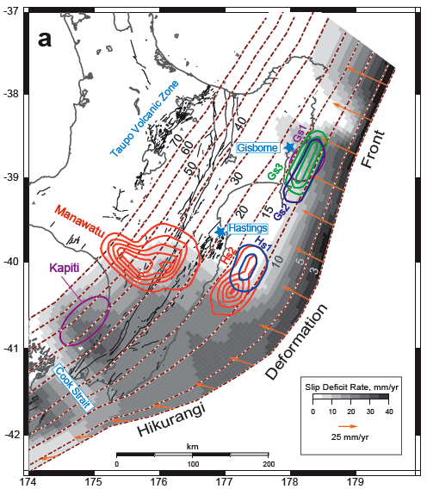
Some Common Observations (2):
Ide et al, Nature (447) 2007
McCaffrey et al, Nature Geoscience 2008
• Slow slip localizes “near” the base of rupture in past large
EQ’s… Or near 125°C on the up-dip side of megathrust…
I.e., near transition from stick-slip to stable sliding

Slide 13
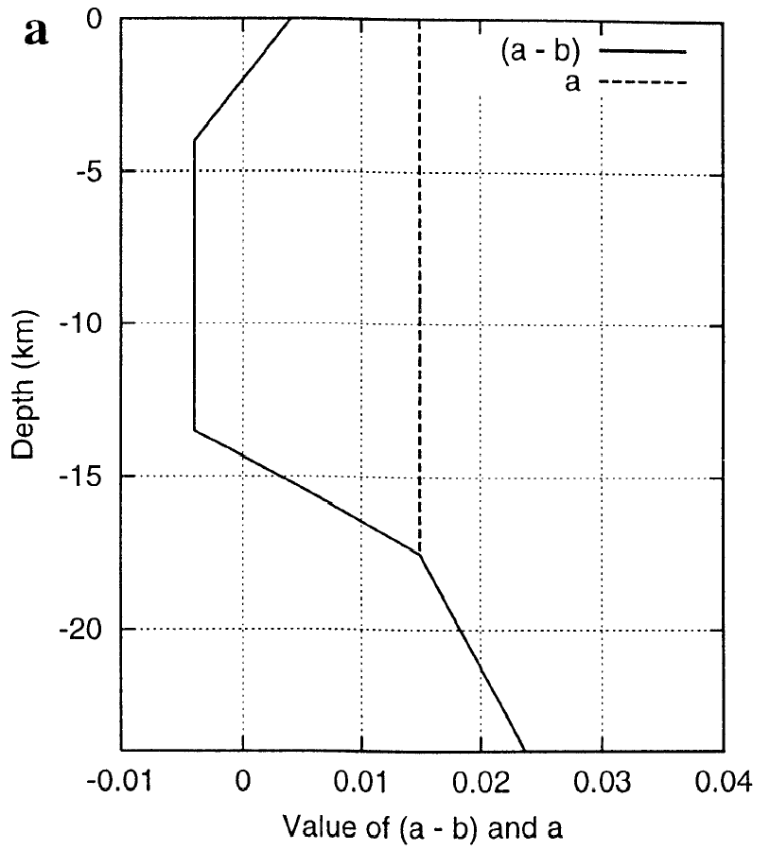
Fault Friction and Slip Velocity
Depend on:
• Two frictional constants a and b plus
a length scale D_{c}
• a – b < 0: friction decreases with increasing
slip velocity (→ unstable)
• a – b > 0: friction increases with increasing
slip velocity (→ stable)
• a, b, D_{c} depend on temperature, rock type,
pore fluids, gouge properties
• State variable Θ (depends on history of slip,
evolution of contact surface)
• Normal and shear stress on the fault
Favors
Stick-Slip
Favors
Stable
Sliding
Hence Slip Varies Nonlinearly in Both Space and Time!

Slide 14
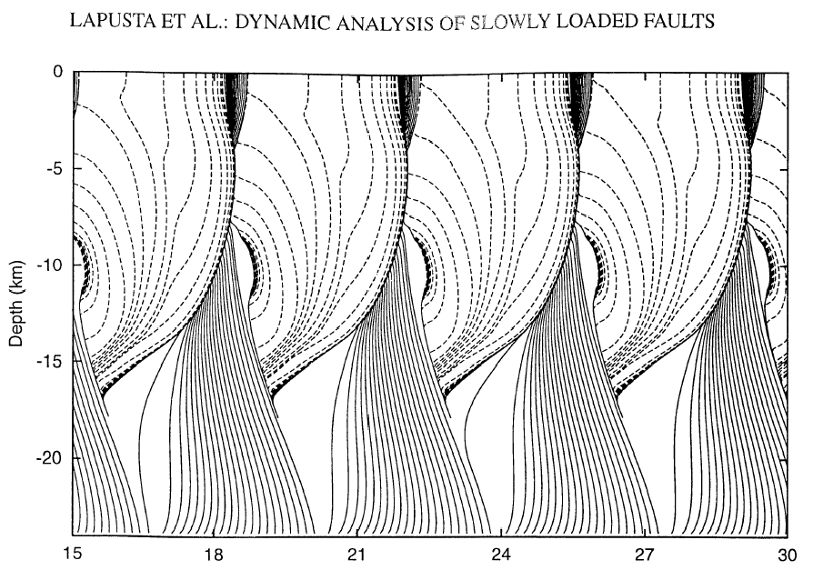
A San Andreas simulation with rate-state constitutive relations…
J. GEOPHYS. RES., 105(E10), 2000
b – a > 0
b – a = 0
Pre-Slip
b – a < 0
b – a = 0
Earthquake
b – a > 0
After-Slip
Cumulative Slip (m)
Predicts many fault slip behaviors that we observe geodetically.
But what form does this part take?

Slide 15
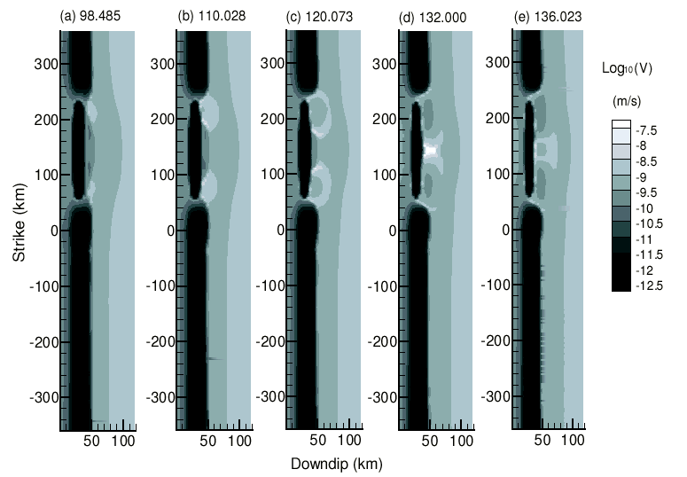
Simulations of subduction zone slip…
Liu and Rice,
JGR 2006
Predict slow slip events focus near the frictional transition!

