Slide 1
Herring et al., 2016 – Plate Boundary Observatory and related networks: GPS data analysis methods and geodetic products

Slide 2
Summary
GAGE provides free real-time data from a ‘community’ network of ~2000 stations, raw data to processed products (station position time series, velocities)
Two analysis centers for GAGE – precise point positioning (CWU) vs double-differencing (NMT) w/ additional model similarities and differences; compare data to evaluate error, combined results on reference frame
Can access JPL and UNR analyses; comparison to GAGE – scale changes; UNR uses different stable NA , JPL and GAGE are similar
What to be aware of – possible sources of error, what is in the data
Some uses of GPS time series – fault behavior; Yellowstone; multipath – soil moisture, snow, vegetation; water vapor, ionosphere, glacial

Slide 3
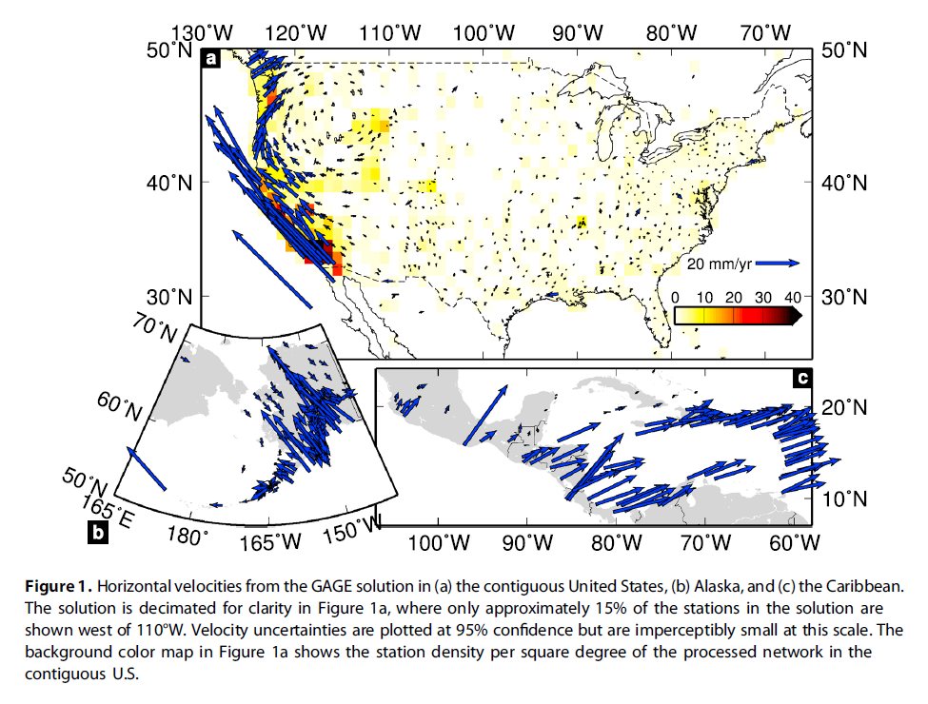
1

Slide 4
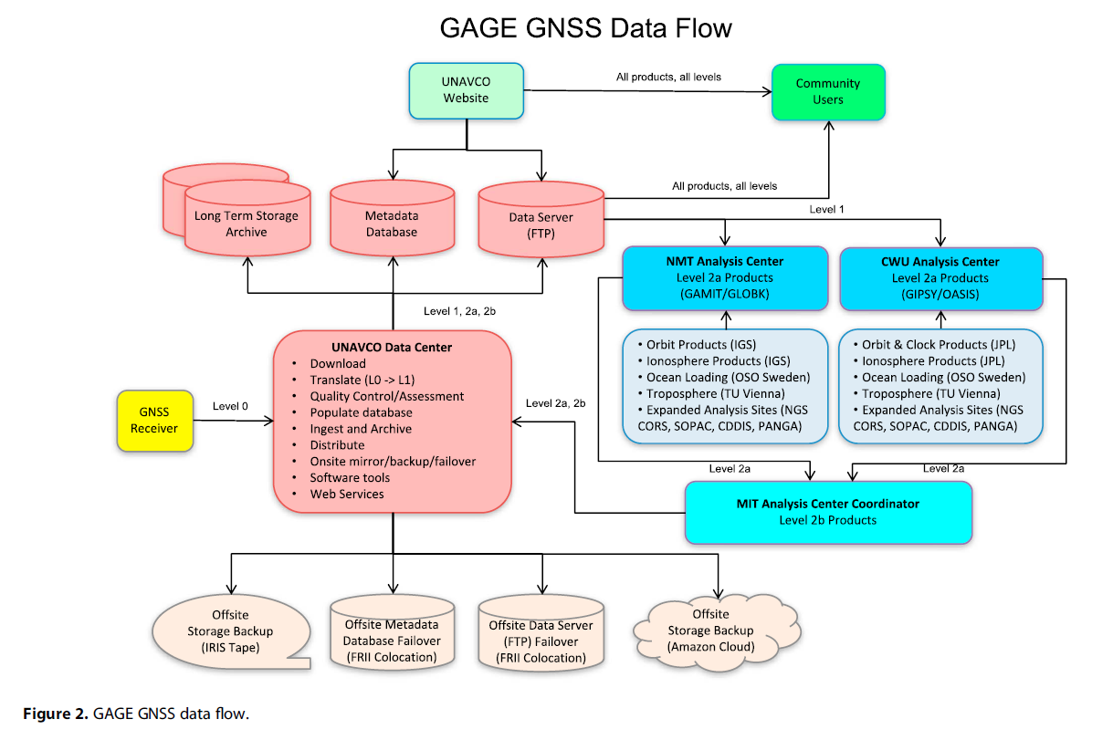
2

Slide 5
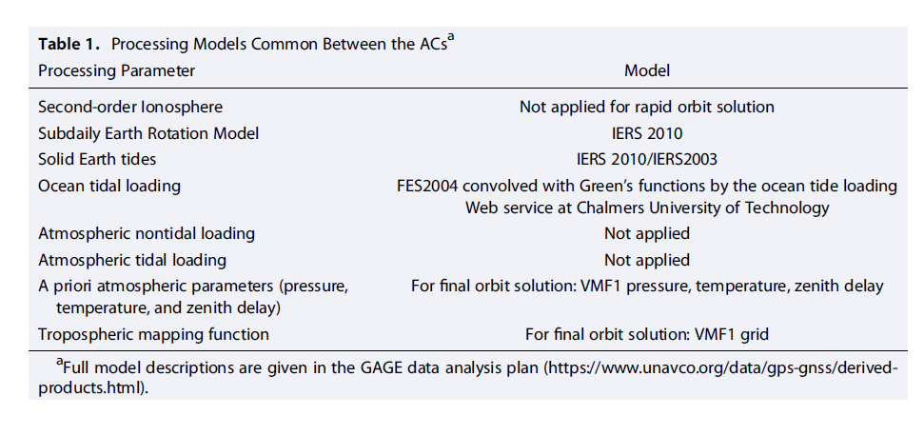

Slide 6
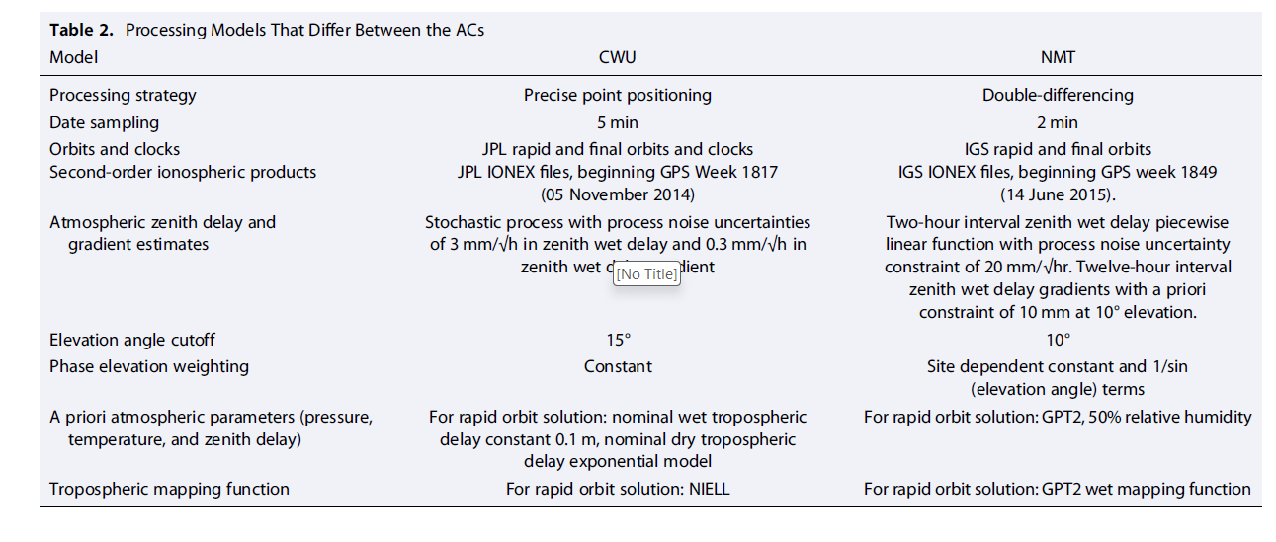

Slide 7
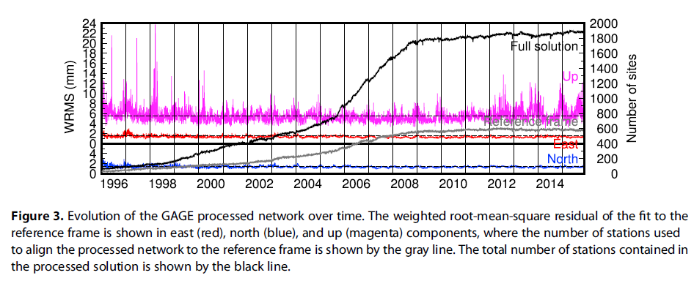
3

Slide 8
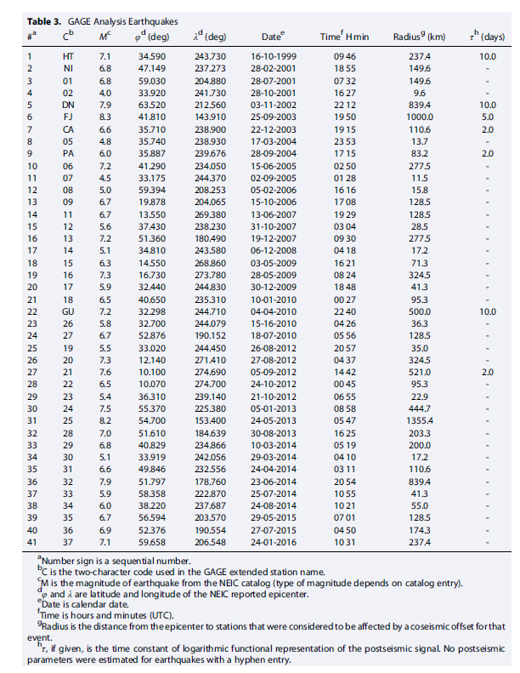

Slide 9
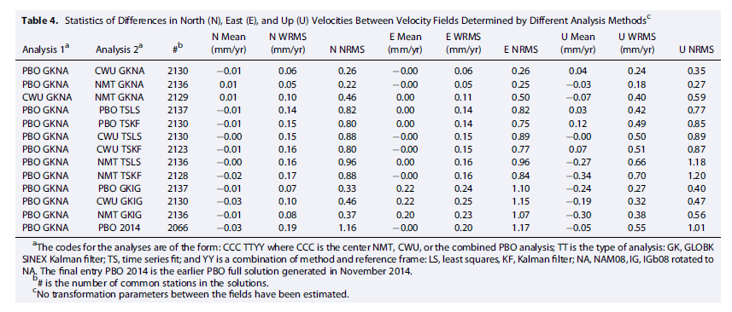
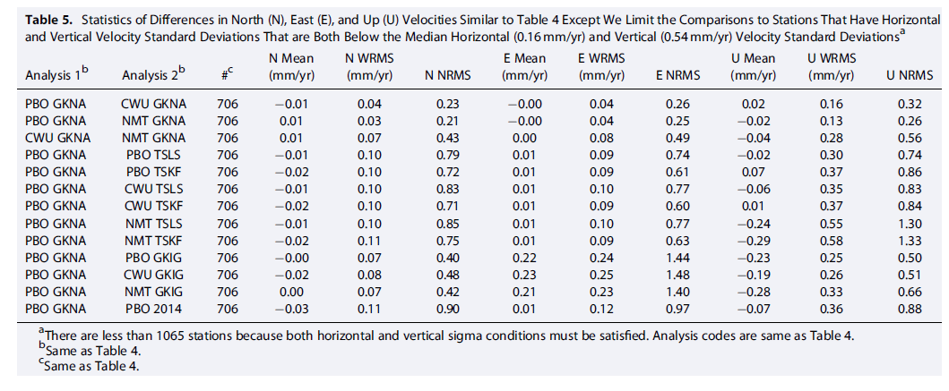

Slide 10
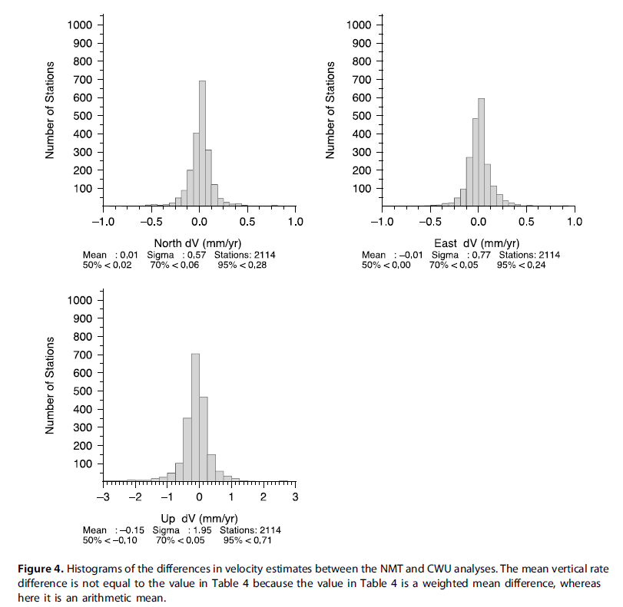
4

Slide 11
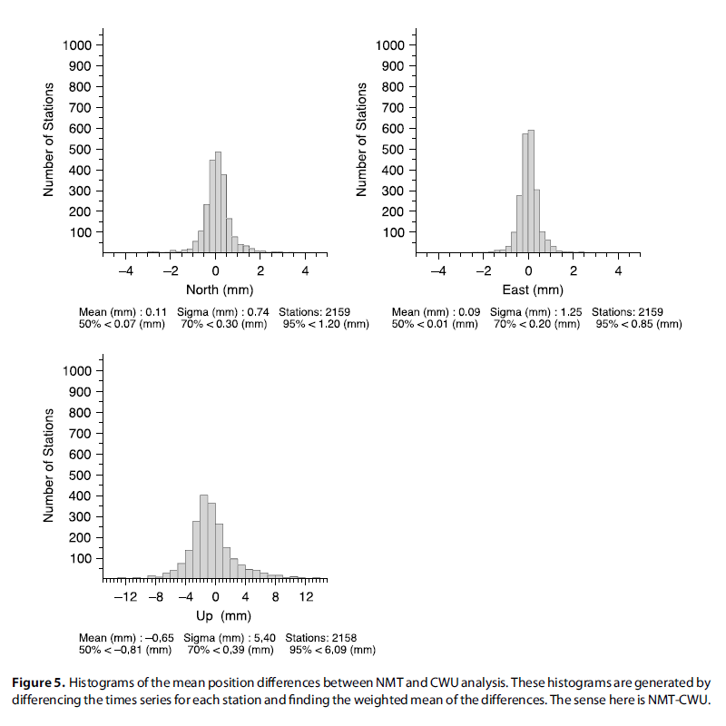
5

Slide 12
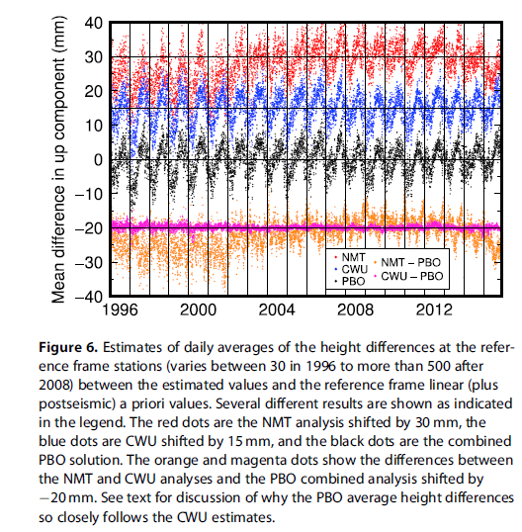
6

Slide 13
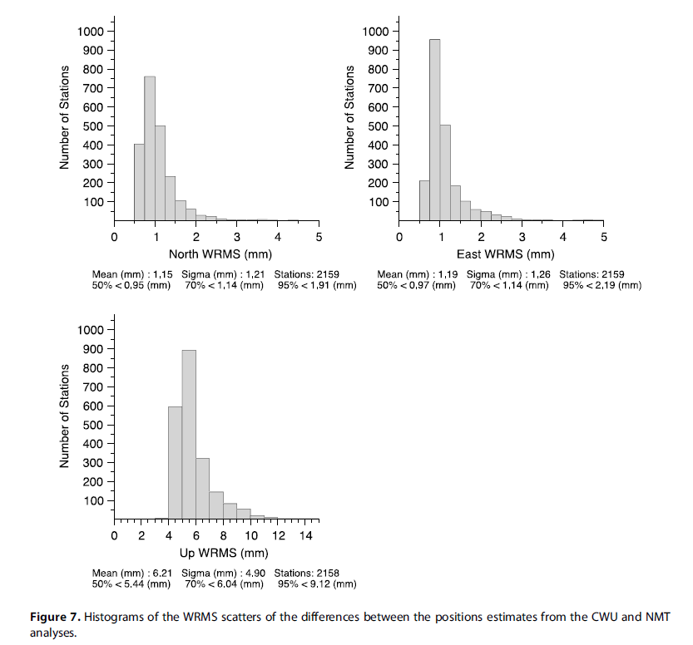
7

Slide 14
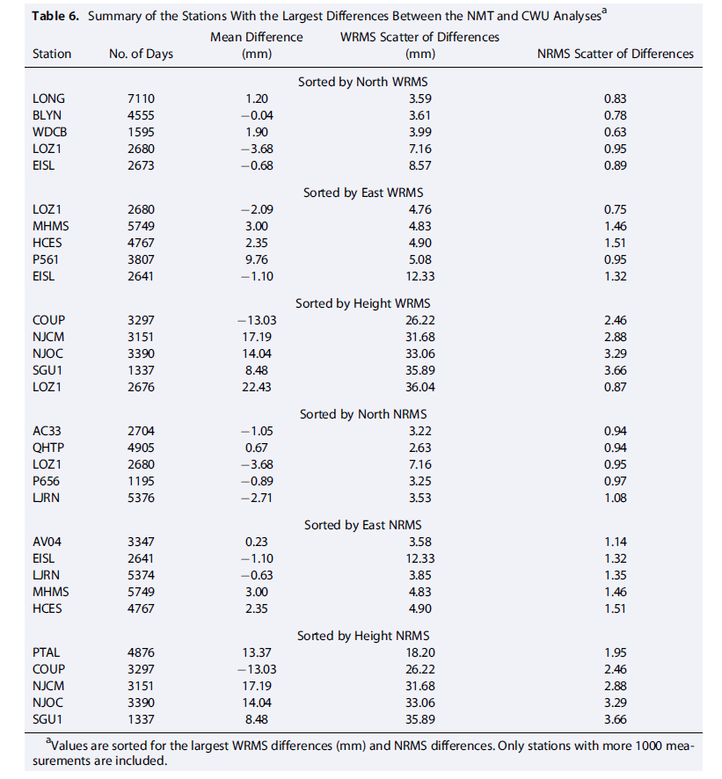

Slide 16
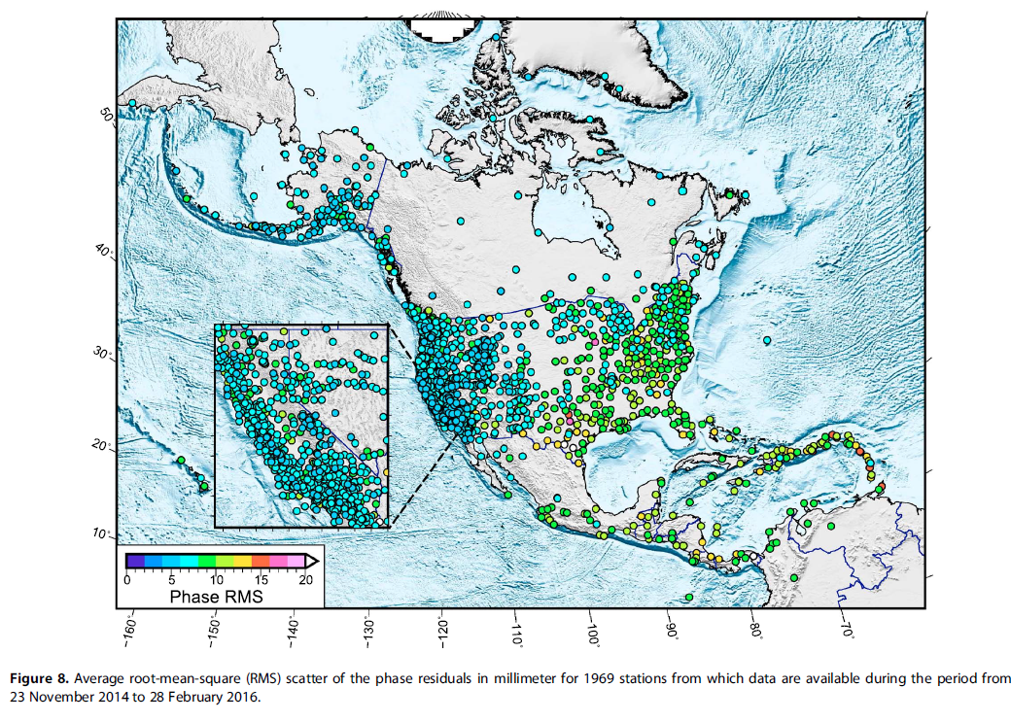
8

Slide 17
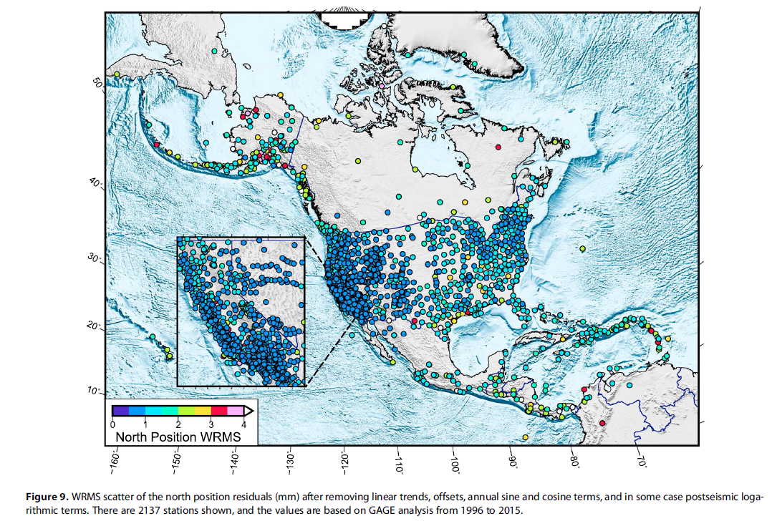
9

Slide 18
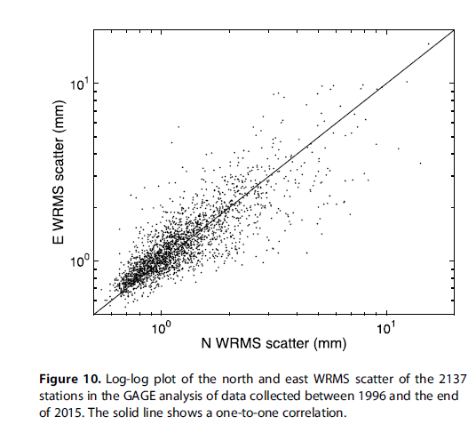
10

Slide 19
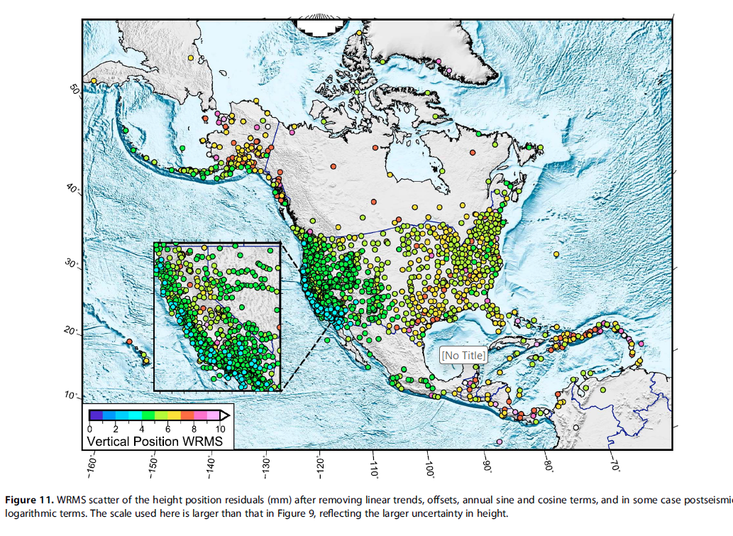
11

Slide 20
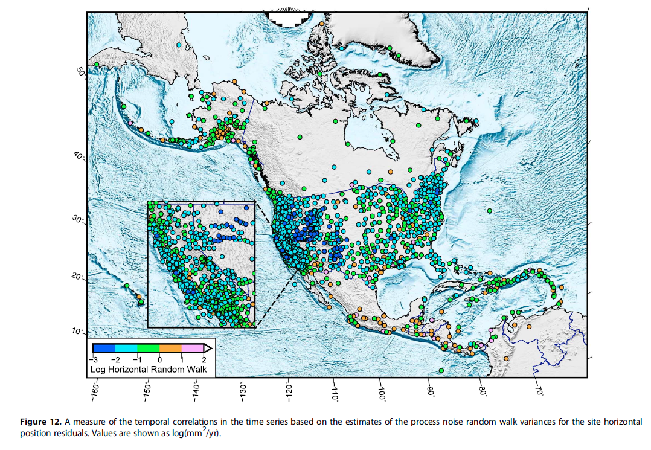
12

Slide 21
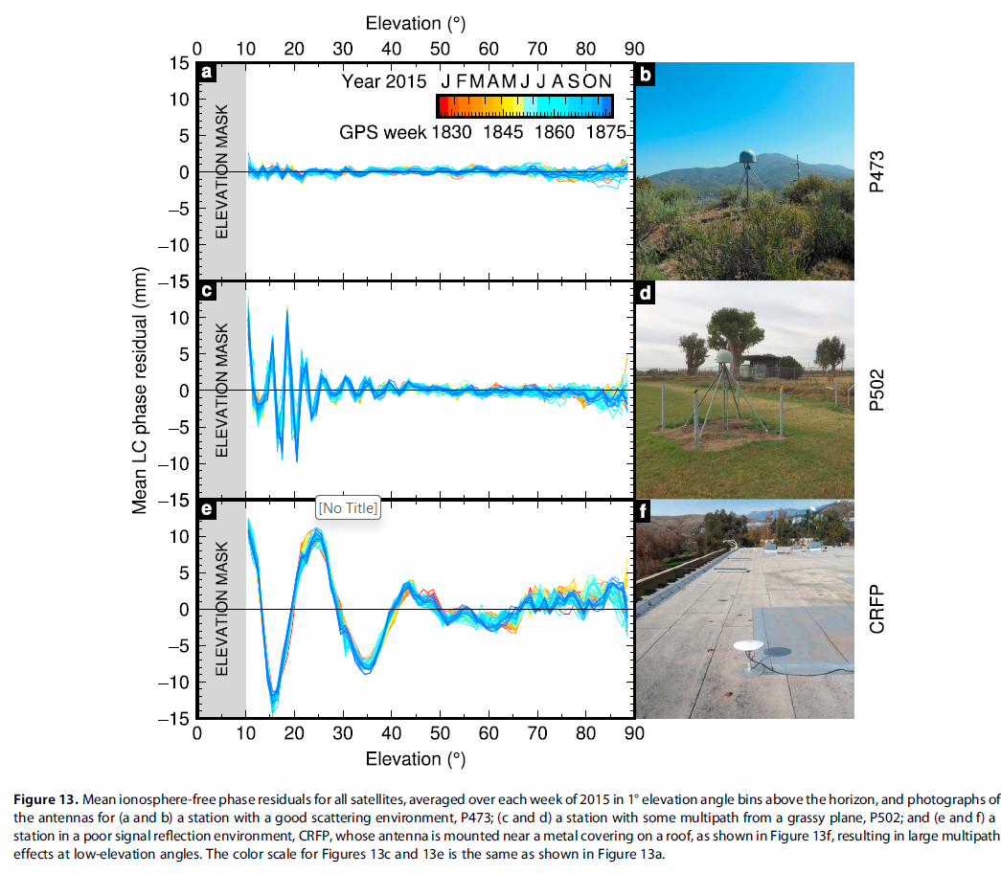
13

Slide 22
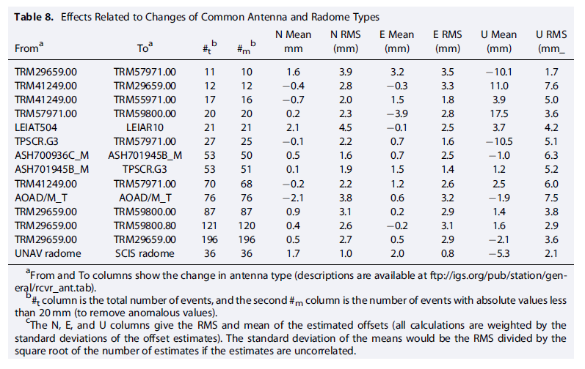

Slide 23
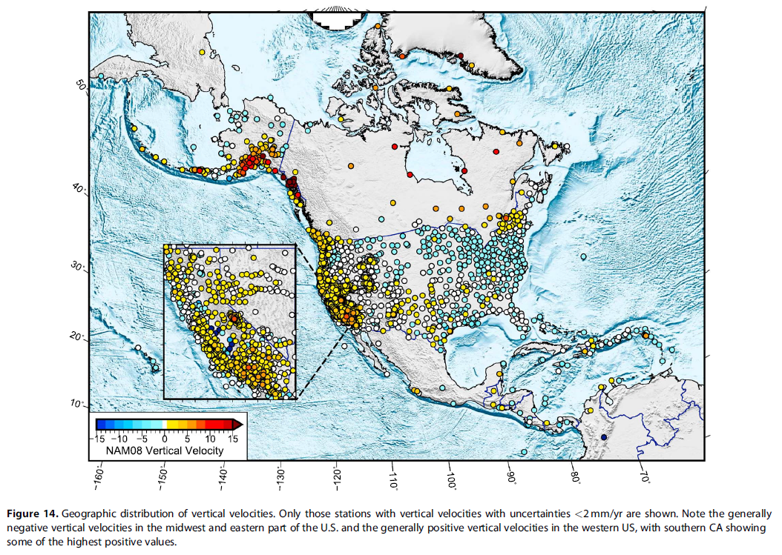
14

Slide 24
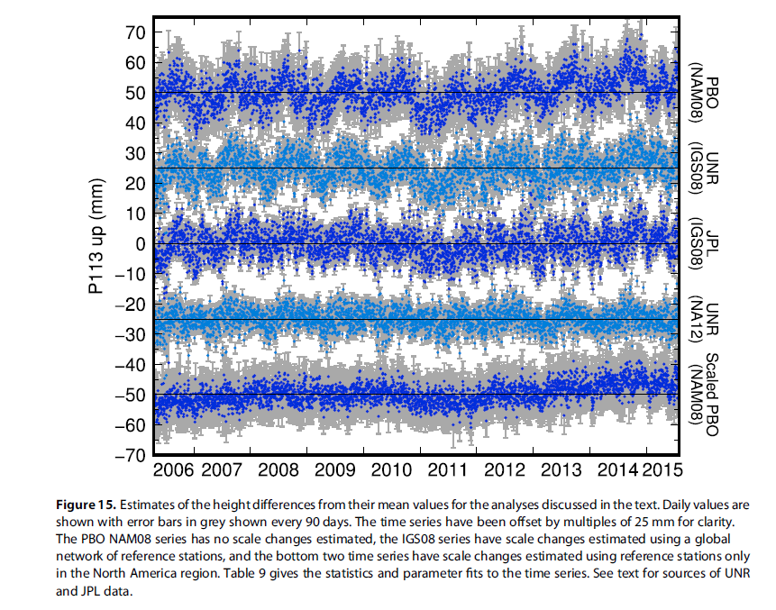
15

Slide 26
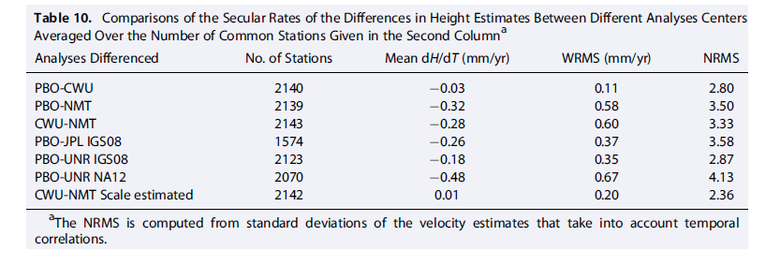

Slide 27
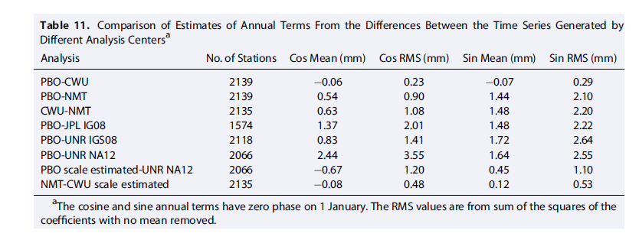

Slide 28
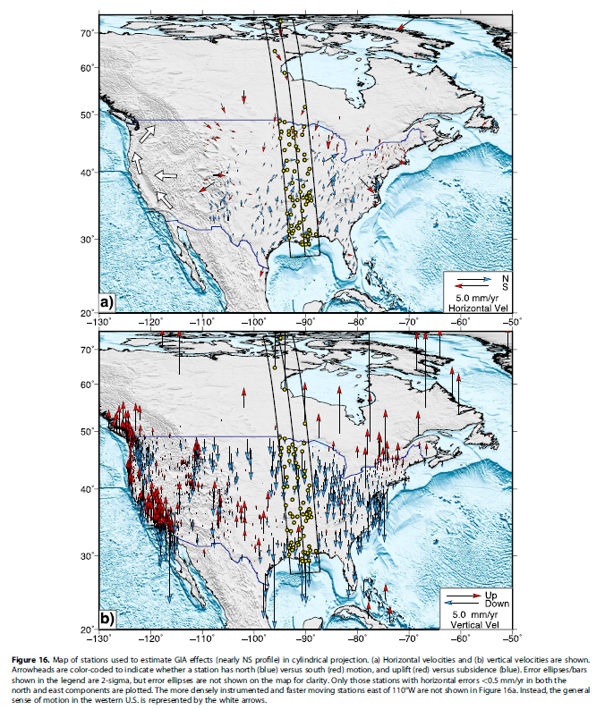
16

Slide 29
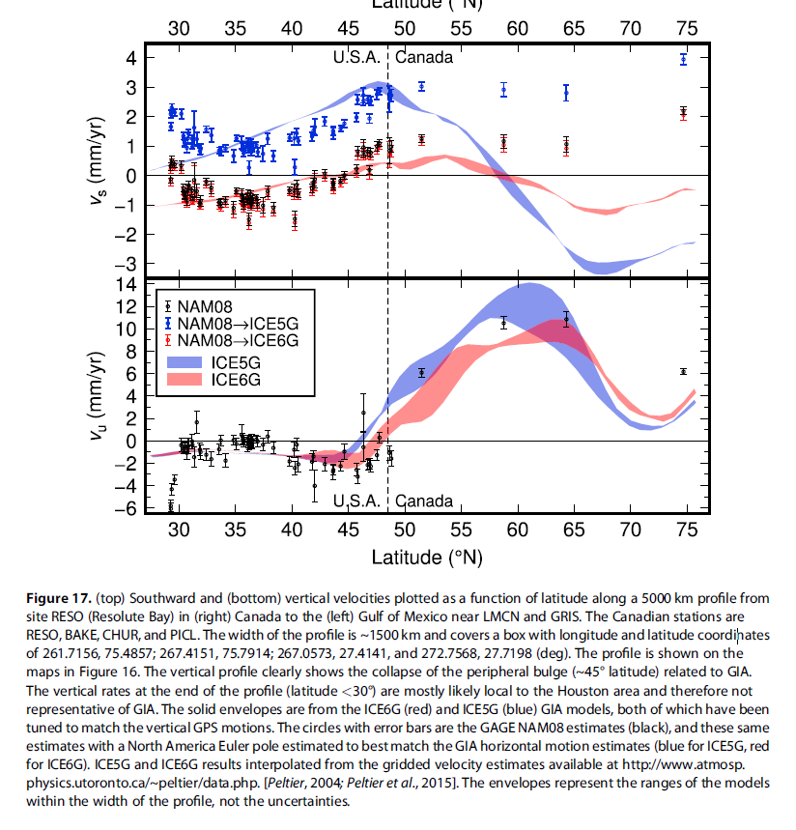
17

Slide 30
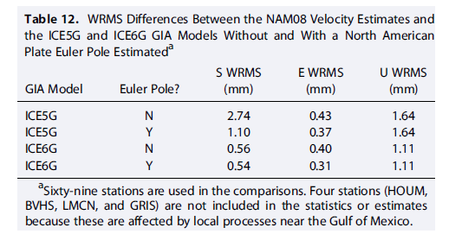

Slide 31
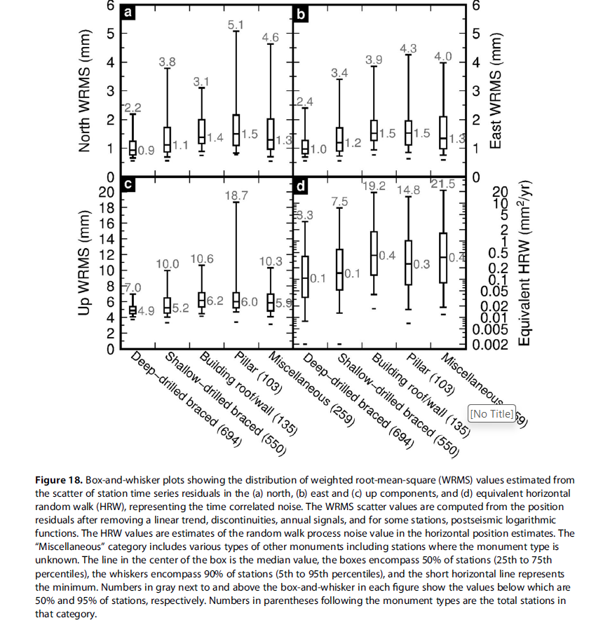
18

Slide 34
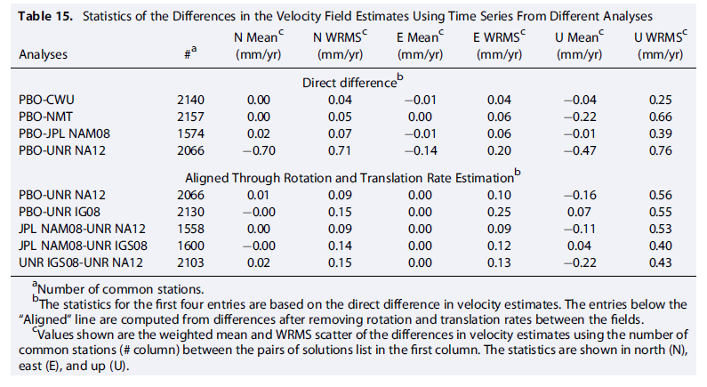

Slide 35
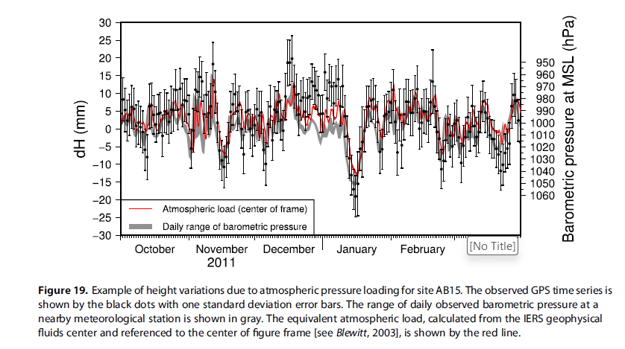
19

