Slide 1
Geology 6600/7600
Signal Analysis
9 Nov 2017
Last time:
• Introduced discussion of Becker et al. (2014):
• Observed topography and modeled elevation fields were
“smoothed” by convolution with 6σ = 300 km-radius Gaussian
→ Could do the same more efficiently via spectral-domain
multiplication by Fourier transform of a Gaussian
→ Meant to remove surface-constructed elevation from the
observations and mimic the flexural filtering of deep mass;
could be more robustly done using flexural response and
the known effective elastic thickness T_{e} (which varies
spatially)
→ Surface-constructed elevation at wavelengths > 200 km
are still present as a “noise field”
© A.R. Lowry 2017

Slide 2
Geology 6600/7600
Signal Analysis
Last time:
• Becker et al. (2014):
→ Isolates “static” (crustal mass) and “dynamic” (mantle,
including mantle lithosphere!) mass using seismic fields
→ Mass in crustal thickness variation only partially correlates
to elevation (global r² = 0.3–0.35; peaks ~ 600 and 2000 km
wavelengths
→ Wavelength-dependent squared correlation coefficients
(analogous to coherence) were calculated by applying a
fourth-order Butterworth filter (bandpass from 0.8λ to 1.2λ)
in the frequency domain, IFT’ing to the spatial domain and
calculating global r². Compares favorably to multitaper
coherence!
→ Filter is real and even, so it should be zero-phase…
Tested by applying to a Kronecker delta function

Slide 3
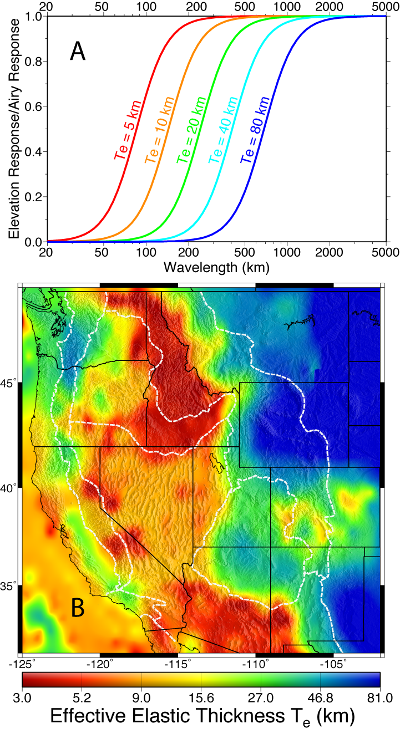
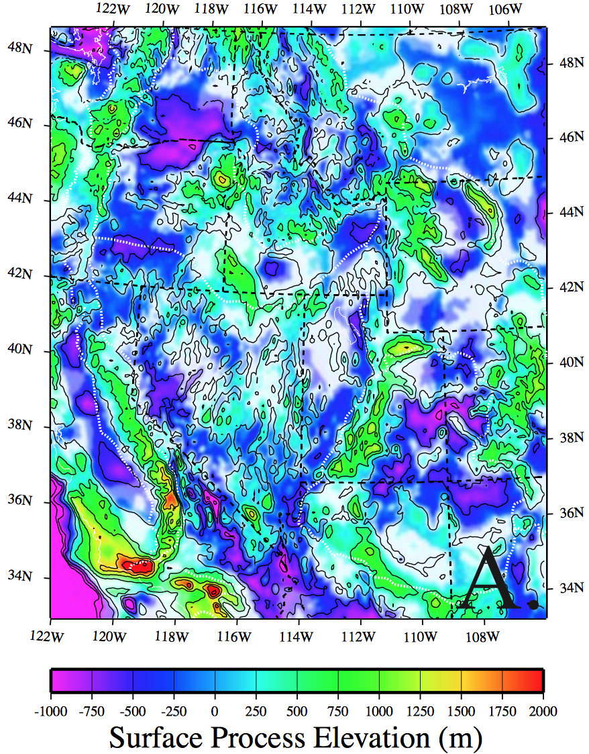
Aside: Flexure and its effect on
elevation: Lowry et al. (2000)
explicitly solved for surface process
elevation at <~ Airy wavelengths

Slide 4
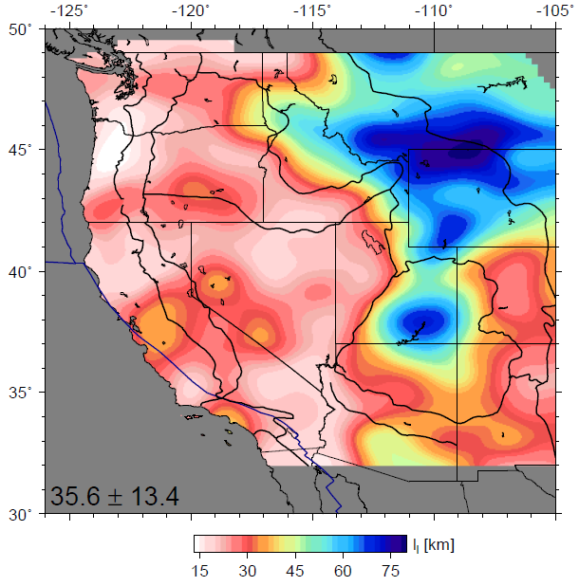
Lithosphere-asthenosphere boundary (?)
Simplified, single surface inferred from PRF by Levander and Miller (2012)
See also Kumar et al. (2012)
Notes:
4

Slide 5
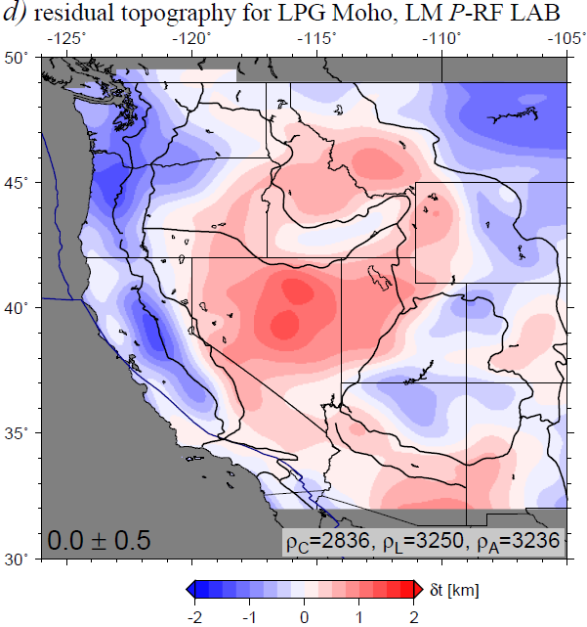
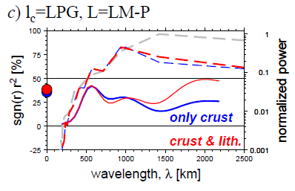
No big improvement
compared to constant
lithospheric thickness
Becker et al. (2014)
Notes:
5

Slide 6
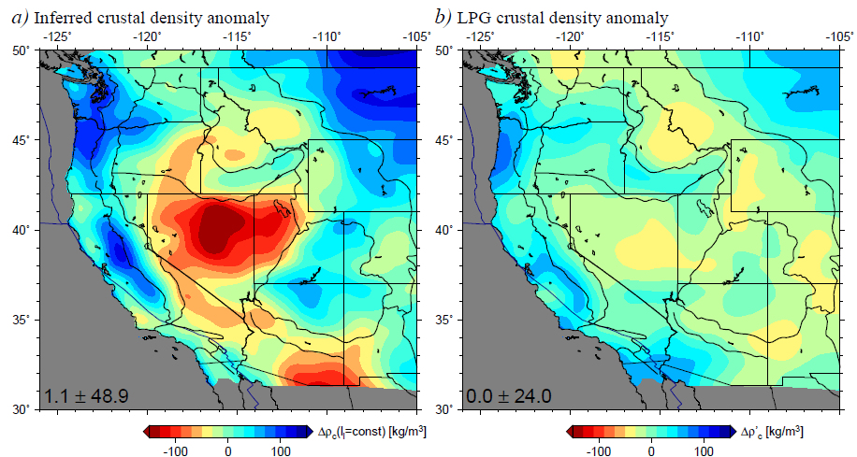
If lithospheric thickness variations doesn’t work,
what about crustal density variations?
Density anomaly for no residual topography
Lowry and Perez-Gussinye (2011)
Notes:
6

Slide 7
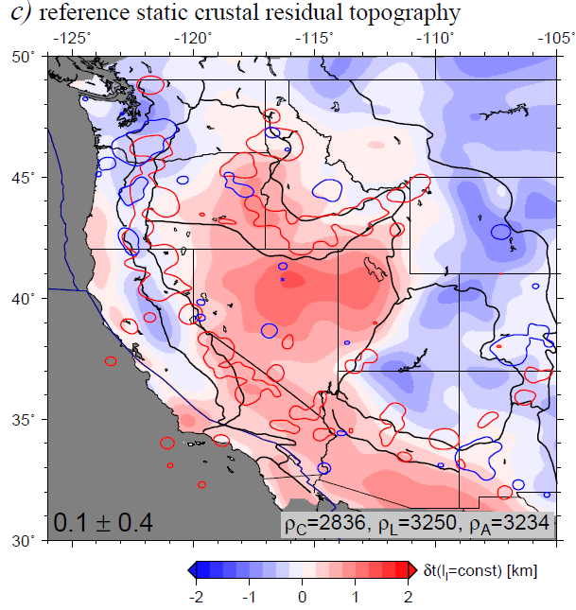
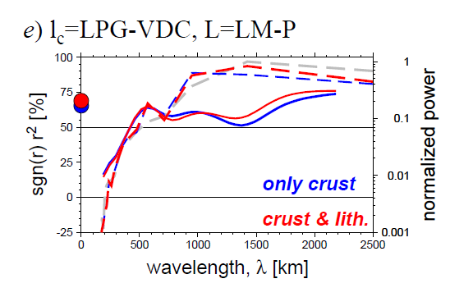
Residual topography including crustal density variations
~60-75% coherence,
but significant RMS
of residual
Red contours: < 20 Ma
Blue contours: > 20 Ma
volcanism from earthchem.org
(cf. McQuarrie and Oskin, 2010; Karlstrom et al. 2012)
Notes:
7

Slide 8
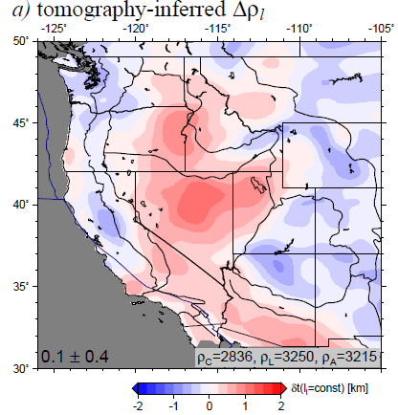
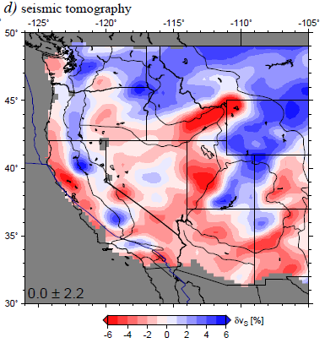
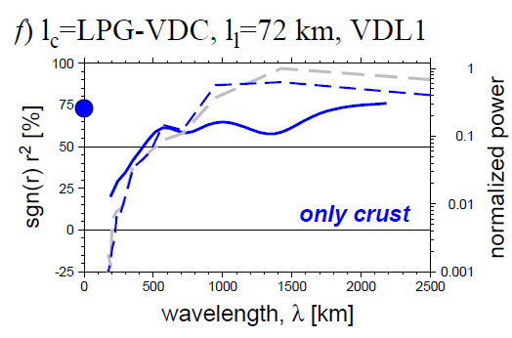
Residual topography including crustal
and lithospheric density variations
Notes:
8

Slide 9
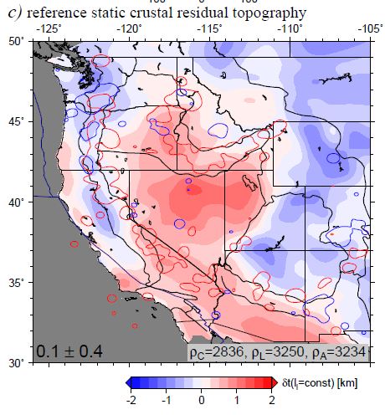
What is the origin of the non-isostatic residual ?
Notes:
9

Slide 10
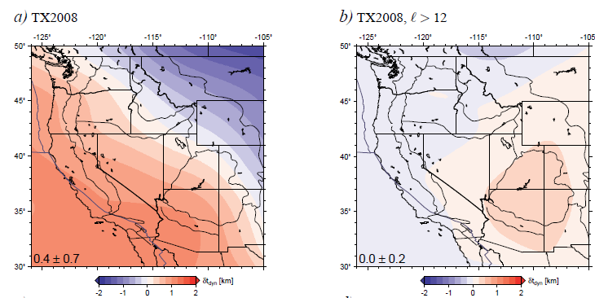
Mantle flow induced topography: Simmons et al. (2007) global tomography
full solution
regional wavelengths
cf. Moucha et al. (2008)
Hager and O’Connell (1981) type computation, topography inferred from radial tractions at surface of spherical mantle circulation model
(results are very similar for FE models with LVVs etc., cf. Ghosh et al., 2013)
Notes:
10

Slide 11
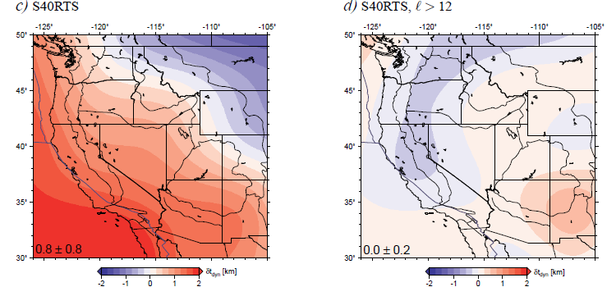
Mantle flow induced topography: Ritsema et al. (2011) global tomography
Notes:
11

Slide 12
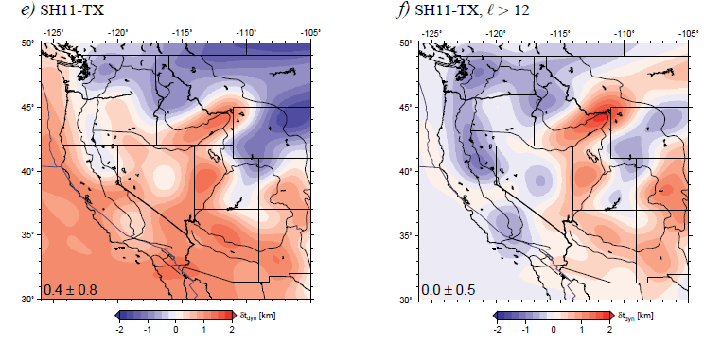
Mantle flow induced topography: Schmandt and Humphreys (2010)
regional model
Results very similar for other recent western US tomography models
(cf. Becker, 2012)
Notes:
12

Slide 13
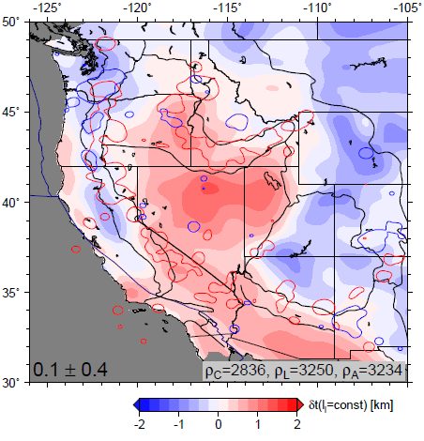
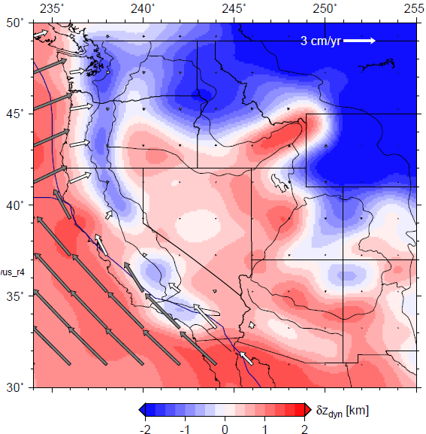
Match between residual and dynamic topography from present-day mantle flow
Correlation ~ 0.6
Becker et al. (2014)
Notes:
13

Slide 14
Conclusions
LAB does not seem to scale with simple lithospheric thickness estimates (MLD?)
Colorado plateau at present not dynamically supported, except at edges
Significant residual topography, particularly in B&R (+) and along subduction regions (-)
Large fraction explained by mantle induced traction
Mismatch indicative of partial melt, radial anisotropy, or chemical heterogeneity

Slide 15
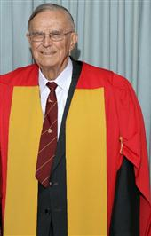
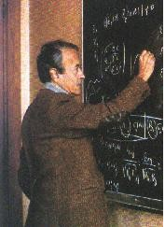
Optimal Interpolation (or “kriging”):
• Like many applied mathematical innovations,
originally developed for an Earth science
problem (Danie Krige’s MSc sought to
extrapolate ore grade in a gold mine!)
• His ideas formed the basis for geostatistics,
the applied statistics developed further
by Georges Matheron, which conceptualized
a “regionalized variable” (with properties
intermediate between between those of a
deterministic and random variable)… I.e.,
continuous, but governed by (possibly
unknown) processes too complex or poorly
measured to yield predictive power.
• The regionalized variable is what we call in
this class a stochastic process
Danie Krige
Georges Matheron

Slide 16
Optimal Interpolation (or “kriging”):
• First estimate the semivariance, or variogram, as
the expected value of the squared difference between
measurements as a function of the distance between:
(1) Bin all permutations of pairs of measurements
according to the distance between the two
measurements
(2) Given n_{j} measurement-pairs in the bin of distance Δ_{j},
Distance between measurements:
Bin 1
2
3
4
5
Δ₄
Δ₂
Δ₁
Δ₁
(Note that the “semi” in semivariance
comes from division by 2n_{j} instead
of just n_{j}…)
Δ₃
Δ₄
Δ₁
Δ₂
Δ₄

Slide 17
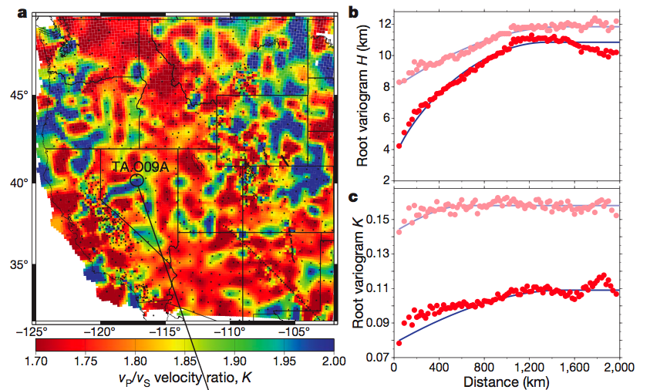
Bin every 20 km;
min of 5000 pairs
Intercept is ~σ ² of
a measurement…
“Sill” is ~σ ² of the
random variable!
Here from LPG11: At each measurement, square the difference
from every other measurement, add it to the sum in a
distance bin, divide by 2n of that bin.

Slide 18
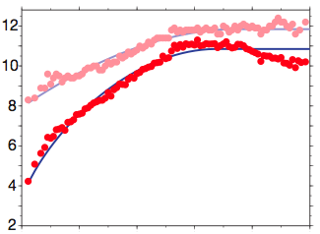
The difference between the sill and the variogram, γ(Δ),
corresponds to the autocovariance:
Thus for many types of processes one
can model the variogram using just a
few parameters. A zero-mean
Gauss-Markov process would have autocorrelation
function of the form:
(In LPG11, modeled variogram using a spherical model of
the form:
This is not rooted in probability theory, and one might do better
by using a smoothed version of the observed variogram…)
σ₀²
–C_{xx}!
σ_{n}²

Slide 19
In punctual kriging (simplest form), we would like to
estimate the value of the field at a point p as a weighted
sum of the measurements at nearby points:
(Note this assumes stationarity: i.e., there is no “drift” in the
random variable). The goal of course is to choose the
weights w_{i} that minimize the estimation error:
which we can do by taking the derivatives with respect to
the weights and setting to zero… After some algebra :-)
this gives N equations in N unknowns:
However to be unbiased, we also require:

Slide 20
To accommodate the additional equation we introduce a
slack variable (a Lagrange multiplier, λ) to the set of
eqns:
And solve! The optimal estimate at the point (i.e., having the
smallest possible error
given the surrounding
measurements) is:
The estimation variance is the weighted sum of the
semivariances for the distances to the measurements used,
plus a contribution from the slack variable:

Slide 21
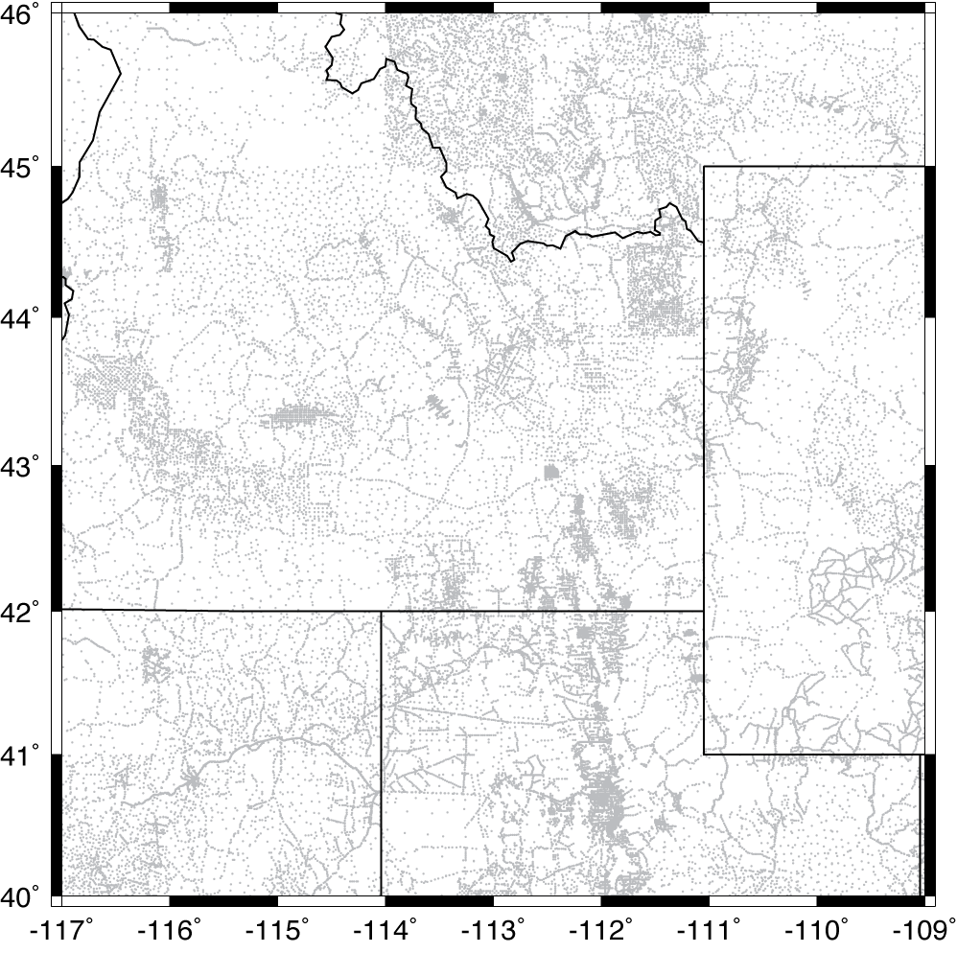
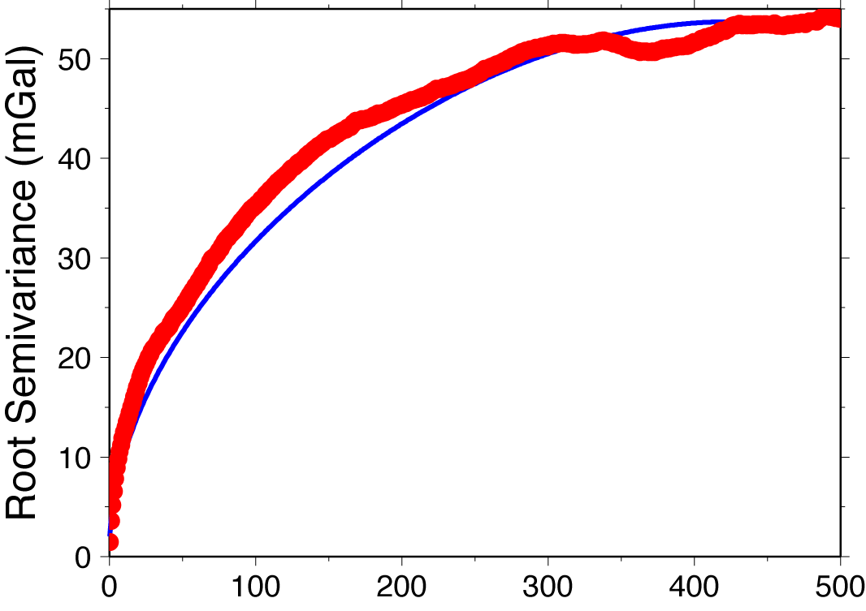
Example: Interpolation of PACES database gravity
measurements to a grid:
• Semivariance at mean distance 200 m is already 1.5 mGal;
1 km = 3.6 mGal, 2 km = 5.2 mGal (!!!)
• Obviously some areas (valley bottoms, populated, lotsa roads) pretty densely measured; some untouched…

Slide 22
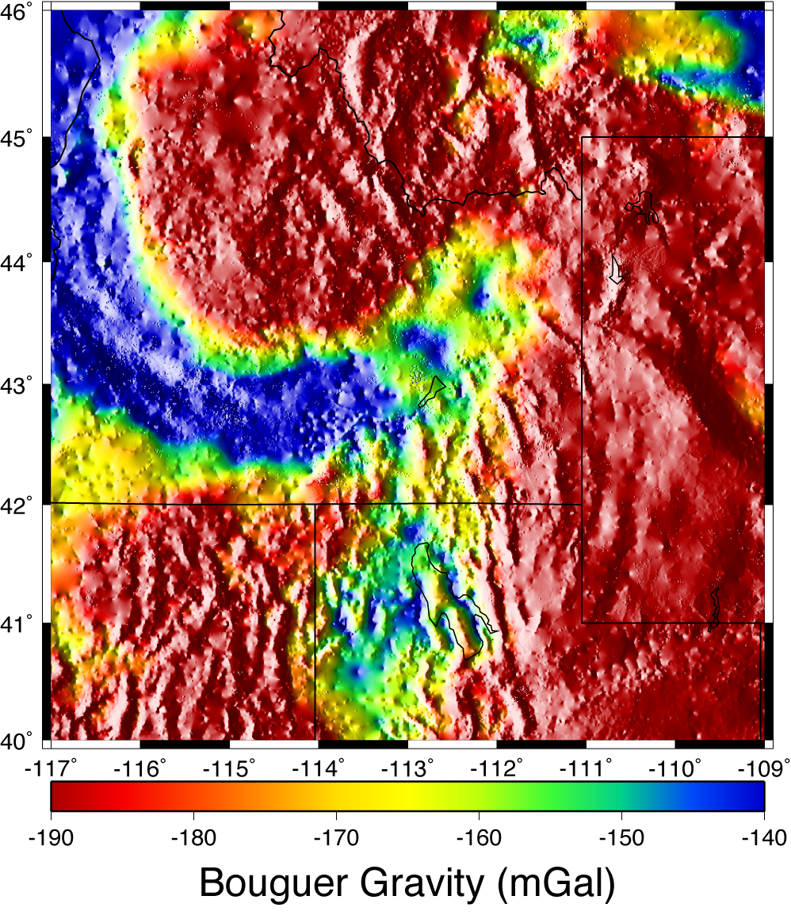
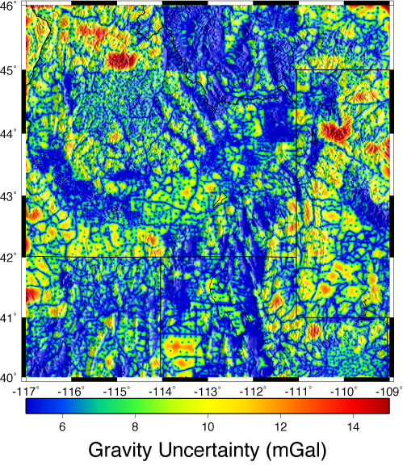
Uncertainty mostly over 5 mGal, up to 20 in wilderness areas.
Gravity here is draped over the gravity gradient… Notice that
some sites are evident outlier points! Poor network adjustment?

