Slide 1
Geology 6600/7600
Signal Analysis
29 Aug 2017
Some useful pointers from the syllabus
6600 differs from 7600 in the expectation that PhD
student’s research projects will involve substantial
amounts of data &/or new methodology/algorithm
development. (PhDs will also do additional exercises).
Semester projects should begin in the next three or four
of weeks; should be related to a thesis topic (if
applicable); should be interesting to you!
• Always feel free to ask questions! (It helps!)
• So, what do you want to know about Signal Analysis?
© A.R. Lowry 2017

Slide 2
Notes and Notation!
• The most important points of each lecture (in my opinion)
are summarized on the first slide of the following lecture
• Note the notation!
→ Arial Black, italic means Important, pay
attention…
→ Arial Black, italic, red font means
Critically Important concept or terminology
that I expect you to understand intimately
for exercises and projects
→ Times New Roman, italic, black font means this is an
equation or an algebraic variable
→ A Red Box with Grey Background means this is an
especially important concept or equation

Slide 3
Signal Analysis is a set of tools that
can be used to extract information
from sequences of random
variables…
A sequence of random variables is any real-valued
function defined on a sample-space, usually
measurements or outcomes of an experiment, which are
not inherently predictable. We can think of it as a “vector”
with a random element, which we will denote:
Note: In this context, the overbar denotes a vector;
the tilda designates a random variable. For those of you
who have taken (or will eventually take) Inverse Theory,
Seismology, etc… This notation should be familiar!

Slide 4
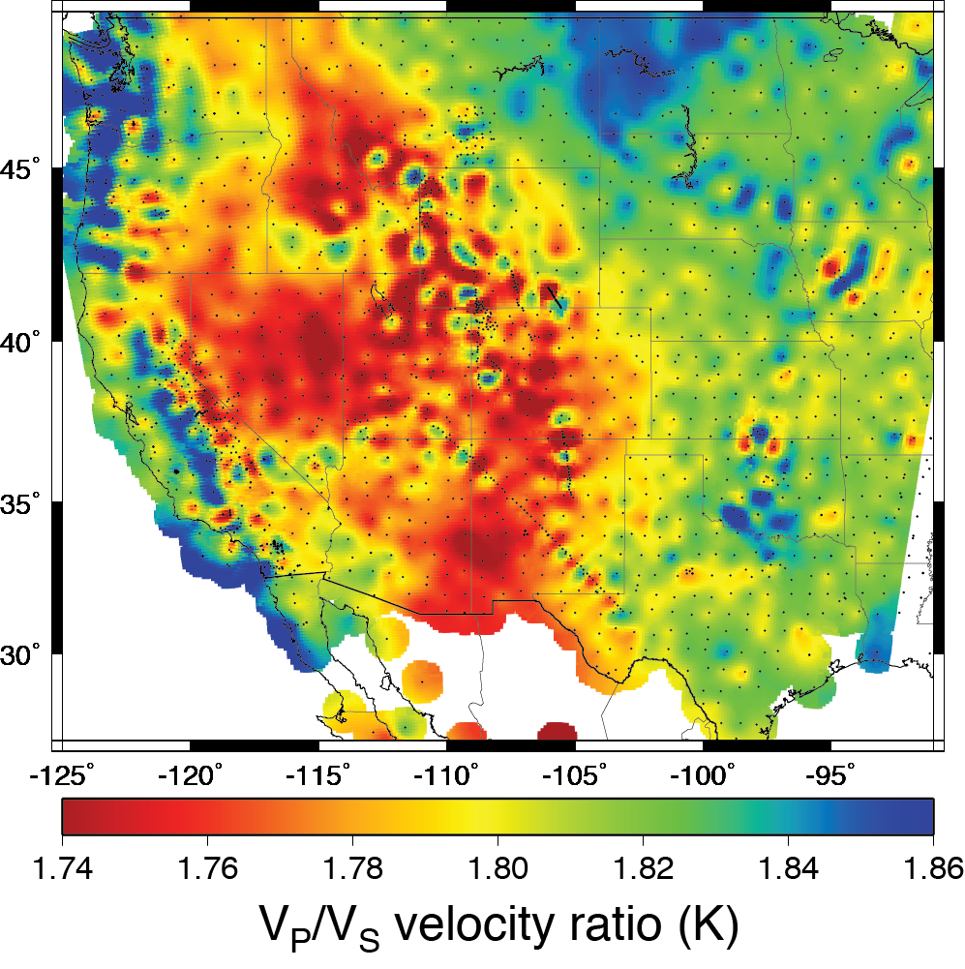
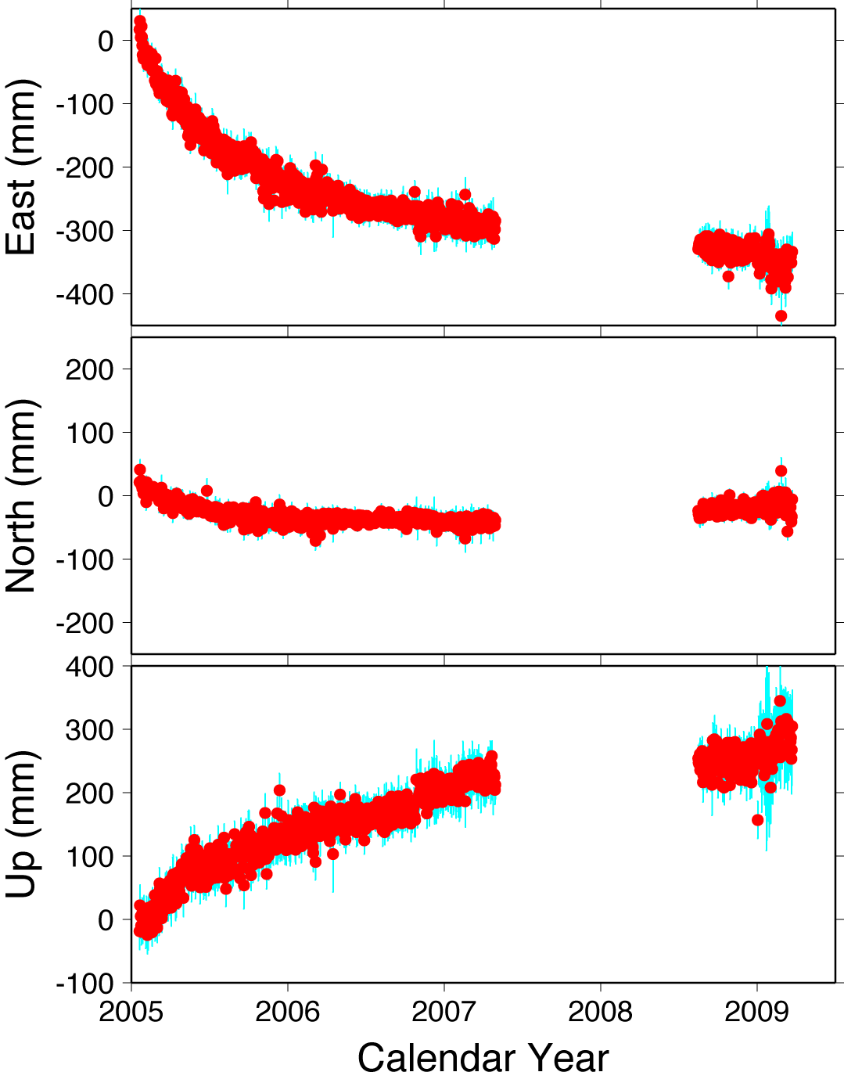
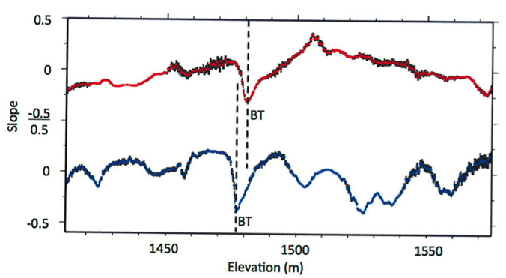
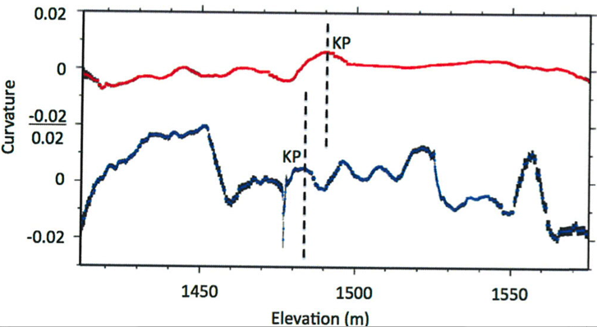
There are multiple senses in which “randomness” may be part
of a sequence of variables:
E.g.,
• The measurements are imprecise or incomplete (i.e., they
have errors)
• The variable is deterministic, but the inputs are unknown
• The variable reflects inputs from many different processes

Slide 5
When randomness is involved, we describe properties in
the language of probability and statistics…
Some definitions which may (or may not) be familiar:
• A joint multivariate cumulative distribution
function (CDF) describes, for arbitrary x, the relational
probabilities:
• A joint probability density function (PDF) is the
derivative of the distribution function:

Slide 6
These are more familiar in less generalized, univariate forms.
For example, the normal (Gaussian) probability density function
is given by:
Given a normally-distributed variable , the CDF is:
(Here the angle brackets <•> denote expected value).
(For the joint normal distribution function, PDF is:)

Slide 7
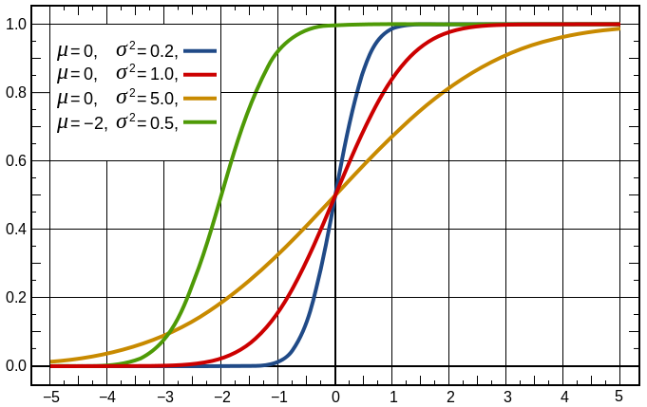
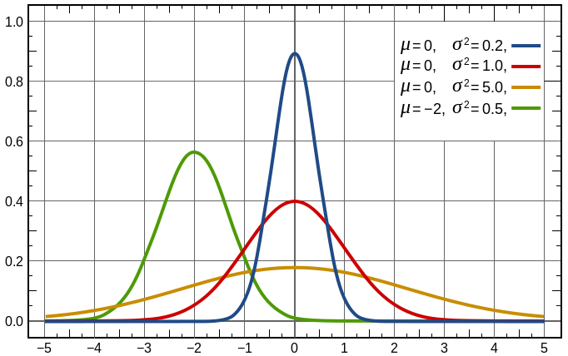
So as examples of the multivariate
forms:
Cumulative distribution
function:
Probability density function:
• F and f are defined for all x
• Each random variable x_{i} in the
sequence has its own unique
statistical properties
F
f
~
x

Slide 8
One can equivalently say that the distribution function is
the multiple integral of the probability density function
over the variables:
Marginal densities are the probability density
functions distinctly associated with one (or more)
variables, e.g.:
(The latter example can be useful in defining correlations,
for example.)

Slide 9
Random variables are considered independent
if the probability density function is equivalent to the
product of the marginal densities:

Slide 10
Multivariate Statistics:
The mean of some function of random variables
can be expressed in terms of the probability density
function as:
For a simple example, if then:
If these are independent variables, then:
(because !)

Slide 11
The vector mean of a sequence of independent random
variables is thus:

Slide 12
The covariance of two random variables is defined as
If the RV’s are independent,
and hence C_{ij} = 0 (in which case, the RV’s are uncorrelated).
The variance of a RV is
These can be combined for all RV’s in a sequence as the
covariance matrix:
(always symmetric)

Slide 13
Aside: Independent versus Uncorrelated
• Random variables are said to be uncorrelated if their
covariance C = 0.
• If two RV’s are independent, they are uncorrelated
However uncorrelated is not equivalent to
independent.
(Consider for example x₁ uniformly distributed on [–1,1],
and )
Thus uncorrelated variables may still be dependent
variables…

Slide 14
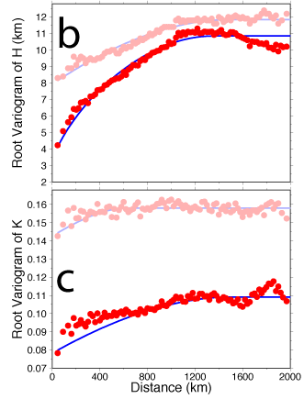
Recall independent RV’s
are uncorrelated, but
uncorrelated RV’s are not
necessarily independent…
At left are variograms,
which are expressions of
the variance of measurements
as a function of the distance
between measurements.
Are H(x,y) independent
variables? Are K(x,y)?

