Slide 1
Geology 6600/7600
Signal Analysis
31 Aug 2017
Last time:
Signal Analysis is a set of tools used to extract information
from sequences of random variables…
“Review” of multivariate statistics:
• Joint multivariate cumulative distribution function:
• Joint probability density function:
• Univariate normal PDF:
• Multivariate ”:
© A.R. Lowry 2017

Slide 2
Geology 6600/7600
Signal Analysis
Last time cont’d:
• Marginal probability density function:
• Independent RV’s:
• Mean of a function g of random variables:
• Vector mean of a sequence of independent random
variables:
• Covariance of two random variables is:
(= 0 if independent).

Slide 3
The correlation R_{ij} differs from the covariance in that the
mean is not subtracted within the expectation operator:
(although R and C will be the same if the variables are
zero-mean). Thus if variables are independent, R_{ij} = μ_{i}μ_{j}.
In matrix form we can write:
Recall that for uncorrelated random variables,
And since C_{ij} = R_{ij} – μ_{i}μ_{j}, we can write:

Slide 4
Recall from last time that the multivariate normal
distribution function is given by:
At the time, C and μ came outta nowhere…
Now, we have an inkling of what they are!
Exercise: show that for the case in which all random
variables are uncorrelated,

Slide 5
Application:
Consider an average of N independent, identically-distributed
random variables (example: N independent measurements
of an unchanging property):
The expected value of the average is:
Recall the variance so:
Hence, the standard deviation on multiple measurements
of the expected value of a property decreases as 1/ !

Slide 6
~
~
This would imply that, if x’s are Gaussian*, so is z… True?
“Recall” that the Fourier transform of a function f (x) is defined
as:
We can express the Fourier transform of z as a characteristic
function:
So if x’s are independent,
From this one can show (advanced exercise?) that
• if each x_{i} is N(μ,σ), then z is N(μ,σ/ )
• the Fourier transform of a Gaussian function is also a
Gaussian function
~
~
~
~
* “Gaussian” and “normal” distribution are used interchangeably in this class.

Slide 7
The Central Limit Theorem states that as N → ∞,
a sum of random variables z tends to a normal
distribution regardless of the distributions of the
individual x_{i}’s… i.e., the random variables do not have
to be identically distributed in order for the sum to be
Gaussian.
~
~

Slide 8
Stochastic Processes
(or, “Random” Processes)
We can think of signals as having two types:
• Deterministic signals are completely predictable if a
limited number of parameters are known (e.g., we can
exactly predict behavior of a sine wave if we know the
amplitude, frequency and phase).
• Stochastic signals by contrast are inherently
unpredictable a priori.
A stochastic process is a family of functions of random
variables. Let’s take the example of random variables
sampled in time t, and multiple measurements (or,
“realizations”) of the rv’s which we can denote n_{i}:

Slide 9
Stochastic Process: a family of functions
where n_{i} denotes the outcome (or
realization) of a measurement:
The collective grouping of functions and measurements is
referred to as an ensemble, and the mean over all the
measurements n is the ensemble average. If the time
average for individual functions n_{i} = the ensemble average,
the functions are considered to be ergodic.
t₀
t

Slide 10
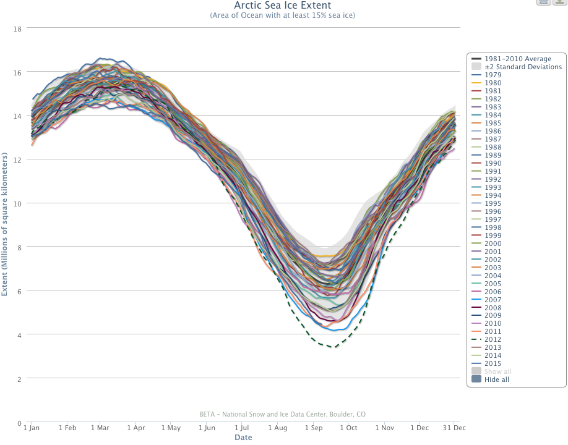
For example…
Ergodic?
Not ergodic?

Slide 11
For example…
Not ergodic.

Slide 12
To simplify the notation, we’ll let
denote the random process (i.e., the n is implied).
Let x(t) be a random variable x at a specified time t.
The joint multivariate cumulative distribution
function, or F-distribution, is:
with first-order probability density function:
The second-order CDF and PDF are:
~
~

Slide 13
The mean of the process is:
The autocorrelation is:
And the autocovariance is simply the autocorrelation
minus mean(t₁) times mean(t₂).
Example (from Papoulis): Let x(t) be a random process with
μ(t) = 3; R(t₁,t₂) = 9 + 4e^{–0.2|t1–t2|}
This is a stationary process, defined as having
constant μ and R dependent only on difference in time.
What is the variance at t = 5? Covariance at (5,8)?

Slide 14
Consider another example: Let be a
random process in which rv’s r and φ are independent,
and φ is uniformly distributed such that f(φ) = 1/2π
on {–π,π}.
Recalling trig identities: cos(x + y) = cos(x)cos(y) – sin(x)sin(y)
2 sin(x)sin(y) = cos(x – y) – cos(x + y)
Note that:

Slide 15
Hence the autocorrelation of a single-frequency sinusoidal,
stationary process is the cosine function:
R(τ)
τ = t₁ – t₂

