Slide 1
Geology 6690/7690
Geodesy & Crustal Deformation
18 Sep 2023
GPS Positioning: Signals & Codes
• GPS Signal Structure consists of three+ codes superposed on
two+ signals (up to five on newer satellites)
• Receivers distinguish satellite transmissions from microwave background
by cross-correlating antenna reception with known PRN codes of the SV’s
• Tectonic-Grade (and other highest-accuracy) Receivers track phase
Φ of carrier signals (L₁, L₂, eventually L₄ & L₅?) and use the doppler to
determine range change over time
• Errors in estimates of satellite position, satellite clocks (& other
common-mode errors) are reduced by differencing two or more
receivers to each satellite
• Double-differencing (two satellites, two receivers) ensures an integer
ambiguity (= range at the first phase observation, when using doppler).
Read for Wed 20 Sep: Wahr §3.1-3.2 (67-75)
© A.R. Lowry 2023

Slide 2
Read for Fri (22 Sep)
Borsa, A. A., Agnew, D. C., & Cayan, D. R. (2014). Ongoing
drought-induced uplift in the western United States. Science,
345(6204), 1587-1590.

Slide 3
GPS Error Sources (and Mitigation)
Single Difference Correction
Satellite position and SV clocks:
Real-time (Nav Message) orbit
plus clock drift errors ~ 5 m
Various orbit estimation centers
(e.g., IGS, JPL) solve for satellite
position, velocity, clocks and
provide to users (error ~ 3-6 cm)
Network positioning applications
remove these common mode
errors by differencing
• Precise point positioning does not
difference; neglects these errors
A
B
Δρ_{a} → Δρ_{b}
Double Difference Residual
1
2
A
B
ρ_{1a} – ρ_{2a} – ρ_{1b} + ρ_{2b}
(yields an ambiguity that’s
an integer # of wavelengths)

Slide 4
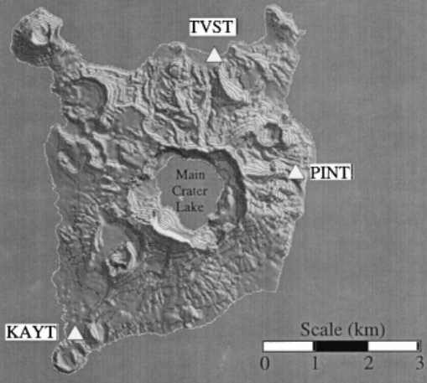
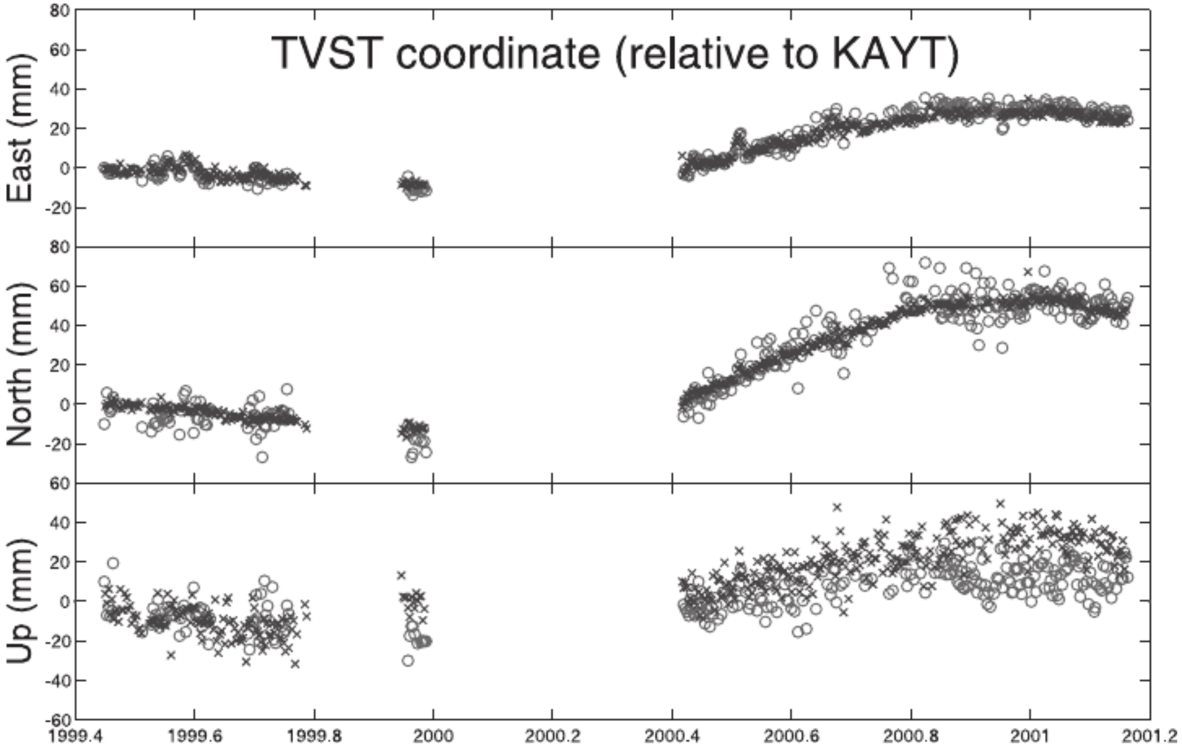
Atmosphere I. The Ionosphere:
Note: These are errors in double-differenced daily GPS positions!!!
Bartel et al., JGR 2003
x’s are double-differenced positions using two frequencies;
circles positioned using L₁ only... Differenced over < 5 km.

Slide 5
GPS Error Sources (and Mitigation)
Atmosphere I. The Ionosphere:
Uppermost layers of the atmosphere
(30–50 km altitude) are ionized
by solar radiation
Has dispersive effect on
microwave ⇒ Refractive index
n = c/v depends on frequency f as:
n = 1 + c₂/f ² + c₃/f ³ + c₄/f ⁴ + …
To first order can correct this by a
linear combination of phase at
two different frequencies:
Φ_{LC} = Φ_{L1} – f₂ Φ_{L2}/f₁
(the “ionosphere-free” linear
combination!)
Is responsible for most
(~1 m) error in WAAS-
corrected single-
frequency positions…
Ideally use dual-freq…
Potential for greater
improvement using an
additional frequency (⇒
higher order correction!)

Slide 6
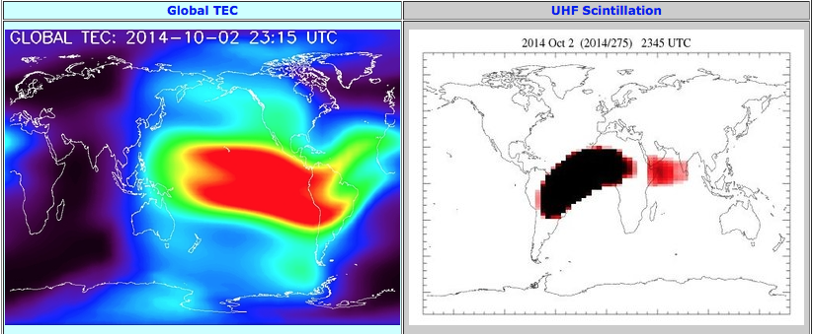
GPS Error Sources (and Mitigation)
Atmosphere I. The Ionosphere:
One person’s noise is another person’s signal… GAIM
(developed here on campus) used GPS measurements
of Total Electron Content to model space weather in real-time.

Slide 7
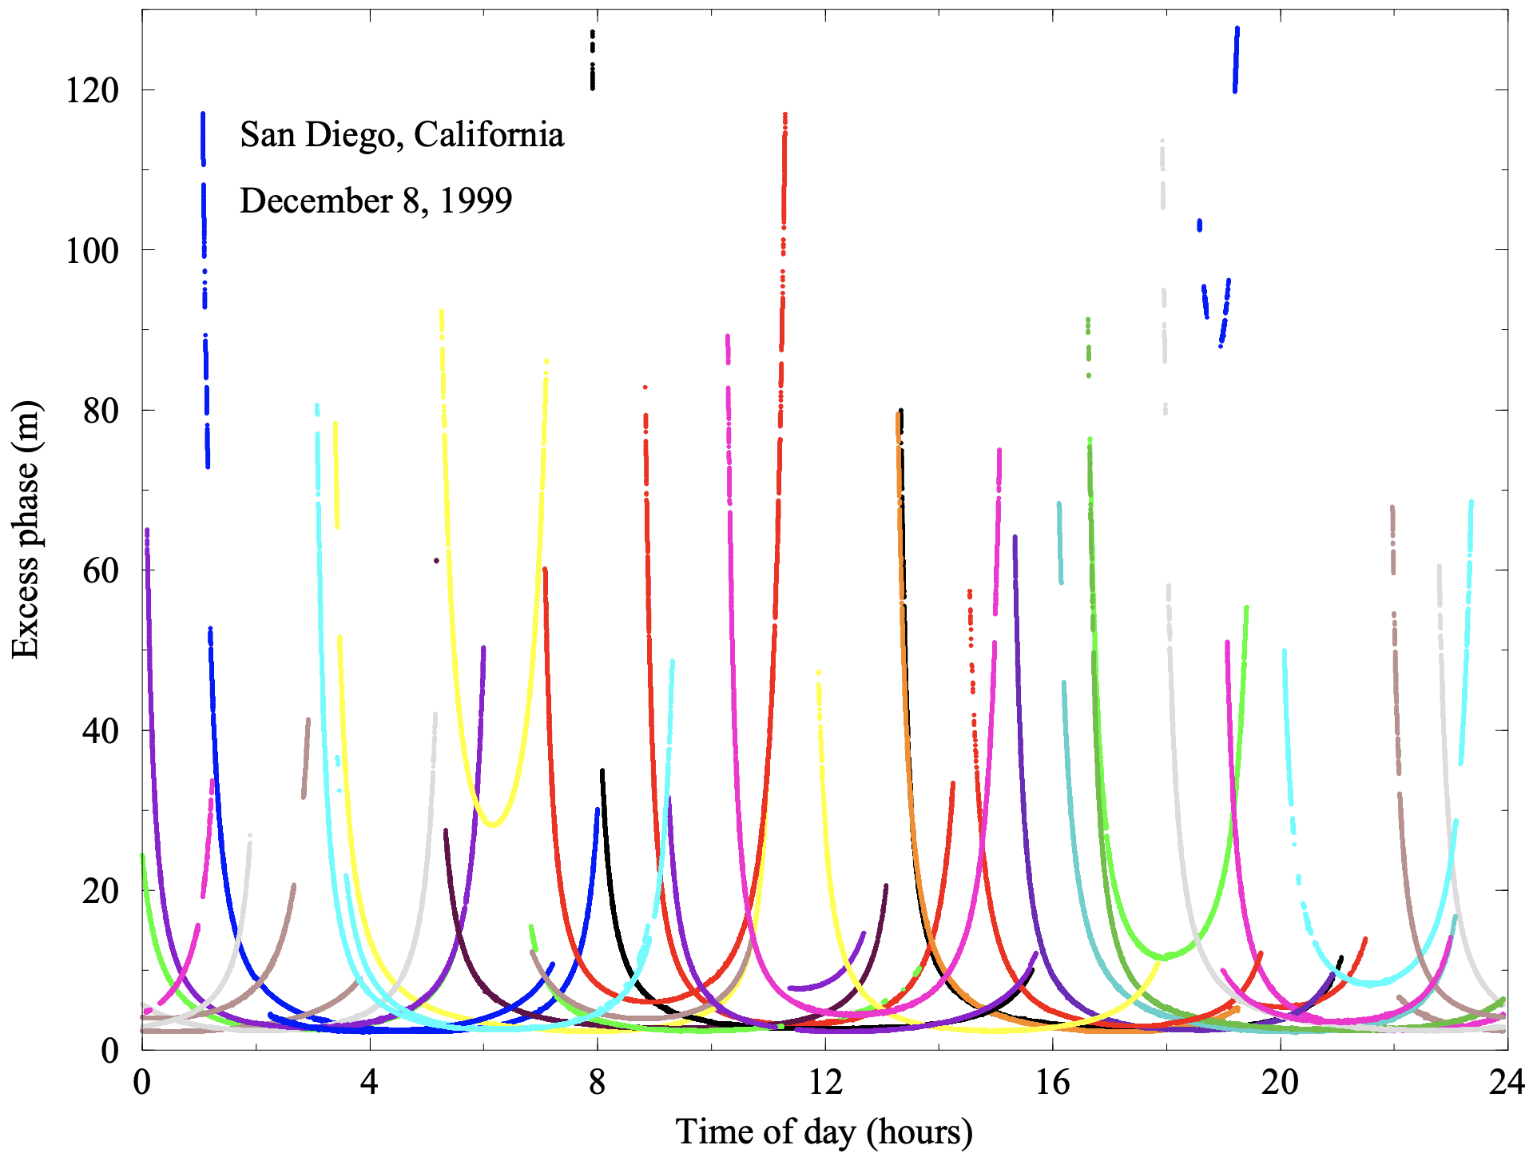
GPS Error Sources (and Mitigation)
Atmosphere II. The Troposphere:
Point-positioning uses one receiver (no differencing)
Note: These are slowing in point-positioned 1-sec GPS ranges!!!

Slide 8
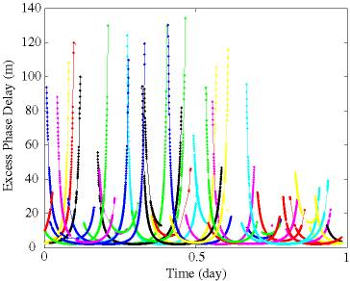
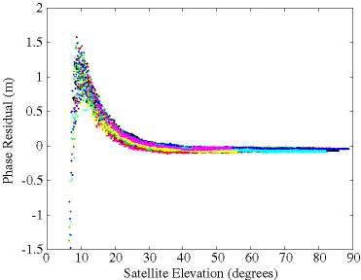
GPS Error Sources (and Mitigation)
Atmosphere II. The Troposphere:
Index of refraction depends on
pressure, temperature, water vapor
in the atmosphere: increases
apparent range by 2 to 100+ m
Excess phase path for a
single day of GPS
measurement
Generally correct
via a single-
parameter elevation
mapping function (e.g.,
wet Neill) but > 1 m errors remain at
low elevation angle after correction.

Slide 9
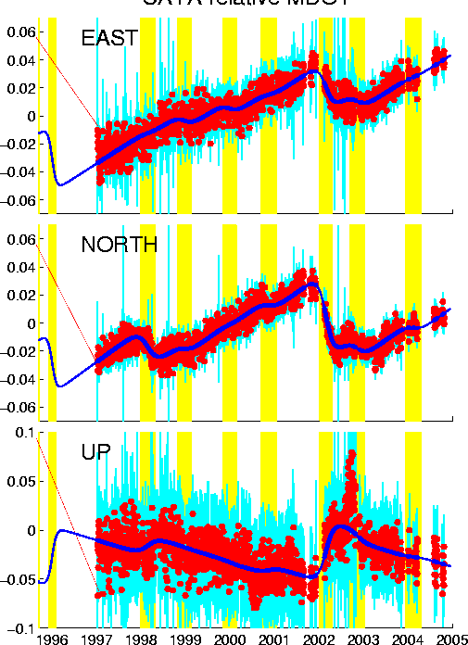
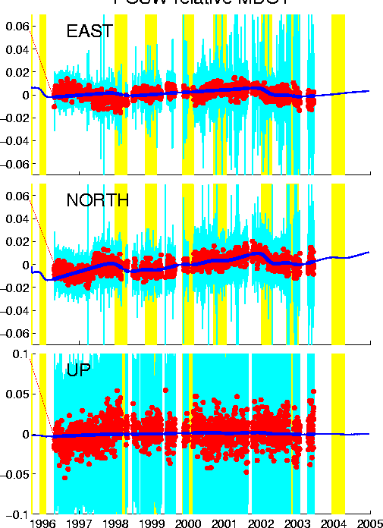
GPS Error Sources (and Mitigation)
Atmosphere II. The Troposphere:
CAYA (Elev 26 m) rel MDO1
POSW (Elev 3940 m) rel MDO1

Slide 10
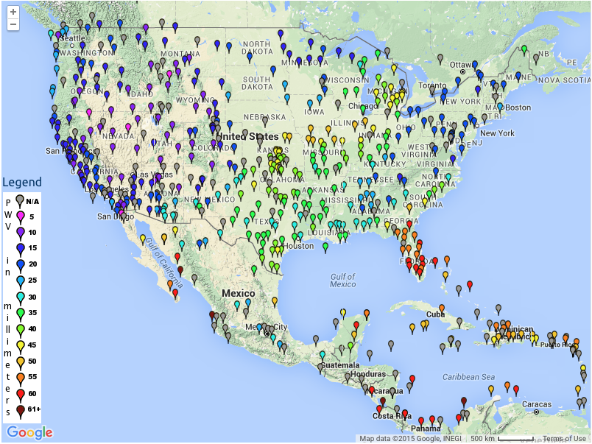
But again,
one person’s
noise is another’s
signal. This courtesy
of SUOMINET…

