Slide 1
GEO 5/6690 Geodynamics
1 Feb 2023
Last Time: Conductive Thermal Transfer (Cont’d)
• Topography introduces a variable surface temperature T_{S}
(related to atmospheric lapse rate) & a changing distance to
the T_{S} boundary; can solve using sinusoids (via the
Fourier transform!)
• When thermal transfer is time-dependent (e.g., slab
cooling; plate cooling) the heat equation also involves
time:
• Elevation reflects the geotherm via thermal isostasy…
(e.g., ocean bathymetry). For instantaneous rifting with a
stretching factor β,
Note: Solutions to the
heat equation often
involve the error
function (erf),
e.g., half-space
cooling:
H
Read for Mon 6 Feb: T&S §4.18-4.28
© A.R. Lowry 2023

Slide 2
Next Journal Article Reading
Friday Feb 3: Roy et al. (2009) Nature
459, 978-982…
Shelby Dianne will lead!

Slide 3
About grad student semester projects:
The goal is to find a semester project that:
• Relates to your thesis research (or if that’s not possible,
one that relates to your interests in solid Earth processes)
• Utilizes observational data that you either collected
yourself or obtained from databases
• Uses methods, models and/or physical relations that are
part of the topical material of this course
Products (to be graded) will include:
• A 10-20 minute GSA/AGU-style oral presentation, to be
given during our final exam period. (Undergrads receive
credit for attendance and good questions!)
• A 5-10 page writeup of the project motivation, background,
methods and results
Contact me with your ideas for brainstorming & guidance!

Slide 4
Example II: “Instantaneous” Rifting (McKenzie EPSL 1978)
Basically a cooling model:
crust
crust
crust
mantle
lithosphere
l
mantle
lithosphere
mantle
lithosphere
Higher temperature lower density; isostasy implies
lower density should correspond to higher elevation!
Elevation h decays ~ exponentially as
where β is stretching factor; characteristic time τ is

Slide 5
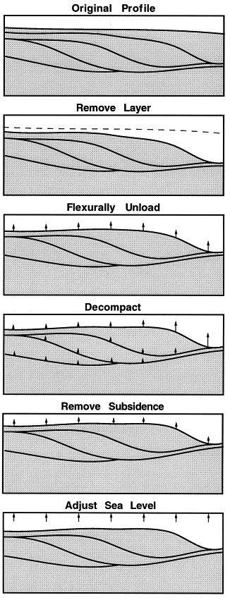
Cartoon from Steckler et al., Mar. Geol. 1999
How might we measure time-dependence
of elevation following rifting?
~1-2 km over 10-100 Myrs ≤ 0.1 mm/yr.
You wouldn’t see this with GPS unless
right at the beginning of the exponential!
Need measurements of elevation change
on geological time scales…
One approach is to look at the
sedimentary record. Backstripping :
Isostatic balance of water + sediment
+ crust + mantle. After correcting for
sediment compaction (can predict from
load) and sea level change, get
elevation change!

Slide 6
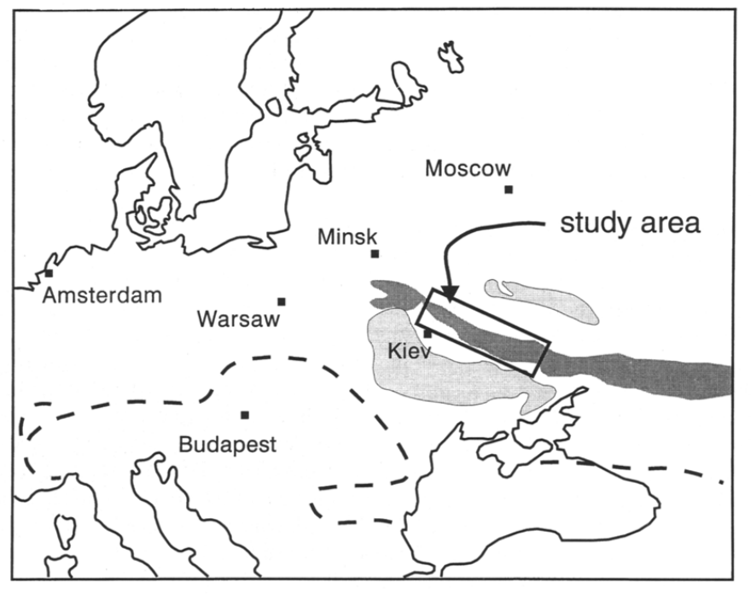
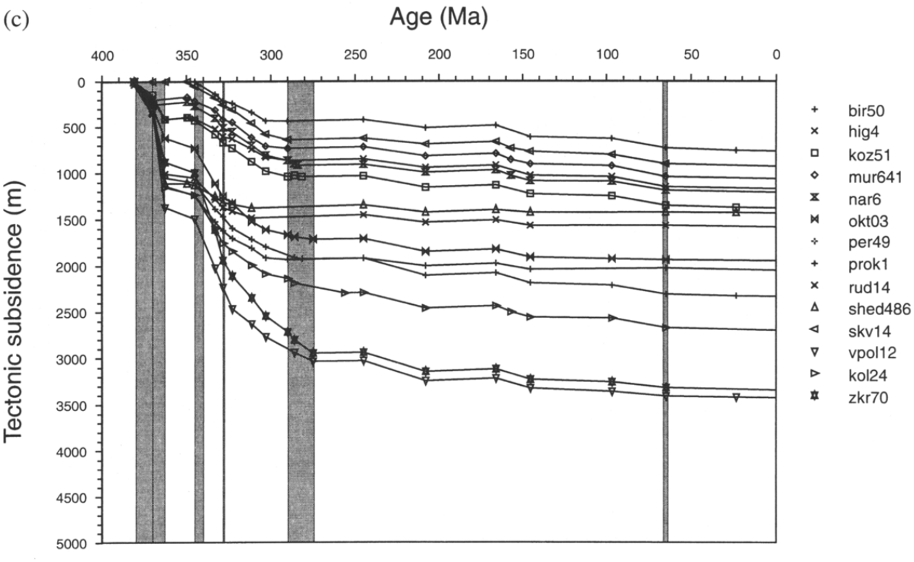
Subsidence curves from
rift basins (example here
from late-Devonian
Dniepr-Donets basin in
the Eastern European
craton, Ukraine) often
show the ~exponential
subsidence profiles
predicted by stretching
models

Slide 7
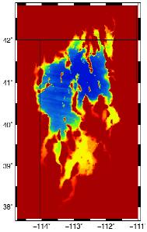
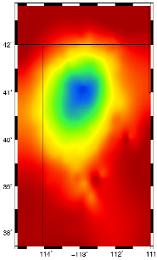
Recall isostasy reflects material moving from higher pressure
and toward lower pressure to achieve equilibration and
indicates flow
ρ₁
ρ₂
ρ_{m}
~ Constant P =

Slide 8
The Adiabat (the “other” part of the geotherm):
approximately describes mean temperature in
convecting systems
0
Temperature
1200-1400 ºC
0
Conductive
50-300
km
Depth
Adiabat: Temperature
increases with pressure
but energy doesn’t
change
Convective

