Slide 1
GEO 5/6690 Geodynamics
1 Mar 2023
Last Time: RHEOLOGY
Rheology describes the operator relating stress to strain:
and includes linear elastic, linear viscous, nonlinear viscous,
viscoelastic, plastic, …
Stress is force per unit area; in a continuum fully described
by a tensor with 9 components (three force directions acting
on each of three different directions). Strain also is a
9-component tensor describing deformation in response to
applied stress
Ductile flow in the Earth occurs by a combination of diffusion
creep (σ = ηε ; moves atoms along grain boundaries) and
dislocation creep (σ = η_{eff}(σ)ε ; dislocations move in
grains). The latter dominates lithosphere and shallow
asthenosphere!
.
.
Read for Fri 3 Mar: T&S §7.5–7.11
© A.R. Lowry 2023

Slide 2
First Assignment:
Posted on course website!
Due Mar 3 at 1:30 pm
Next Journal Article Reading:
For Wednesday Mar 15: Becker et al. (2015)
Western U.S. intermountain seismicity
caused by changes in upper mantle flow,
Nature, 524(7566), 458-461.

Slide 3
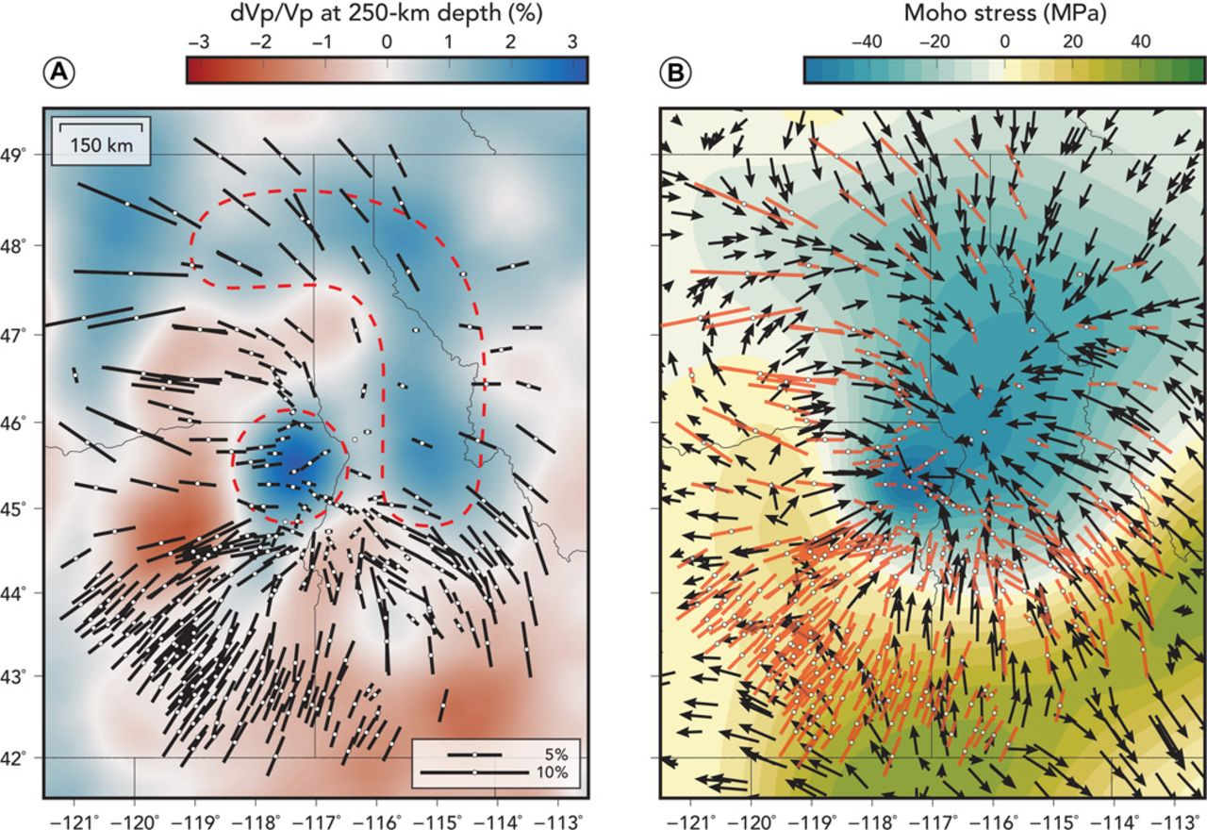
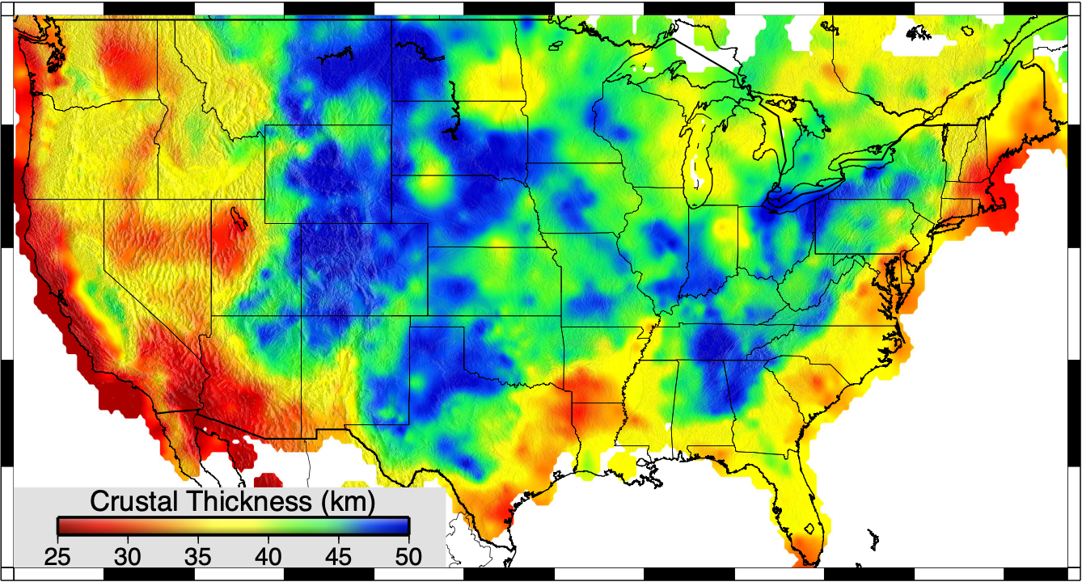
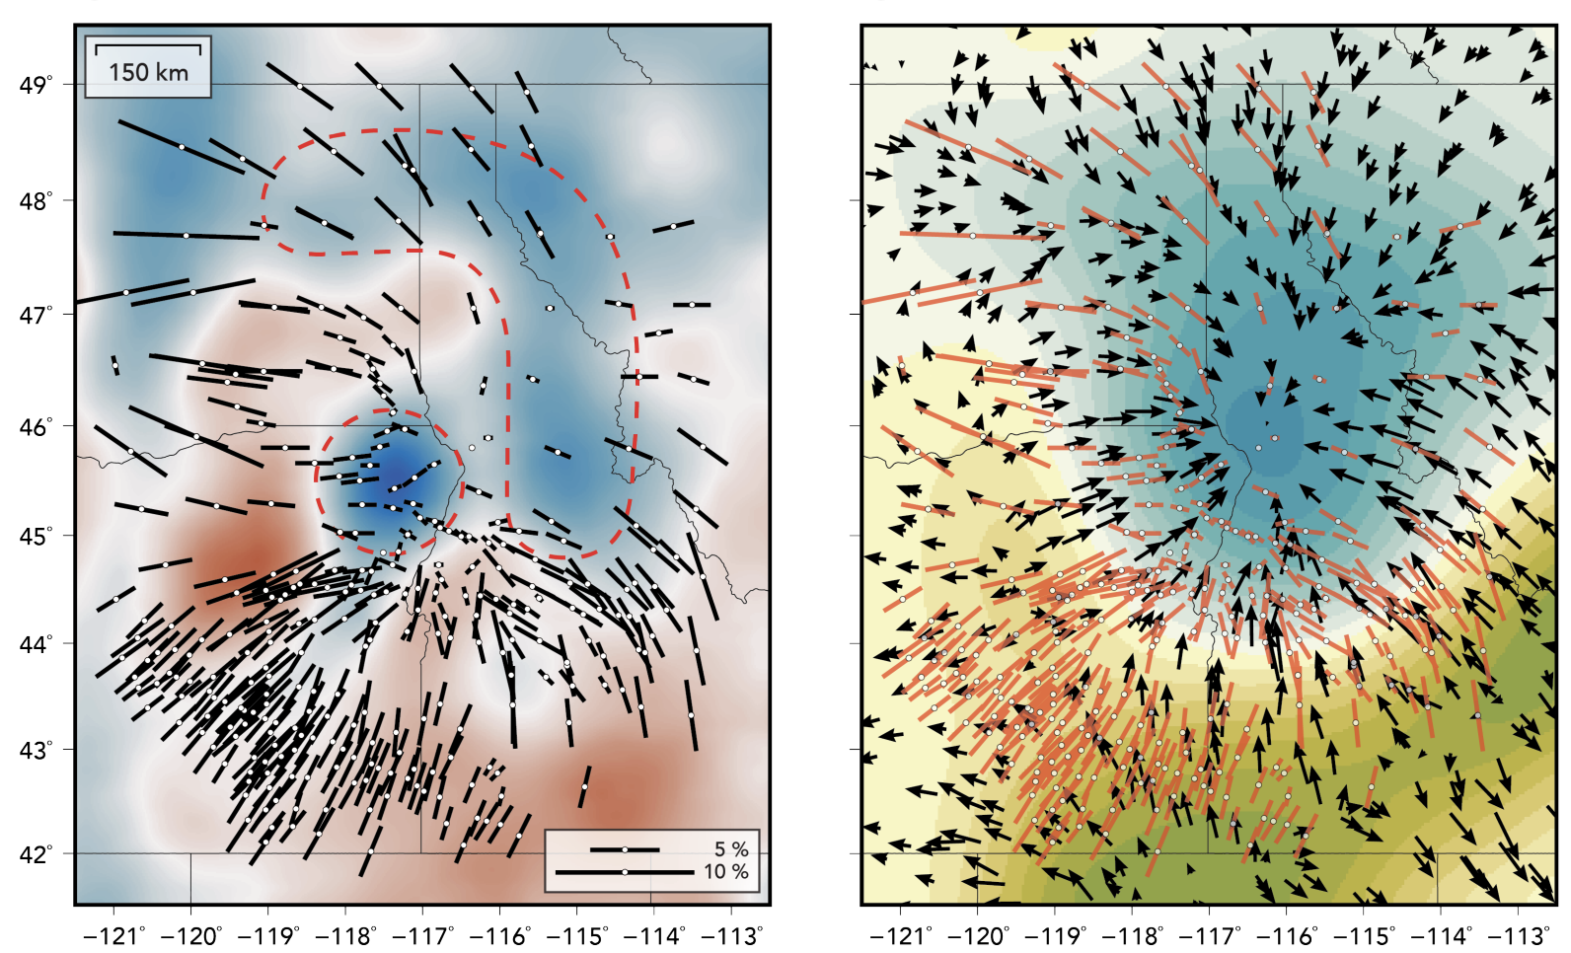
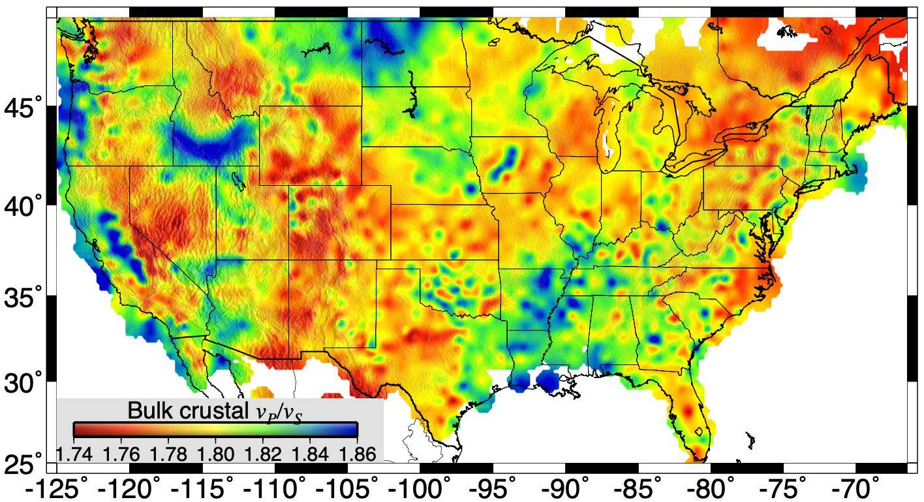
• Model implies thicker crust under Wallowa… √!
• Assumes constant viscosity crust… ?
Observed
Modeled
Castellanos et al., Sci. Adv., 2020
(Without Wallowa load…)

Slide 4
But practically, there are just four types
that are important in Earth dynamics…
Hooke’s Law (Elastic)
Byerlee’s Law (Friction)
σ = Cε
τ = μσ_{n} + C
τ is (failure) shear stress;
σ_{n} is normal stress;
μ is frictional coefficient;
C is cohesion
σ is stress;
ε is strain;
C are elastic constant(s)
Viscous (linear creep)
Viscous (power-law creep)
.
.
σ = η_{diff} ε
σ ^{n} = η_{disl}ε
σ is stress;
ε is strain-rate;
η_{diff} is viscosity
of diffusion creep
n is power-law exponent;
η_{disl} is viscosity
of dislocation creep
.

Slide 5
But practically, there are just four types
that are important in Earth dynamics…
Hooke’s Law (Elastic)
Byerlee’s Law (Friction)
σ = Cε
τ = μσ_{n} + C
Seismic timescales
τ is (failure) shear stress;
σ_{n} is normal stress;
μ is frictional coefficient;
C is cohesion
Upper Lithosphere
σ is stress;
ε is strain;
C are elastic constant(s)
Viscous (linear creep)
Viscous (power-law creep)
.
.
σ = η_{diff} ε
σ ^{n} = η_{disl}ε
σ is stress;
ε is strain-rate;
η_{diff} is viscosity
of diffusion creep
n is power-law exponent;
η_{disl} is viscosity
of dislocation creep
.
Asthenosphere
Lower Lithosphere

Slide 6
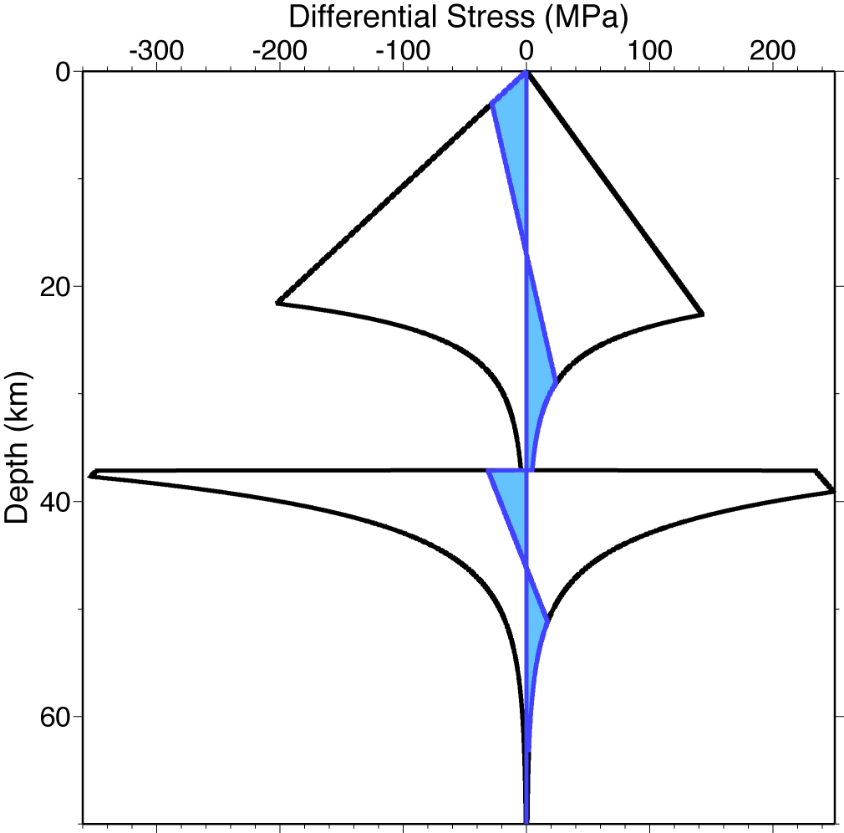
Laboratory studies of rock strain use roughly the same
equations as those derived from first principles in mineral
physics, but collapse them to observable constant params
Frictional
(Byerlee)
depends on:
• Lithology
(pyroxene > olivine > feldspar > quartz)
• Water fugacity f_{H2O}
• Temperature T
(and to a lesser extent)
• Strain rate ε
• Grain size d
• Pressure P
Ductile flow
(Dislocation Creep)
.
Ductile flow
(Dislocation Creep)
Ideally, we would like to use geophysics to determine each
in situ! But it’s not so simple.

