Slide 1
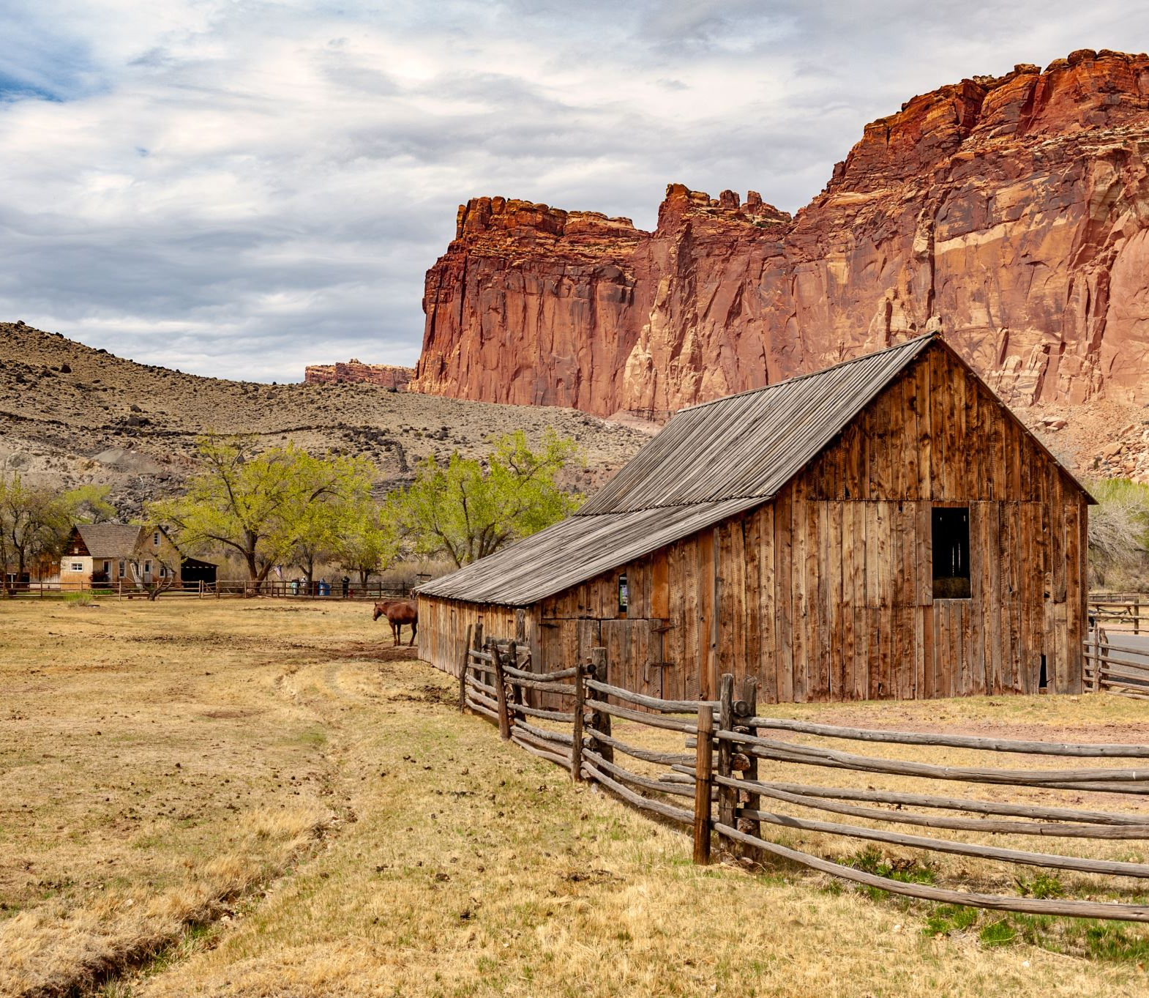
Colorado Plateau magmatism and uplift by warming of heterogeneous lithosphere
Mousumi Roy, Thomas H. Jordan & Joel Pederson

Slide 2
Vocabulary
Bouguer Gravity : a gravity anomaly, corrected for height at which it is measured and the attraction of terrain. The height correction along gives a Free-air gravity anomaly.
Free-air gravity anomaly is in turn related to the observed gravity.
Epeirogenic: is upheavals or depressions of land exhibiting long wavelengths and little folding apart from broad undulations
Eustasy: change in sea leave throughout the world, caused typically by movements of parts of the Earth’s crust the melting of glaciers.
Isopycnic: surfaces of constant density.

Slide 7
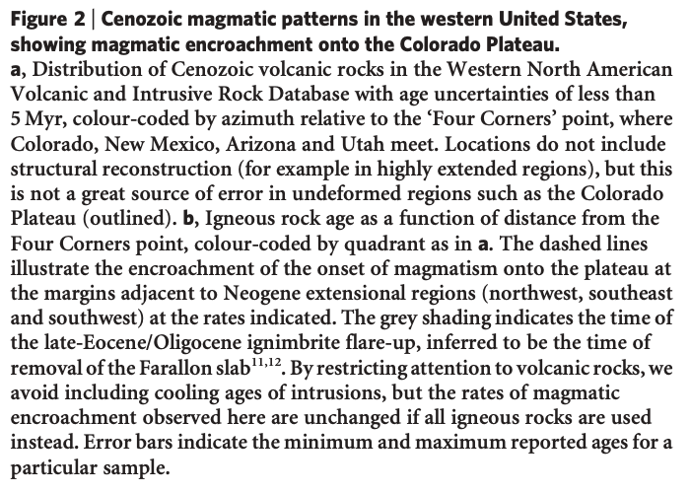

Slide 8
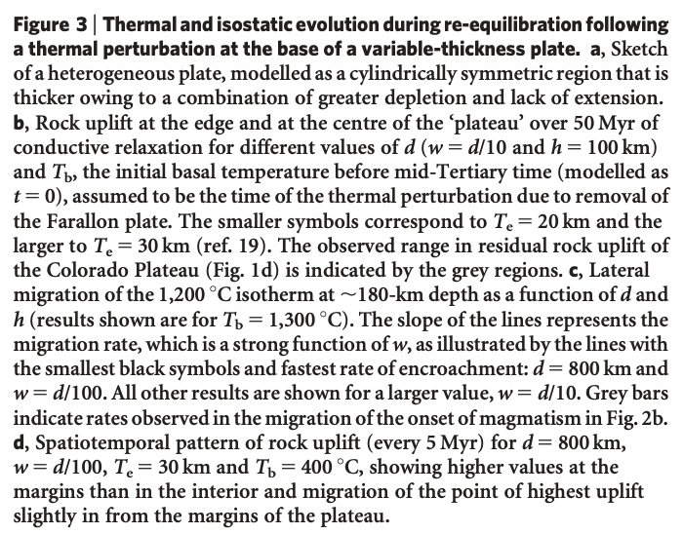

Slide 9
