Slide 1
GEO 5/6690 Geodynamics
3 Mar 2023
Last Time: RHEOLOGY
Flow Rheology depends on mineral-type (i.e. lithology),
temperature, pressure, & volatile state (especially hydration!)
Diffusion also depends on grain size, but only dominates for
very small (<50 μm) grain size and/or very low stress
Temperature is often inferred from surface heat flow, which
is a poor predictor of temperature at depth…
Lithology can be inferred from crustal seismic imaging
(thickness for depth to olivine; v_{P}/v_{S} for quartz vs feldspar)
Yield Strength Envelopes approximate deviatoric stress
supported by the lithosphere; assume a brittle field rheology
(friction coefficient, pore fluid pressure) plus strain rate
Read for Mon 13 Mar: T&S §7.5–7.11
© A.R. Lowry 2023

Slide 2
Next Journal Article Reading:
For Wednesday Mar 15: Becker et al. (2015)
Western U.S. intermountain seismicity
caused by changes in upper mantle flow,
Nature, 524(7566), 458-461.

Slide 3
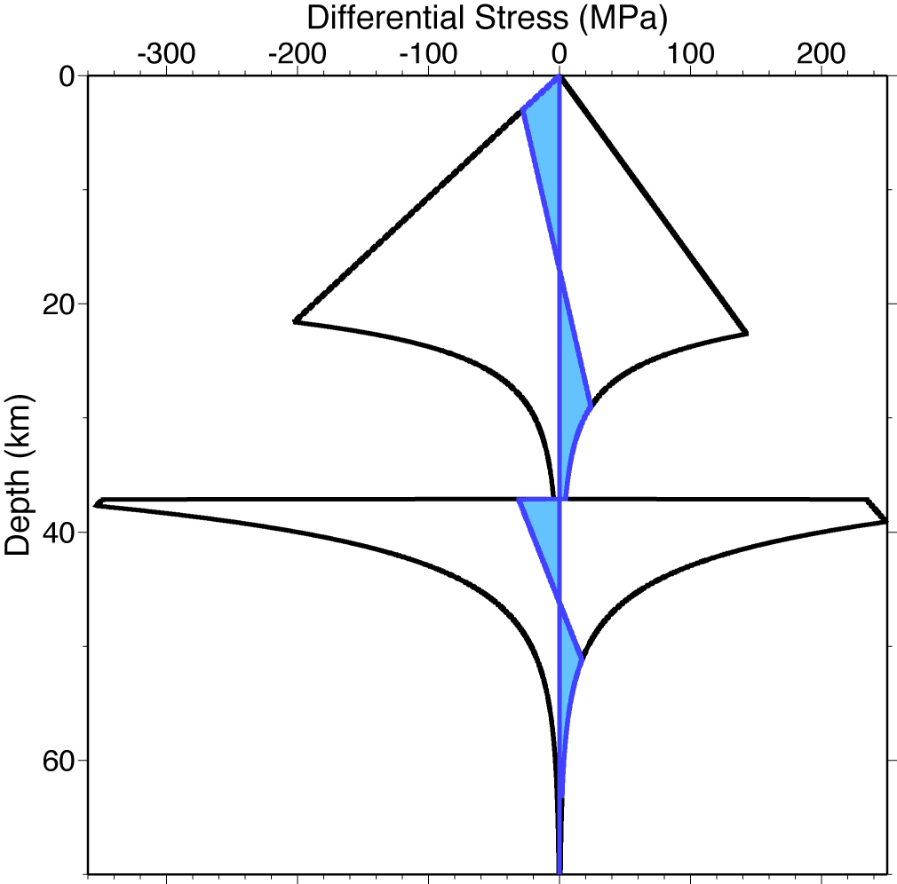
Laboratory studies of rock strain use roughly the same
equations as those derived from first principles in mineral
physics, but collapse them to observable constant params
Frictional
(Byerlee)
depends on:
• Lithology
(pyroxene > olivine > feldspar > quartz)
• Water fugacity f_{H2O}
• Temperature T
(and to a lesser extent)
• Strain rate ε
• Grain size d
• Pressure P
Ductile flow
(Dislocation Creep)
.
Ductile flow
(Dislocation Creep)
Ideally, we would like to use geophysics to determine each
in situ! But it’s not so simple.

Slide 4
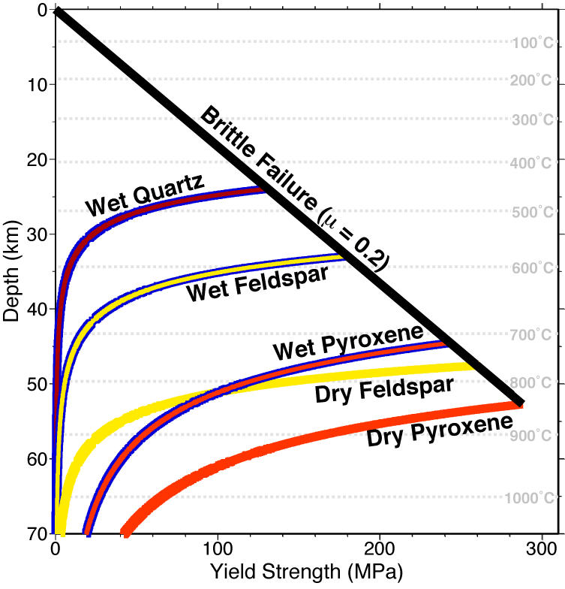
Brittle-field (Amonton’s or
Byerlee’s law) assumes
elastic-plastic
constitutive law
In Yield
Strength
Envelopes, we
often assume
steady-state
horizontal
strain (i.e.,
constant strain
rate) for
dislocation
creep laws
That assumption
is valid for long
time-scales but
not for all depths!
Ductile assumes Newtonian
or non-Newtonian viscous flow

Slide 5
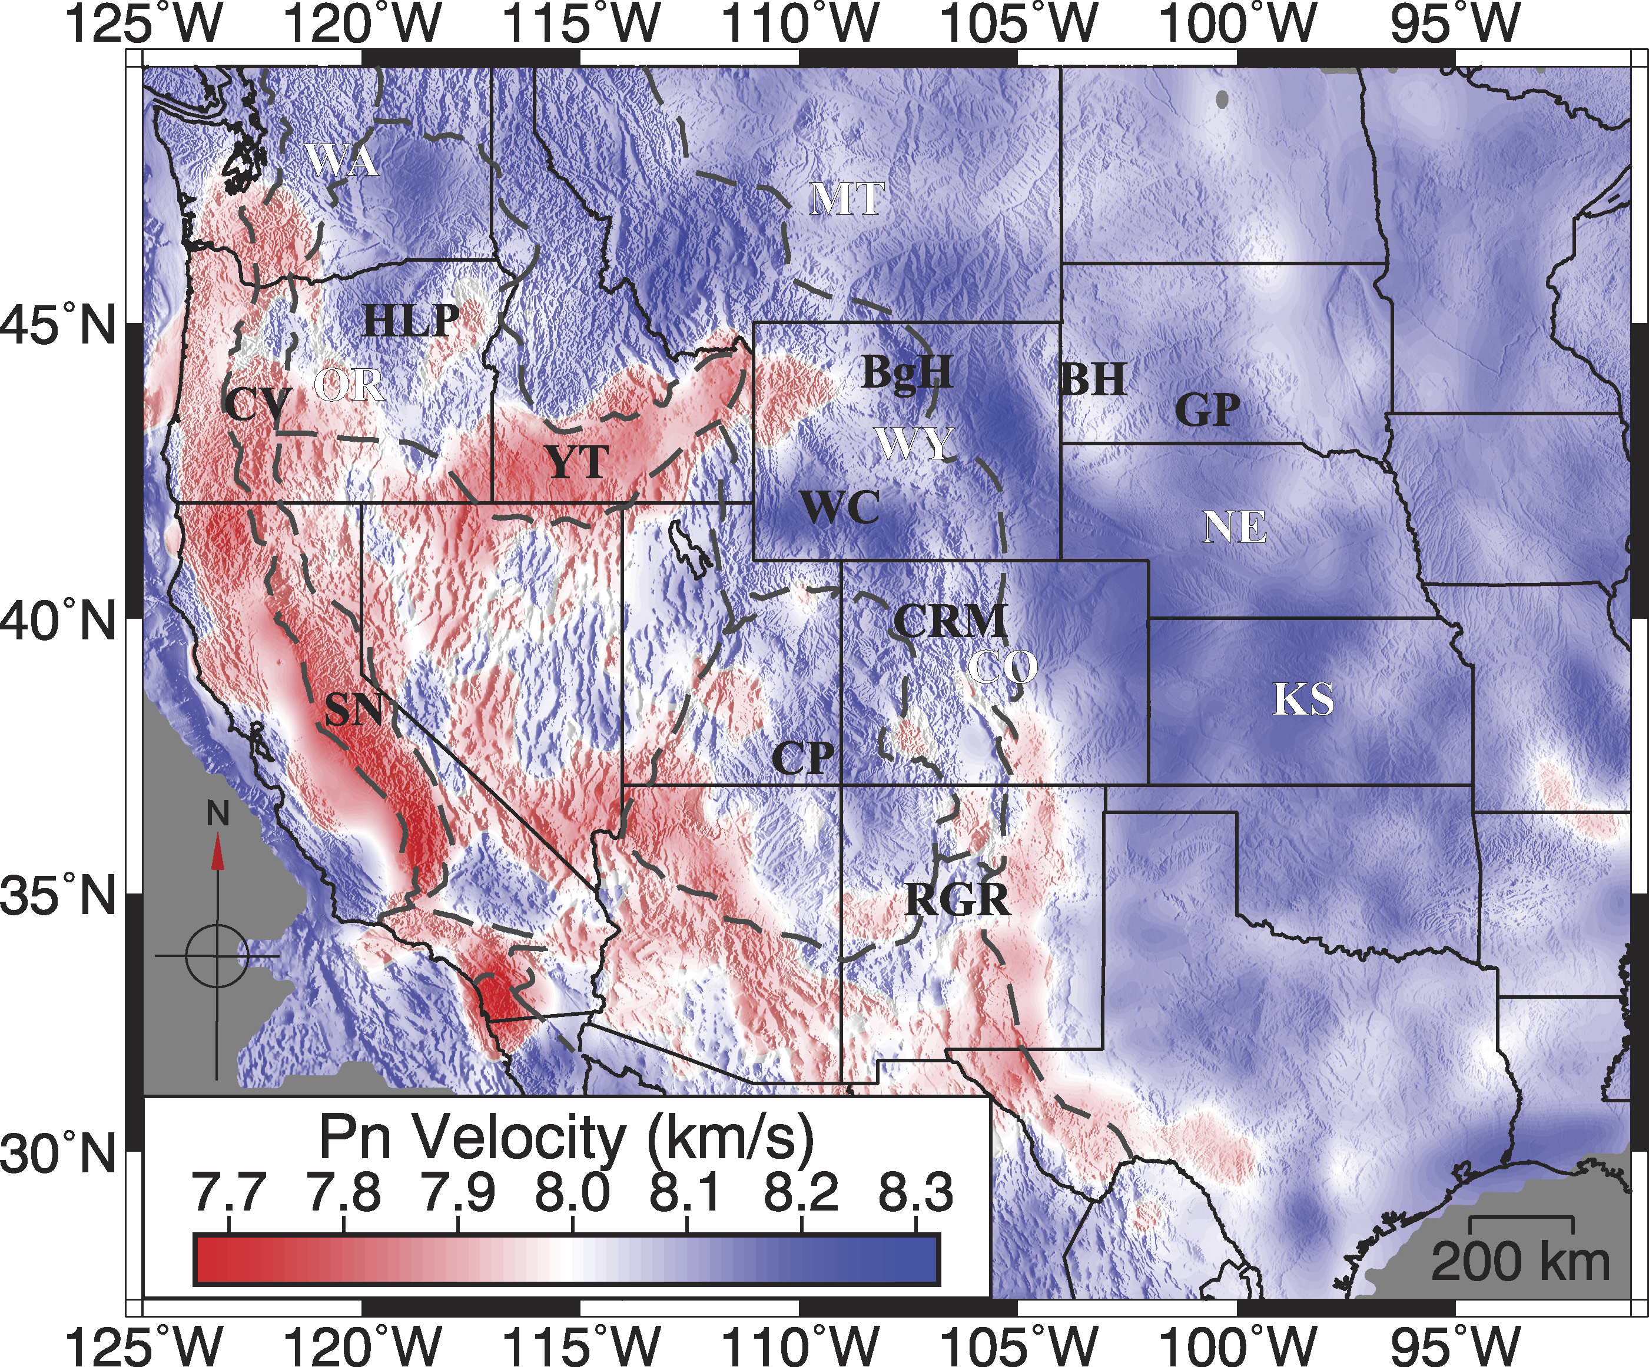
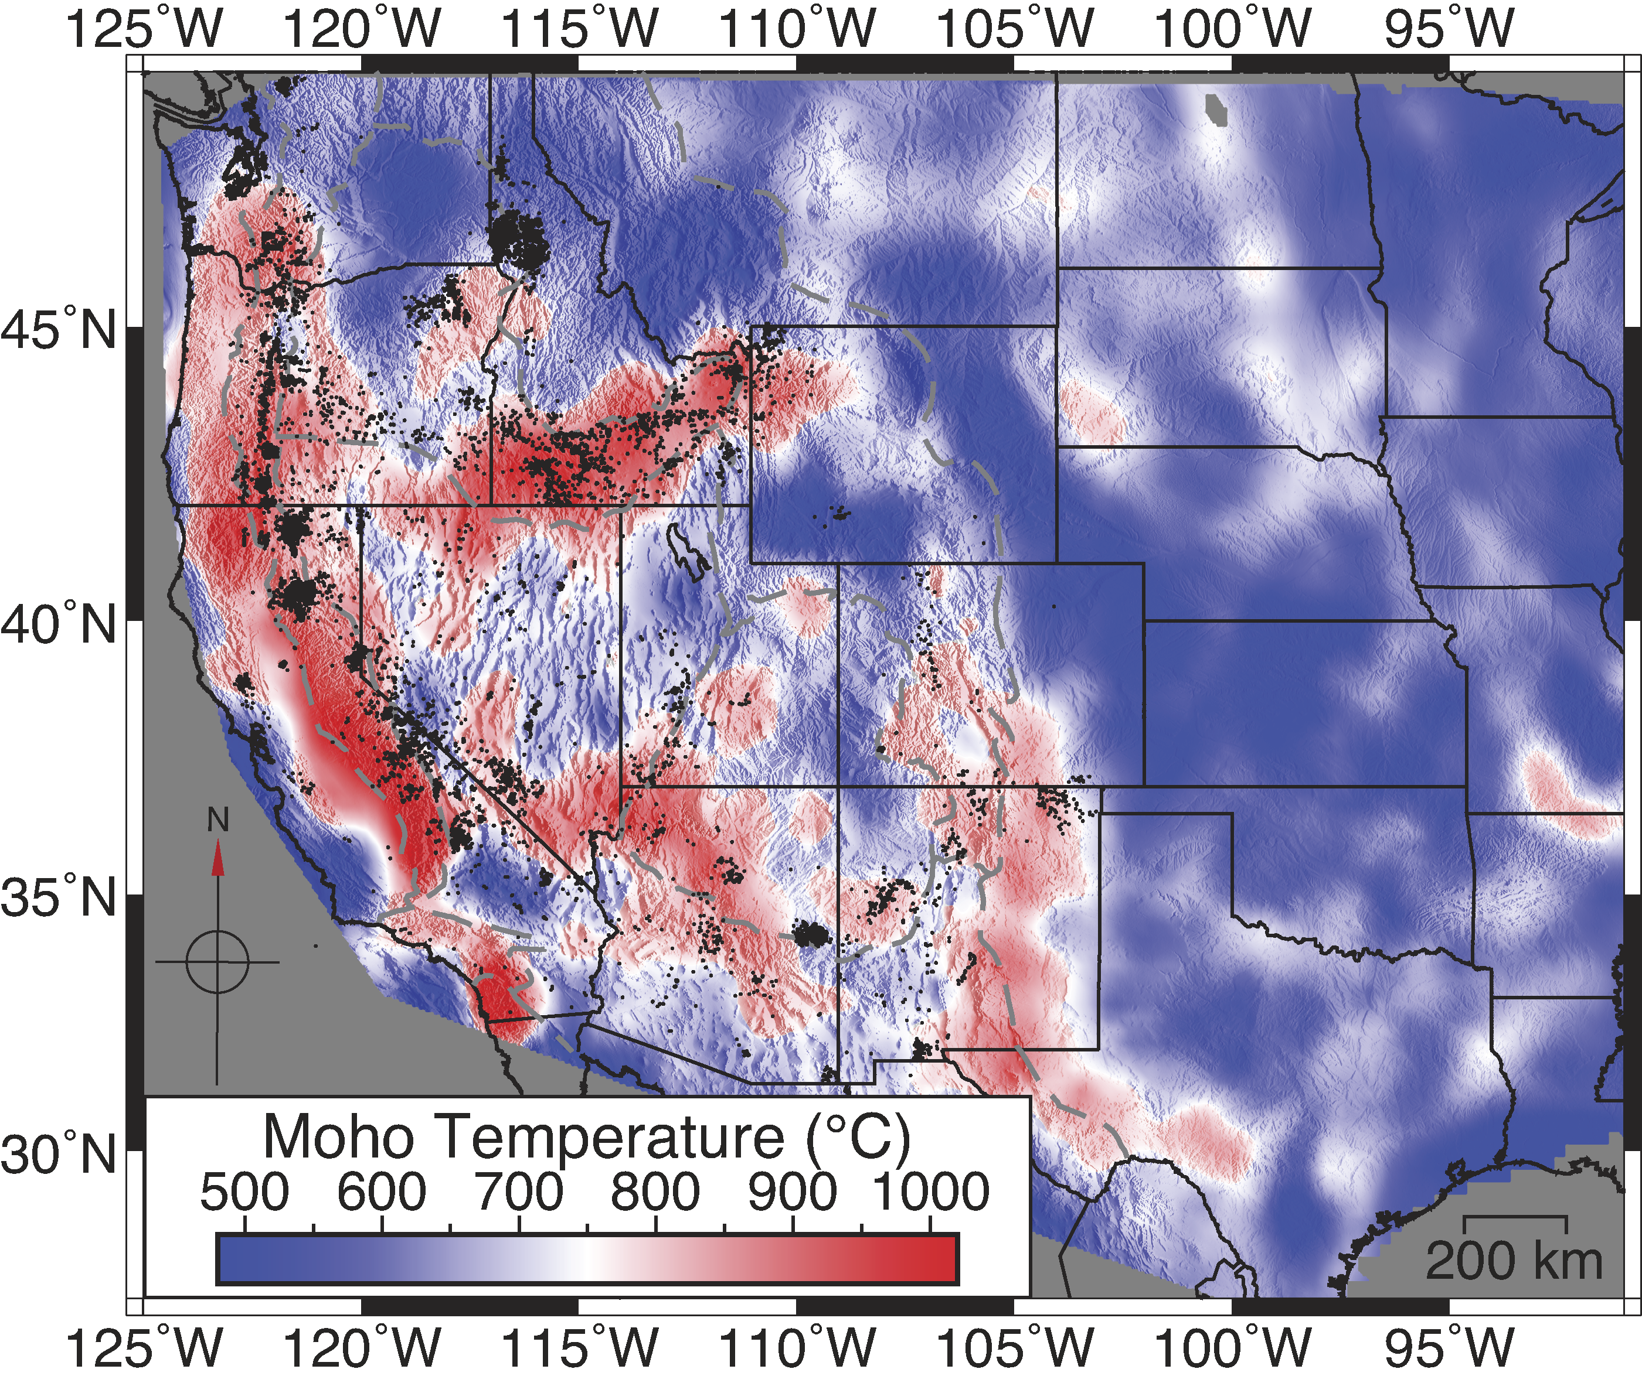
Temperature T → surface heat flow, seismic velocities
Moho temperature T_{Moho} from P_{n} phase:
P_{n} velocity variation
Moho temperature from
P_{n} & mineral physics
After Buehler & Shearer, JGR 2017
Schutt et al., Geology 2018

Slide 6
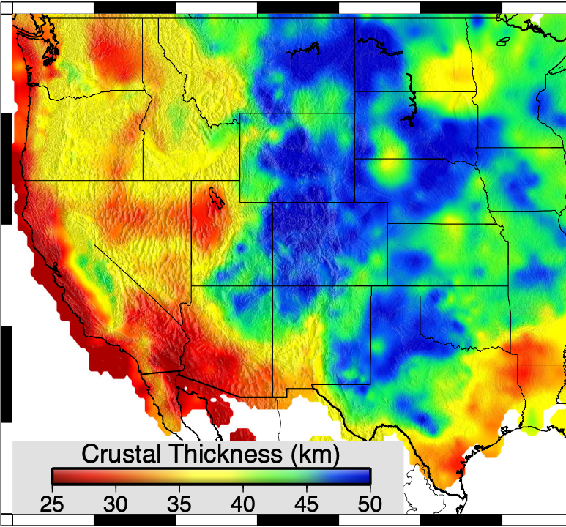
Remember that depths vary for these Ts!
Moho temperature from
P_{n} & mineral physics
(Because the Moho is deeper
in the stable part of the
continental lithosphere…)
Schutt et al., Geology 2018

Slide 7
Dry
Wet
These
temperatures are
sufficiently high
to produce some
lower crustal flow
for all likely
crustal lithologies,
wet or dry…
Note viscosity is
very sensitive
to lithology &
hydration state!
Pyroxene
Schutt et al., Geology 2018
Feldspar
Olivine
Quartz

Slide 8
This raises a question…
How close are we (i.e., what else would we
need to know) to perform physics-based
predictive modeling
of deformation in the Earth?

