Slide 1
GEO 5/6690 Geodynamics
4 Sep 2024
Last Time: Concepts/Definitions of Lithosphere
→ *Generally* Includes Crust & Uppermost Mantle
• Plate tectonics: Rigid “plate” moving over fluid asthenosphere
• Thermal boundary layer (conductive over convective)
• “Elastic” upper layer that supports recoverable stress/strain
• Rheologically strong layer (“mechanical boundary layer”)
• Seismogenic layer
• Seismic “Lid” (high seismic velocity over lower velocity)
• “Tectosphere”: Basalt-depleted mantle (major elmt chem)
• Isotopic geochemistry (related to age of rock “reservoir”)…
• REE: Depleted or enriched (depending) in Large-Ion Lithophile
elements; Light Rare Earth elements; other incompatible els.
These (observation-based) concepts derive from several
different/related processes, so represent different rock volumes!
Read for Friday 6 September: T&S 132-149 (§4.1-4.12)
© A.R. Lowry 2007-2024

Slide 2
Book-keeping:
Possible to change the time
& place that this class meets?

Slide 3
How to use these powerpoints:
• Review them often: Before each class, and while doing
homework exercises
• The most important points of each lecture (in my opinion)
are summarized on the first slide(s) of the next lecture
• Note the notation!
→ Arial Black, italic means Important, pay
attention…
→ Arial Black, italic, red font means
Critically important concept or terminology
that I expect you to understand well
for exercises
→ Times New Roman, italic, black font means this is an
equation or an algebraic variable
→ A red box with grey background means this is an
especially important concept or equation

Slide 4
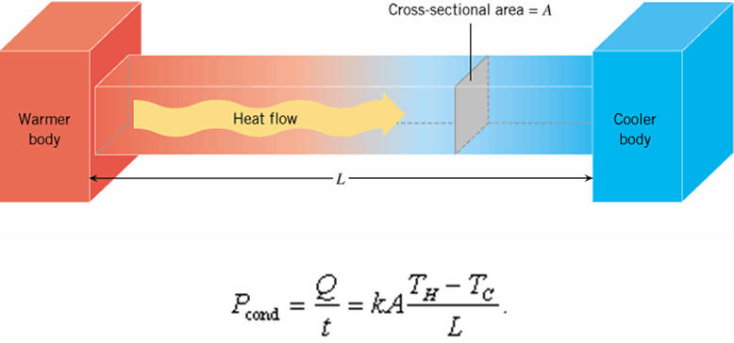
Today: The Geotherm
Four types of heat transfer are relevant in solid Earth:
I. Conduction ≡ Molecular collisions
➲ Slow & inefficient: ~100 Myr “traveltime”
for a thermal pulse to travel 100 km
➲ Dominates in Thermal Boundary Layer

Slide 5
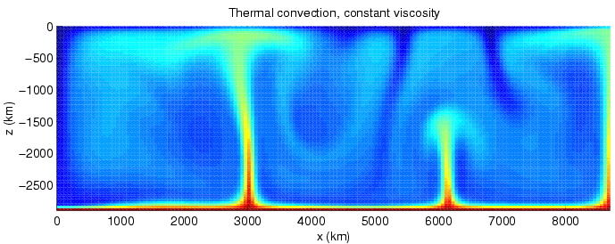
Four types of heat transfer are relevant in solid Earth:
II. Convection ≡ Thermal buoyancy-driven, active
transport of heat in a fluid
➲ Implies Rayleigh # exceeds a critical value;
has a preferred length scale ~ vertical
thickness of convecting layer (for 2D flow)
➲ General circulation ⇒ Everything is
moving… As a fluid, driven by buoyancy
Image courtesy Harro Schmeling

Slide 6
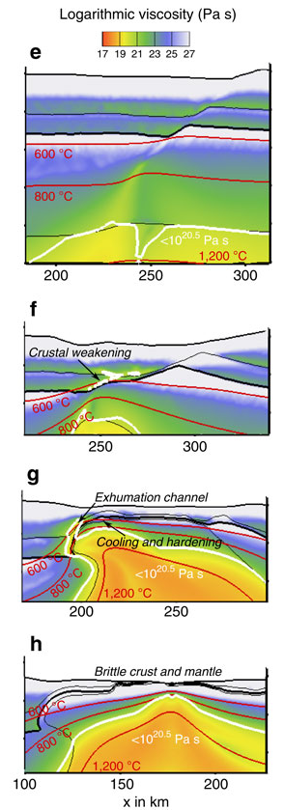
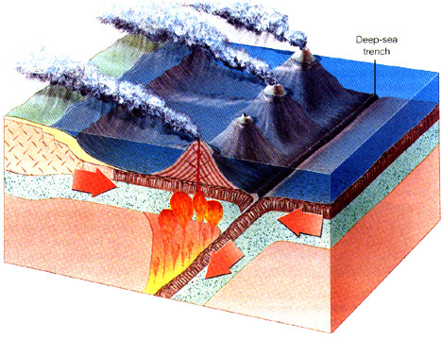
Four types of heat transfer are relevant
in the solid Earth:
III. Advection ≡ Heat carried by
flux of material by processes other
than wholesale buoyancy-driven flow
➲ Examples include magmatic
intrusion, erosion/deposition,
tectonic strain, groundwater
Brune et al., Nat. Comm., 2014

Slide 7
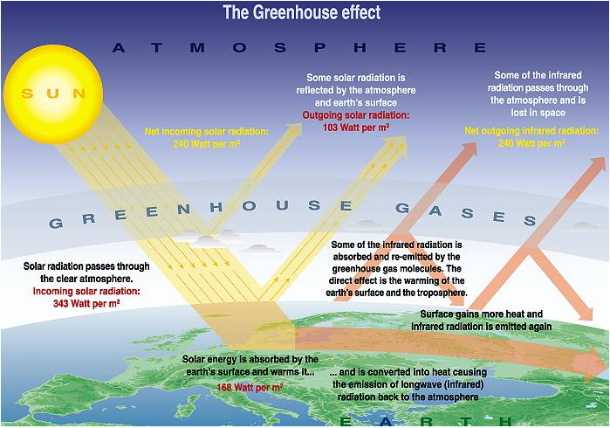
Four types of heat transfer are relevant in solid Earth:
IV. Radiation ≡ Transfer by electromagnetic
radiation (light)
➲ Not usually considered important in the
solid Earth, but some (controversial)
measurements
have suggested it could
contribute to
mantle transfer…
Certainly matters
for the Earth’s
surface
temperature!

