Slide 1
GEO 5/6690 Geodynamics
5 Apr 2023
Last Time: Brittle-field rheology
Byerlee’s Law describes (static!) frictional shear strength τ as
a linear function of pressure → normal stress σ via τ = μσ,
where m is friction coefficient (0.6 for most rocks but weaker,
0.1–0.2, for clays). Strength also reflects work done (gravity),
pressure dependence on depth, pore-fluid pressure
Earthquakes occur only in the frictional regime, & earthquakes at
a given depth also require that stress exceeds strength and
that friction is velocity-weakening (stick-slip) rather than
velocity-strengthening (stable)!
Frictional slip in laboratory studies is dynamical, and empirically
depends on two friction coefficients (a, b), a critical slip distance
D_{c}, and a state variable (called rate- & state-dependent
friction)
Read for Mon 10 Apr: T&S §3.1-3.16
© A.R. Lowry 2023

Slide 2
Next Journal Article Reading:
For Friday Apr 7: Shreedharan! et al.
(2023) Science, 379, 712-717.
Morgan will lead!

Slide 3
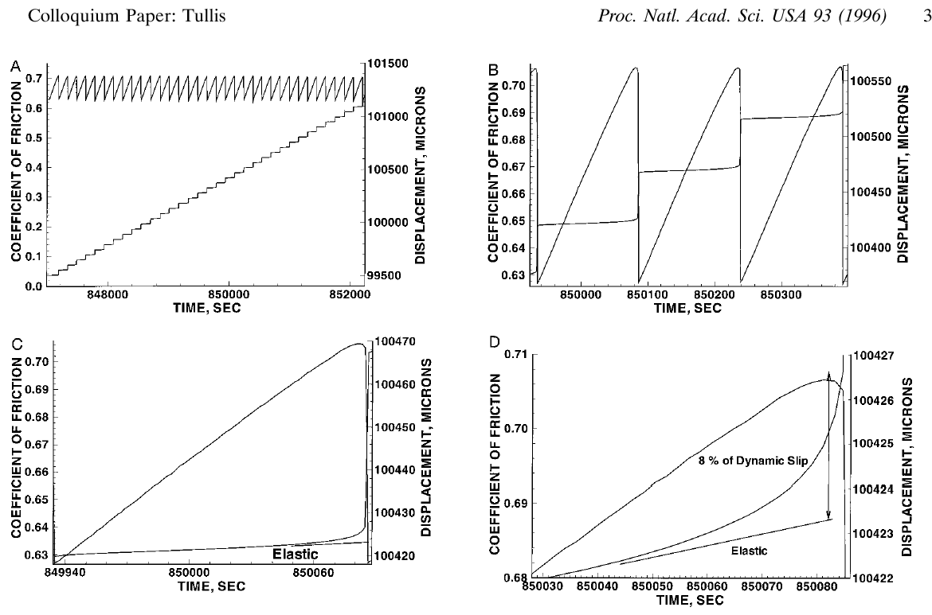


Important to note: Frictional slip is dynamical and also
depends on slip rate, and “state” of entanglement at contacts
Actual μ $⟹$ failure…
$$“μ”=\frac{τ}{σ_{N}}$$
Elastic stress
& strain are linear!

Slide 4
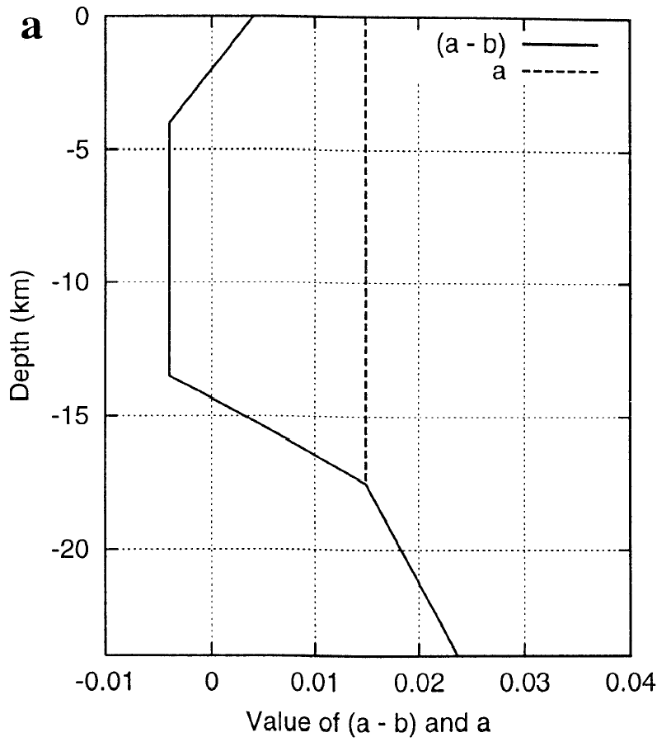
Fault friction and slip velocity:
Depend on:
• Two frictional constants a and b plus
a length scale D_{c}
• a – b < 0: friction decreases with increasing
slip velocity (→ unstable)
• a – b > 0: friction increases with increasing
slip velocity (→ stable)
• a, b, D_{c} depend on temperature, rock type,
pore fluids, gouge properties
• State variable Θ (depends on history of slip,
evolution of contact surface)
• Normal and shear stress on the fault
“Favors”
Stick-Slip
“Favors”
Stable
Sliding
(Approximation of P-T dependent
Laboratory friction measurements)
τ = μσ
Hence friction & slip vary nonlinearly in both space and time!
Notes:
Too complex

Slide 5
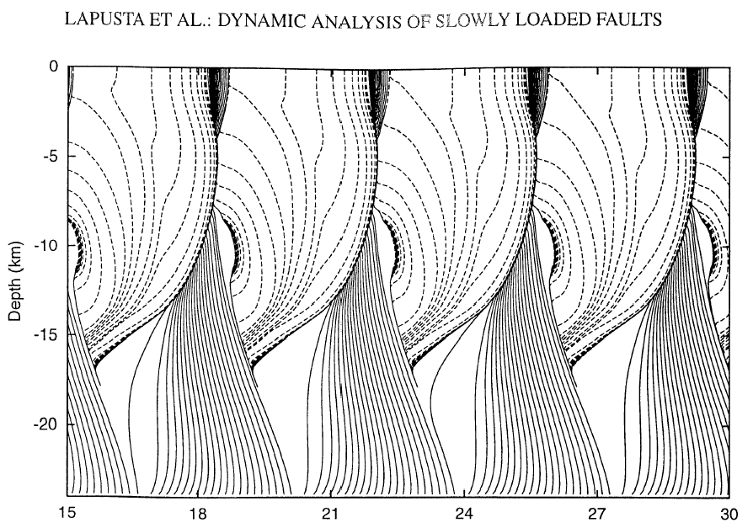
A San Andreas simulation with rate-state constitutive relations…
J. GEOPHYS. RES., 105(E10), 2000
b – a > 0
b – a = 0
Pre-Slip
b – a < 0
b – a = 0
Earthquake
b – a > 0
After-Slip
Cumulative Slip (m)
Predicts fault slip behaviors that we observe with geodesy.
(But what form does this part take?)

Slide 6
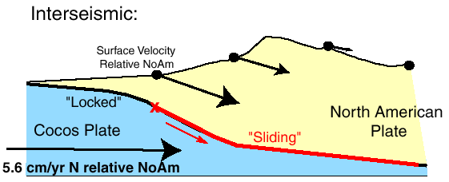
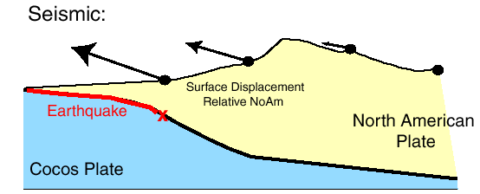
The Earthquake Cycle (With a Broad Brush)
Elastic strain
(potential
energy)
accumulates
during
interseismic
& is released
(converted to
heat and
mechanical
energy) during
earthquakes
Notes:
Too complex

Slide 7
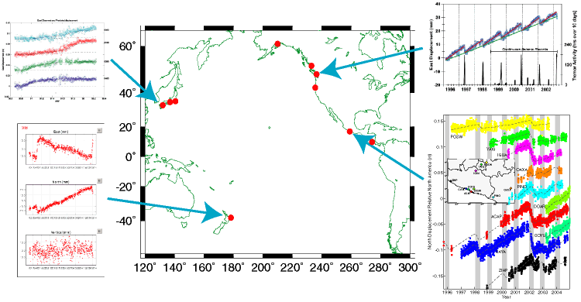
Slow fault slip events are observed
(geodetically) around the globe:
Dragert et al. 2001; Rogers & Dragert 2003
Hirose et al. 1998; Miyazaki et al. 2003
Douglas et al. 2005
Lowry et al. 2001; 2006

Slide 8
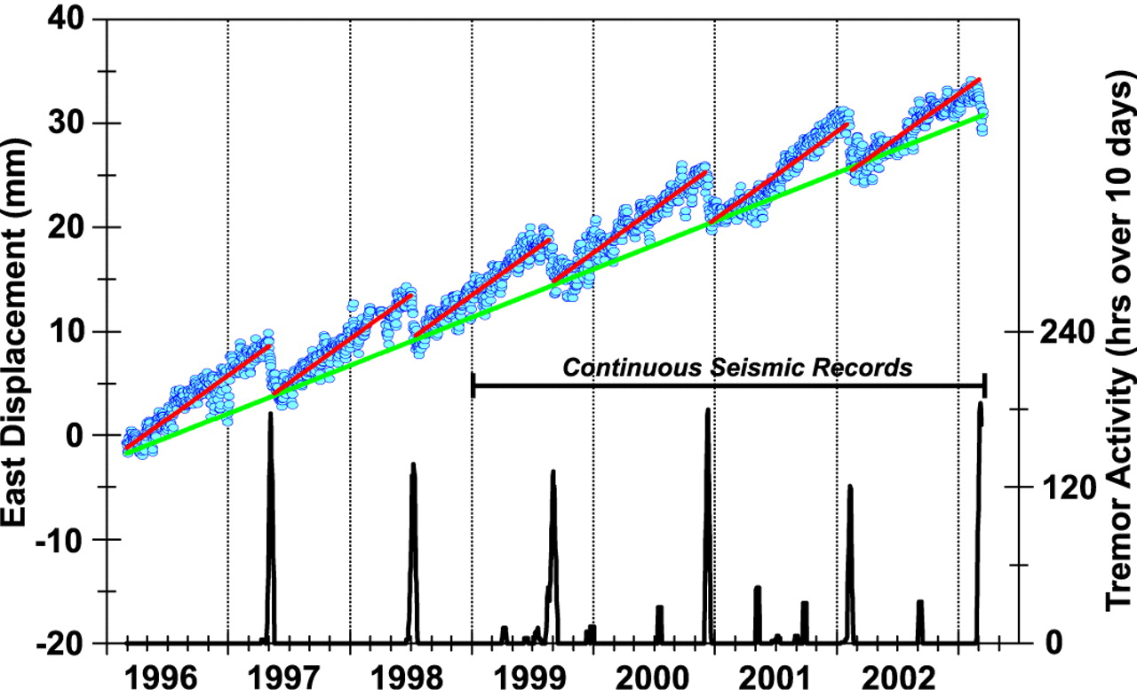
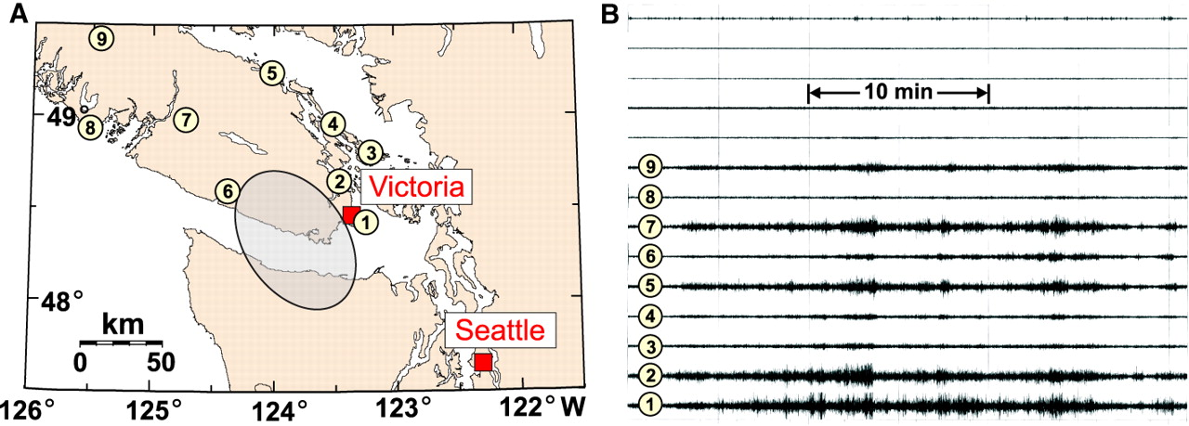
Commonly associated with tremor:
• Seismic recordings exhibit
coincident 1–5 Hz tremor
in some (but not all)
locations (Cascadia,
Japan, Mexico)
Rogers and Dragert, Science, 300, 2003

Slide 9
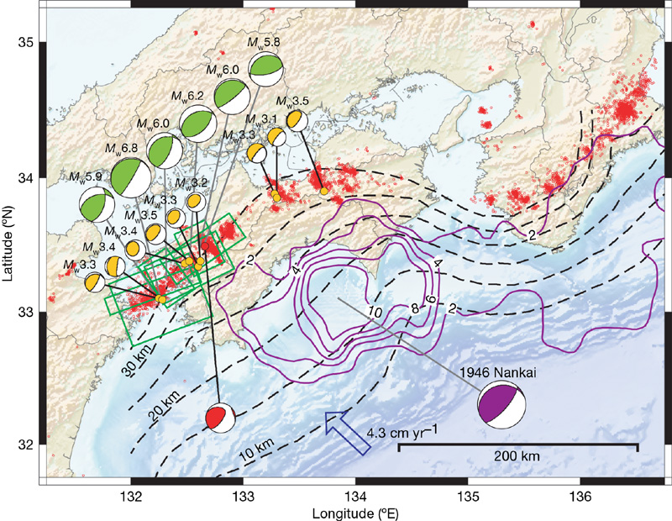
Interpretation?
Ide et al, Nature (447) 2007
Tremor has radiation pattern & location consistent with
a superposition of lots of M_{w} 1.5–3.5 “slow eq” events

Slide 10
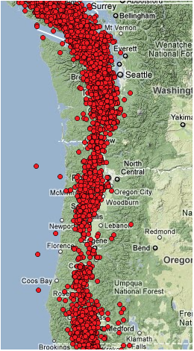
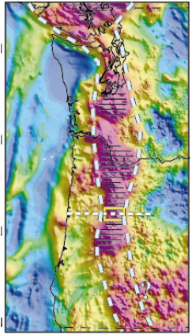
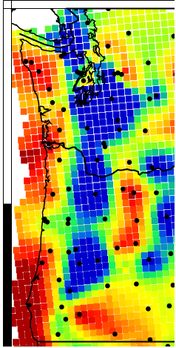
Tremor locations
2009-2011
Serpentinized
Subduction Wedge
(Blakely et al.,
Geology, 2005)
Raw EARS
“Crustal Thickness”

Slide 11
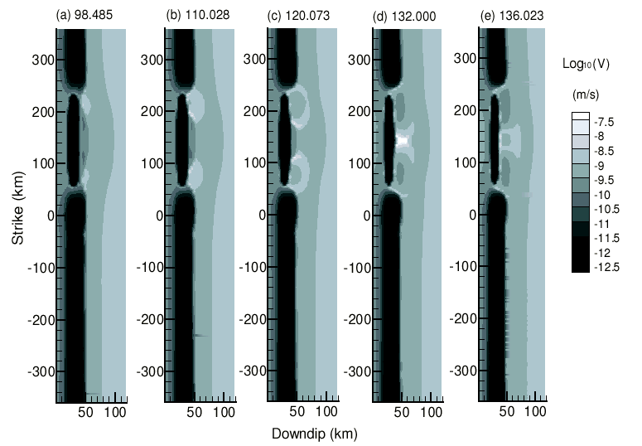
Rate & state frictional simulations of subduction zone slip…
Liu and Rice,
JGR 2006
Also predict slow slip events focus near the frictional transition!

