Slide 1
GEO 5/6690 Geodynamics
6 Feb 2023
Last Time: Transient Geotherms
• Elevation reflects the geotherm via thermal isostasy…
(e.g., ocean bathymetry). For instantaneous rifting with a
stretching factor β,
• Sedimentary records can be used to recover elevation
history via backstripping (remove a sedimentary package;
correct for isostatic subsidence; correct compaction; adjust
for sea level and track changes through time!)
Read for Wed 8 Feb: T&S §4.18-4.28
© A.R. Lowry 2023

Slide 2
Next Journal Article Reading:
For Wednesday Feb 16: Kellogg et al.,
Science 283, 1881-1884 (1999).

Slide 3
Science is a process of discovery by which
we increase knowledge…
Inductive Reasoning
Deductive Reasoning
begins with
begins with a
Observations
Hypothesis
used to generate a
predicts testable
Hypothesis
Observations
The
Scientific
Method
Additional observations/
experiments
If well supported, may become
Theory

Slide 4
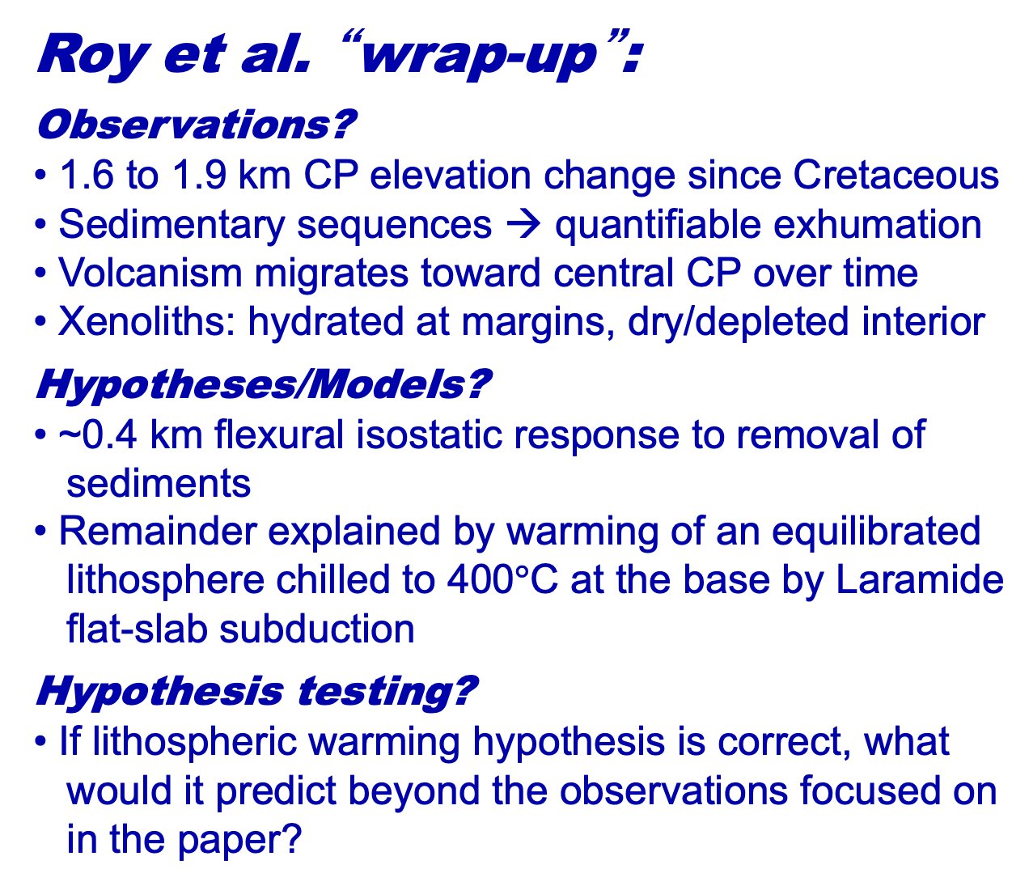
Roy et al. “wrap-up”:
Observations?
• 1.6 to 1.9 km CP elevation change since Cretaceous
• Sedimentary sequences → quantifiable exhumation
• Volcanism migrates toward central CP over time
• Xenoliths: hydrated at margins, dry/depleted interior
Hypotheses/Models?
• ~0.4 km flexural isostatic response to removal of
sediments
• Remainder explained by warming of an equilibrated
lithosphere chilled to 400$°$C at the base by Laramide
flat-slab subduction
Hypothesis testing?
• If lithospheric warming hypothesis is correct, what
would it predict beyond the observations focused on
in the paper?

Slide 5
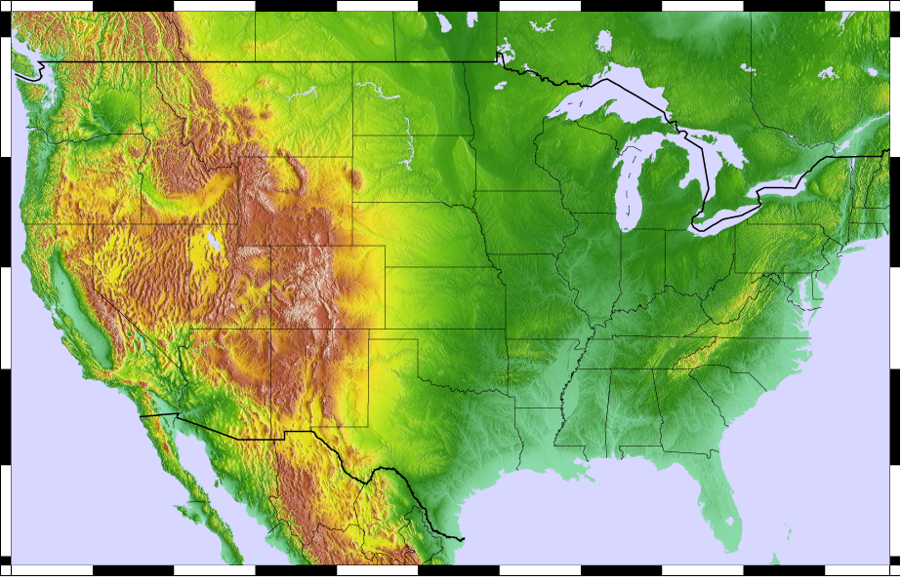
Roy et al. “wrap-up”:
Food for thought:
• If elevation increased by lithospheric
warming after Laramide, where should
it have risen?
• And what should it have looked like
before flat-slab subduction?

Slide 6
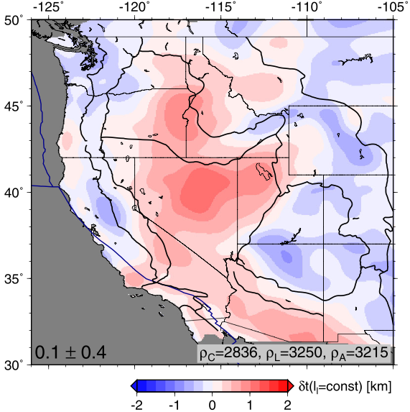
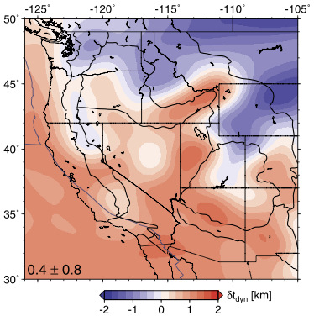
Roy et al. “wrap-up”:
Residual
elevation
after removing
the lithosphere
Food for thought:
• If elevation increased by lithospheric
warming after Laramide, where should
it have risen?
• And what should it have looked like
before flat-slab subduction?
Elevation
derived
from below the
lithosphere
Becker et al. EPSL 2014

Slide 7
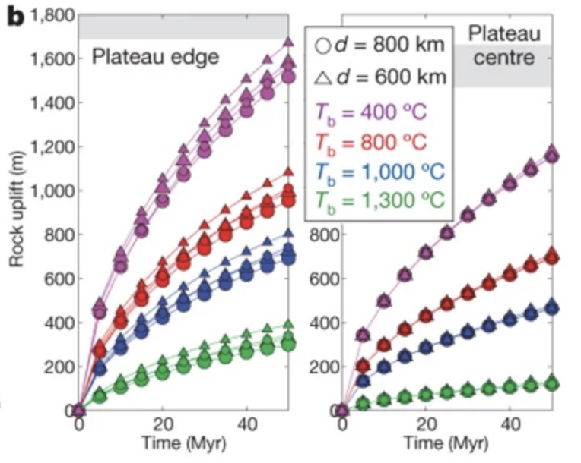
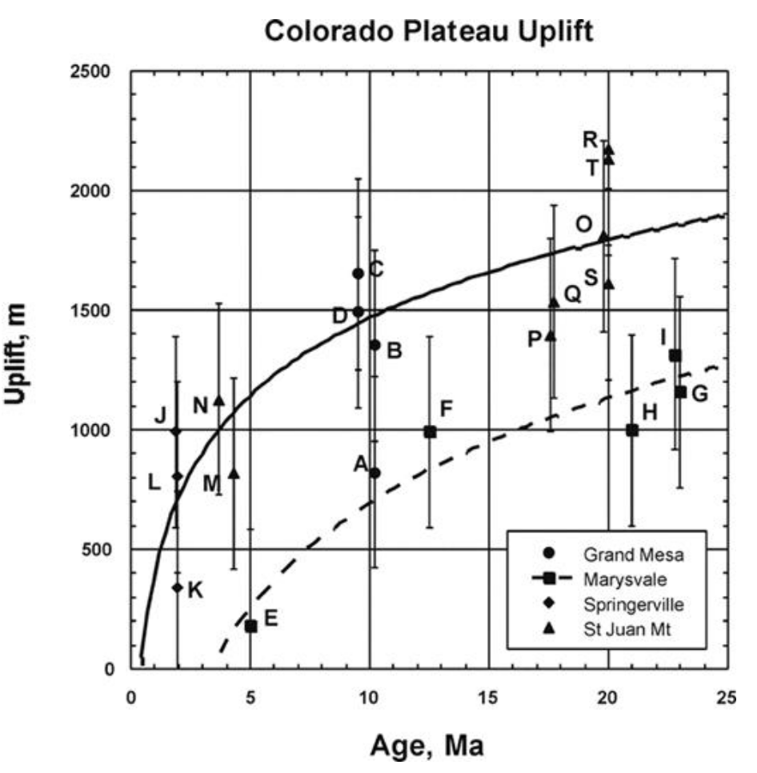
Roy et al. “wrap-up”:
Hypothesis testing:
What does the modeling imply
about timing of uplift?
Uplift history using
paleopressure in vesicular
basalts
(Sahagian et al., Geology
2003)

Slide 8
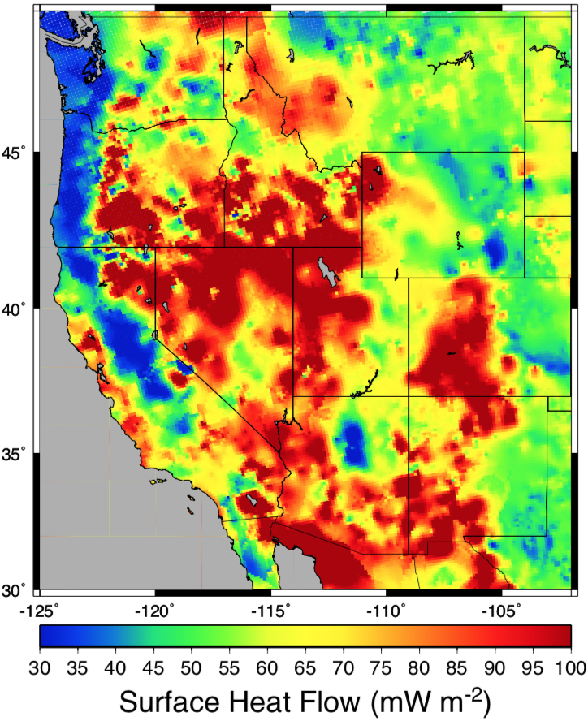
Recall surface heat
flow…
> 50 mW/m²
requires advection;
For advection by
rifting alone, >90
mW/m² requires a
strain rate in excess
of 3x10⁻¹⁵ s⁻¹.
Intermountain seismic
belt is ~1x10⁻¹⁵ s⁻¹;
Rio Grande Rift is
nearer 4x10⁻¹⁶ s⁻¹!

