Slide 1
GEO 5/6690 Geodynamics
6 Sep 2024
Last Time: The Geotherm
Four Modes of Heat Transfer:
• Conduction (Molecular collisions = slow & inefficient)
• Convection (Thermal buoyancy-driven flow in general
circulation = very efficient, relatively rapid)
• Advection (Heat carried by material flux other than
thermally-driven general-circulation flow)
• Radiation (At quantum level, thermal kinetics can
convert to a photon or photons can be absorbed &
converted to thermal energy)
Convection dominates in the mantle > 1300°C;
conduction dominates “Thermal Boundary Layer”
associated with the lithosphere (but advection can be
significant!)
Read for Monday 9 September: T&S 132-149 (§4.1-4.12)
© A.R. Lowry 2007-2024

Slide 2
Book-keeping:
We have reserved this classroom
(G308) for 1:30-2:30 on Sep 9,
Oct 7, Nov 4 & Dec 2!

Slide 3
First Journal Article Reading:
For Monday Sep 16: Furlong & Chapman,
Ann. Rev. Earth Planet. Sci. 41, 385-410
(2013).

Slide 4

The Geotherm:
0
Temperature
1200-1400 ºC
0
Conductive
50-300
km
Adiabat: Temperature
increases with pressure
but energy doesn’t
change ($⟹$ constant
potential
temperature)
Depth
Convective

Slide 5
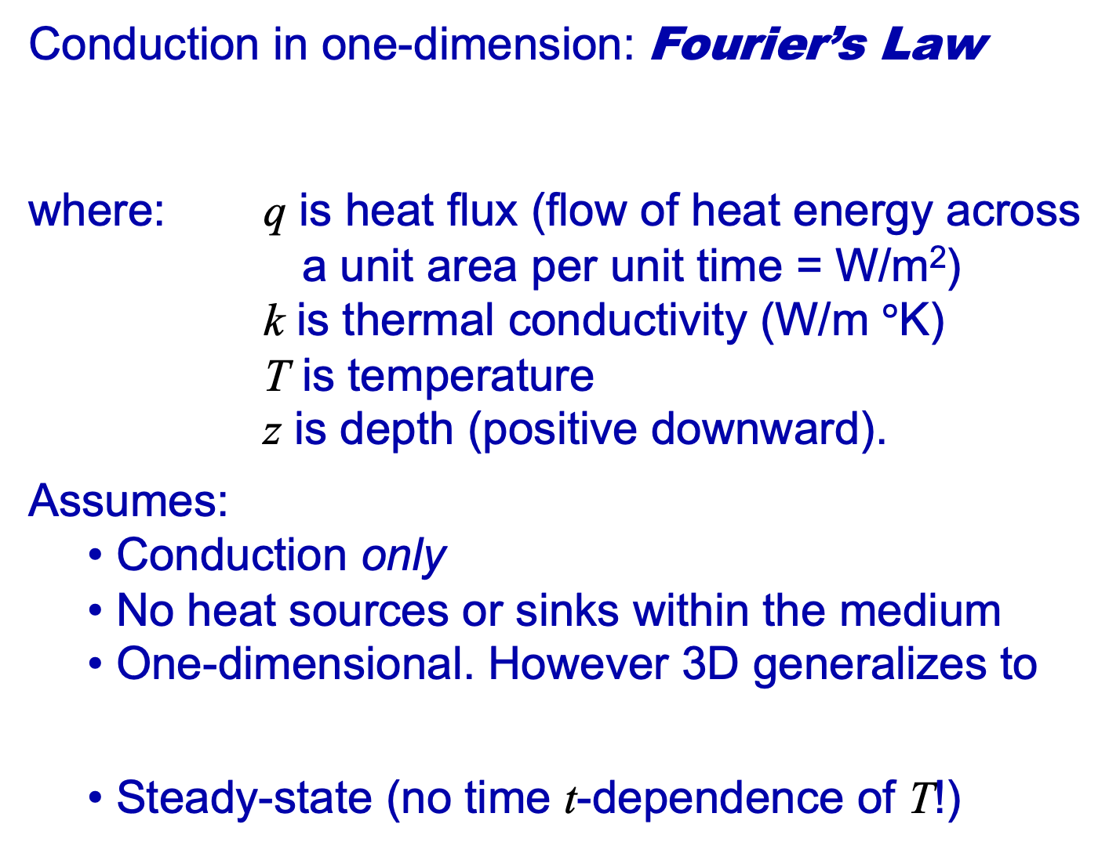
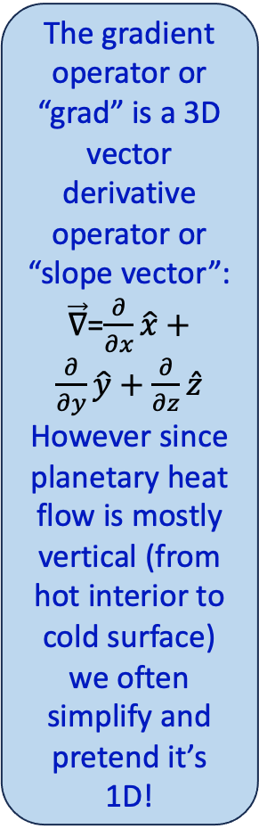
Conduction in one-dimension: Fourier’s Law
where: q is heat flux (flow of heat energy across
a unit area per unit time = W/m²)
k is thermal conductivity (W/m $°$K)
T is temperature
z is depth (positive downward).
Assumes:
Conduction only
No heat sources or sinks within the medium
One-dimensional. However 3D generalizes to
Steady-state (no time t-dependence of T!)
The gradient operator or “grad” is a 3D vector derivative operator or “slope vector”:
$\vec{∇}$=$\frac{∂}{∂x}\hat{x}+\frac{∂}{∂y}\hat{y}+\frac{∂}{∂z}\hat{z}$
However since planetary heat flow is mostly vertical (from hot interior to cold surface) we often simplify and pretend it’s 1D!

Slide 6
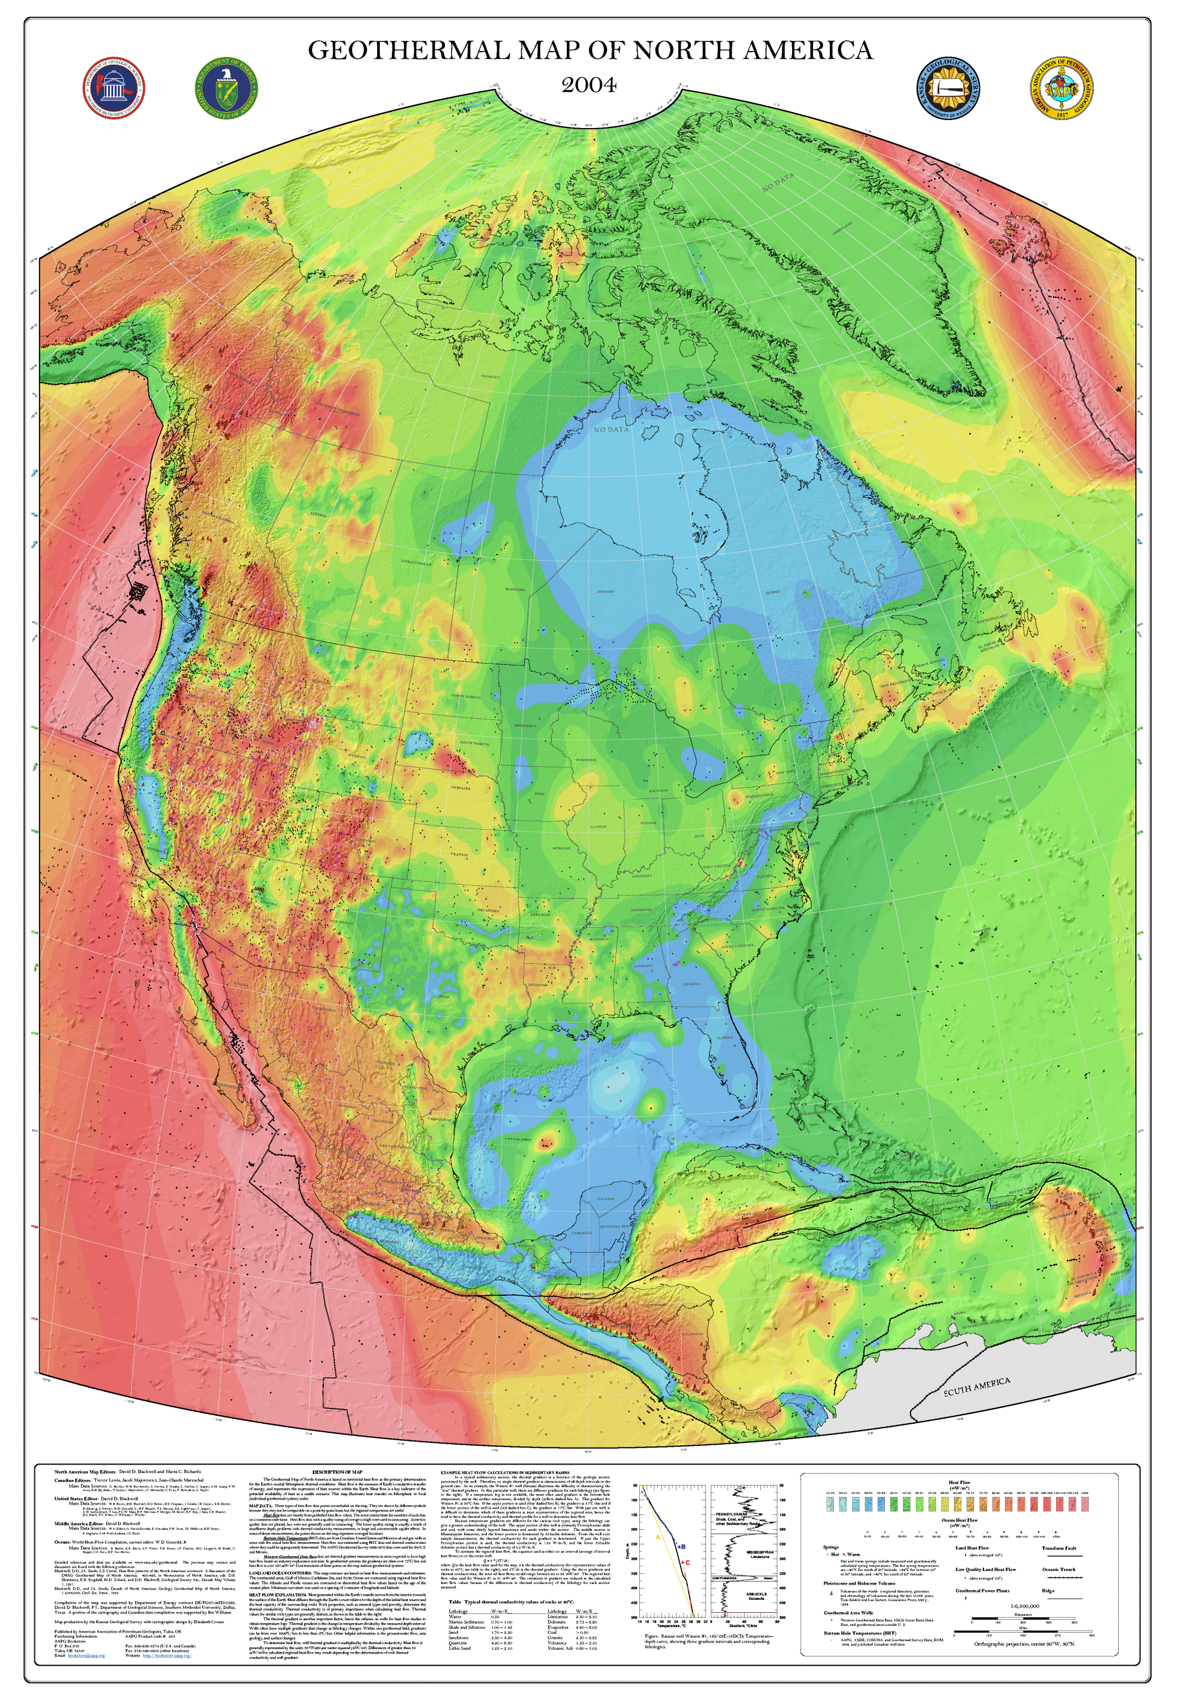
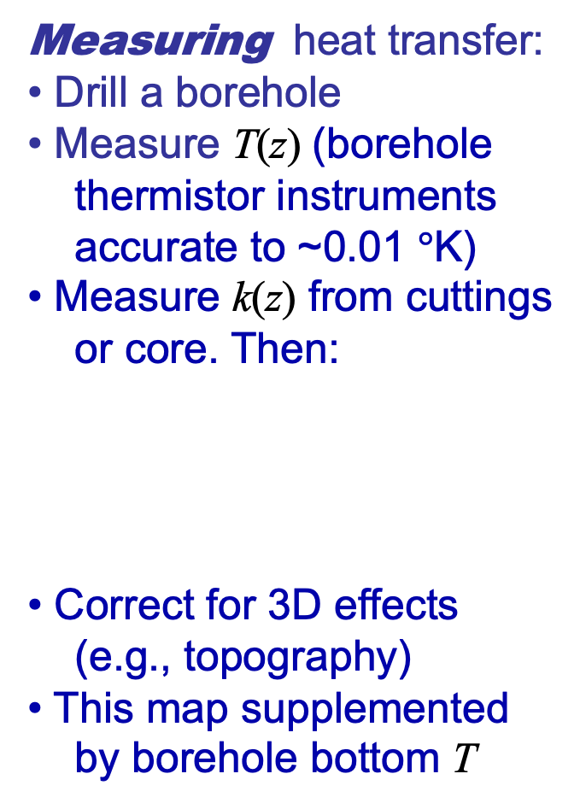
Measuring heat transfer:
• Drill a borehole
• Measure T(z) (borehole
thermistor instruments
accurate to ~0.01 $°$K)
• Measure k(z) from cuttings
or core. Then:
• Correct for 3D effects
(e.g., topography)
• This map supplemented
by borehole bottom T
Blackwell and Richards (2004)
map of surface heat flow q_{S}

Slide 7
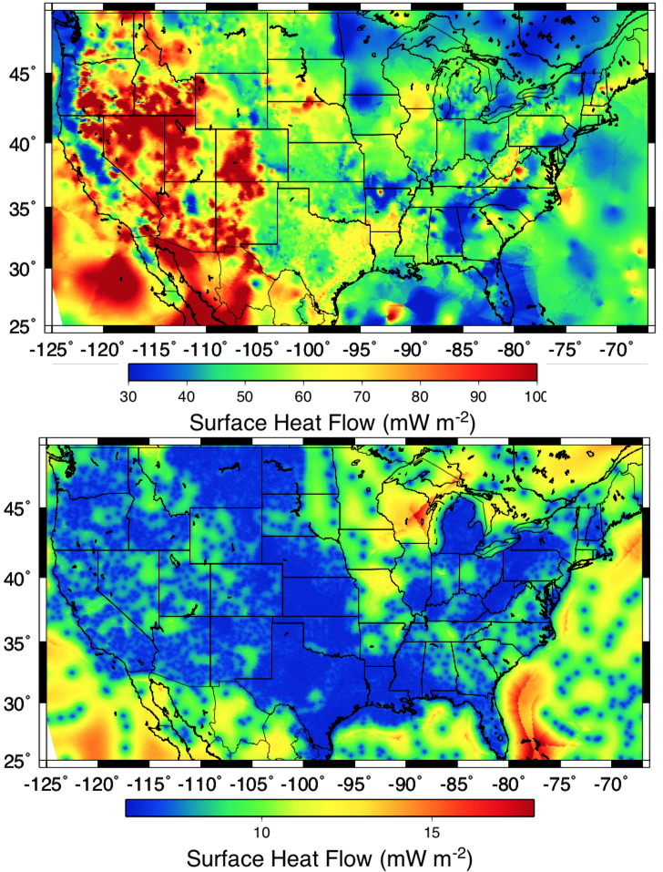
Here’s a slightly different
version just for the
conterminous United
States. The top is surface
heat flow; the bottom is
one-sigma uncertainty
(predominantly related
to sampling limitations)

Slide 8
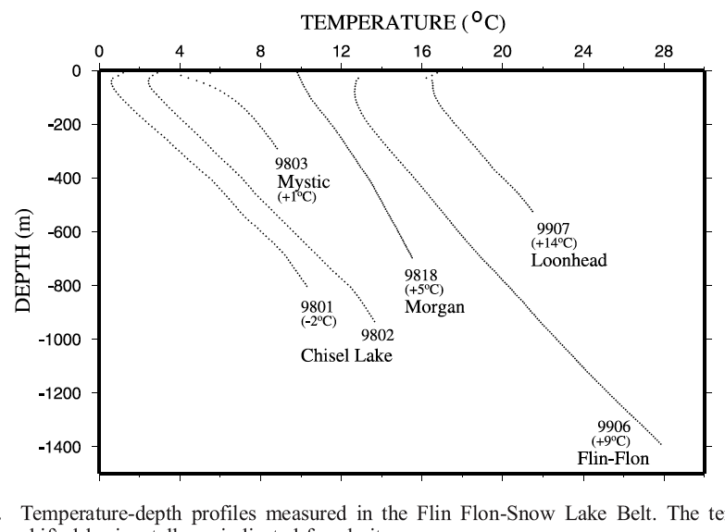
Measurements of surface heat flow:
• Measure temperature T versus depth z in
a borehole
• Measure thermal conductivity k of rock
versus depth (from cuttings or core)
• Calculate q
using
Rolandone et al., JGR 2002

Slide 9
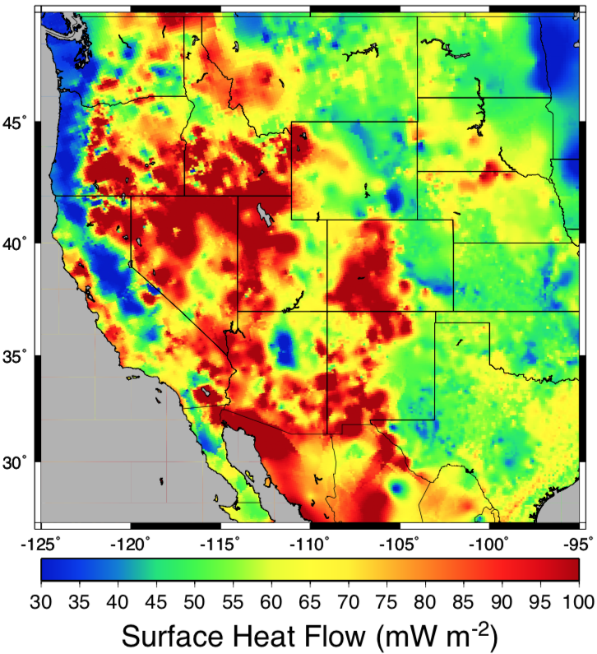
Detail for the
western US
Cordillera:
What matches
your preconceptions,
and why?
What do you find
surprising?

Slide 10
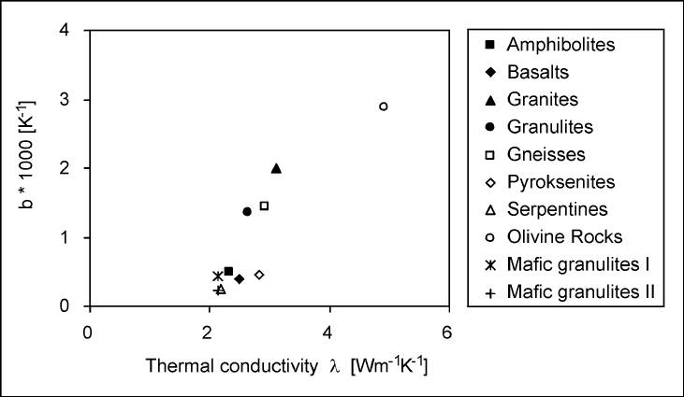
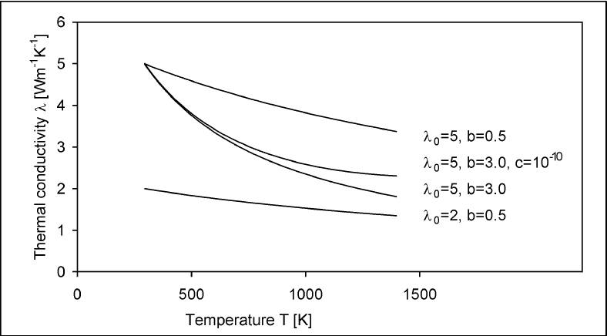
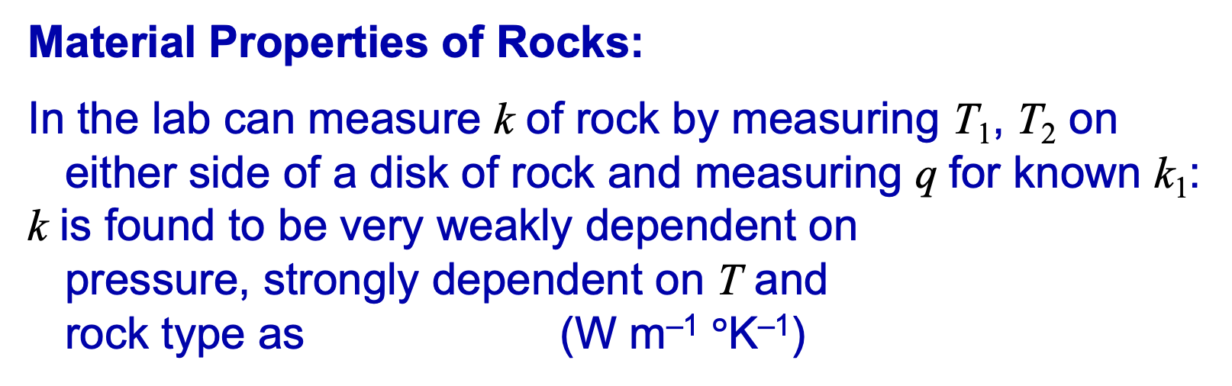
T₀
Material Properties of Rocks:
In the lab can measure k of rock by measuring T₁, T₂ on
either side of a disk of rock and measuring q for known k₁:
k is found to be very weakly dependent on
pressure, strongly dependent on T and
rock type as (W m^{–1} $°$K^{–1})
Known k₁
T₁
T₂
T₃
k
B
k
B
B
k
B
k
B
k
B
k
From measurements by Siepold, Tectonophysics 1998

Slide 11
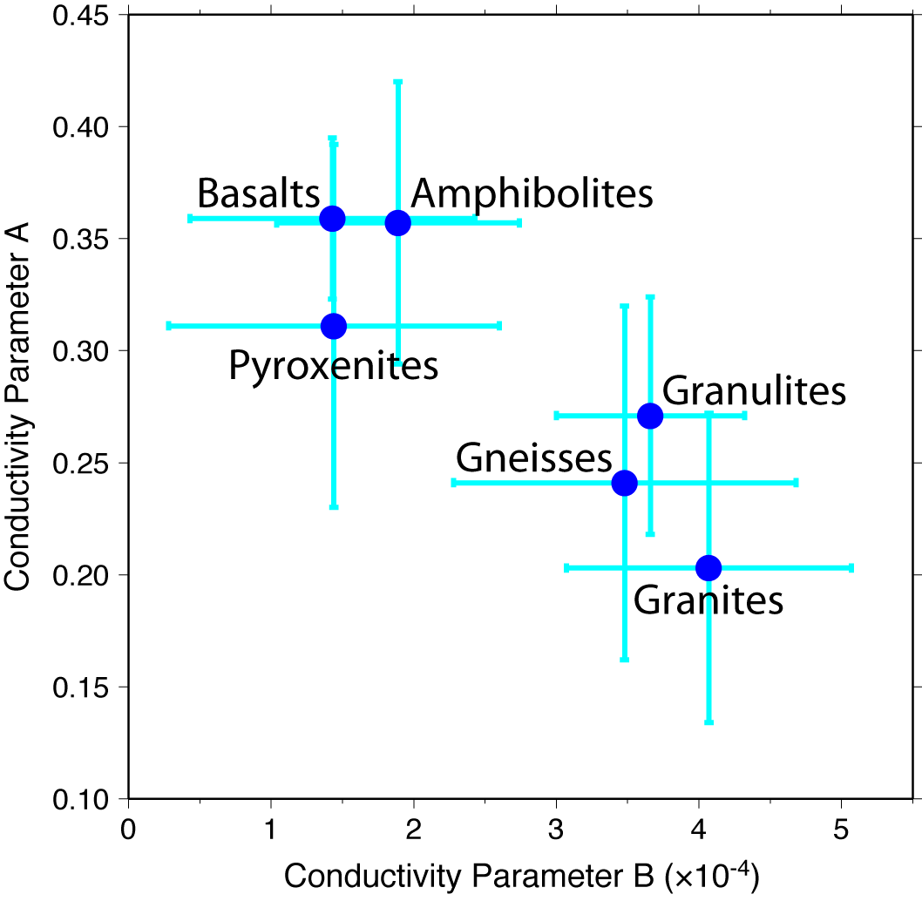
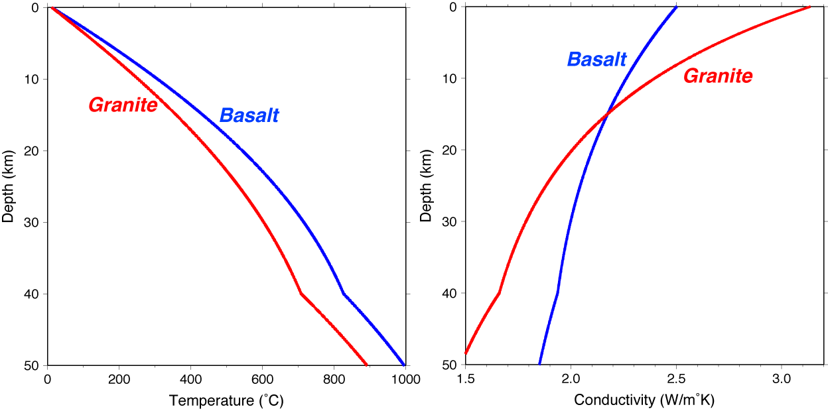
Quartz-rich rocks have
higher reference conductivity
but greater temperature sensitivity,
so thermal gradient is steeper for
mafic rocks at shallow depths
but less steep for deep rocks!
Increasing T

Slide 12
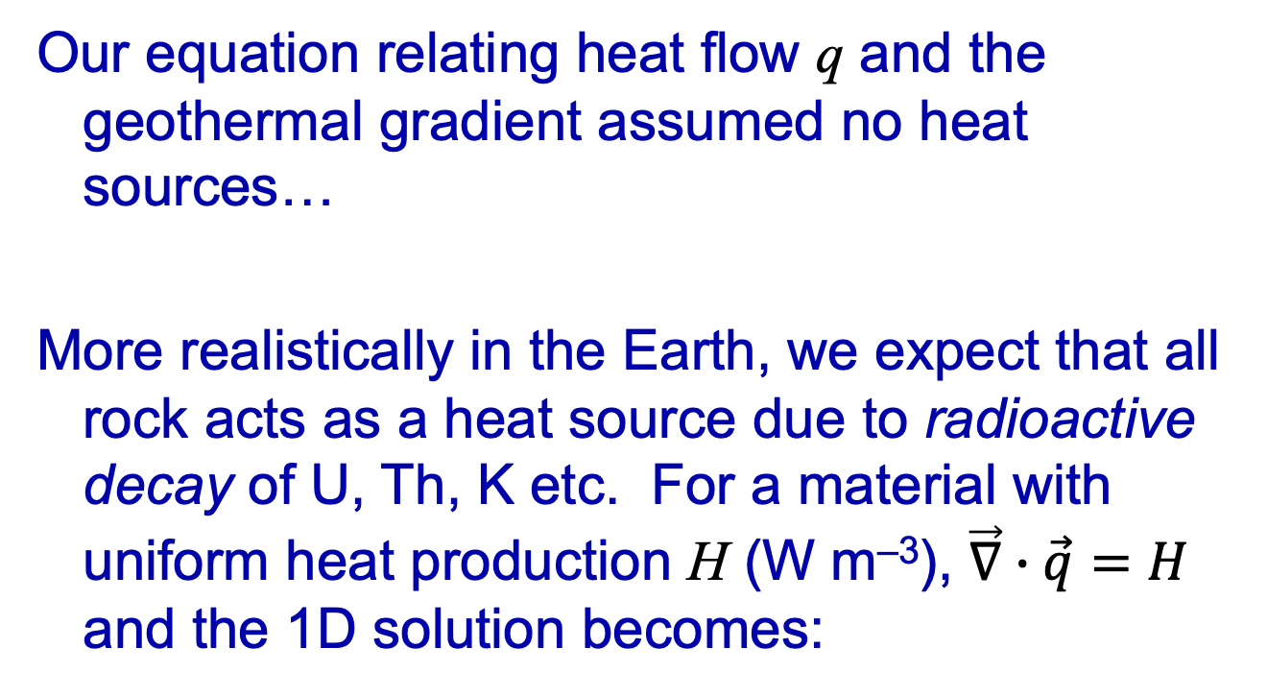
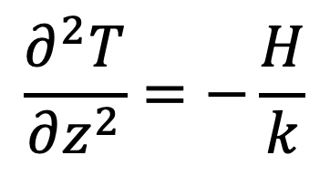
Our equation relating heat flow q and the
geothermal gradient assumed no heat
sources…
More realistically in the Earth, we expect that all
rock acts as a heat source due to radioactive
decay of U, Th, K etc. For a material with
uniform heat production H (W m^{–3}), $\vec{∇}∙\vec{q}=H$
and the 1D solution becomes:
$$\frac{∂^{2}T}{∂z^{2}}=−\frac{H}{k}$$

Slide 13
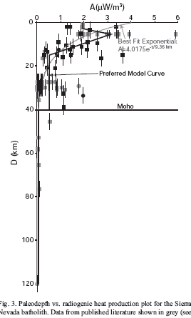
Material Properties of Rocks:
We can measure H of rock from
U, Th, K concentrations (inferred
by measuring radioactive
decay products, e.g. γ -rays).
H is generally high in granitic rocks
(particularly near top of intrusions),
lower in lower crustal rocks, very
low in the mantle…
Some sort of decrease in
radioactive heating with depth was
inferred by early studies of
crystalline basement terranes
because surface heat production,
if extrapolated through the crust,
would exceed surface heat flow!
H
Brady et al
Lithos 2006

Slide 14
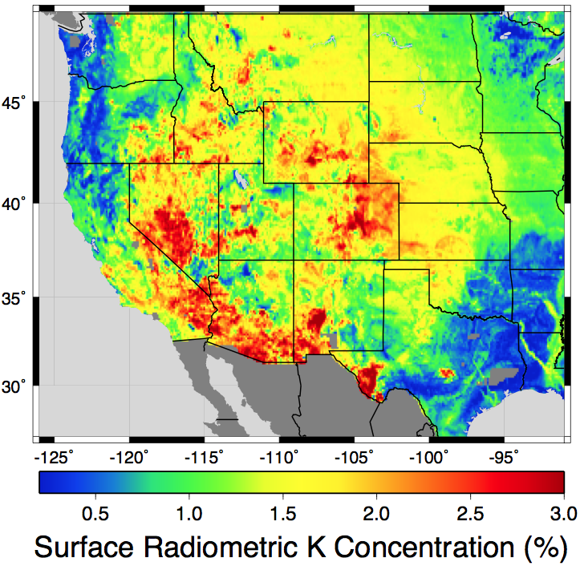
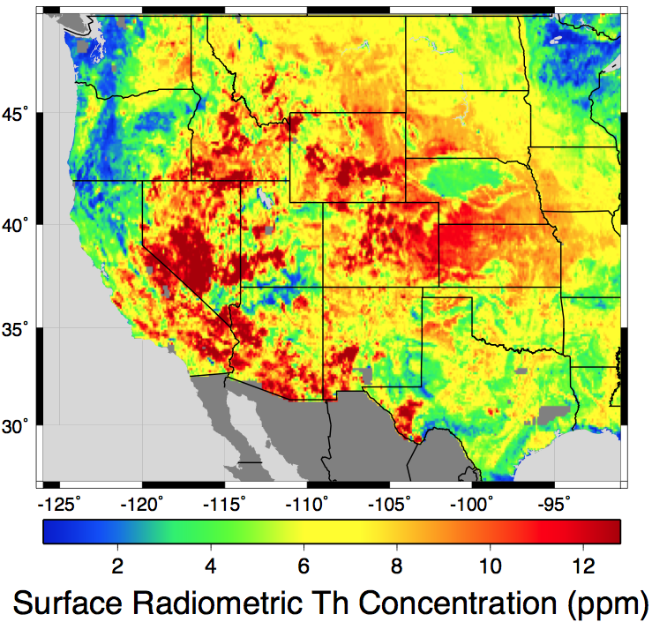
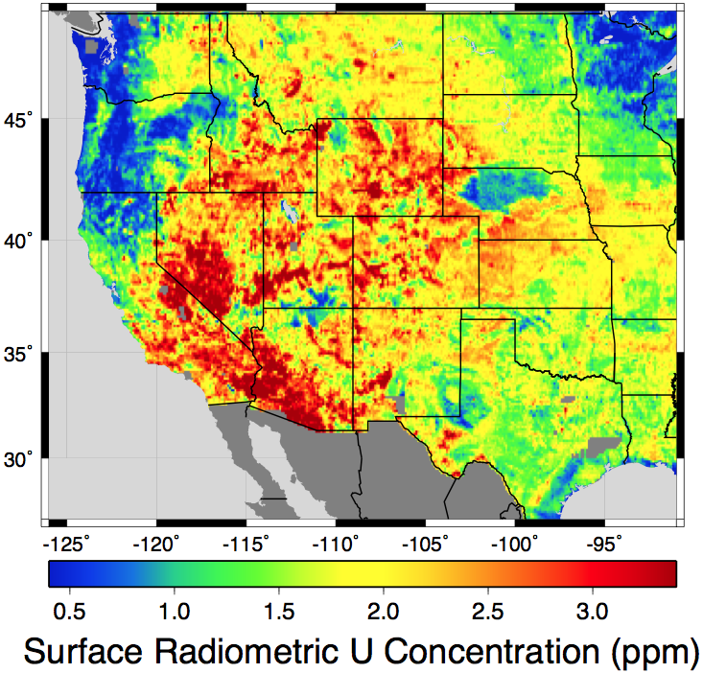
K
Th
U
Surface radiogenic element concentrations (averaged over
10-km scales)
US Geological Survey has flown aero-spectral gamma at
relatively high resolution (<1 km pixel) over the entire
conterminous United States… Gamma from below ~50 cm
depth is absorbed by overburden, but gamma rays can travel
far in the atmosphere. So, measurements represent the
average properties of surface soil & rocks. Can these be
used to draw inferences about deeper rocks also?

Slide 15
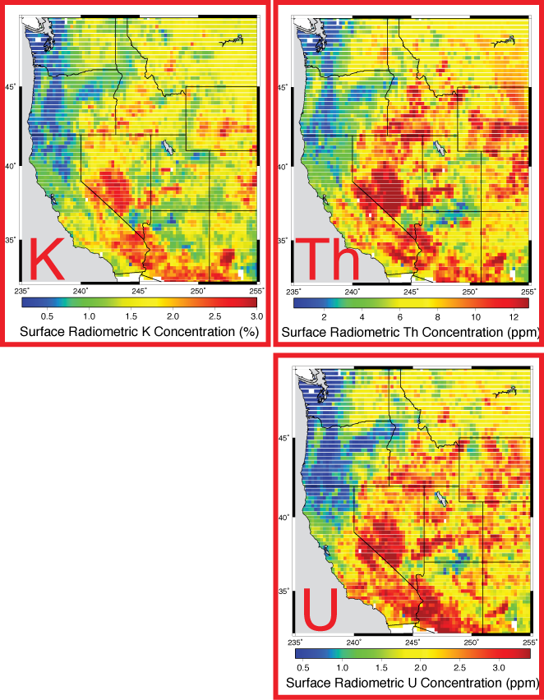
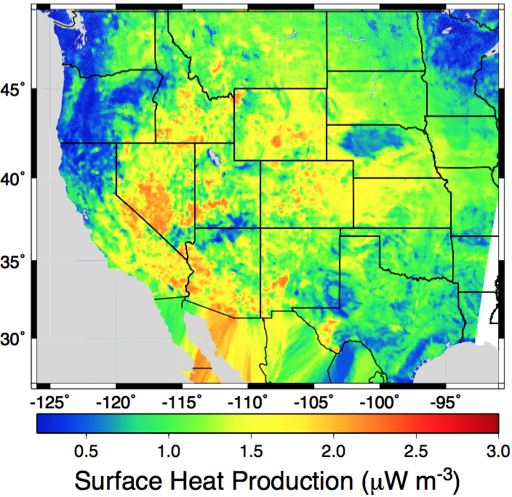
Combined
radioactive
heat
production
can be
estimated
from (T&S eqn 4-8):
H₀

Slide 16
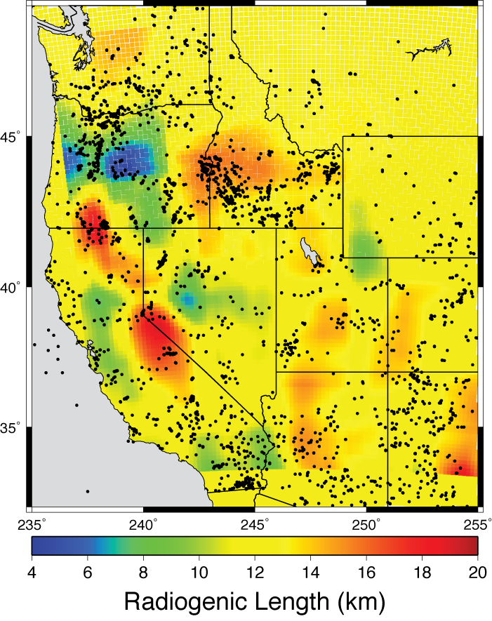
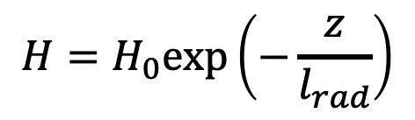
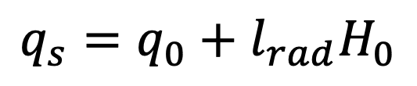
If heat production truly
decays exponentially
with depth, i.e.,
for some length-scale
parameter l_{rad},
then if heat flux at the
base of the lithosphere
q₀ is constant, we would
expect:
Here solved for slope &
intercept of line fit
averaged within
500X500 km windows.
$$H=H_{0}\text{exp}\left(−\frac{z}{l_{rad}}\right)$$
$$q_{s}=q_{0}+l_{rad}H_{0}$$

Slide 17

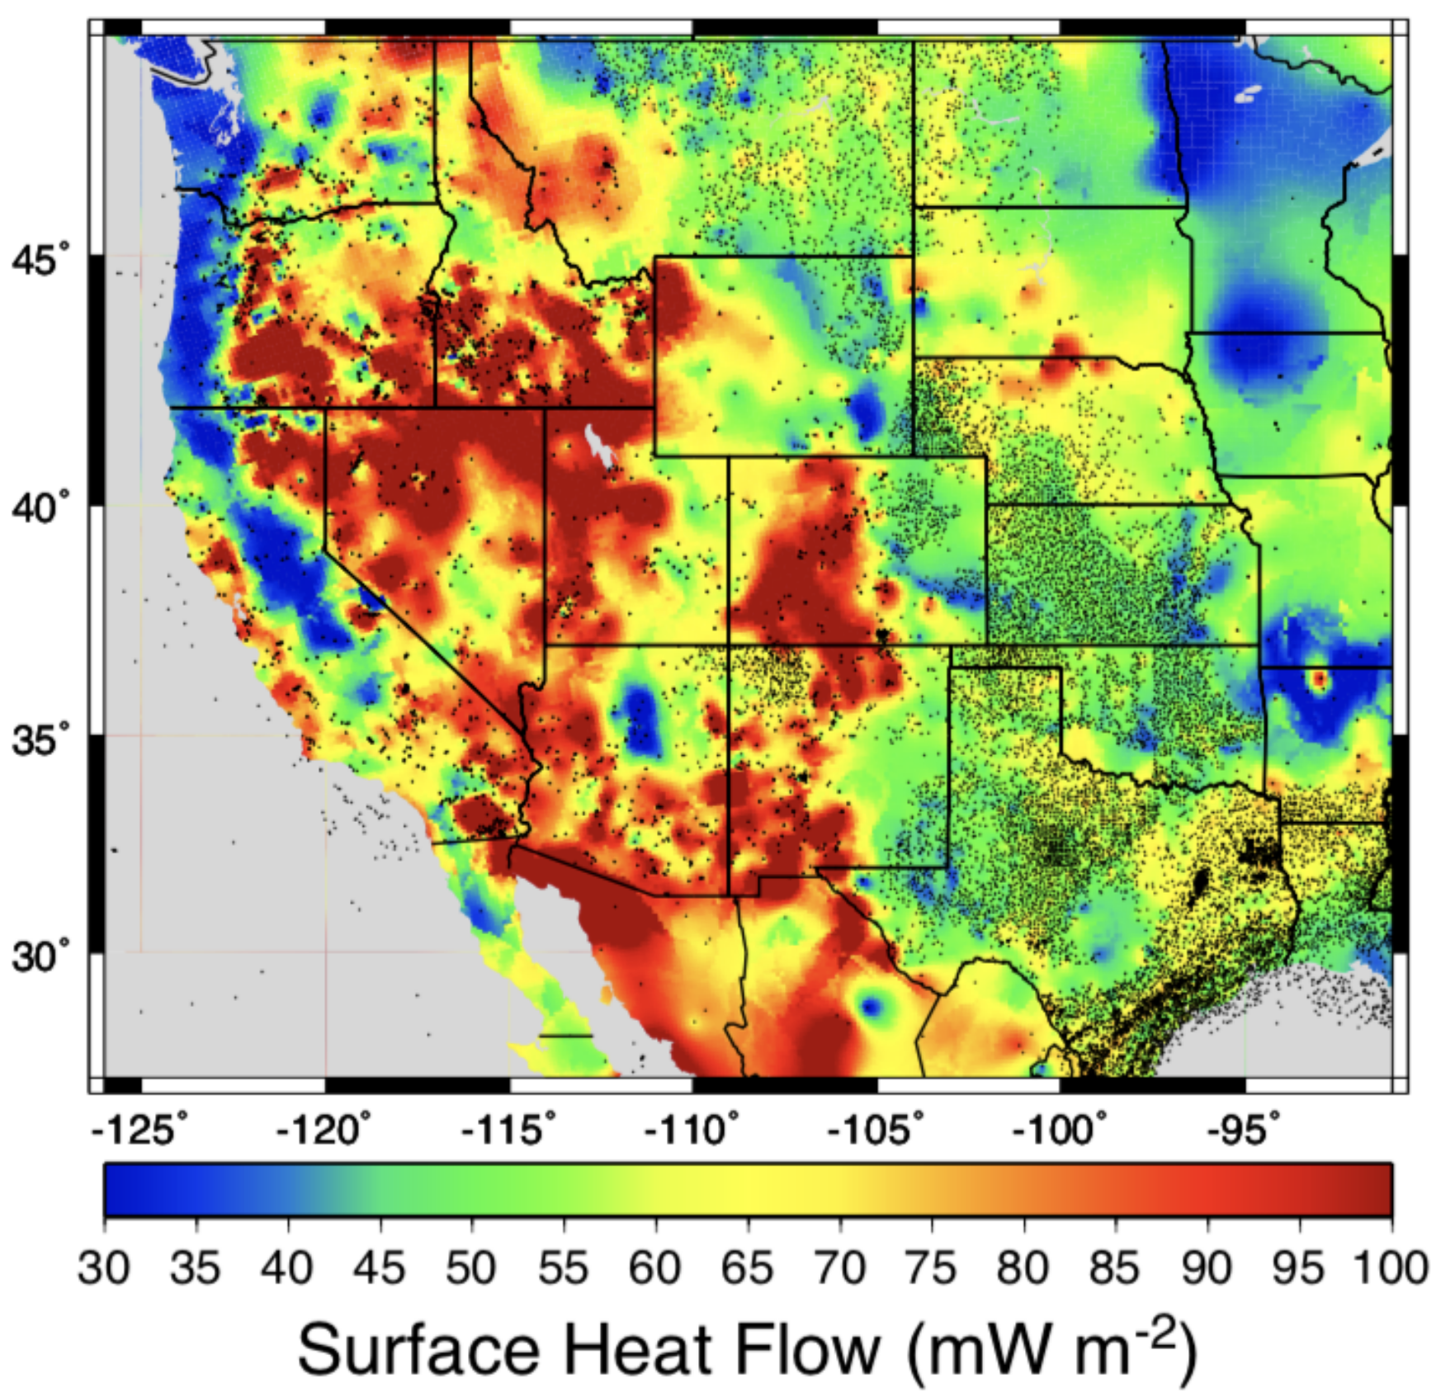
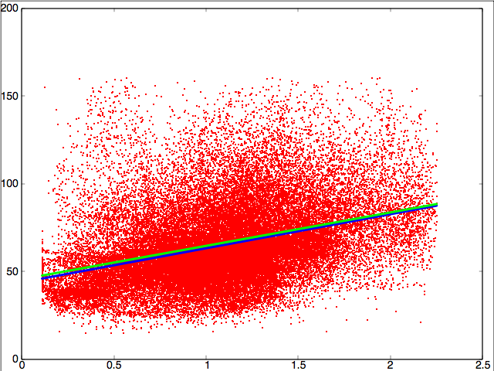
However… Surface H₀ is not
always locally derived; heat
flow q_{S} is not always dominated
by conduction, and there is a
whole lot of scatter in the
“linear” relationship between
H₀ & q_{S}

Slide 21
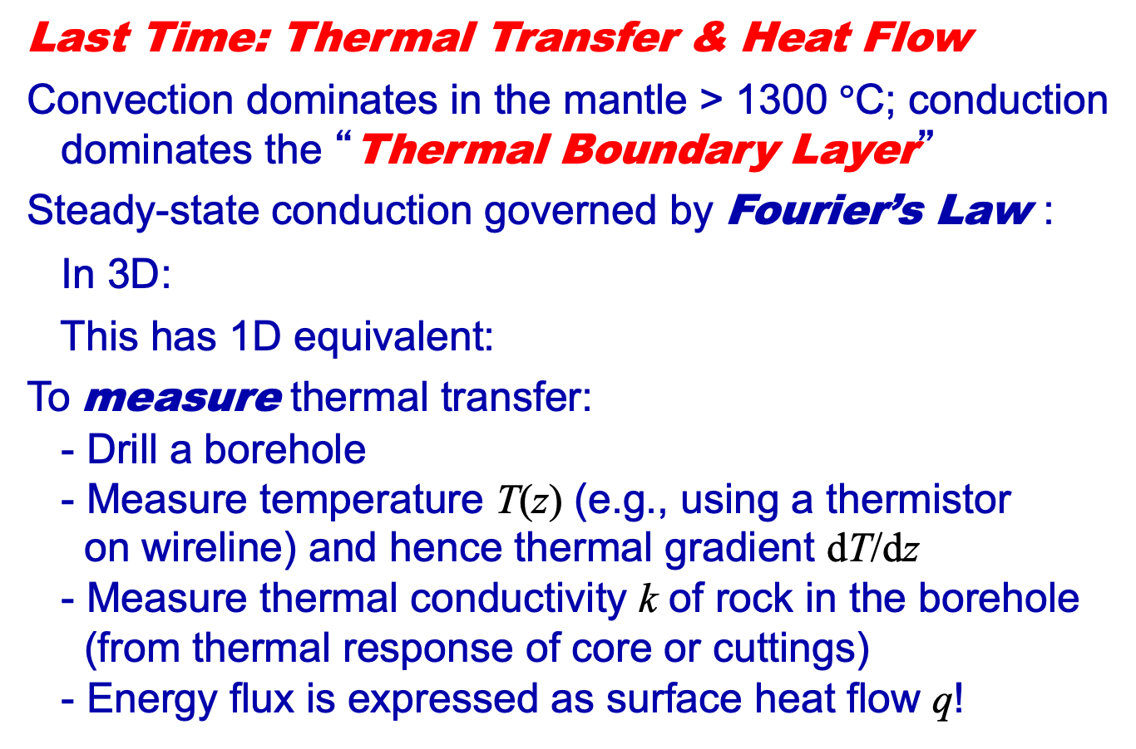
GEO 5/6690 Geodynamics
20 Jan 2023
Last Time: Thermal Transfer & Heat Flow
Convection dominates in the mantle > 1300 $°$C; conduction
dominates the “Thermal Boundary Layer”
Steady-state conduction governed by Fourier’s Law :
In 3D:
This has 1D equivalent:
To measure thermal transfer:
- Drill a borehole
- Measure temperature T(z) (e.g., using a thermistor
on wireline) and hence thermal gradient dT/dz
- Measure thermal conductivity k of rock in the borehole
(from thermal response of core or cuttings)
- Energy flux is expressed as surface heat flow q!
Read for Wed 25 Jan: T&S §4.1-4.12
© A.R. Lowry 2023

