Slide 1
GEO 5/6690 Geodynamics
8 Feb 2023
Last Time: More on elevation of the western U.S.
• Observations in Roy et al. included elevation, sedimentation
(→ rock uplift/burial), spatial migration of volcanism, xenoliths
• Modeled as isostatic response to sediment unloading (0.4 km)
plus warming since removal of flat slab…
• Neglects observations related to thermal elevation predicted
before flat slab subduction or elevation outside of CP…
• Melting at their predicted temperatures requires water!!!
• Seismic imaging suggests much of current elevation is sourced
within the crust!
• And elevation in Basin & Range/Rio Grande rifts requires
asthenospheric buoyancy
Read for Fri 10 Feb: T&S §4.18-4.28
© A.R. Lowry 2023

Slide 2
Next Journal Article Reading:
For Wednesday Feb 15: Kellogg et al.,
Science 283, 1881-1884 (1999).
Jacob L. will lead!

Slide 3
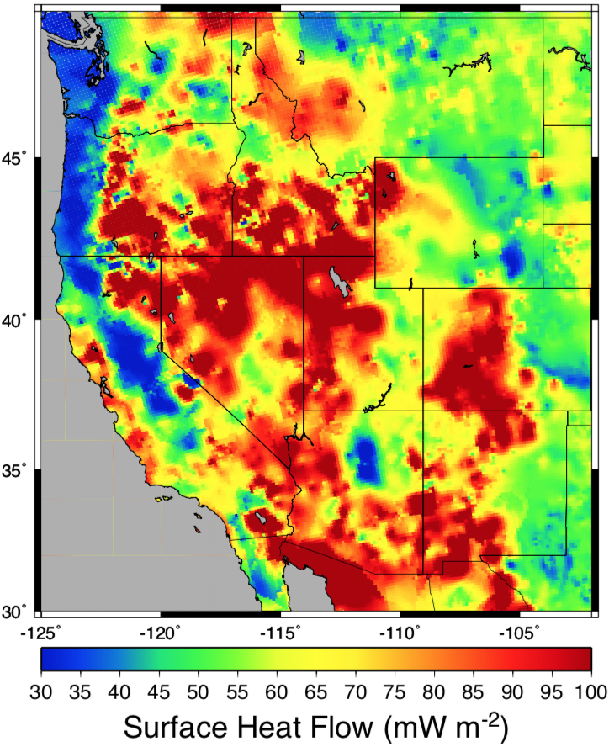
Recall surface heat
flow…
> 50 mW/m²
requires advection;
For advection by
rifting alone, >90
mW/m² requires a
strain rate in excess
of 3x10⁻¹⁵ s⁻¹.
Intermountain seismic
belt is ~1x10⁻¹⁵ s⁻¹;
Rio Grande Rift is
nearer 4x10⁻¹⁶ s⁻¹!

Slide 4
The Adiabat (the “other” part of the geotherm):
approximately describes mean temperature in
convecting systems
0
Temperature
1200-1400 ºC
0
Conductive
50-300
km
Depth
Adiabat: Temperature
increases with pressure
but energy doesn’t
change
Convective

Slide 5
The Adiabat:
What happens when mantle material moves up or down
within a vertical column of flow?
Assume:
• No transfer of heat energy into or out of volumetric
elements (constant entropy s)
• Compressibility β, coefficient of thermal expansion α
are independent of pressure P, temperature T
• Acceleration of gravity, g, is independent of depth
No phase changes in the material
s

Slide 6
(From Turcotte & Schubert:)
Defn of compressibility:
Change in pressure:
Change in entropy:
Then a change in pressure (i.e., depth) yields a change in
temperature:
(No heat energy transfer ⇒ This oversimplifies convection!!!)

Slide 7
Of course reality is always a bit more complicated… PREM,
from seismic normal mode analysis.

